Slide 1
Systematic approach to engineering design
Laboratorio Proyecto
Maestría microelectrónica FI-UBA
p. Julian 2025

Slide 2
Systematic approach
Strategy for the development of solutions which aims to increase the probability of technical and economic success of product design.
This is done by creating a dependable approach which allows careful planning and systematic execution so that the whole design task reduces to a logical and comprehensible exercise and also allows recovery from inevitable errors.
It also allocates a time schedule for the design stages which in turn leads to a predictable project timetable.
Would all of this take too much time?
These steps will need to be examined at least implicitly as a designer prepares a design.
It is much better to be systematic about it rather than leave to chance whether or not some aspect of the design has been properly covered.

Slide 3
Research
Review existing results and products
Consider problems and successes associated with existing approaches, costs and marketplace needs
Output: Document with all related results and products, and considerations

Slide 4
Problem definition
Recognize the need.
A need statement defines current unsatisfactory situation.
Define the goal
brief, general and ideal statement.
Define objectives
Quantifiable expectations of performance of design
Define constraints
Requirements that the design must satisfy
Output: Specification document
Definition of Specification: set of documented requirements to be satisfied by a material, design, product, or service.

Slide 5
Problem definition
Example:
Need statement:
Current test procedures for the ZZZ are too time intensive
Goal: How are we going to address the need
To design an improved test fixture for the ZZZ
Objective:
Design a fixture that allows loading and unloading of items in less than 5 seconds, and which automatically sequences through the testing conditions
Constraints: Define permissible range of design and performance parameters
Dimensions cannot be modified
Test requires 110VAC power for the product

Slide 6
PLANNING
Schedule activities
Gantt chart: what tasks and in what order?
Cost of activities
Personnel time
Budget constraints

Slide 7
Conceptual design
Abstract the task
Establish functional structures
Search for solution principles
Combine solution principles and produce variants
Brainstorm, let imagination fly. Avoid detail and critique.
Evaluate variants (technically and economically)
Come up with a backup alternative
Output: Different concepts and their functional structures
Before the conceptual design stage is started a decision is needed as to whether a conceptual elaboration is really needed or whether known solutions allow the designer to proceed directly to the preliminary and detail design phase.

Slide 8
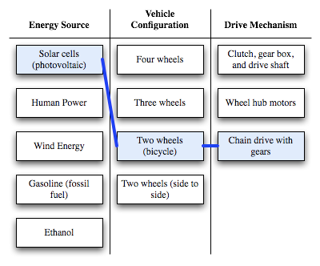
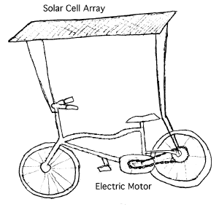
Conceptual design
Wide options

Slide 9
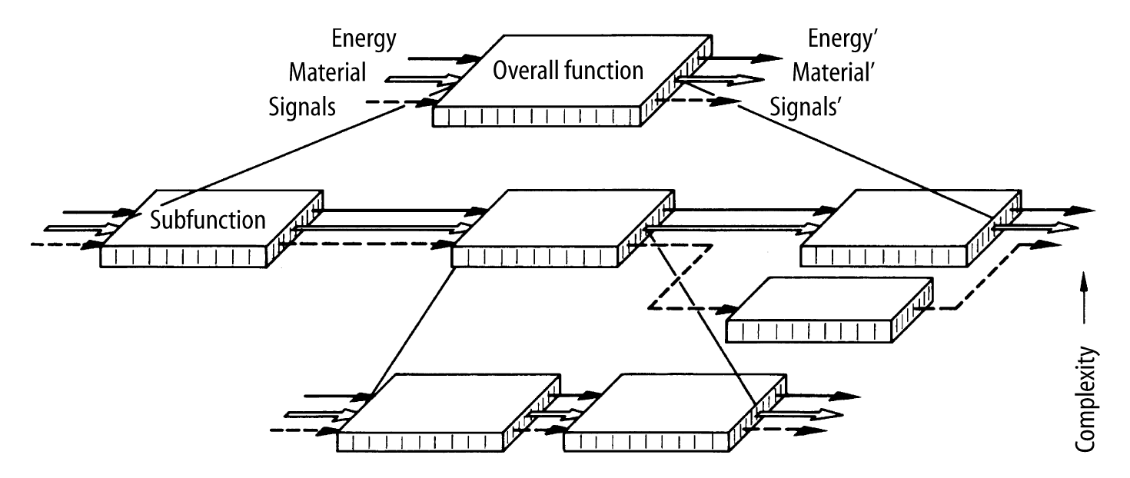
Preliminary design
Break down the system into sub-systems and lower level elements
Allocate the system requirements down to the elements or level desired (so that is a meaningful input for design)
Synthesis: define combination and structure of components (not final). Several approaches are possible.
Analysis: evaluate the approaches (modelling, simulation, etc) and their performance and determine the preferred approach
Output: An overall system configuration with performance, cost and other requirements
This is the very latest to which assessment of financial viability of the project can be left.

Slide 10
Preliminary design
Clear definition of the subsystems and their interfaces
Electronic systems
System Block Diagram, followed by a description of the subsystems, their interfaces and requirements.
Mechanical
3D mechanical rendering of the system with subassemblies clearly identified. (Exploded View of the system, followed by a description of the subsystems, their interfaces and requirements).
Software
Structural framework of physical components. A hierarchical decomposition of the physical components of the solution, down to the level of individually compiled program units.
For every physical component: functional components, interfaces, languages and tools for implementation, diagram with flow of information).

Slide 11
Electrical
System block diagram
120 rpm
max
Photosensor
400 degrees per rev.
Pulse counter
Integration time: 1s max
motor
10 bits
MAIN Power Supply
5/12V 2A
MOTOR Supply FILTER
Fh=10Hz, 1% reg.
2
Controller
Fs=1KHz
DIG Power Supply
5V 0.1A
Inverter
5/12V
1A
Trajectory
sequencer
10 bits
10Hz
Fh=10Hz, 1% reg.
Osc.
100KHz
5ppm
10kbps
Computer
Comm
PWM
100KHz
Trajectory
memory
Trajectory
20KB

Slide 12
Electrical
Next, you specify the requirements for each block and interface. For example, for the digital power supply:
1) Digital power supply requirements
Vi = 7-20V
Io = 1 A
T = 0 to 125 °C
Load regulation: < 100mV
Quiescent current: 50mA max
Dropout voltage: 2V
Output noise: 50uV
Output voltage drift: 1 mV / ºC

Slide 13
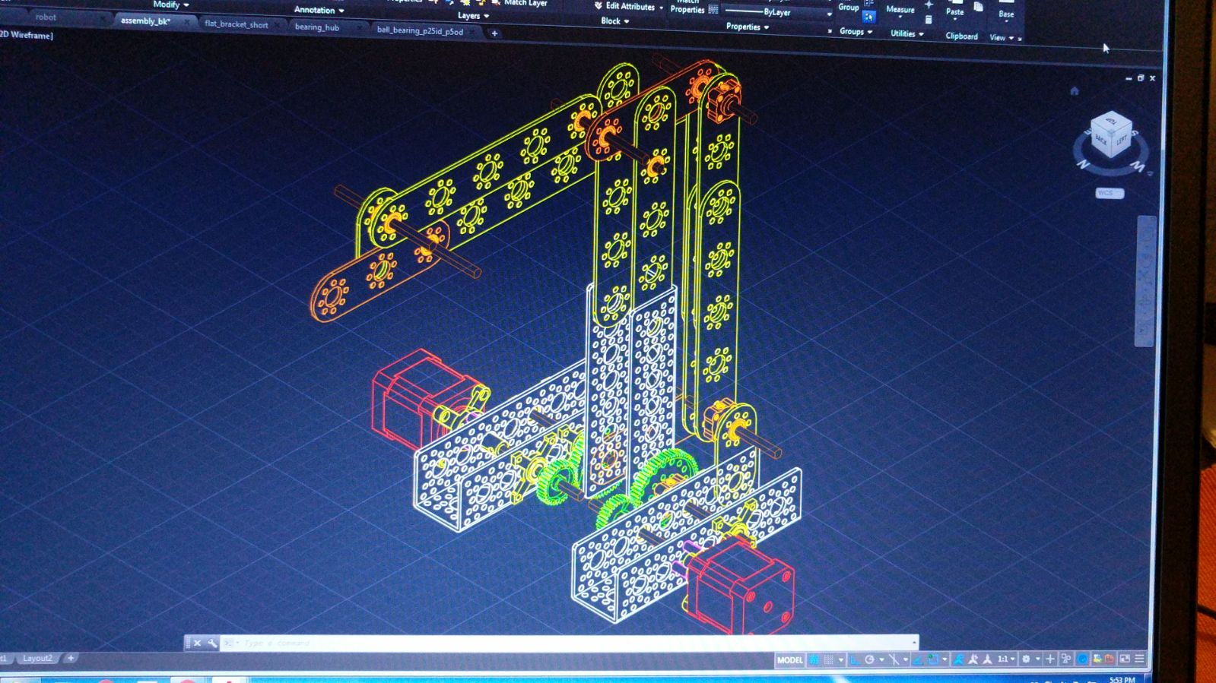
Mechanical
3D view of the system. In addition you will need
to describe subsystems, interfaces and ther requirements
120 rpm
max
Photosensor
400 degrees per rev.
Pulse counter
Integration time: 1s max
motor
10 bits
MAIN Power Supply
5/12V 2A
MOTOR Supply FILTER
Fh=10Hz, 1% reg.
2
Controller
Fs=1KHz
DIG Power Supply
5V 0.1A
Inverter
5/12V
1A
Trajectory
sequencer
10 bits
10Hz
Fh=10Hz, 1% reg.
Osc.
100KHz
5ppm
10kbps
Computer
Comm
PWM
100KHz
Trajectory
memory
Trajectory
20KB

Slide 14
Detailed design
Definition of system elements:
Subsystems, units, assemblies, lower-level component parts, software, data, and the elements of logistics support.
This phase further elaborates each aspect of the project/product by complete description through solid modeling, drawings as well as specifications.
Preparation of design data
Physical models of system or major components
System integration and test
Verification that requirements have been met
Deliverable:

Slide 15
Design flow
Problem definition
Conceptual Design
Preliminary Design
Detail Design
Research
Planning

Slide 16
Would all of this take too much time?
These steps will need to be examined at least implicitly as a designer prepares a design.
It is much better to be systematic about it rather than leave to chance whether or not some aspect of the design has been properly covered.

Slide 17
Schedule
Gantt Chart
Create a list of all tasks
Estimate the duration of each task and who’s responsible
Identify key milestones in the project
Think and decide which tasks are independent (or floating) and which depend on other ones

Slide 18
Schedule
Gantt Chart example
Board design
Tasks
Simulate schematics w/Spice: 10 days - John
Draw PCB: 7 days - Charles
Fabricate PCB: 10 days - Charles
Order components: 4 days - John
Assembly PCB: 3 days - Martin
Test: 2 days - John
Milestones
Working Schematic
PCB design
BoM
Think and decide which tasks are independent (or floating) and which depend on other ones

Slide 19
references
G. Pahl, W. Beitz, Engineering Design: A systematic approach, Springer, 2007
Dr. Seung Hyun Lee, Ch.6 Preliminary & Detail Design, http://www.iems.co.kr/CPL/lecture/part2/6.%20Preliminary%20&%20Detail%20Design.pdf
S. P. Taya, ``Engineering Design Process”, International Journal of Computer Science and Communication Engineering, NCRAET 2013.
K. O'Shaughnessy, R. H. Sturges, ``A systematic approach to conceptual engineering design,” https://pdfs.semanticscholar.org/cc1a/edeb896c42e4c0a5e76f541f50d7424ae29d.pdf, 1991.

Slide 20
Gerhard Pahl and Wolfgang Beitz's Theory of Systematic Engineering Design & Practice

Slide 21
1. Start off with product planning and a clarification of the task
1.1 Clarify the task and build out the specification and requirements
The specification may not be comprehensive and often will require clarification and additional information.
determine the clear aims that the solution needs to achieve.
be sure that there will be the requisite commercial motivation and intellectual stimulation to carry the design through to fruition.
At the end of this phase the specification will be fully developed and requirements and constraints compiled.

Slide 22
2. Conceptual design phase
Before the conceptual design stage is started a decision is needed as to whether a conceptual elaboration is really needed or whether known solutions allow the designer to proceed directly to the preliminary and detail design phase. If not, then a conceptual design phase needs to be undertaken.

Slide 23
2. Conceptual design phase
2.1 Abstract the task to identify the essential problem
Abstracting the task means describing it in the broadest way. This makes clear what the overall function should be. Too narrow a view of the task, or a quick prejudged one, may well lead the designer down a path to a non-optimum solution; one which would ultimately detract from the technical and economic success of the product.

Slide 24
2. Conceptual design phase
2.2 Establish the functional structures
This is both an articulation of the boundaries of the solution (what is in and out of the design) and the functional way in which energy, material and signals (information) flow (are processed or converted) from input to output to meet the specification. It involves breaking down the overall function into sub-functions until the sub-function task becomes clear and simple. In essence, the development of functional structures aims to assist in discovering solutions.

Slide 25
2. Conceptual design phase
2.3 Search for solution principles
There may be many means and ways in which a solution to a sub-function can be achieved and the designer seeking an optimum technical and economic solution will need to elaborate a wider range of possible solutions in order to be able to assess the comparative merits of each possibility.
A successful solution is more likely to spring from the choice of the most appropriate principle than an exaggerated concentration on the finer points.

Slide 26
2. Conceptual design phase
2.4 Combine the solution principles into variants
The larger product is built up from smaller solutions proving the sub-functions. As a result there is likely to be a number of product concepts or variants which can be derived in this way.
This development of solution options is the strength of the systematic approach.

Slide 27
2. Conceptual design phase
2.5 Evaluation of concept variants using technical and economic criteria
The designer needs to first draw up a set of evaluation criteria and then assess the relative merits of a solution using a bottom up approach starting from the sub-functions which make up each concept variant. In this way a comparative technical and economic evaluation can be built up for each concept variant and allows a decision to be made as to which particular solution should be manufactured.
An additional purpose of such an evaluation is to select one or two back-up solution which, while not as cost-effective, could nevertheless be deployed in place of the first choice should this turn out to be necessary.

Slide 28
3. Embodiment design
In the embodiment design stage, many details will need to be clarified, confirmed or optimised and as this is done it will become more obvious whether the right solution concept has been chosen.
No embodiment design can hope to correct a poor solution concept.
The end of the embodiment design is the very latest to which assessment of financial viability of the project can be left.

Slide 29
3. Embodiment design
3.1 Develop a definitive layout and check that the requirements are met
For each concept solution variant the designer will need to determine the layout which will end up being the technical product or system and check that function, strength and spatial compatibility requirements are met.

Slide 30
4. Carry out a detail design
4.1 Detail design
The exploration of options does not finish with a conceptual solution but extends to the physical realization of the products. Again the principle of systematic design should be applied to make the choice of suitable components, materials, forms and finishes.
4.2 Documentation
Detail design also includes the production of final design drawings which can be used to manufacture the product. This firms up each possible product concept solution into a potentially manufacturable design. At this stage, a designer can say that they have explored all of the factors which potentially could significantly impact on the design, ending up with one or more potentially manufacturable designs.

Slide 31
Would all of this take too much time?
These steps will need to be examined at least implicitly as a designer prepares a design.
It is much better to be systematic about it rather than leave to chance whether or not some aspect of the design has been properly covered.

