Slide 1
Rezervare bilete la film
Tugurin Iuliana
342 A3

Slide 2
Cuprins
1. Documentul XML
2.Documentul DTD
3. XSD Schema - Restrictie
4.Document XSL Transform
5.Aplicatia
6.Limbaje si clase folosite
7.Bibliografie

Slide 3
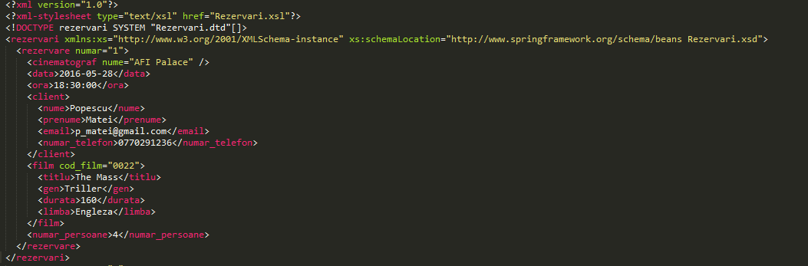
1. Documentul XML

Slide 4
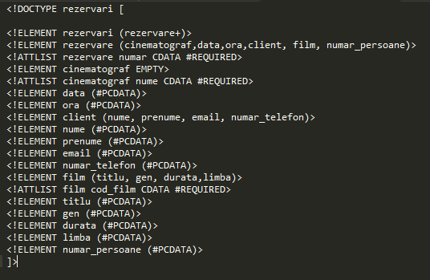
2. Documentul DTD

Slide 5
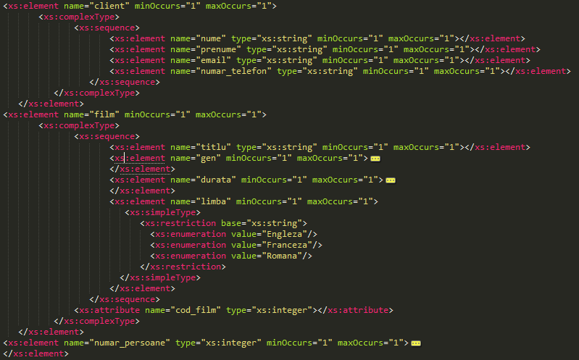
3. XSD Schema – Restrictie

Slide 6
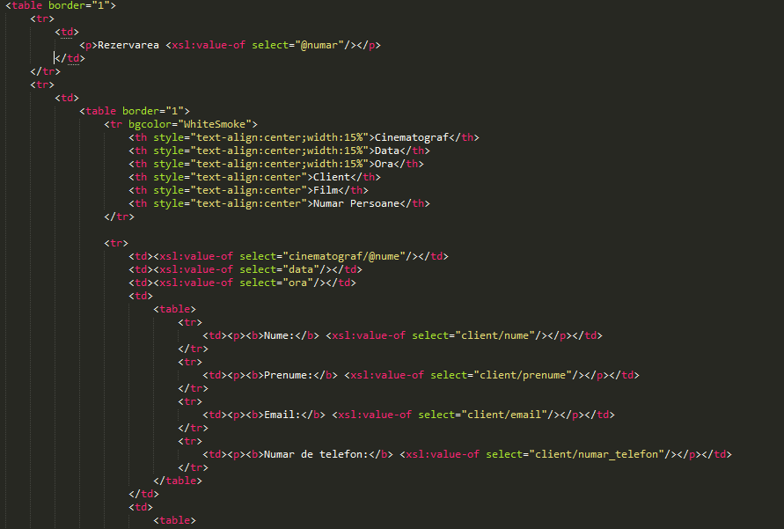
4. Document XSL Transform

Slide 7
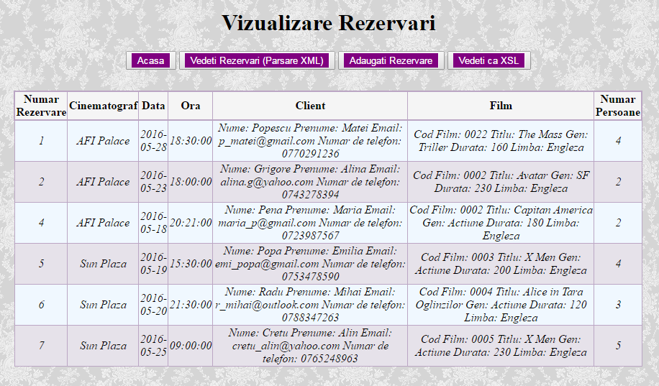
5. 1.Aplicatia – Parsare XML

Slide 8
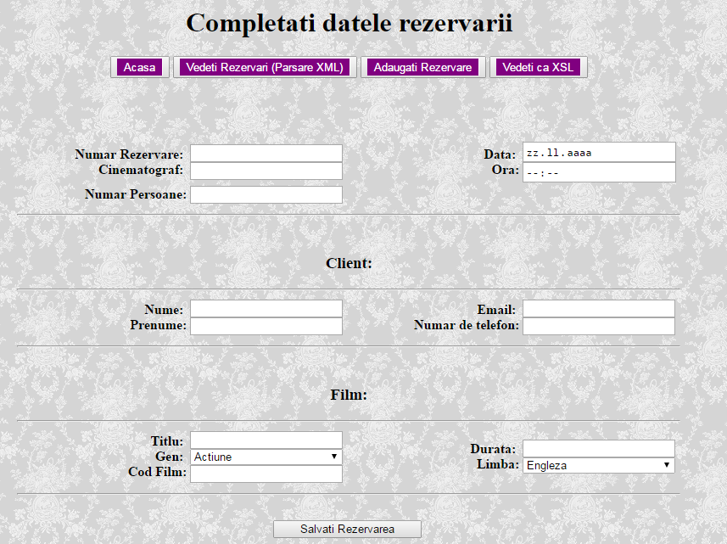
5.2. Aplicatie – Adaugare rezervare

Slide 9
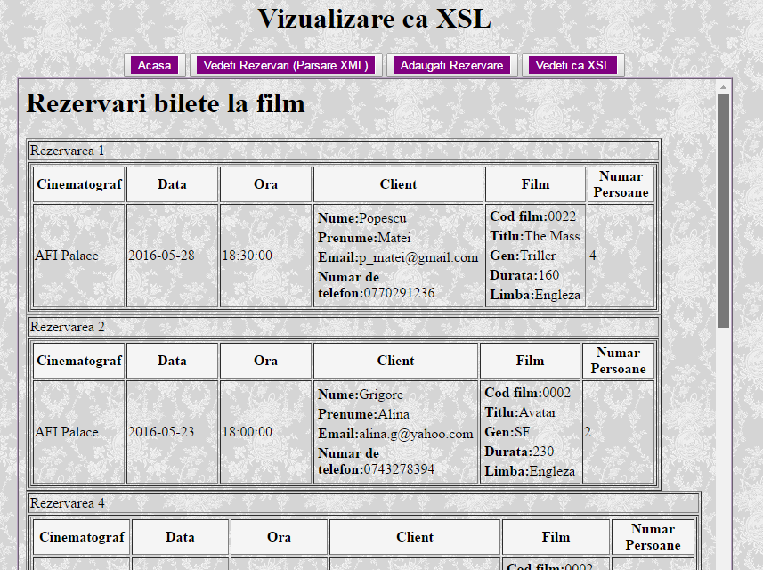
5.3. Aplicatie – Vizualizare ca XSL

Slide 10
6. Limbaje si clase folosite pentru aplicatie
Aplicatia a fost realizata in Visual Studio 2015 ca proiect de tip WebForm
Limbaje: C#, HTML, CSS
Pentru parsarea documentului am folosit clasa XmlDocument
Transformarea documentului XML cu ajutorul fisierului XSL se face folosind clasa XslCompiledTransform

Slide 11
7. Bibiografie
1. http://stackoverflow.com/questions/4447404/xml-files-to-web-form-with-net\https://msdn.microsoft.com/en-us/library/extfcy1c(v=vs.110).aspx
2. http://stackoverflow.com/questions/215515/creating-an-xmlnode-xmlelement-in-c-sharp-without-an-xmldocument
3. http://stackoverflow.com/questions/740751/how-do-you-link-xml-to-a-xsd
4. http://www.w3schools.com/xml/schema_dtypes_date.asp
5. https://msdn.microsoft.com/en-us/library/aa983475(v=vs.80).aspx
6. http://xmlwriter.net/xml_guide/element_declaration.shtml
7. http://xmlvalidation.com/

Slide 12


