Slide 1
PREDICTING TERM DEPOSIT SUBSCRIPTION
CENTENNIAL COLLEGE
GLEN GEORGE BAUTISTA
MARIA PAULA SANCHEZ GALINDO

Slide 2
AGENDA
Executive Summary
Introduction, Objective, Approach
Business Understanding
Definitions, Scenario
Data Understanding
Initial Observations
Data Preparation and Modeling
Data Preparation, Model Exploration, Model Selection
Actions
Conclusions and Recommendations

Slide 3
EXECUTIVE SUMMARY
Approach
Objective
CRISP-DM
Classification Models
Introduction
Examine clients’ information and behavior to identify which factors influence their decision to open a term deposit.
Conduct statistical analysis and evaluate various models.
Increase campaign effectiveness.
Direct product introduction is prevalent in numerous industries, including the banking industry.
By evaluating bank marketing data, it is possible to select the style of marketing to implement.
The effectiveness of marketing campaigns should be addressed in order to reduce labor costs and enhance revenues.

Slide 4
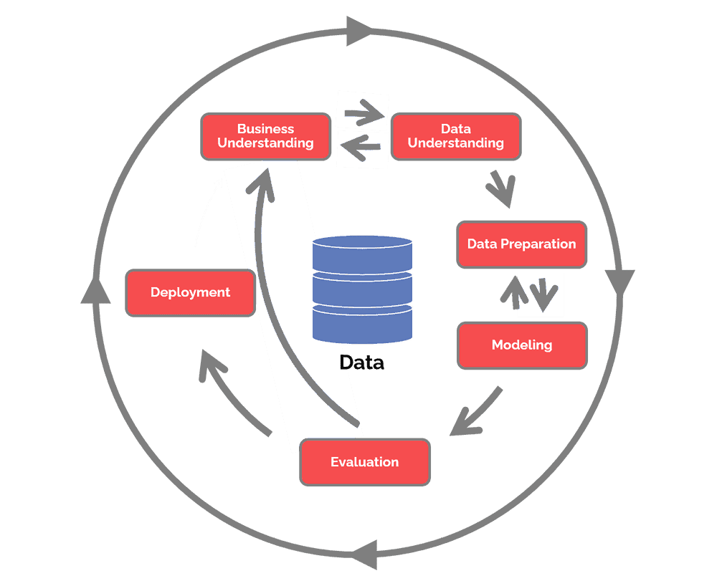
APPROACH
Cross Industry Standard Process for Data Mining
Approach
Objective
CRISP-DM
Classification Models
Introduction
Examine clients’ information and behavior to identify which factors influence their decision to open a term deposit.
Conduct statistical analysis and evaluate various models.
Increase campaign effectiveness.
Direct product introduction is prevalent in numerous industries, including the banking industry.
By evaluating bank marketing data, it is possible to select the style of marketing to implement.
The effectiveness of marketing campaigns should be addressed in order to reduce labor costs and enhance revenues.
Source: Data Science Process Alliance
Notes:
Hotz, B. N. (2022, August 8). What is CRISP DM? Data Science Process Alliance. https://www.datascience-pm.com/crisp-dm-2/

Slide 5
BUSINESS UNDERSTANDING
THE INDUSTRY
TERM DEPOSIT
STRATEGY
A deposit held at a financial institution that has a fixed term.
Communicating straight to the customer via telephone calls.

Slide 6
BUSINESS UNDERSTANDING
CLASSIFICATION MODEL
Client Data
Campaign Contact Information
age, marital status, loan status, etc.
last contact, preferred contact type, etc.

Slide 7
INITIAL OBSERVATION
OVERALL RESPONSE RATE
89%
11%
Client non-subscription of term deposit
Client subscription of term deposit

Slide 8
DATA UNDERSTANDING
63%
93%
NO HOUSING LOAN
NO PERSONAL LOAN
99%
64%
NO CREDIT CARD
NOT CONTACTED
FROM PAST
CAMPAIGN
52%
83%
MARRIED
CONTACTED VIA
CELLULAR

Slide 9
DATA PREPARATION
Variables Investigation
Minimum values
Maximum values
‘Unknown’ data
Data Cleansing
Outliers
Missing values
Unnecessary columns

Slide 10
MODELLING
Model Exploration
Model Recommendation
Modeling Approach
Metrics
Default Classifiers
Hyperparameter Tuning
Comparison Table
Model Selection
Model Recommendation
The approach to modeling in this investigation was divided in two groups, for both of them the set of techniques utilized were the same (Random Forest Classifier, Decision Tree Classifier, Logistic Regression Classifier, and Gradient Boost Classifier), with the difference that in the second group, we did a hyperparameter tuning.

Slide 11
MODEL EXPLORATION
1
2
3
4
Modeling Approach
Metrics
Default Classifiers
Hyperparameter Tuning
Divided into two groups (default classifiers, classification with hyperparameter tuning)
Accuracy, Recall, Specificity, Precision, Balanced Accuracy, F1 score, AUC-ROC Curve
Random Forest Classifier
Decision Tree Classifier
Logistic Regression Classifier
Gradient Boost Classifier
Hyperparameter Tuning using GridSearch

Slide 12
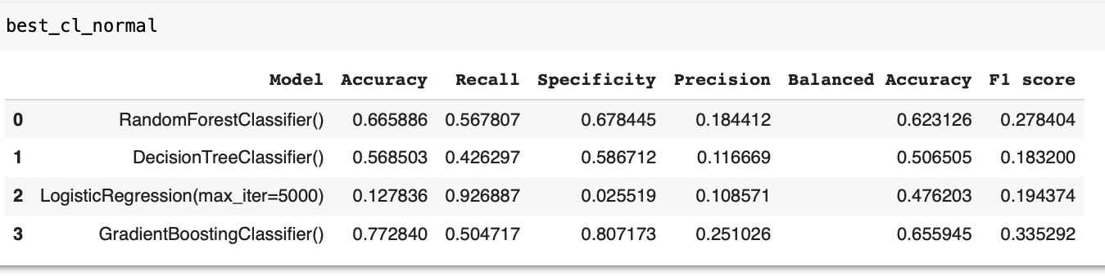
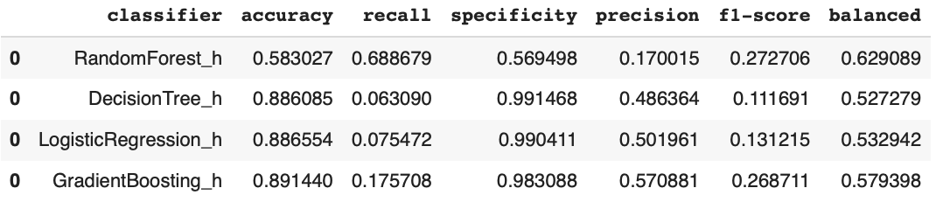
MODEL RESULTS
Comparison for Default Classifiers
1
Table 2: Comparison table results of classifiers models with default parameters
2
Comparison after Hyperparameter Tuning
Table 3: Comparison table for the result of the models – Hyperparameter Tuning

Slide 13
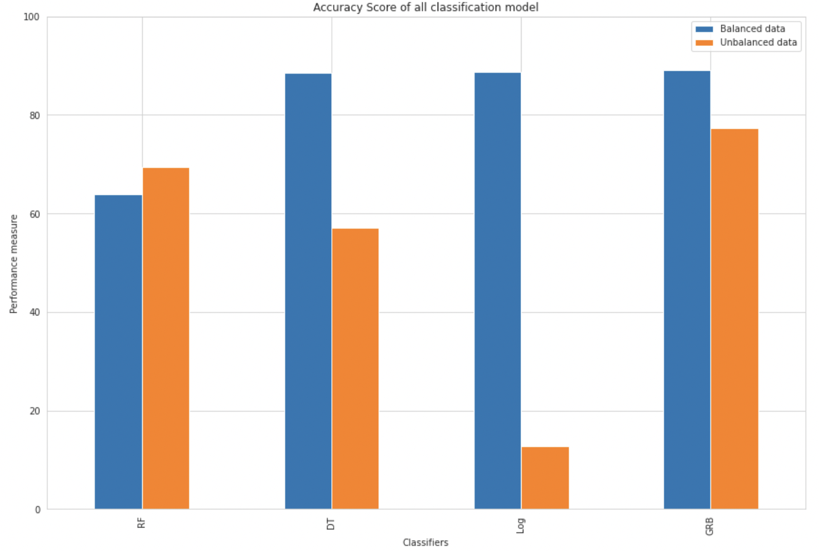
MODELING SELECTION
Figure 1: Plot - Accuracy score of all classification models.

Slide 14
PROJECT FLOW
1
2
3
4
Data Source
Structure Investigation
Variables Investigation
Deal with
Outliers
8
7
6
Check for
Class Imbalance
5
Handle missing
values
Train Test Split
Transform
Variables
9
Modeling
10
Hyperparameter
Tuning
11
12
Conclusions and Recommendations
Model Selection

Slide 15
CONCLUSIONS
Administrative and blue-collar professionals are more receptive to accept the term deposit.
Higher educated customers are more knowledgeable of considering the term deposit offer.
Married customers are likewise more inclined to
consent to the term deposit.
May is the most effective month to conduct
a bank marketing campaign.

Slide 16
RECOMMENDATIONS
Focus on specific categories.
Focus future campaigns in professional and married customers to have a elevate probability of acceptance rate.
Further data is required to identify unseen correlations between variables.
Taking into account the time of the company.
Increase the time of contact with customers.
Form target groups based on sociological-economic categories.

Slide 17
THANK YOU!
MARIA PAULA SANCHEZ GALINDO
GLEN GEORGE BAUTISTA
Business Analytics and Insights
Centennial College
Business Analytics and Insights
Centennial College

