Slide 1
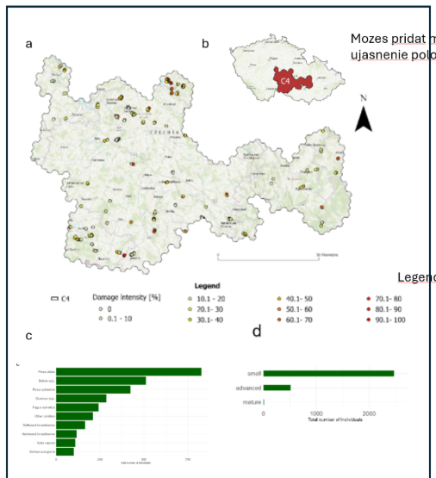
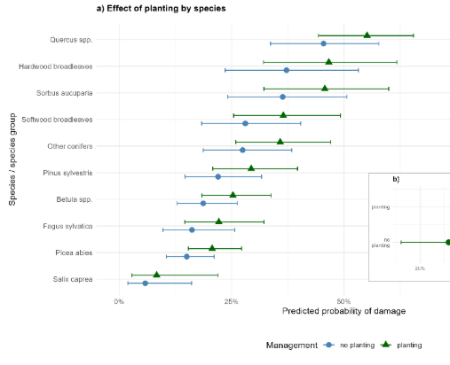
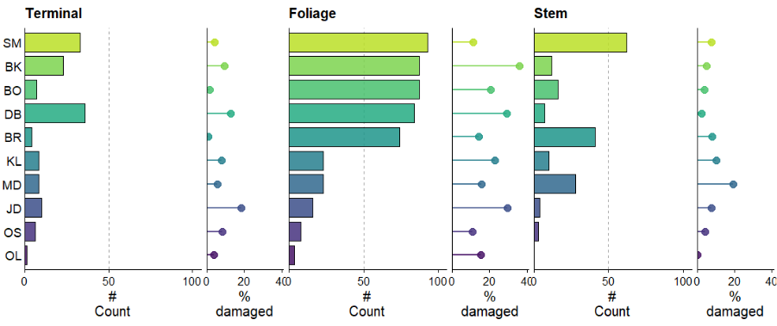
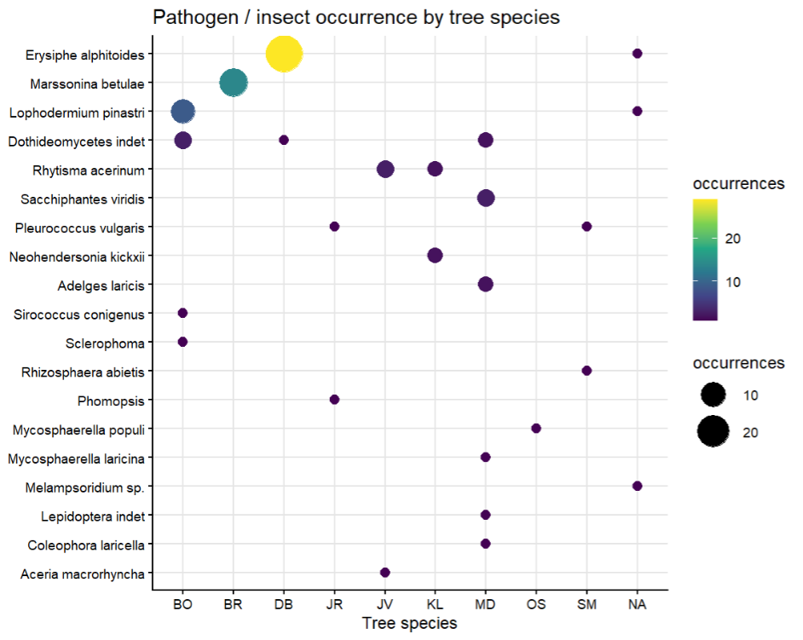
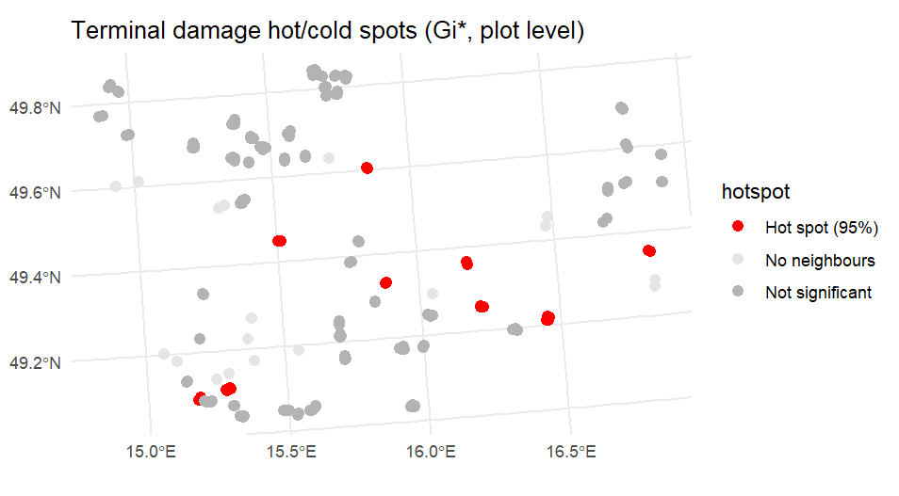
Patterns, agents and drivers of damage in early tree regeneration
following the post-2017 disturbance wave in Central Europe
Fig. 1. Study area and overall damage distribution per species
Fig. 5 drivers? (management/ tree species??)
Fig. 2 Damage distribution by species and allocation on tree
Fig. 3Cause of damage: zver, mechanizace,.. (tbd)
Fig. 6 Occurrence of pathogenes per species
Fig. 4 Damage intensity and clusring of damage

Slide 2
