Slide 1





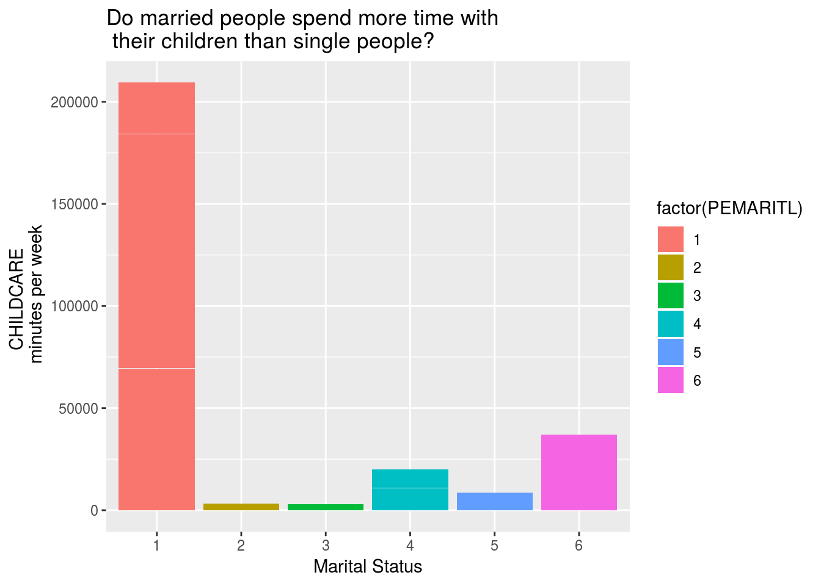
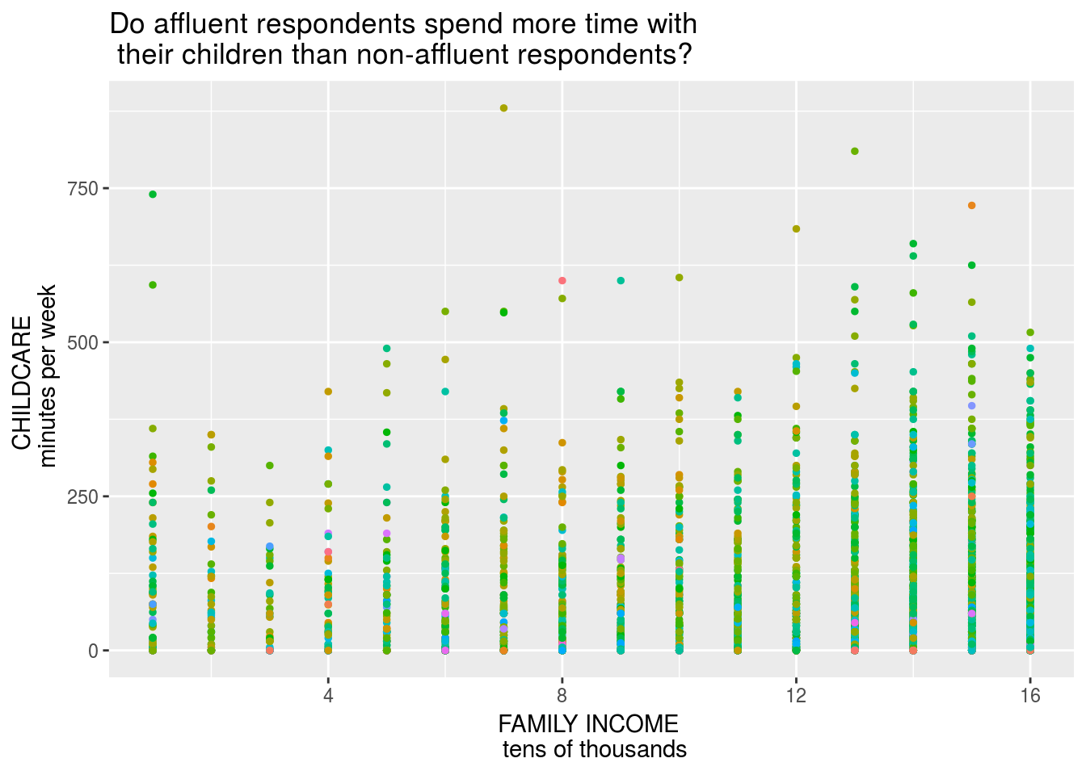
Family Survey Maria Ramos
Affiliated institutions
ABSTRACT
RESULT
CONCLUSION
The American Times used a survey to keep track on what people are doing in a daily basis. People were asked to keep A diary for one day and recorded the amount of time spend doing such activity.
Base on my evidence on research shows that a female spend more time than a male does. This chart shows that a male spend on average 19 min per week, while a women spends 33.1 min per week. It also shows that married couple that have both parents involve spend more time with their children. while never married parents spend less time with their children. Working full time or part time does not affect the time spend with their children. The color in the chart is by age.
SEX | Avgerage parent spend childcare
1 (male) | 19.0
2 (female) | 33.1
OBJECTIVE
Do a Women or men spend more time with their children. Does working full and or part time affect the time spend with their children. Does age and if the parents are married have an impact on time spend with their children.
Married –spouse present Married –spouse absent Widowed Divorced Separated Never married
METHOD
Look at the data from the survey from The American Times. Analyze the survey and organize then into groups by age, income and time. Pot the information
BIBLIOGRAPHY
https://www.bls.gov/tus/atuscpscodebk16.pdf The American times

