Slide 1





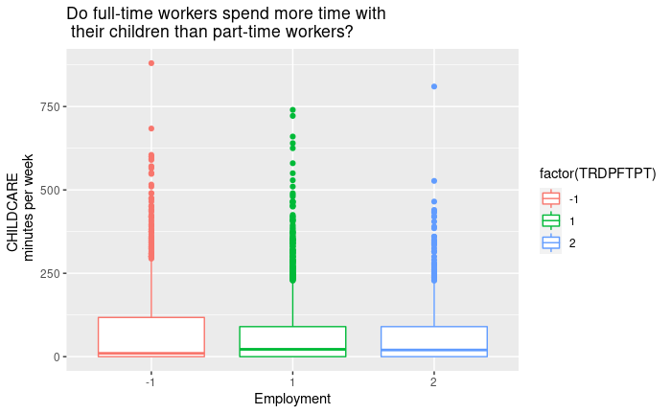
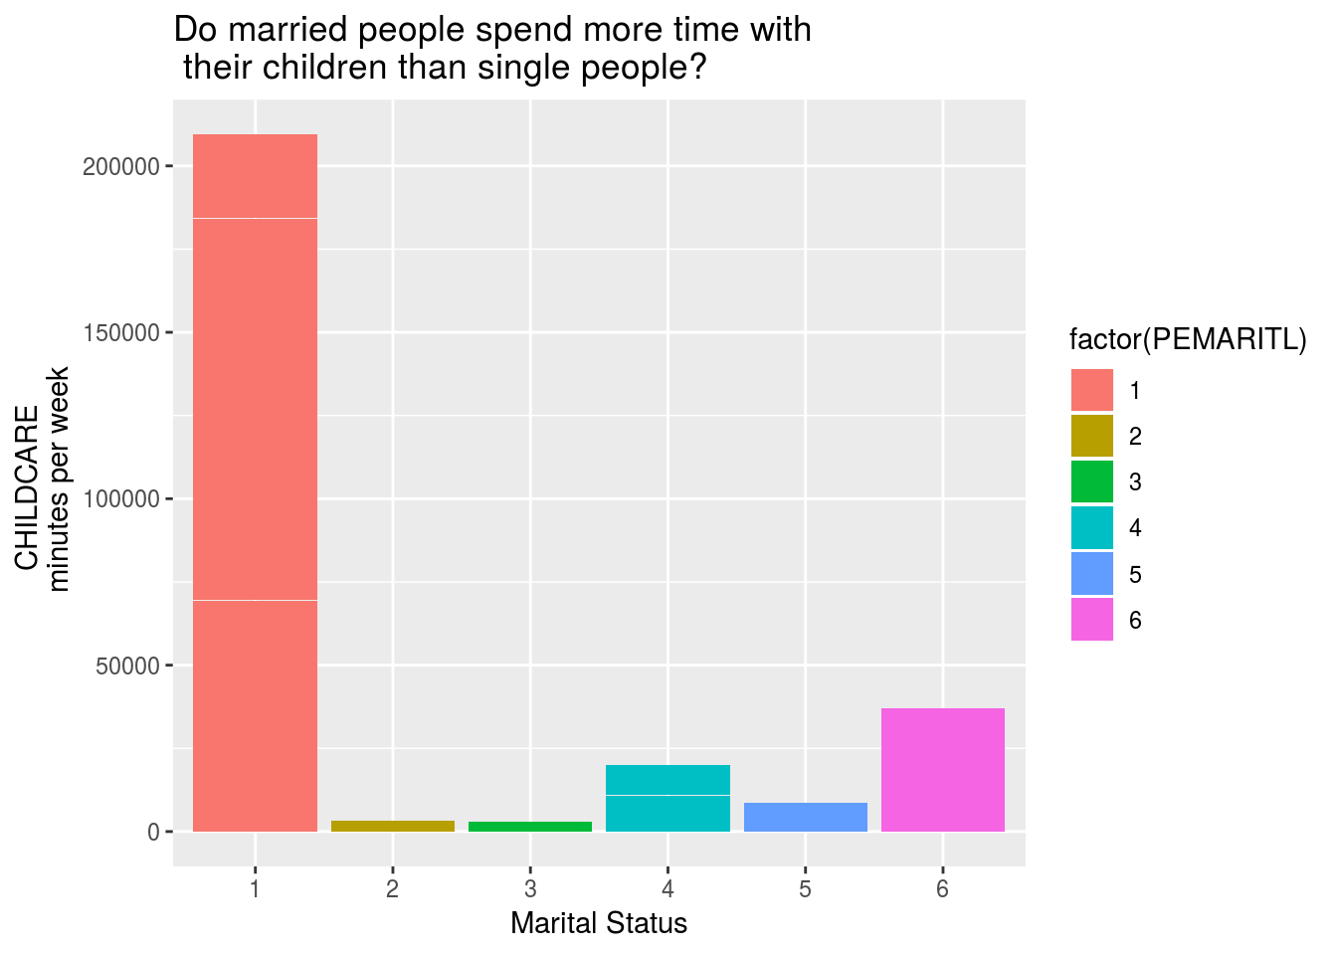
Family Survey Maria Ramos
Affiliated institutions
ABSTRACT
RESULT
CONCLUSION
The American Times used a survey to keep track on what people are doing in a daily basis. People were asked to keep a diary for one day and recorded the amount of time spend doing such activity.
Based on the data collected, research shows that the female gender typically spends more time with their offspring or child than a male does. The diagram shows that a male spends on average 19 min per week, while a women spends 33.1 min per week. (As seen in F1) Research shows that children with both parents spend more time with their kids as opposed to children without both parents or parents that are divorced/separated. (As seen In F3) Working full time or part time does affect the time parents spend with their children. The color in the chart is by employment status. Red is unemployed parents; the green is for full time working parents and finally the blue is for part time working parents. (As seen in F2)
SEX | Average parent spend childcare
1 (male) | 19.0
2 (female) | 33.1
OBJECTIVE
F1
Is the time spent with children greater for men, or for women? Does working full or part time affect the time spend with their children. Does the age of married parents affect the time shared with their children?
Unemployed Full time Part time
F3
METHOD
Read the analyze the data from The American Times. Use the text from the surveys to get the data to later graph the information. Summarized weather a male for a female spent more time with their children.(f1) Review weather A parent working full time or part time influence the time spent with their children.(F2) Elaborated if parents being married or not has an outcome on the time spent with their children.(F3)
Married –spouse present Married –spouse absent Widowed Divorced Separated Never married
BIBLIOGRAPHY
The US Bureau Of Labor Statistics https://www.bls.gov/tus/lexiconwex2016.pdf https://www.bls.gov/tus/atuscpscodebk16.pdf https://www.bls.gov/tus/atusintcodebk16.pdf Accessed June 2017
F2

