Slide 1
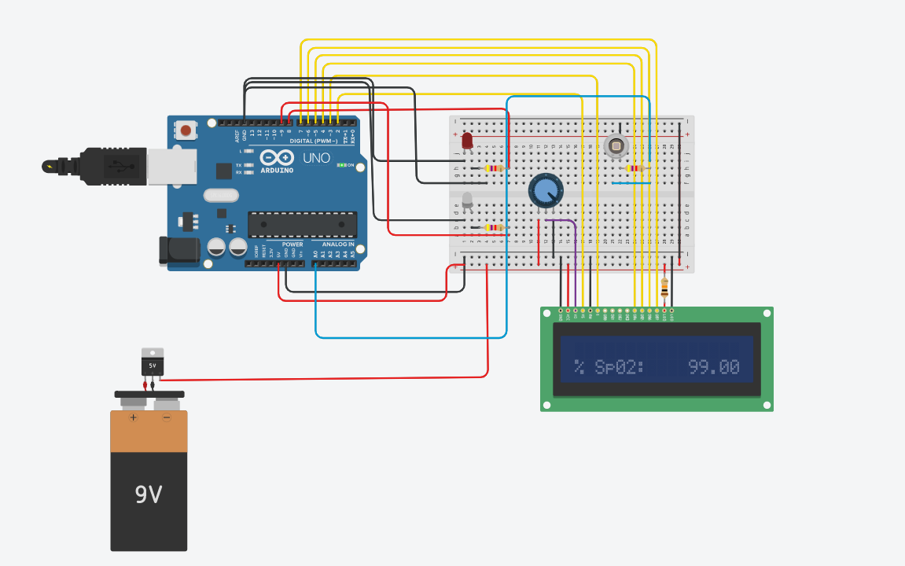
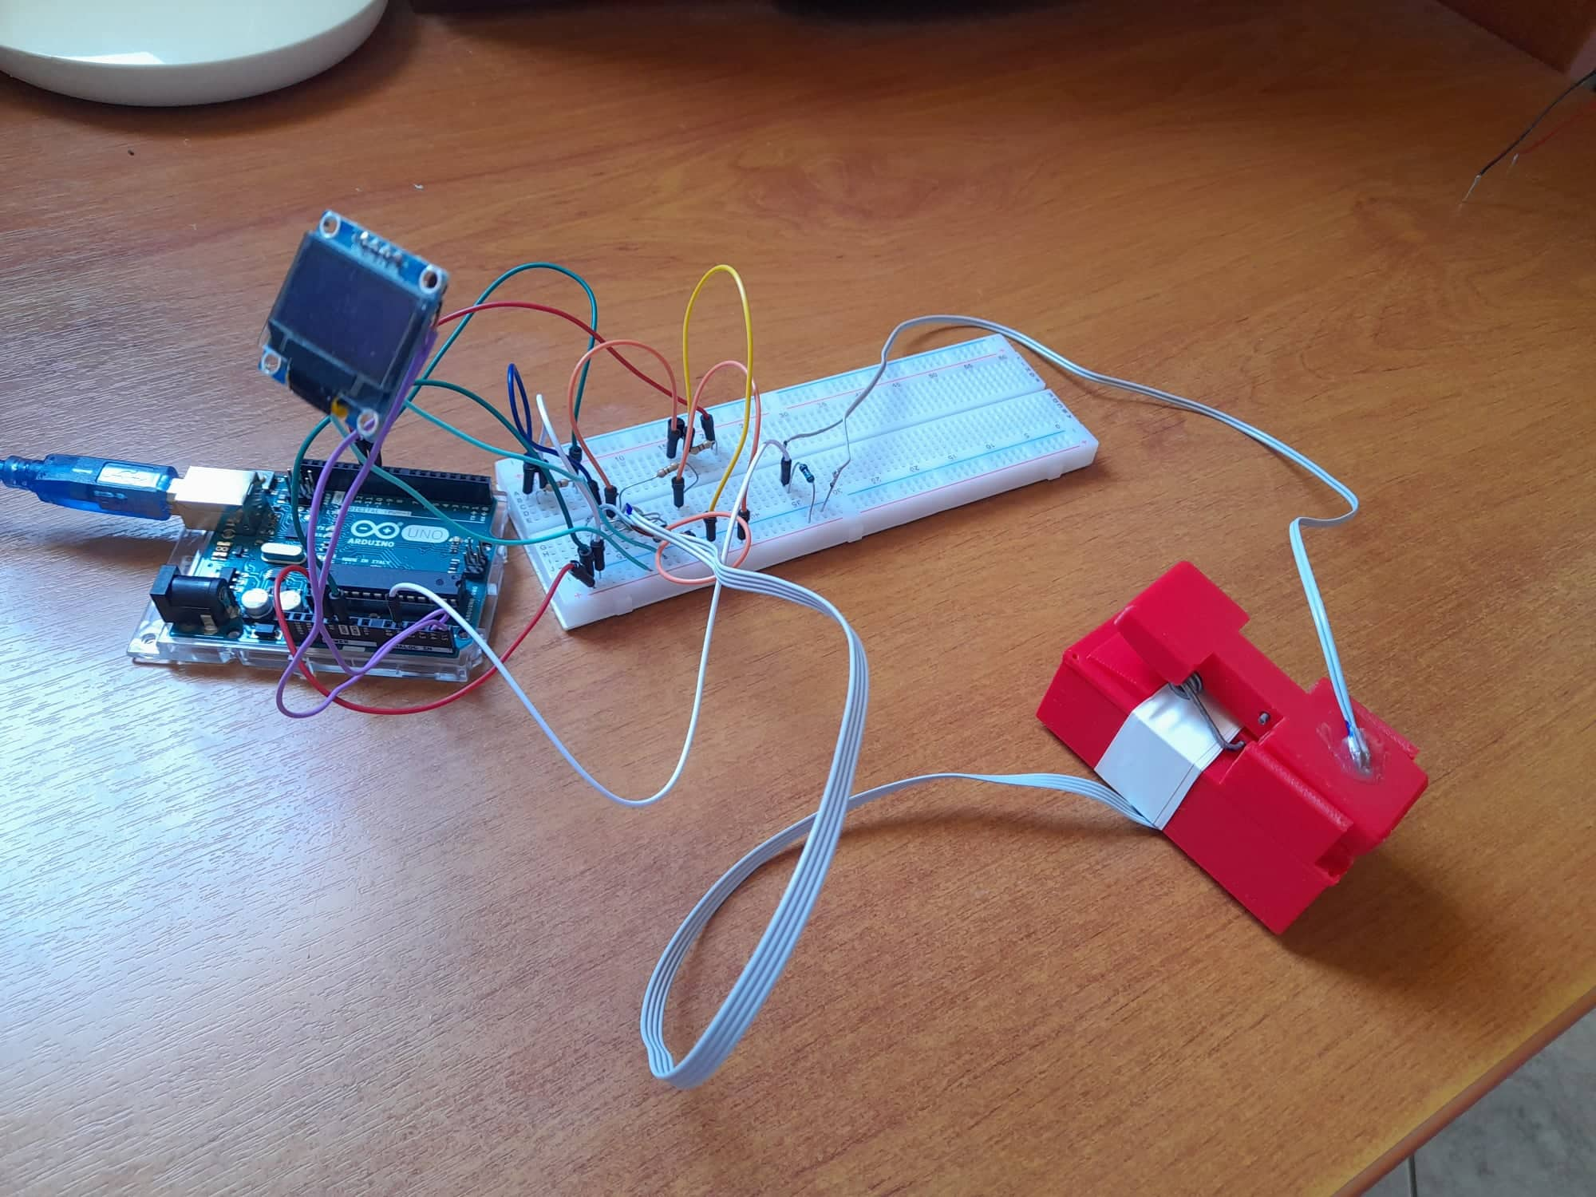
The implementation of an impulse oximeter using Arduino microcontroller
MARIA REVYTHI
MSc Biomedical Engineering, Department of Electrical and Computer engineering, University of Patras
ABSTRACT
MATERIALS & METHODS
RESULTS
RESULTS
If a person can intermittently monitor his or her oxygen saturation level, he or she can identify his or her condition early and thus seek medical attention. This poster describes the design and implementation of low-cost pulse oximeter. The principal components of that device are a Red led light, an Infrared led light, a photodiode and an Arduino Uno microcontroller. This health-monitoring device evaluates the physiological parameter of oxygen saturation. The system is designed in Tinkercad and then simulated to test its performance. Following that, the hardware implementation is carried out. A system of leds-photodetector was used in order to sense the arterial oxygen saturation level of blood signal from an individual’s fingertips and then converted it into digital data in the microcontroller via its programming instructions. The finger clip was made by a 3D printer. The designed system was put to the test by measuring the SpO2 levels of several people from various ages. Furthermore, the same individuals were tested using a standard machine purchased from the market. The test results were found to be very satisfied, with an average percentage of error of only 0.52 percent. Moreover, the total cost of this pulse oximeter is in EUR 45,69, which makes it an affordable solution for all people.
The table below describes analytically the components, which are used, in order to implement the oximeter.
The pulse oxygen saturation level is measured for 10 people of various ages simultaneously using our designed oximeter and a standard oximeter purchased from the market. The following graph shows the data for various ages of people. The percent errors varies from 0% to 2.1% . However, the average percentage of error is very less, only 0.52%, which shows the accuracy of this pulse oximeter.
The following table shows the cost analysis
 | Components | Quantity | Price(in EUR)
1 | Arduino UNO | 1 | 24
2 | OLED display | 1 | 8.9
3 | Red led | 1 | 0.08
4 | Infrared led | 1 | 0.12
5 | Photodiode | 1 | 0.86
6 | npn Transistor BC547 | 2 | 0.08
7 | 9V Battery | 1 | 1.45
8 | Battery Cap | 1 | 0.4
9 | Wires | 20 | 1.8
10 | Breadboard | 1 | 2.6
11 | Resistor 1 Mohm | 1 | 0.8
12 | Resistor 80 ohm | 2 | 0.8
13 | Resistor 50 ohm | 2 | 0.8
14 | Finger-clip | 1 | 3
 | TOTAL |  | 45.69
 | Components
1 | Arduino UNO
2 | OLED display
3 | Red led
4 | Infrared led
5 | Photodiode
6 | Finger clip
7 | npn Transistor BC547
8 | Resistors
9 | 9V Battery
10 | Wires
11 | Breadboard
Using a microcontroller and a system of leds photodetector, a simple and low-cost pulse oximeter was designed, simulated, implemented and tested. The system is portable, and no medical staff are required to measure a patient’s oxygen level. Without going to doctors or physicians, the patient can easily measure and monitor his oxygen level and send the data for advice or treatment from any remote location.
In the future, power consumption and costs should be
reduced by replacing the power supply with a rechargeable battery and developing an application for real-time data analysis on smartphones.
Overall, the main goal of providing a simple, portable, and cost-effective solution for measuring pulse oxygen saturation levels for people in low- and middle-income countries was achieved.
CONCLUSIONS
ACKNOWLEDMENTS
I would like to express my special thanks of gratitude to Emil Valchinov who helped me in designing the pulse oximeter. I am really thankful to him.

