Slide 1
Rent Offers Generator
Team Members: Claudia-Maria Munteanu, Maria Sintea
Mentor: Andrei Napradean

Slide 2
Short description
A user inputs an apartment search criteria containing neighbourhood, price range, nr of rooms, using a UiPath form.
The robot will navigate to imobiliare.ro and search for apartments based on the given search criteria.
The robot will filter the search results by price, ascending, and extract data for the top 5 results, namely name, price and URL.
The robot will generate an Excel report with the extracted data and send it to a desired email address.

Slide 3
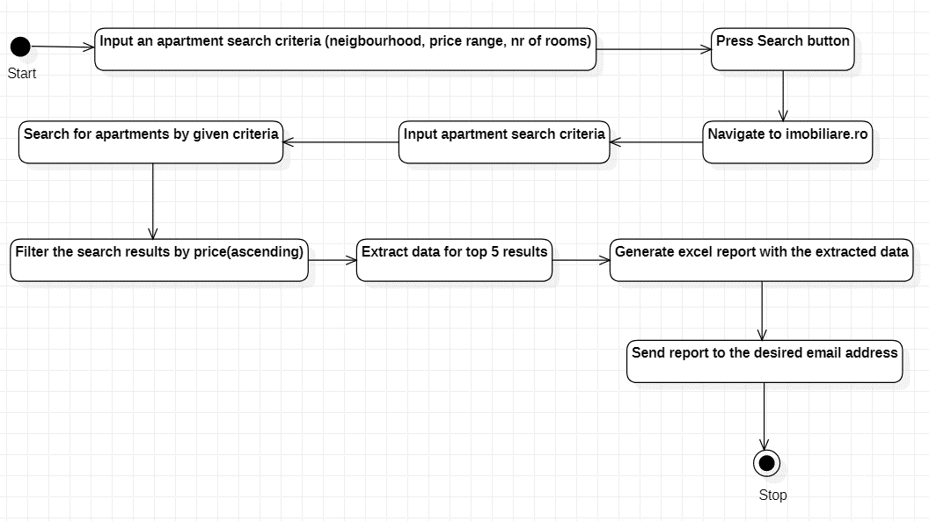
Process Diagram

Slide 4
Particularities
We use a configuration file to store values that are the same for all processes
We store the results into an Excel file
We are sending an Outlook email with the results
The inputs are taken through a form
The form is used also for inputs validation

Slide 5
challenges
Making sure that we use the same browser in all workflows
Choosing the right activity to select the information in the web page
Creating the right selectors for the selection of the information

Slide 6
conclusions
Our experience: We learned a lot about how robot process automation works and how complicated it can be to make sure that the application will run correctly in every case. Our mentor has been very supportive and gave us some really useful ideas.
Further improvements: We could improve our application so that it will work on more cities, not just with Cluj neighbourhoods. We could also integrate a new feature that will show the user the locations of the top five apartments on a map.

