Slide 1
Built-in collections
Petrivska Marianna

Slide 2
Creating an Array var arr = new Array(element0, element1, ..., elementN); var arr = Array(element0, element1, ..., elementN); var arr = [element0, element1, ..., elementN]; var arr = new Array(arrayLength); var arr = Array(arrayLength); // This has exactly the same effect var arr = []; arr.length = arrayLength;
Petrivska Marianna

Slide 3
Array In addition to a newly defined variable as shown above, arrays can also be assigned as a property of a new or an existing object: var obj = {}; // ... obj.prop = [element0, element1, ..., elementN]; // OR var obj = {prop: [element0, element1, ...., elementN]}; In ES2015, you can use Array.of static method to create arrays with single element. let wisenArray = Array.of(9.3); // wisenArray contains only one element 9.3
Petrivska Marianna

Slide 4
Attention!!!
var arr = [42]; // Creates an array with only one element:
// the number 42.
var arr = Array(42); // Creates an array with no elements
// and arr.length set to 42; this is
// equivalent to:
var arr = [];
arr.length = 42;

Slide 5
Populating an array
var emp = [];
emp[0] = 'Casey Jones';
emp[1] = 'Phil Lesh';
emp[2] = 'August West’;
Note : if you supply a non-integer value to the array operator in the code above, a property will be created in the object representing the array, instead of an array element.
var arr = [];
arr[3.4] = 'Oranges';
console.log(arr.length); // 0
console.log(arr.hasOwnProperty(3.4)); // true

Slide 6
Populating an array
You can also populate an array when you create it:
var myArray = new Array('Hello', myVar, 3.14159);
var myArray = ['Mango', 'Apple', 'Orange’];

Slide 7
Referring to array elements
var myArray = ['Wind', 'Rain', 'Fire’];
You then refer to the first element of the array as myArray[0] and the second element of the array as myArray[1]. The index of the elements begins with zero
Note : the array operator (square brackets) is also used for accessing the array's properties (arrays are also objects in JavaScript). For example,
var arr = ['one', 'two', 'three'];
arr[2]; // three
arr['length']; // 3

Slide 8
Understanding the length
The length property is special; it always returns the index of the last element plus one (in the following example, Dusty is indexed at 30, so cats.length returns 30 + 1). Remember, JavaScript Array indexes are 0-based: they start at 0, not 1. This means that the length property will be one more than the highest index stored in the array:
var cats = [];
cats[30] = ['Dusty'];
console.log(cats.length); // 31
You can also assign to the length property. Writing a value that is shorter than the number of stored items truncates the array; writing 0 empties it entirely:
var cats = ['Dusty', 'Misty', 'Twiggy'];
console.log(cats.length); // 3
cats.length = 2;
console.log(cats); // logs "Dusty, Misty" - Twiggy has been removed
cats.length = 0;
console.log(cats); // logs []; the cats array is empty
cats.length = 3;
console.log(cats); // logs [ <3 empty items> ]

Slide 9
Iterating over arrays
var colors = ['red', 'green', 'blue'];
for (var i = 0; i < colors.length; i++) {
console.log(colors[i]);
}
var colors = ['red', 'green', 'blue'];
colors.forEach(color => console.log(color));

Slide 10
Iterating over arrays Note that the elements of an array that are omitted when the array is defined are not listed when iterating by forEach, but are listed when undefined has been manually assigned to the element:
var array = ['first', 'second', , 'fourth'];
array.forEach(function(element) {
console.log(element);
});
// first // second // fourth
It is not advisable to iterate through JavaScript arrays using for…in loops because normal elements and all enumerable properties will be listed.

Slide 11
Array methods
concat() joins two or more arrays and returns a new array. join(delimiter = ',') joins all elements of an array into a string. var myArray = new Array('Wind', 'Rain', 'Fire'); var list = myArray.join(' - '); // list is "Wind - Rain - Fire“ push() adds one or more elements to the end of an array and returns the resulting length of the array. var myArray = new Array('1', '2'); myArray.push('3'); // myArray is now ["1", "2", "3"] pop() removes the last element from an array and returns that element. shift() removes the first element from an array and returns that element. unshift() adds one or more elements to the front of an array and returns the new length of the array. var myArray = new Array('1', '2', '3’); myArray.unshift('4', '5'); // myArray becomes ["4", "5", "1", "2", "3"] slice(start_index, upto_index) extracts a section of an array and returns a new array. splice(index, count_to_remove, addElement1, addElement2, ...) removes elements from an array and (optionally) replaces them. It returns the items which were removed from the array.
Petrivska Marianna

Slide 12
Array methods
reverse() transposes the elements of an array, in place: the first array element becomes the last and the last becomes the first. It returns a reference to the array.
sort() sorts the elements of an array in place, and returns a reference to the array.
indexOf(searchElement[, fromIndex]) searches the array for searchElement and returns the index of the first match.
var a = ['a', 'b', 'a', 'b', 'a'];
console.log(a.indexOf('b', 2)); // logs 3
console.log(a.indexOf('z')); // logs -1, because 'z' was not found
lastIndexOf(searchElement[, fromIndex]) works like indexOf, but starts at the end and searches backwards.
map(callback[, thisObject]) returns a new array of the return value from executing callback on every array item.
filter(callback[, thisObject]) returns a new array containing the items for which callback returned true.
every(callback[, thisObject]) returns true if callback returns true for every item in the array.

Slide 13
Array methods
some(callback[, thisObject]) returns true if callback returns true for at least one item in the array.
reduce(callback[, initialValue]) applies callback(accumulator, currentValue[, currentIndex, array]) for each value in the array for the purpose of reducing the list of items down to a single value.
reduceRight(callback[, initialValue]) works like reduce(), but starts with the last element.
var a = [10, 20, 30];
var total = a.reduce(function(accumulator, currentValue) { return accumulator + currentValue; }, 0);
console.log(total) // Prints 60

Slide 14
Multi-dimensional arrays
var a = new Array(4);
for (i = 0; i < 4; i++) {
a[i] = new Array(4);
for (j = 0; j < 4; j++) {
a[i][j] = '[' + i + ', ' + j + ']';
}
}
Row 0: [0, 0] [0, 1] [0, 2] [0, 3]
Row 1: [1, 0] [1, 1] [1, 2] [1, 3]
Row 2: [2, 0] [2, 1] [2, 2] [2, 3]
Row 3: [3, 0] [3, 1] [3, 2] [3, 3]

Slide 15
Typed Arrays
To achieve maximum flexibility and efficiency, JavaScript typed arrays split the implementation into buffers and views. A buffer (implemented by the ArrayBuffer object) is an object representing a chunk of data; it has no format to speak of, and offers no mechanism for accessing its contents. In order to access the memory contained in a buffer, you need to use a view. A view provides a context — that is, a data type, starting offset, and number of elements — that turns the data into an actual typed array.
new TypedArray();
new TypedArray(length);
new TypedArray(typedArray);
new TypedArray(object);
new TypedArray(buffer [, byteOffset [, length]]);
var int16 = new Int16Array(2);
int16[0] = 42;
console.log(int16[0]); // 42

Slide 16
Typed Array views
Int8Array -128 to 127
Uint8Array 0 to 255
Uint8ClampedArray 0 to 255
Int16Array -32768 to 32767
Uint16Array 0 to 65535
Int32Array -2147483648 to 2147483647
Uint32Array 0 to 4294967295
Float32Array 1.2x10-38 to 3.4x1038
Float64Array 5.0x10-324 to 1.8x10308
BigInt64Array -263 to 263-1
BigUint64Array 0 to 264-1

Slide 17
Symbol.iterator
Symbols offer names that are unique and cannot clash with other property names. Also, Symbol.iterator will return an object called an iterator. This iterator will have a method called next which will return an object with keys value and done.
The value key will contain the current value. It can be of any type. The done is boolean. It denotes whether all the values have been fetched or not.

Slide 18
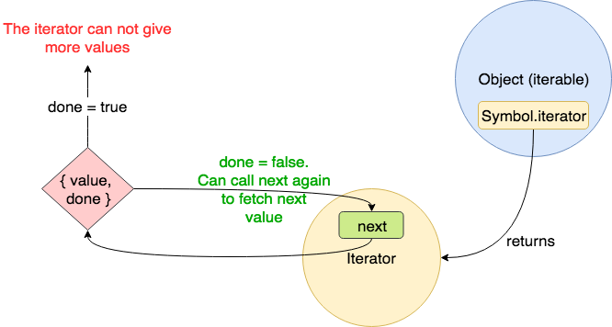
Scheme of iterator

Slide 19
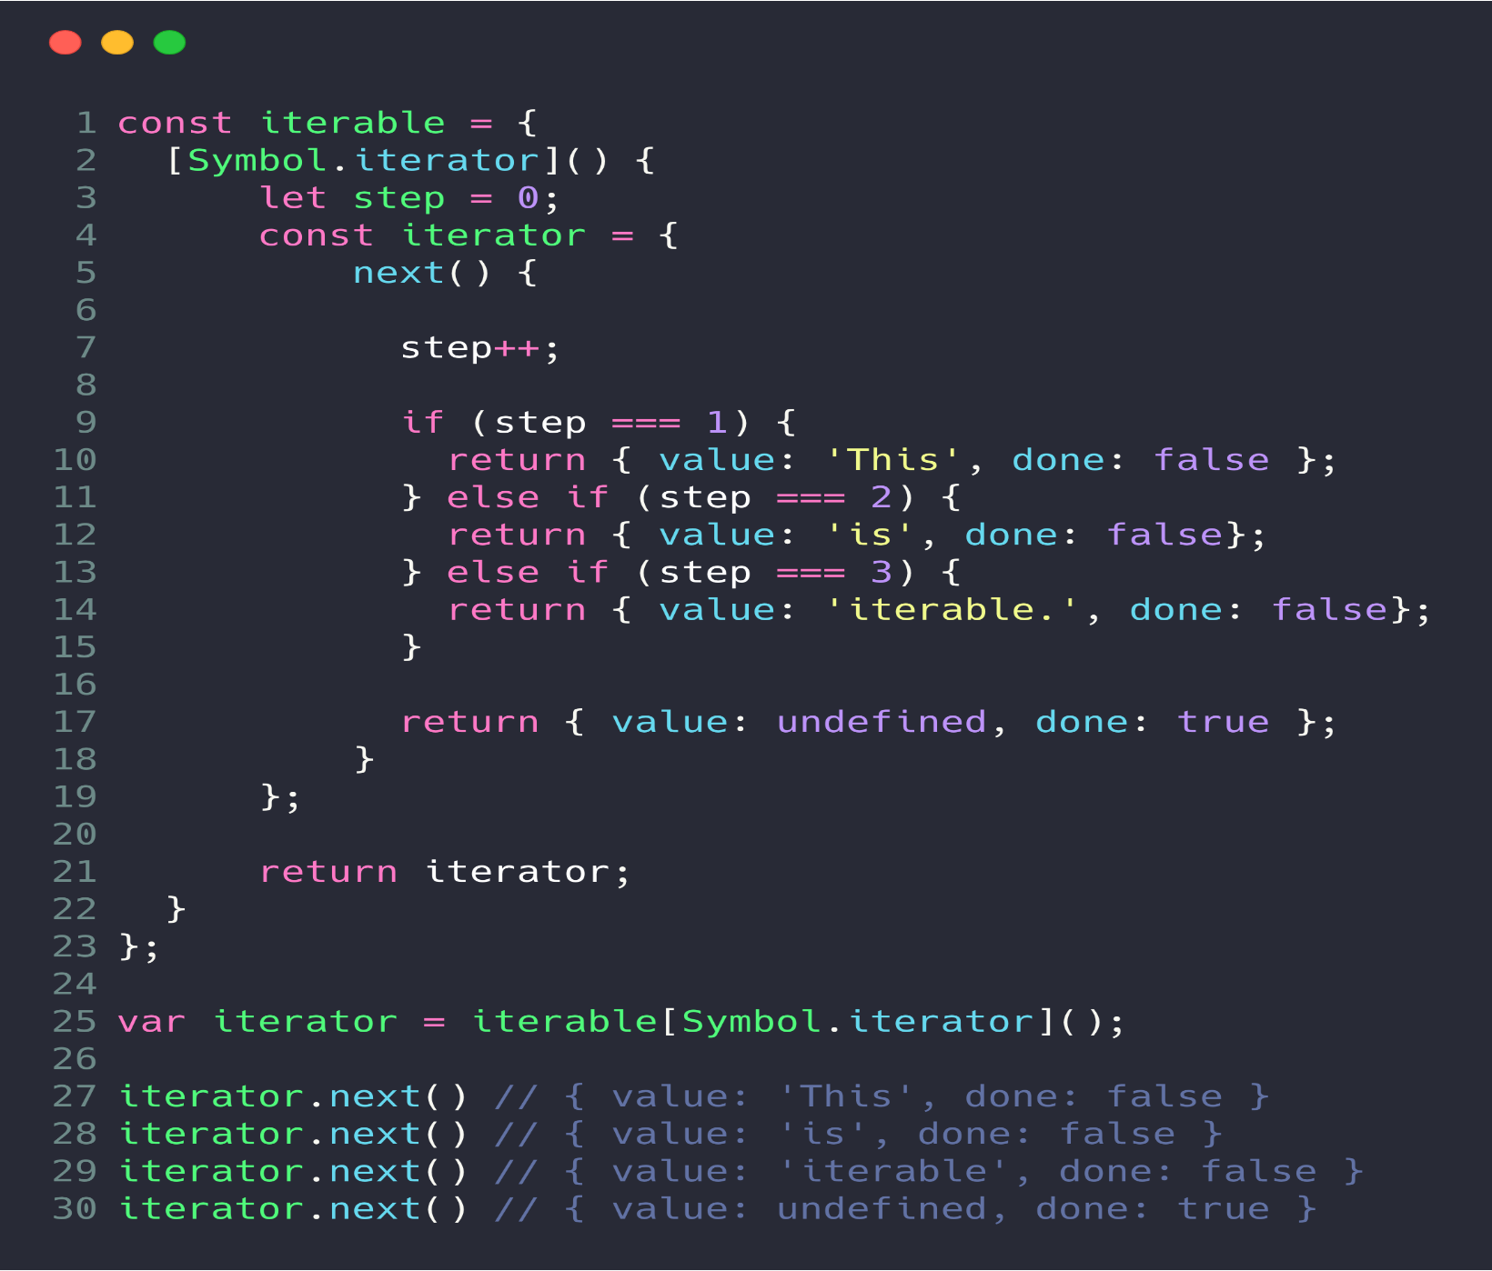
Making objects iterable

Slide 20
Map
“ The Map object holds key-value pairs. Any value (both objects and primitive values) may be used as either a key or a value.”
let old_map = {
"key1":"value1",
"key2":"value2",
"key3":"value3",
}
console.log(old_map.key1); // output value1
console.log(old_map.toString()) // output [object Object]

Slide 21
Map in action
let map = new Map();
map.set('key1', 123);
console.log(map.get('key1')); // output 123
console.log(map.has('key1')) // output true
console.log(map.delete('key1')); // output true (removed)
console.log(map.has('key1')); // output false

Slide 22
WeakMap
A WeakMap is a Map where the keys are weak — in other words, if all references to the key are lost and there are no more references to the value it can be garbage collected, unlike Map (it is a very important point).
WeakMap has the same API as Map, but one big difference: you cannot iterate over it, neither the keys, nor the values, nor the entries and you cannot clear a WeakMap, either.

Slide 23
Set
A set is a collection of items which are unique i.e no element can be repeated. Set in ES6 are ordered: elements of the set can be iterated in the insertion order. Set can store any types of values whether primitive or objects.
Set.prototype.size – It returns the number of elements in the Set.
Set.prototype.add() – It adds the new element with a specified value at the end of the Set object.
Set.prototype.delete() – It deletes an element with the specified value from the Set object
Set.prototype.clear() – It removes all the element from the set.
Set.prototype.entries() – It returns an iterator object which contains an array having the entries of the set, in the insertion order.

Slide 24
Example
var set1 = new Set();
// adding element to the set
set1.add(50);
set1.add(30);
set1.add(40);
set1.add(20);
set1.add(10);
// using entries to get iterator
var getEntriesArry = set1.entries();
// each iterator is array of [value, value]
// prints [50, 50]
console.log(getEntriesArry.next().value);
// prints [30, 30]
console.log(getEntriesArry.next().value);
// prints [40, 40]
console.log(getEntriesArry.next().value);

Slide 25
Set methods
Set.prototype.has() – It returns true if the specified value is present in the Set object.
Set.prototype.values() – It returns all the values from the Set in the same insertion orde
Set.prototype.keys() – It also returns all the values from the Set in the insertion order
Set.protoype[@@iterator]() – It returns a Set iterator function which is values() function by default.

Slide 26
WeakSet
The major difference of a WeakSet with the set is that a WeakSet is a collection of objects and not values of some particular type.
METHODS DESCRIPTION
add(value) a new object is appended with the given value to the weakset.
WeakSet_Object.add(value)
delete(value) Deletes the value from the WeakSet collection.
WeakSet_Object.delete(value)
has(value) Returns true if the value is present in the WeakSet Collection, false otherwise.
WeakSet_Object.has(value)
length() Returns the length of weakSetObject
WeakSet_Object.length()

Slide 27
Sources https://developer.mozilla.org/uk/docs/Web/JavaScript/Guide/Regular_Expressions https://www.tutorialspoint.com/javascript/javascript_regexp_object.htm https://www.geeksforgeeks.org/javascript-weakset/https://developer.mozilla.org/en-US/docs/Web/JavaScript/Reference/Global_Objects/WeakMap?source=post_page-----f38f9c4ed2b6----------------------

