Slide 1

WanderWide: A Travel Management System
This presentation outlines the Software Requirements and Design Document for WanderWide, a travel management system designed to streamline travel planning and management.
By: Maria Naeem, Ammar Hussain, Malaika Afzal
Notes:
1

Slide 2
System Overview
Purpose
Scope
WanderWide aims to provide a unified platform for booking transportation and accommodation, simplifying the travel planning process.
The system includes features for service providers to manage their offerings and customers to search, book, and manage their travel plans.
Notes:
2

Slide 3
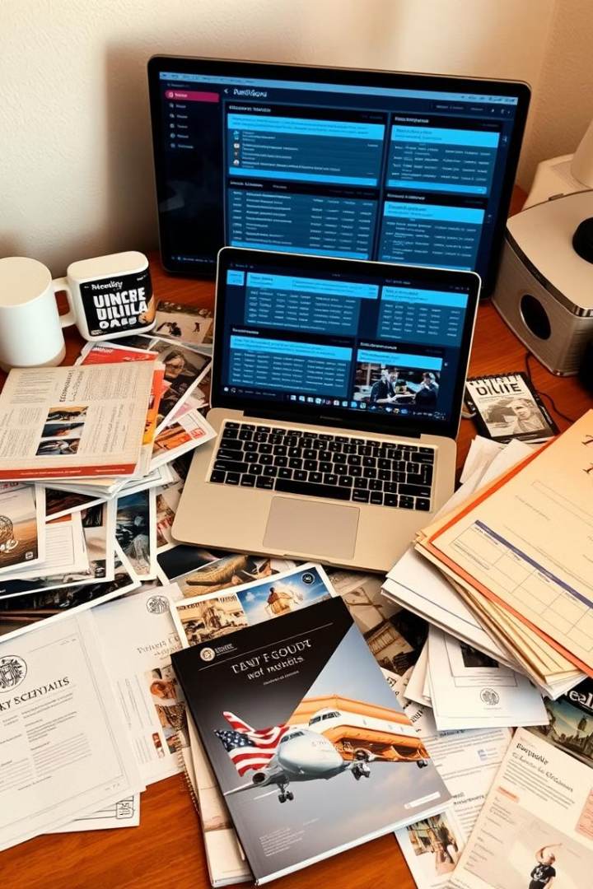

Objectives and Challenges
1
Centralize Services
2
Streamline Operations
Provide a single platform for booking flights, trains, buses, and hotels.
Enable service providers to manage bookings and feedback efficiently.
3
Address Challenges
Tackle the fragmentation of travel planning with a unified solution.
Notes:
3

Slide 4

Functional Breakdown
Service Provider
Customer
Add/Update Services
Search and Browse Services
View Bookings
Book Travel Services
View Customer Feedback
View Booking History
Notes:
4

Slide 5

Performance Requirements
3
2,000
Concurrent Users
Response Time
Customers should receive booking responses within 3 seconds during normal operation.
The system must handle up to 2,000 concurrent users.
Notes:
5

Slide 6
Quality Attributes
Reliability
1
Minimize downtime, aiming for 99.9% uptime.
2
Usability
Intuitive interface with easy navigation for booking services.
Maintainability
3
Well-documented code for easy updates and maintenance.
Notes:
7

