Slide 1

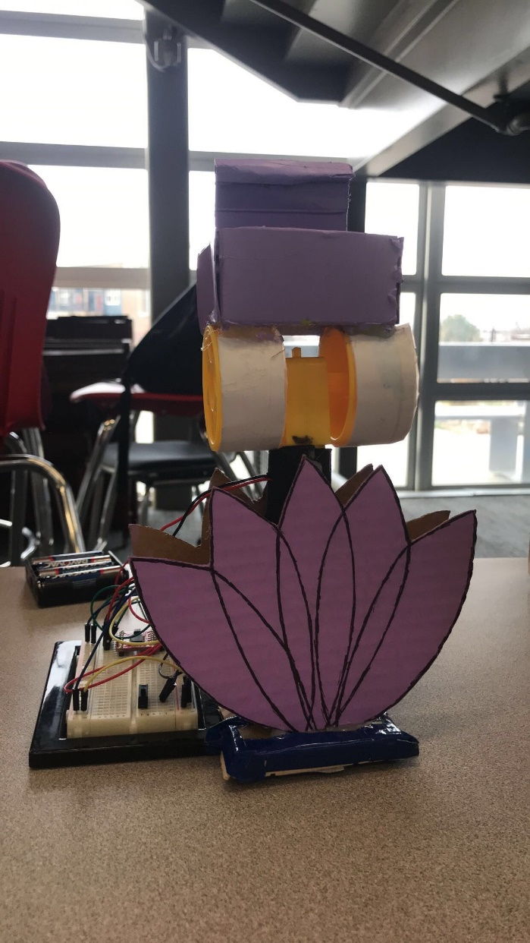
PING PONG PROJECT
Maria V & Karyna T

Slide 2

Process
1. We started by looking through the guide book we were provided and found a code for a motor to use
2. Then we built an idea off of the motor we chose
3. We sketched the idea
4. We built our project based on the sketch
5. Fixed any details and made it look better

Slide 3
Challenges
Getting the main part to not fall over and stay up
Figuring out the wires
Plugging in the code

Slide 4
What We’re Proud Of
We were able to finish the project early
We were able to decorate it
Our first idea worked

Slide 5
How We Could Fix Our Poster
Make a physical poster
Spend more time on it

Slide 6
Design Changes
We started with a cylinder for the base and changed it to a flatter surface, then we changed it again by taping it to the wire part

Slide 7
How We Contributed
Maria:
I wired everything and fixed the code
I made the sketch
Helped decorate
Karyna:
Helped decorate
Came up with some ideas for the design
Helped build the design

