Slide 1
Message Flow Application
Training project by Maria Verbene

Slide 2
Project tools
Spring Boot
Spring Integration
Maven
Apache Kafka
PostgreSQL

Slide 3
Project description
Message flow between:
Kafka topics,
HTTP-request,
PostgreSQL database
Handling messages:
deserialization from JSON and setting new properties
Multithreading:
additional thread copies incoming messages to PostgreSQL

Slide 4
Project logic
Kafka Producer
@Bean
IntegrationFlow
getting kafka message key, setting handled timestamp
POST-request
Kafka topic ‘topic1’
setting handled timestamp
checking whether user is registered
NO
YES
Kafka topic ‘topic2’
@Bean
IntegrationFlow
@Bean
IntegrationFlow
PostgreSQL database

Slide 5
Project tools and key points
Annotation used:
KafkaProperties, JdbcTemplate - set with application.properties and @Autowired
Messaging Endpoints:
Message Handler interface
Channel Adapters:
Kafka.messageDrivenChannelAdapter
Kafka.outboundChannelAdapter
Http.inboundGateway
Message Channels:
PublishSubscribe Channel
Direct Channel
@Autowired | @Configuration | @RestController
@Beans | @EnableIntegration | @RequestMapping
@Component | @SpringBootApplication | @PreDestroy
@ConfigurationProperties | @Test

Slide 6

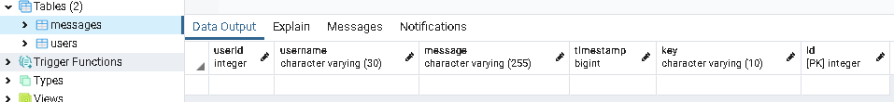
PostgreSQL Database
‘postgres’
Table1
Table2
Users
Messages
id | primary key
username | var char(30)
age | integer
id | primary key
userid | integer
username | var char(30)
message | var char(255)
timestamp | big int
key | var char(10)
foreign key

Slide 7
Multithreading
Additional Thread for copying incoming messages to PostgreSQL:
Main thread
ThreadJDBC
collects each 5 new incoming messages in Map
adds new messages from Map in database tables
notify()
wait()
notify()
wait()

Slide 8
Project deploy in local Kubernetes
Building docker image with jib maven plugin
Helm chart with dependent charts:
Confluent Platform helm chart
(https://confluentinc.github.io/cp-helm-charts/)
PostgreSQL helm chart (docker image: postgres)
MessageFlowApp helm chart (docker image: mverbene/messageflow)
Commands for application deployment:
helm install
kubectl cluster-info
kubectl get pods / services / deployments
kubectl describe pod / service / deployment
kubectl logs pod

Slide 9
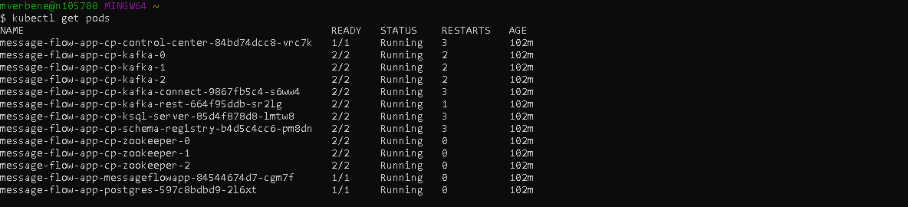
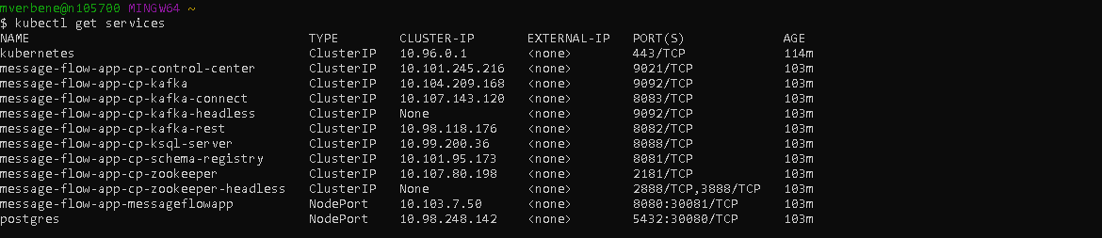

Slide 10
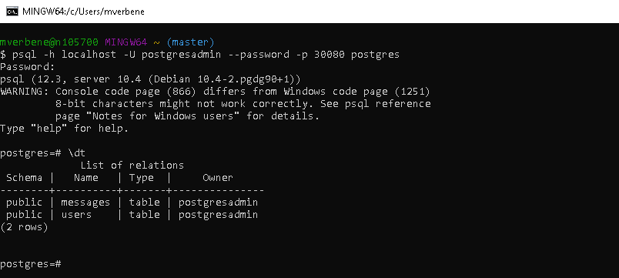
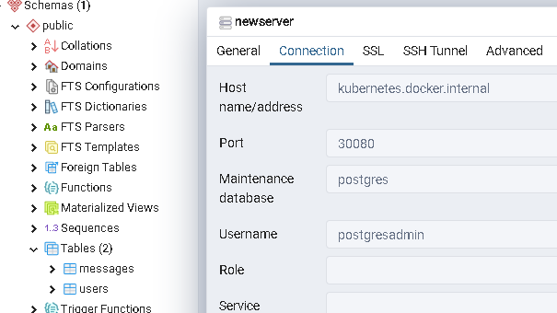
PostgreSQL

Slide 11
Call for Kafka consumer and producer in Kubernetes
kubectl exec -c cp-kafka-broker -it message-flow-app-cp-kafka-0
-- /bin/bash /usr/bin/kafka-console-producer
--broker-list localhost:9092 --topic topic1 --property "parse.key=true“ --property "key.separator=:"
kubectl exec -c cp-kafka-broker -it message-flow-app-cp-kafka-0
-- /bin/bash /usr/bin/kafka-console-consumer
--bootstrap-server localhost:9092 --topic topic1 --property "parse.key=true" --property "key.separator=:"
kubectl exec -c cp-kafka-broker -it message-flow-app-cp-kafka-0
-- /bin/bash /usr/bin/kafka-console-consumer
--bootstrap-server localhost:9092 --topic topic2 --property "parse.key=true" --property "key.separator=:"

Slide 12
API endpoints
GET
/messages
- show result of inner join request for tables ‘users’ and ‘messages’
POST
/person
- accepts messages in JSON

Slide 13
Source code:
https://github.com/mariaverbene/MessageFlow/tree/newest-branch

Slide 14
Thank you very much for your attention

