Slide 1
DEMM
Dynamic
Emergency
Management
Mapping
David Cañones
Marc Millet
Esteve Tarragó
Maria vila

Slide 2
The problem
Situations without enough personnel
Situations with slow response services
Remote locations with low accessibility
Injured people need immediate attention

Slide 3
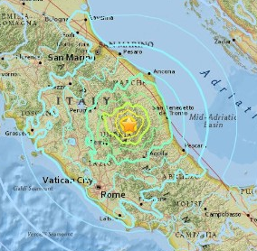
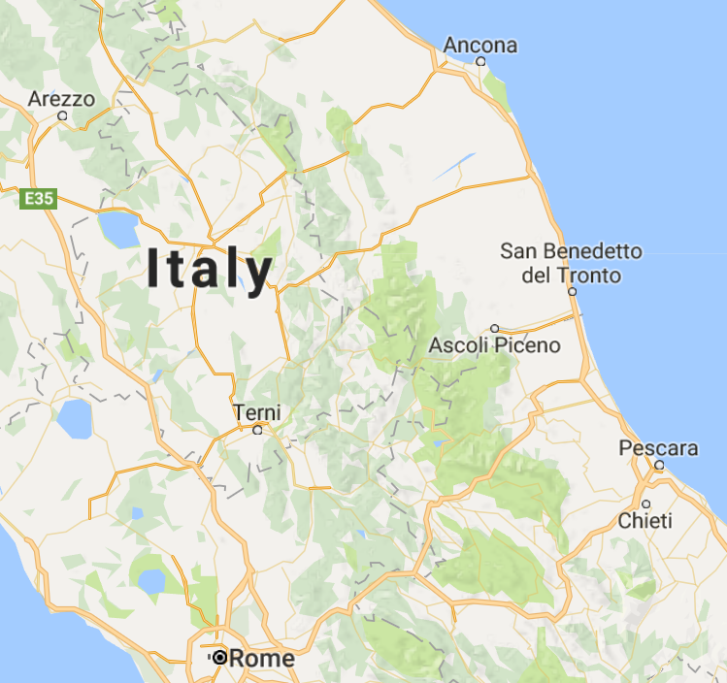



The solution

Slide 4
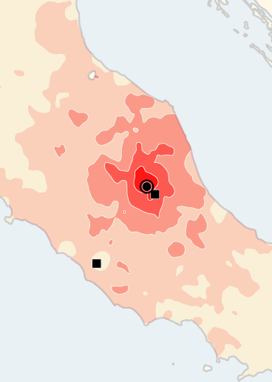
The solution
Real time data on affected areas
Database of needs and resources
Automated management of resources

Slide 5
How it works
Response teams
Requests state
(disaster dependant)
Manual notification
Background Service
Other users
Manual or automatic response
Collect data
Smarphone app
Website
Before the incident
After the incident

Slide 6
How it works
Smartphone app
Background “Black box” which records only the last hour of activity
Government request state triggers a pop-up for the user to answer their state
Users who haven’t answered use the “Black box” data to predict their state
Users can answer their state and their resourcefulness
App can offer some basic survival assistance
App can use biomedical sensors to aid the victim

Slide 7
How it works
Web App
Users can input their responses: injured? Can assist? …
User inputs their location (or is automatically obtained)
User can obtain survival information

Slide 8
How it works
Centralized server
Server discards users which are in immediate range of first response teams
Server divides the data into two weighted sets: needs and resources
Server uses a Depth-First Search (DFS) algorithm to determine assistance routes
Server requests users to help where needed (might ask for more than 1 for redundancy)
Server requests updates to users as late as possible

