Slide 1
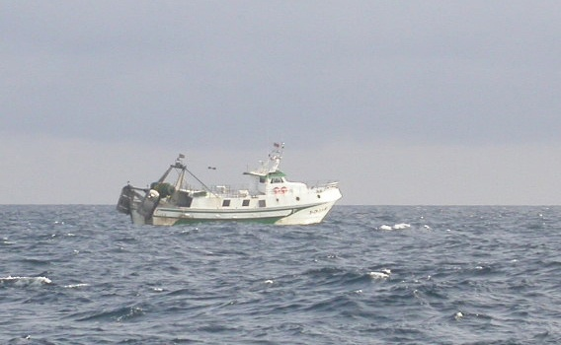

Scientific Advisory Committee on Fisheries (SAC)
Working Group on Stock Assessment of Demersal Species (WGSAD)
Western Mediterranean Stocks (WGSAD-W) Rome, 12-17 December 2022
Assessment of European Hake; Merluccius merluccius, exploited by the Spanish fishery (2002-2021) GFCM geographical sub-area 6 (Northern Spain)
Notes:
...

Slide 2
Stock Assessment Summary
Species: Merluccius merluccius (HKE)
GSA(s): 6-Northern Spain
Authors:., García-Rodríguez et al
Time series: 2002-2021

Slide 3
Stock Assessment Summary
Priority species
Non-priority species
Species category
Other:

Slide 4
Stock Assessment Summary
Benchmark update
Update of 2020
New assessment
Catch advice
Type of stock assessment
Other:
Previous year advice (if any): 2018, 2019, 2021 No additional advice

Slide 5
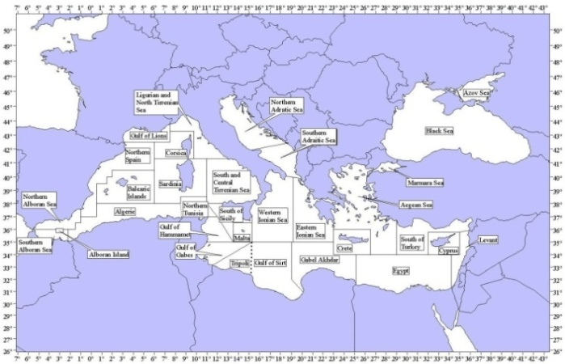

Previous Advices and Stock Status
 | A4a 2019 | A4a 2020 | A4a 2021
F_{0.1} | NO ADVICE | 0.14 | 0.15
F_{current} | NO ADVICE | 1.2 (0.13) _{(2020, 0-2)} | 1.7 (0.16) _{(2021, 0-2)}
F_{c/}F_{0.1} | NO ADVICE | 8.5 | 11.5
GSA6 – Fleet characteristics
Exploited in GSA 6 almost exclusively by trawl* (95% landings) followed by small-scale gillnets (3%) and long lines (2%)

Slide 6
Input Data
Landings have shown important oscillations along the period of the data series.
General decreasing trend is observed
Assessed period 2002-2021
No discard data available for the entire historical series assessed.
Highest discard rates from the bottom trawl fishery.
Negligible for the other gears.
Discard not included in the stock assessment

Slide 7
Input Data
CPUE and Survey Index
N*1000

Slide 8
Input Data
Biological parameters
age | M
0 | 1.8
1 | 0.72
2 | 0.41
3 | 0.31
4 | 0.24
5+ | 0.18
Capuccine et al. 2009. (Tag survey)
Average different methods (Benchmark 2019)
Growth 1 | U
L inf | 110
K | 0.178
T₀ | 0
Catch-at-Length data converted to Catch-at-Age data using cohort slicing.
*DCF Spanish National Programme in the Mediterranean.
age | % mature
0 | 0
1 | 0.2965
2 | 0.9855
3 | 0.99
4 | 1
5+ | 1
Growth II**
Maturity**
a | 0.00677
b | 3.035097
L50 | 27 TL (cm)

Slide 9
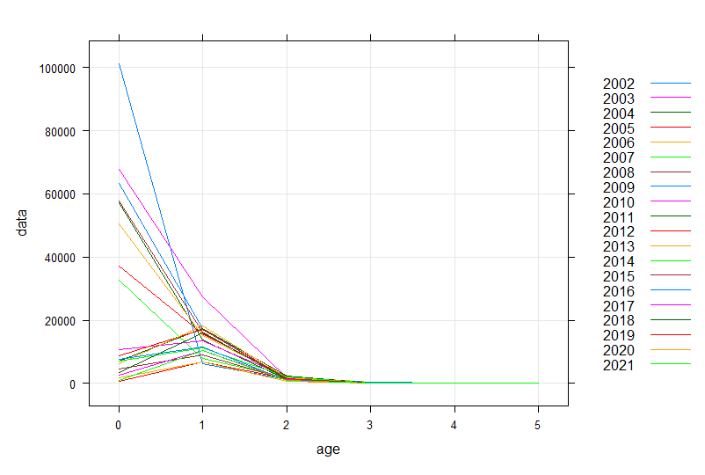
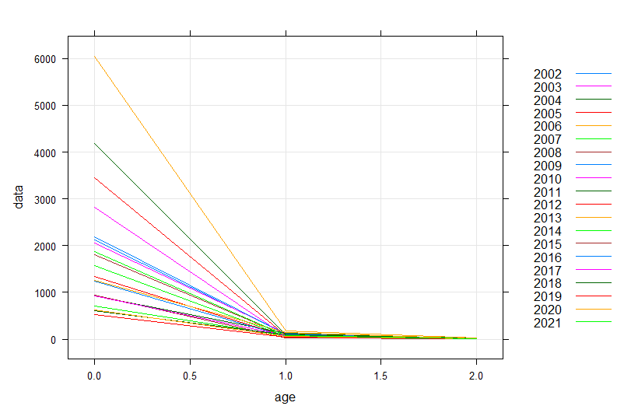
Input Data
Fleet monthly length sampling 2002-2021
Survey length sampling

Slide 10
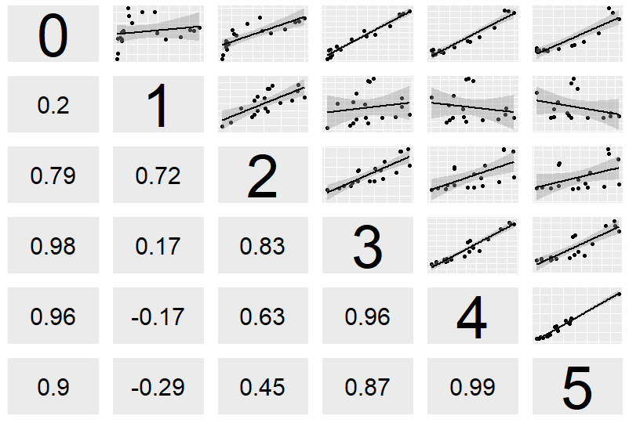
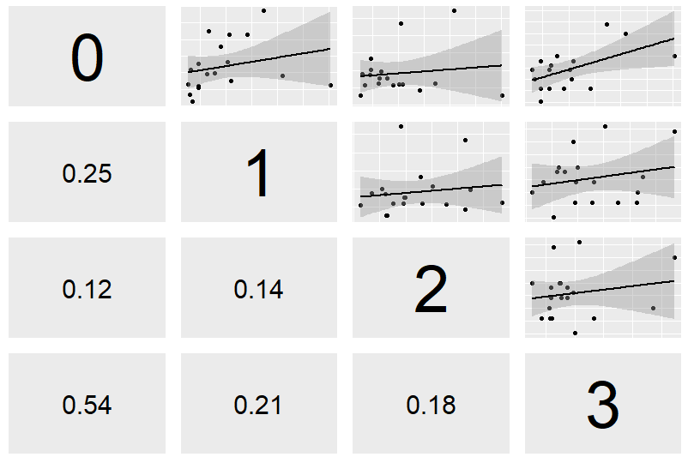
Input Data
Internal Consistency Fleet
Internal Consistency Survey

Slide 11
Assessment methods
a4a statistical catch at age (Jardim et al., 2013)
Y/R analysis
Model Selection procedure
Update 2021 Assessment using A4a model
fmod <- ~ factor(age) + s(year, k=6)+s(year, k =6, by = as.numeric(age == 0))
srmod <- ~factor(year)
qmod <- list(~factor(replace(age, age>3,3))

Slide 12
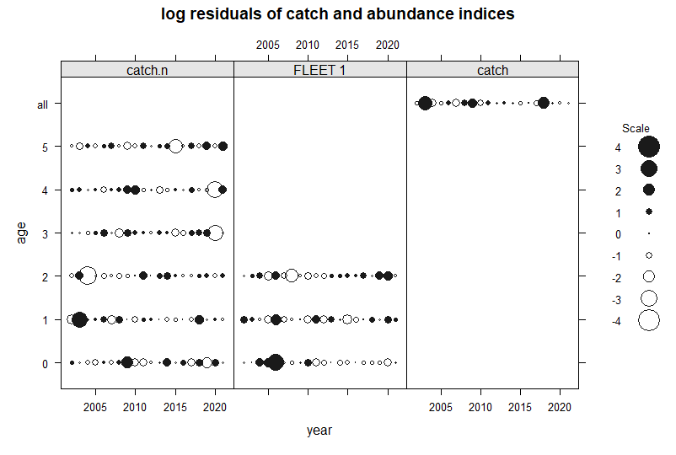
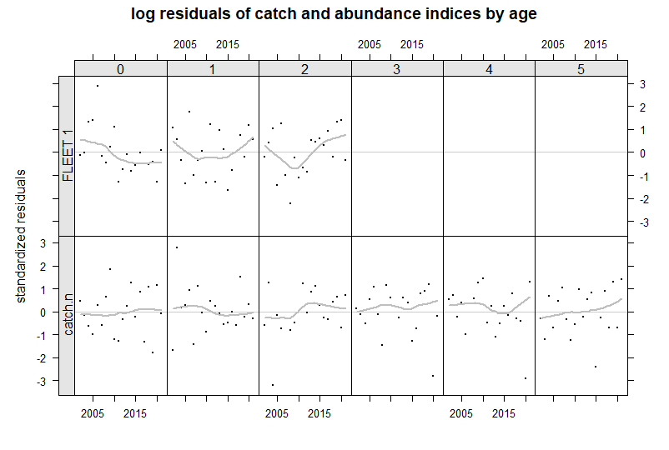
A4a Diagnostics

Slide 13
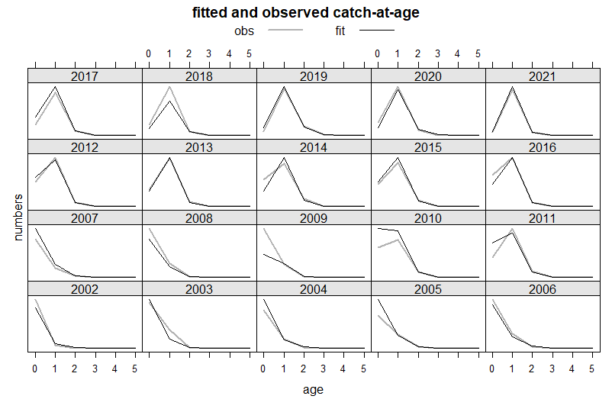
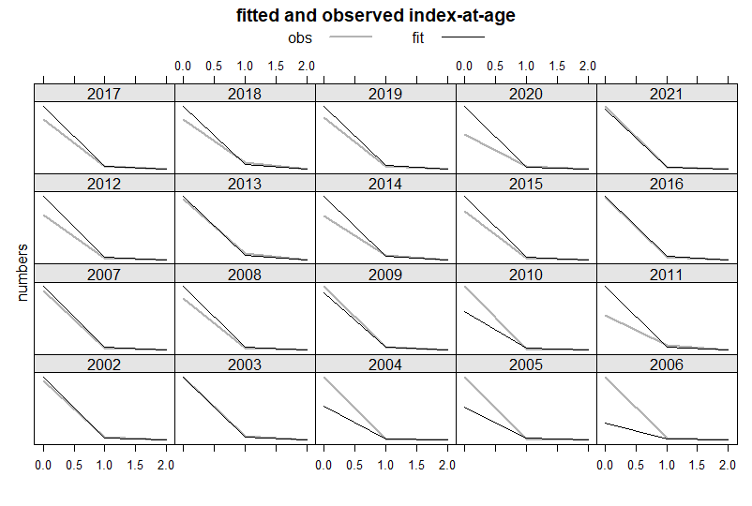
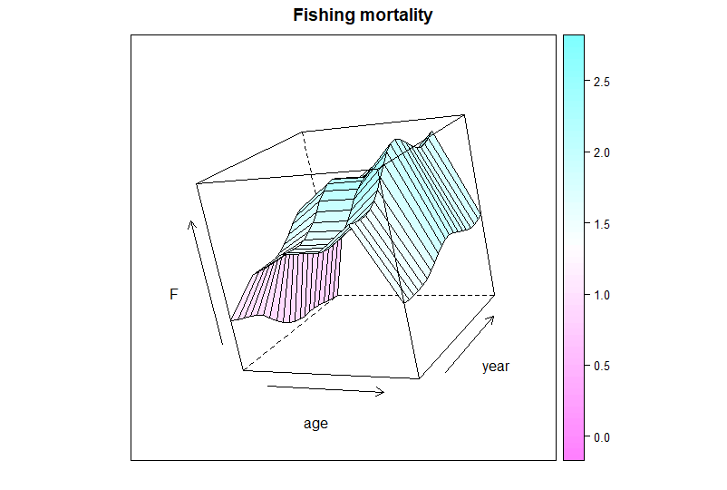
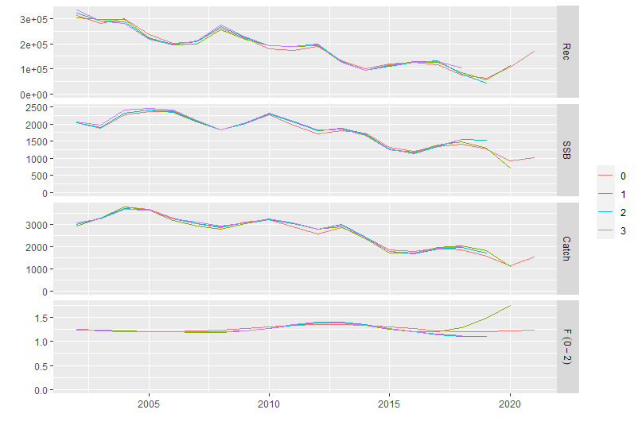
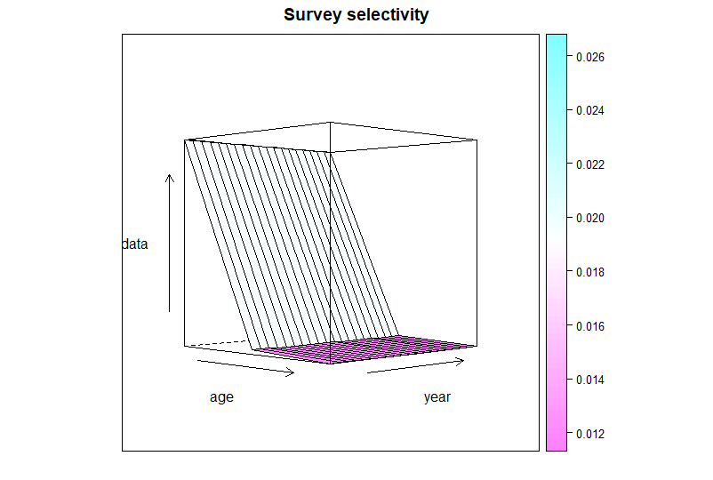
A4a Diagnostics
Mohn Test
fbar ssb rec
0.0988644 0.02633589 0.05577134

Slide 14
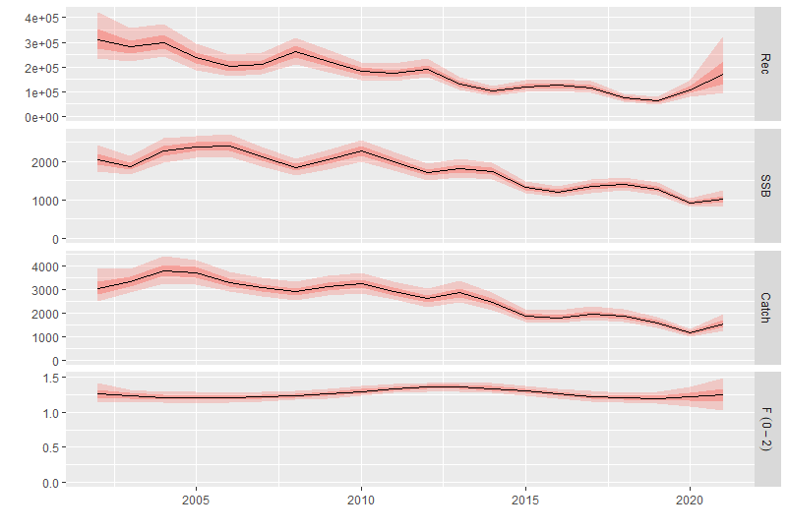
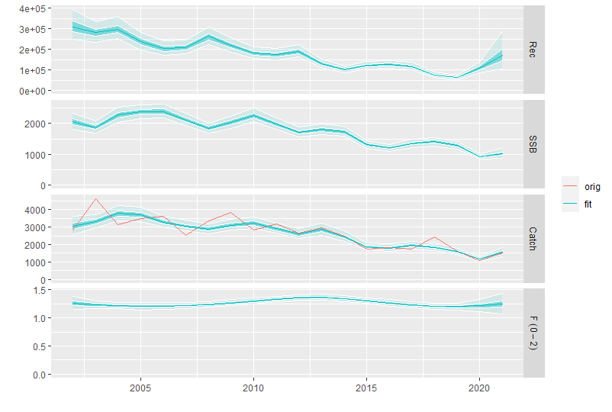
A4a Results

Slide 15
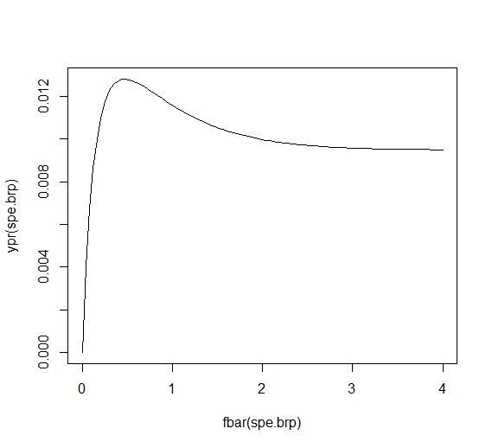
Y/R Analysis
F_{0.1}
F_{CURRENT}

Slide 16
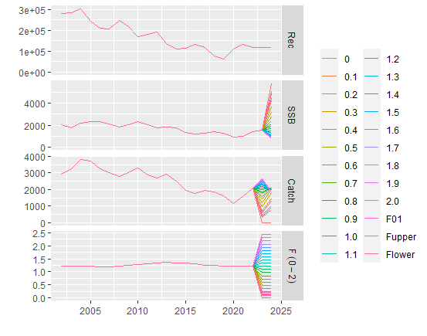
Short term projectins
Deterministic projections (2022-2024)
Arithmetic mean of recruitment, catches and weights at age of the last three years (2019-2021)
F Status Quo is the geometric mean of Fbar1-2 during the last three years (2019-2021)

Slide 17
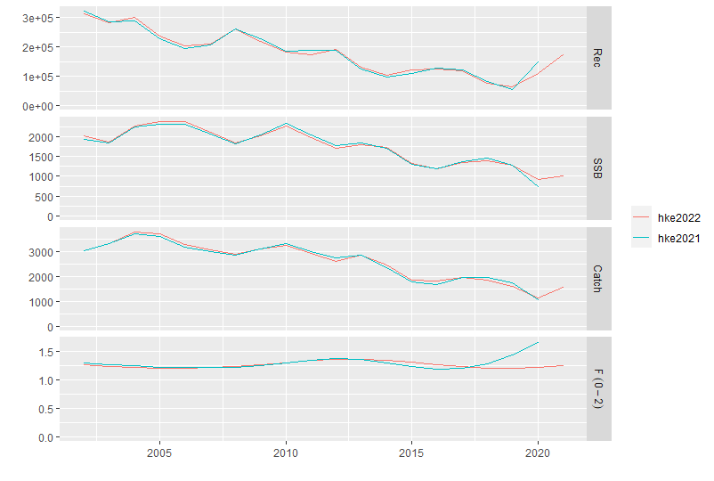
COMPARATIVE 2020 & 2021
 | a4a (2020) | a4a (2021) | a4a (2022)
F 0.1 | 0.14 | 0.15 | 0.12
Fcurrent | 1.2 | 1.73 | 1.24
Fc/F_{0.1} | 8.6 | 11.4 | 10.36

Slide 18
ADVICE & RECOMMENDATIONS:
Fishing mortality indicators: In Overfishing status (IO).
Fc=1.24; F0.1=0.12
High overfishing (OL); Fc/F0.1 =10.36
Stock related indicators: Overexploited (O)
Relative Low biomass (OL), SSBcurrent = 1015t; SSB at 33rd percentile = 1482 t, SSB at 66rd percentile = 1999 t
Management objectives | Management recommendations
Reduce fishing mortality to F _{0.1} | Reduce fishing effort

