Slide 1
Project Title (sub-title if helpful)
Project Team
PI Name and Email

Slide 2
Project title
Project Overview
The purpose of the slide is to provide an overall description of the entire project. Please use graphics.
Key in on critical challenges and point out core technologies you are developing to overcome them.
Protected Data – For DOE ARPA-E Use Only

Slide 3
Project title
Progress on core technology development
Protected Data – For DOE ARPA-E Use Only
Notes:
Model now shown to predict growth data close to or within 95% confidence interval of measured values.

Slide 4
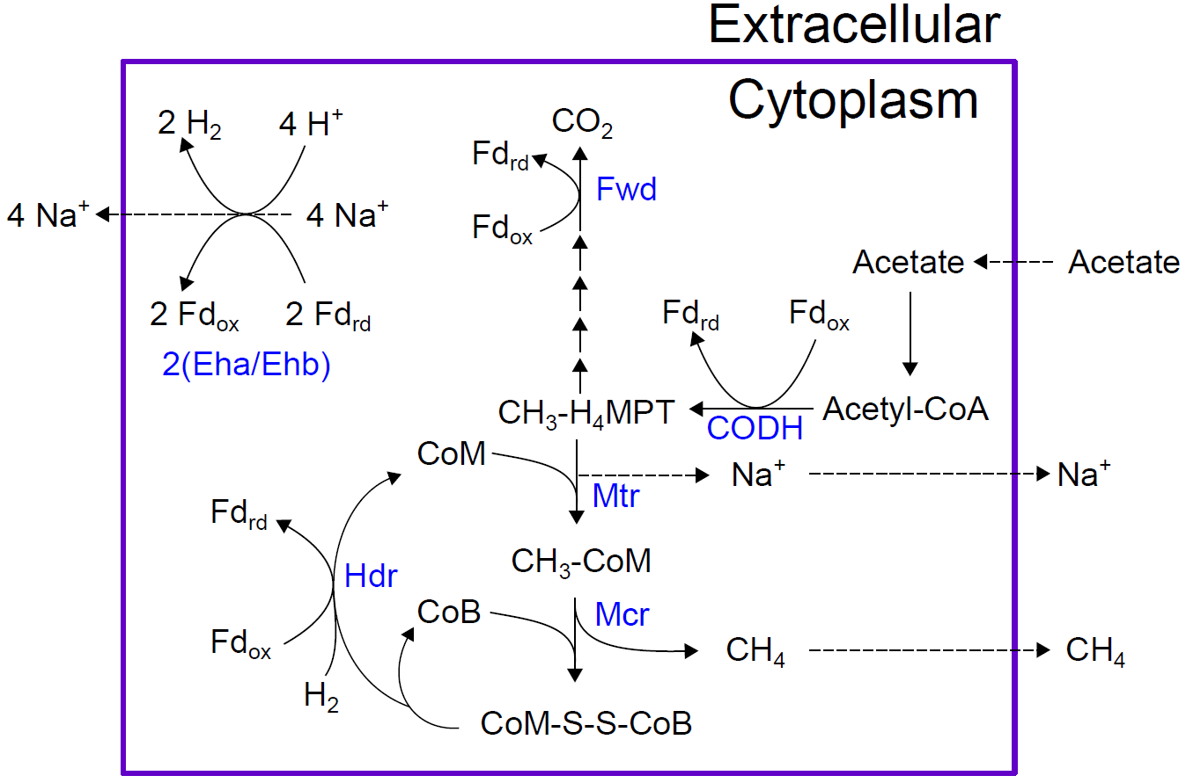
Project title
Progress on core technology development
Protected Data – For DOE ARPA-E Use Only

Slide 5
Project title
Progress on core technology development
DATA SLIDE
The purpose of the slide is to provide a technical update on core technology development. Since our last meeting, several groups have published and/or protected data/innovations. We expect that you will share information to the extent possible to inform other performers on your success.
Protected Data – For DOE ARPA-E Use Only

Slide 6
Project title
Steps toward commercialization
The purpose of the slide is to share information on what if any actions the project team have implemented to push towards commercialization (e.g. newco formation). Please expand on what additional technical advancements or skills are necessary for development of the technology beyond ARPA-E.
Protected Data – For DOE ARPA-E Use Only

