Slide 1


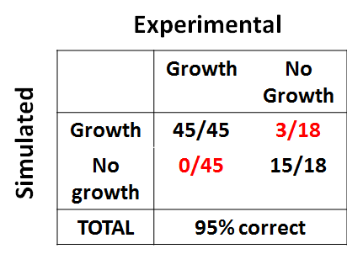


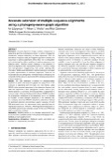

General Model-Building Protocol
Database sources
Draft Network
Constraint-based analysis
Experimental evaluation
Literature sources
Sv=0
Refinement
Notes:
Back to the goals I outlined, it’s a pretty ambitious goal to undertake, so we’d like to have something to help guide us in this process, to hopefully speed it up a bit. Our solution is to build a metabolic model of MM that can assist us as we try to conduct our wet lab research. So now, after all this talk about energy and fuel, I’m going to shift gears now and focus a little more on metabolic modeling. I’ll try and do a thorough job of introducing all the concepts that go into creating and using a metabolic model, but please ask questions if there’s anything I’ve glossed over too quickly or that is confusing. I’ve started out here by showing a general outline that I’ll mostly follow for the next handful of slides, and this shows the protocol we follow to build genome-scale metabolic models. So let’s dive right in to our first step here

Slide 2
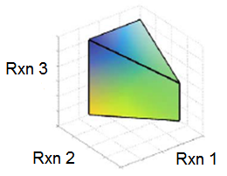
Constraints in Practice
Rxn 1
Rxn 2
Rxn 3
Met A
Met B
Met C
Met D
Met E
ATP
ADP
Reaction Flux (v)
 | Rxn 1 | Rxn 2 | Rxn 3
Met A | -1 | 0 | 0
Met B | 1 | -1 | 0
Met C | 0 | 1 | -1
Met D | 0 | 0 | 1
Met E | -1 | 0 | 0
ATP | 0 | 0 | -1
ADP | 0 | 0 | 1
Apply Constraints
Mass Conservation
Sv = 0
Bounded
Solution Space
Regulation
Vmin ≤ v ≤ Vmax
Stoichiometric Matrix (S)
Kauffman K et al. Current Opinion in Biotechnology (2003)
Price N et al. Nature Reviews Microbiology (2004)
Notes:
The final piece of the model is what gives us the name “constraint-based modeling”; we know from mass conservation that every metabolite must ultimately be conserved. In our simplified scheme, anything created in this first reaction must be used up in the second reaction. Of course, we need to have inlets and outlets somewhere, right? If everything needs to be conserved, then the ends of the reaction pathways have to attach to something, so we make sink reactions for these. Sink reactions that run forwards allow metabolites to leave the model, sink reactions that run backwards allow metabolites to enter the model; they are produced compounds and media compounds, respectively. Because these essentially come from outside the cell through transport, we call these “external” metabolites and we generally know a great deal about what these are, so we set them pretty rigorously.
Okay, so we’ve represented our network as a matrix and said that the product of that matrix and the reaction fluxes must be zero, but we’re not done yet. As you might imagine, there are actually infinite ways to achieve this The other set of constraints that are usually applied are flow constraints; for instance, if we want a sink reaction to only produce a metabolite, we can restrict it to only move forward. These constraints are powerful because they change our solution space. Without any constraints on reactions, they can all run infinitely. For instance, if I gave an organism infinite nutrients, the model believes it could infinitely grow. In order to better match the biology, we are in the habit of restricting reaction fluxes by setting these artificial limits. We can do so on inner reactions and outer, but the outer ones have the most biological relevance because we can actually measure them; you can actually measure uptake rates.

Slide 3
Model Statistics
Feature | 05/2015 | 11/2015
Protein Coding Genes | 524 | 540
% ORF Coverage | 30.4 | 31.4
Internal Reactions | 545 | 586
Exchange/Transport Rxns. | 53/68 | 59/49
Gene-Associated Rxns. | 489 | 500
Dead End Reactions | 219 | 206
Int./Ext. Metabolites | 646/45 | 658/53
Dead End Metabolites | 268 | 259
Notes:
These are just basic statistics and compared to our last update, we’ve got more genes, reactions, and metabolites and fewer dead ends. There are still a lot of dead ends, but these aren’t necessarily a bad thing. All of them are associated with at least one gene, indicating that although we don’t have network connections for them yet, there is some evidence that they are part of a yet-unknown pathway. They represent opportunities for more experimental investigation

Slide 4
Reaction without Genes
Notes:
Only a small portion (< 15%) of our internal reactions lack genes, so here’s a look at those reactions grouped into subsystems. There’s a split here, because some of these are reactions from literature that we haven’t yet identified genes for, but others are just gap-filling reactions that have no basis in literature, they’re just there to fill a hole in the network. For example, the unique coenzyme syntheses are all manually-added reactions from literature, but in cases like the final step of Coenzyme M synthesis, we haven’t yet identified the enzyme that carries out a reaction. That’s distinct from things like vitamin and cofactor synthesis, which are more generic reactions that tie into e.g. Coenzyme B12 synthesis and don’t actually tie to a literature source. Overall, 54% of these reactions are “gap-fills”, the other 46% we would classify as “hypothetical literature reactions”. It’s worth noting that most subsystems came directly from the Model SEED database, which lacks subsystems for some reactions. Thus, we have a significant number of reactions with the “None” subsystem tag.

Slide 5
Gene Knockout Validation
Genotype | H2 | Formate | H2 + Formate | Formate + CO
∆hmd | N | N | N | N
∆mtd | N | N | N | N
∆frcA | N | N | N | N
∆fruA | N | N | N | N
∆frcA∆fruA | N | N | N | N
∆vhcAU∆vhuA | N | N | N | N
∆hdrB2 | N | N | N | N
∆fdhA1 | N | N | N | N
∆fdhA2 | N | N | N | N
∆fdhA1∆fdhA2 | N | L | N | L
∆fdhA2∆fdhB2 | N | N | N | N
∆ehbF | N | N | N | N
∆3H2ase | N | N | N | N
∆5H2ase | L | N | N | N
∆6H2ase | L | N | N | N
∆6H2ase∆cdh | L | L | N | L
∆6H2ase_{supp} | N | N | N | N
∆7H2ase_{supp} | L | N | N | N
Total Correct: | 10 of 10 | 14 of 16 | 2 of 2 | 2 of 2
93.3% Accuracy
Matthews Correlation Coefficient: 0.78
Notes:
We have a small set of actual wet lab knockouts, but we’re doing really well on them with over 90% accuracy and a fantastic correlation coefficient. For comparison on the MCC, the best yeast model clocks in around 0.67. As a caveat, we only have 30 data points and they have many more; however, this indicates excellent agreement with central carbon metabolism.
The two incorrect predictions can be traced back to acetyl-coA synthesis. Normally, acetyl-coA synthase is responsible, but we have an alternate pathway through glycine synthesis that can also produce acetyl-coA. This is important because when we knockout 5 or 6 hydrogenases, acetyl-coA synthase can work reversibly to replenish missing anaplerotic ferredoxin while the alternate pathway makes acetyl-coA. This raises interesting questions about the essentiality of acetyl-coA synthase, something we’re considering as a knockout target.

Slide 6
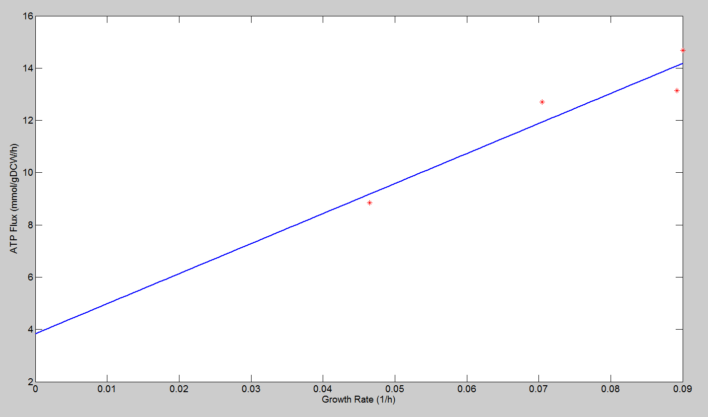
ATP Maintenance Values
NGAM = 3.8
GAM = 115
Notes:
We’ve been conducting experiments to measure ATP maintenance values for our model. Thus far, these are the values we’ve calculated. The GAM value here is actually quite high, so we’re looking at doing some more measurements to get more data points. The NGAM is pretty comparable to what we’ve seen in other models.
These values are helping us fit the our model, they’re our training data. Our measurements are quite distinct from what we found in the literature, so this is also giving us a way to look critically at those data in comparison with our own.

Slide 7
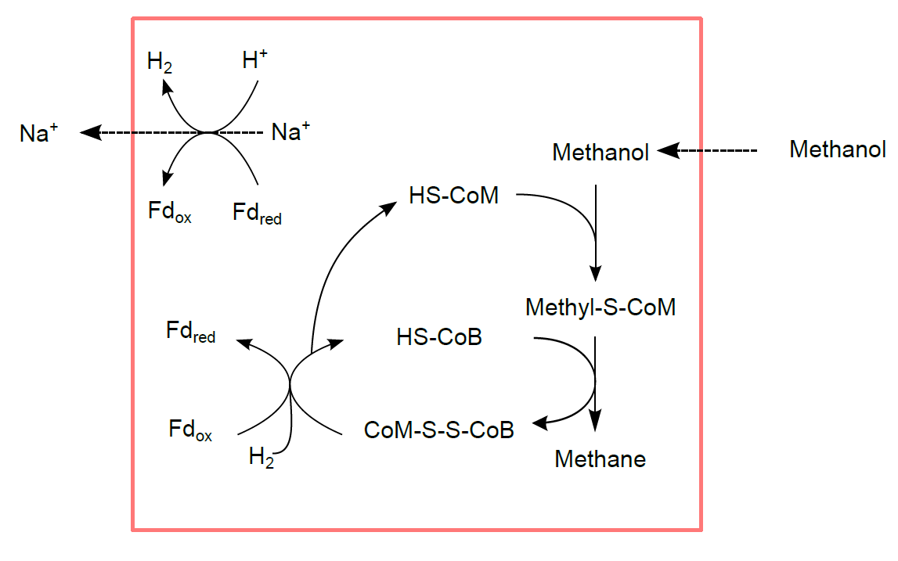
Predicted Methanol Consumption
Notes:
We have used our model to predict consumption of methanol. Here, we’ve cut out the ion gradient generating step, so EhA/EhB takes over as our sodium pump. Not shown here is ATP synthase, which uses that sodium gradient to make ATP. This is pretty much exactly our model’s mechanistic prediction.

Slide 8
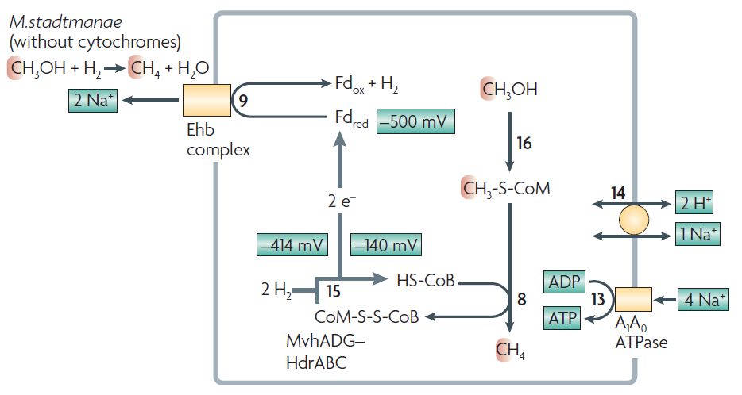
M. stadtmanae Metabolism
Thauer RK. et al. Nature Reviews Microbiology (2008)
Notes:
And for comparison, we can look at Thauer’s review from 2008, in which he mapped out metabolism for M. stadtmanae, a cytochrome-lacking methanogen that consumes hydrogen and methanol to make methane. It actually looks pretty much exactly like our prediction, with the addition of showing ATP synthase and the sodium/proton antiporter.

Slide 9
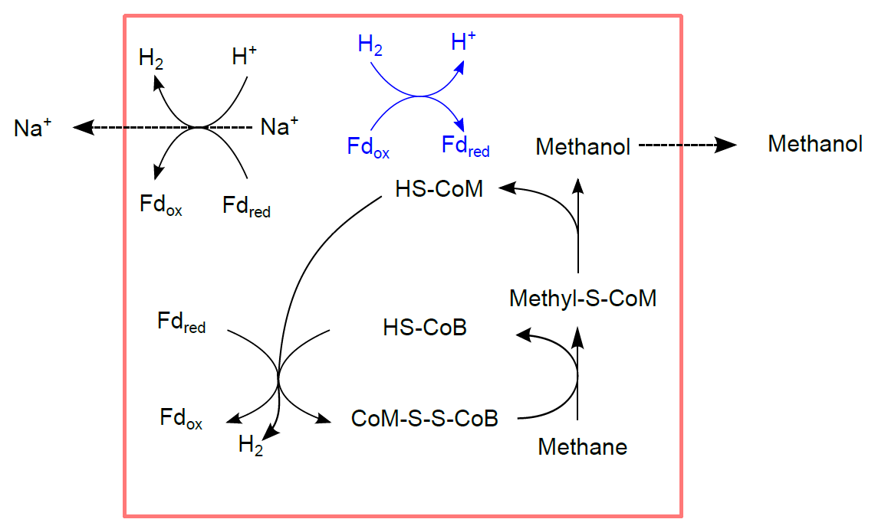
Reverse Methanogenesis
Notes:
In reversing methanogenesis, we’re basically just taking that pathway and working backwards, so the same set of reactions is relevant. The problem here is that HDR is now functioning backwards, so instead of providing reduced ferredoxin for pumping out sodium, it’s now a second big sink for reduced ferredoxin and it’s producing hydrogen.
The solution we’ve found so far is the most trivial: use hydrogen to reduce ferredoxin for both of these reactions. In the model, this actually allows us to predict methanol production from methane.

Slide 10
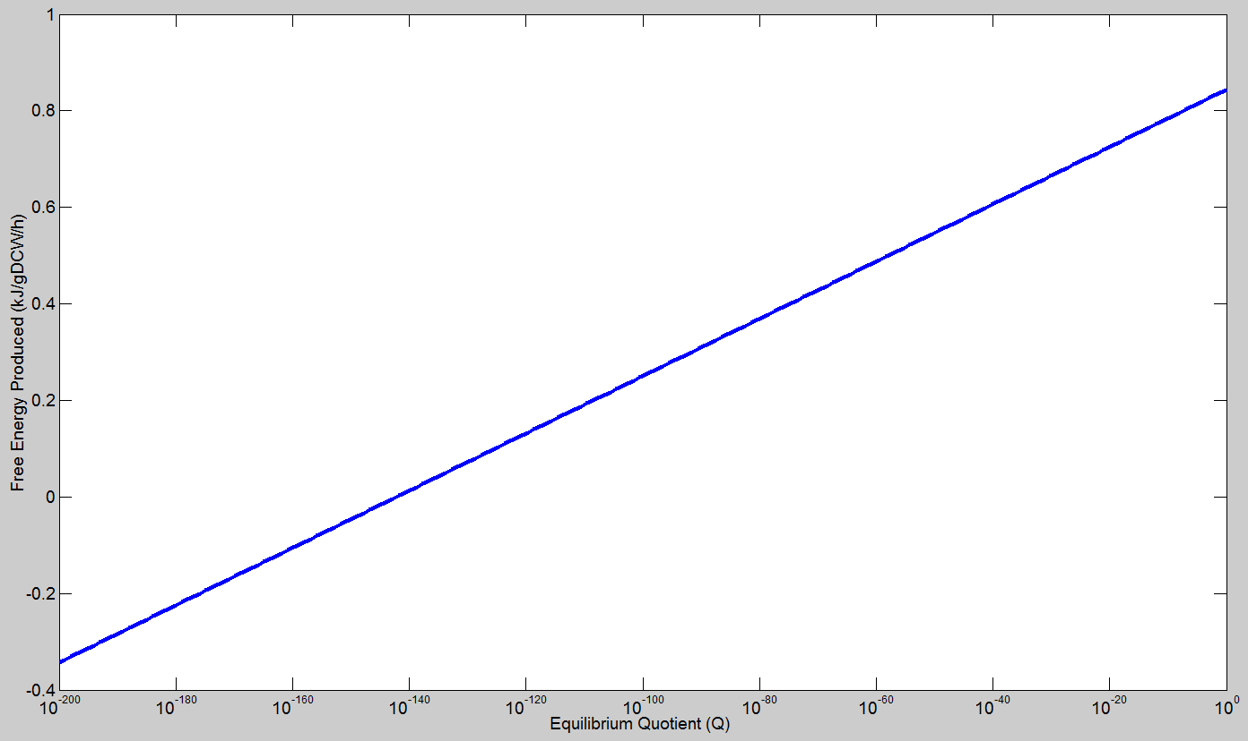
Energetic Considerations
Notes:
However, here we see the importance of considering free energy. The aforementioned solution works really well with regard to stoichiometry, but predicts that we would have positive overall free energy. This goes against the 2nd law of thermodynamics, which constrains overall free energy change to be less than or equal to 0.
For this system, in which all we’ve added is one reaction, we can do a sensitivity analysis on the model free energy prediction versus overall equilibrium quotient, Q. What we see is that not only is the free energy unfavorable when we assume 1 mM concentrations of our metabolites, it continues to be unfavorable all the way down to Q ~ 10^-142. For perspective, that’s more than Avogadro’s number to the 5th. So what this tells us is that no matter what we do in terms of taking away product or flooding our system with substrate, this is very unlikely to work by itself, we need to pair with an electron sink to boost overall free energy

Slide 11
Strain Design Approach
Model +
Reaction Database
SimOptStrain Design
Evaluate Free Energy
Alter Reaction Database
Rank Strain Designs
Evaluated
Predictions
Methanol-Producing
Model
Free Energy
Predictions
Notes:
Here is our approach going forward. We’re using SimOptStrain, a bi-level optimization program that allows us to design strains in our model by adding non-native pathways from a reaction database. Each time we generate a predicted stoichiometric strain design for making methanol from methane, our next step is to evaluate the free energy of that prediction using our model. Those predictions will allow us to rank our proposed strain designs. Based on how that prediction works, we can then alter the reaction database we’re inputting into the algorithm and repeat the process to generate more novel designs.

