Slide 1
Slides for 5/5/2016

Slide 2
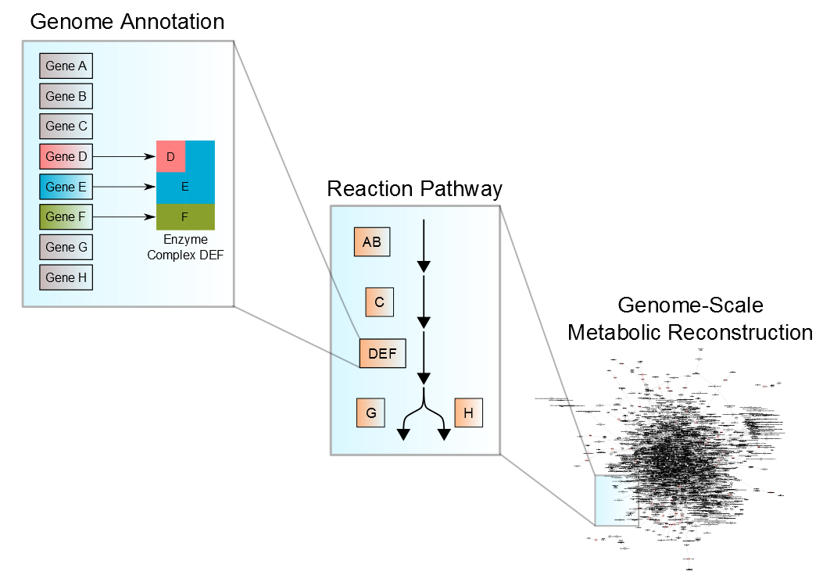
Metabolic Reconstructions Turn Sequences into Functional Networks
Notes:
This just highlights the general process, going from genome to reactions to make a full genome-scale network

Slide 3
iMR540 Accurately Predicts Growth Yields
Notes:
In accordance with our milestones, we predict growth yields accurately, generally within the 95% confidence interval with regard to measured experimental data

Slide 4
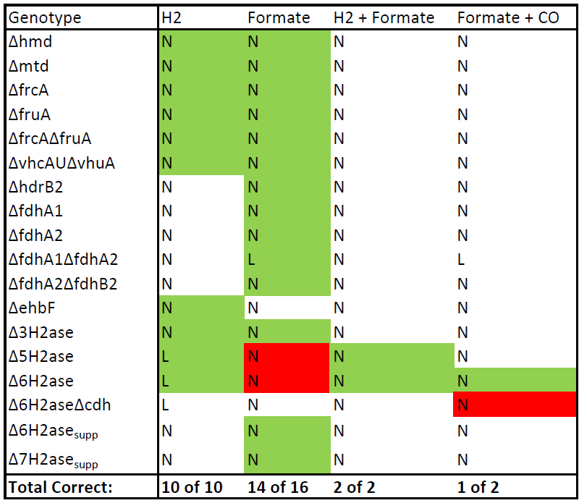
Knockout Validation Suggests High Agreement with Experimental Data
Accuracy = 90%
MCC = 0.67
Notes:
We also meet our goal for predictive accuracy on gene knockouts, with 90% accuracy on our assembled panel. We also get a Matthews Correlation Coefficient of 0.67

Slide 5
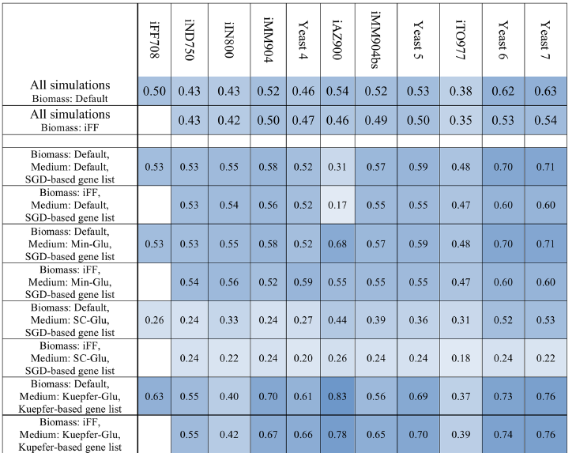
MCC Compares Favorably with High Quality Yeast Models
Heavner B and Price N PLoS Comp. Bio. (2015)
Notes:
Putting the MCC in perspective, it compares quite favorably with the MCC on gene knockouts for models of yeast, which are among the best quality models we know of.

Slide 6
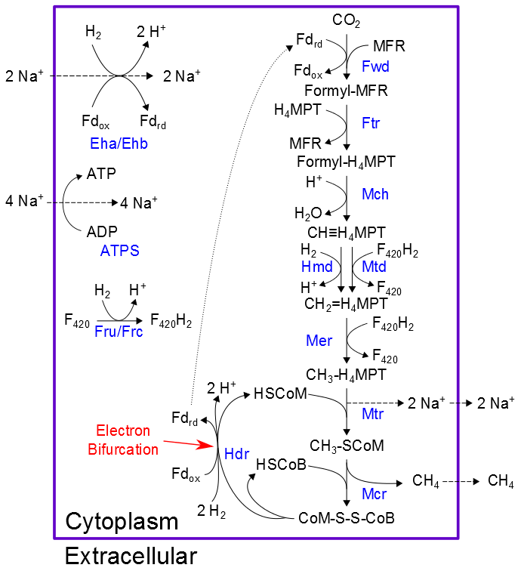
Hydrogenotrophic Methanogenesis Requires Electron Bifurcation
Notes:
The main catabolic pathway under H2 + CO2 consuming conditions are shown here. One thing to note is that in this scheme, ATP is created chemiosmotically, with sodium ions driven out in the Mtr step. And of course, there’s electron bifurcation that ties it all together.

Slide 7
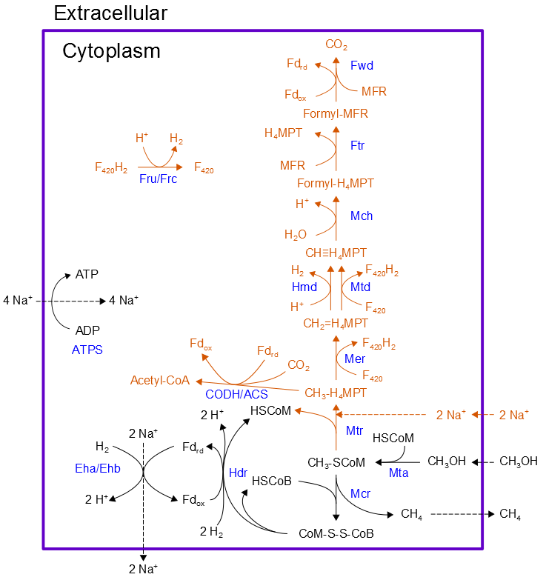
Methanogenesis from Methanol Alters Energy Conservation
Notes:
We predicted growth on Methanol + H2 by adding 1 gene: the Mta (methanol methyltransferase) shown here. When we predict growth under these conditions, the reaction scheme looks much different. Reactions in orange/brown are now relegated to a minor role and as you can see, the Mtr reaction now runs in reverse and cannot create our necessary sodium gradient.

Slide 8
Methanogenesis from Methanol Alters Energy Conservation
Notes:
In this scheme, the only way we’re able to generate the ATP needed for growth is by utilizing Eha/Ehb as the primary sodium pump. The key assumption here is that Eha/Ehb is capable of carrying a stoichiometric level of flux rather than only functioning anaplerotically. If this isn’t the case—and we have reason to hypothesize that Eha/Ehb can only function in an anaplerotic capacity in M. maripaludis—then some type of modification to overexpress Eha/Ehb would likely be necessary.

Slide 9
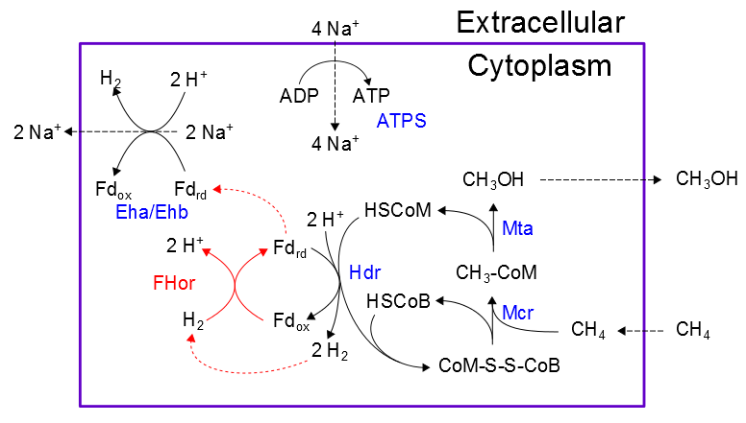
Our Model Predicts AOM to Methanol with One Added Reaction
Notes:
Assuming Eha/Ehb function at a high level, we can go one step further with the model and predict anaerobic oxidation of methane to methanol, thereby fulfilling the goal we set out to achieve. The big change when going in reverse is that Hdr now functions in reverse, oxidizing ferredoxin and producing H2. That breaks the previous cycle of ferredoxin and hydrogen, so now we need some way to generate reduced ferredoxin and we happen to have an electron rich supply of hydrogen available. By adding the ferredoxin:hydrogen oxidoreductase (FHor in this scheme), we complete the pathway stoichiometrically.
Of course, we still have to consider energetics and this scheme is not favorable from a free energy standpoint. We need to add a reducing pathway that couples to this one and makes it favorable.

Slide 10
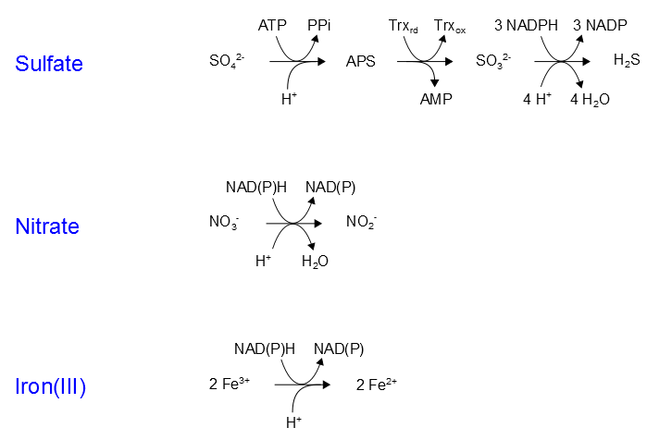
Adding Nitrate Reduction Makes AOM to Methanol Energetically Feasible
Notes:
These three reduction pathways are known to function in methanotrophic consortia in nature; we tested all 3 of these pathways in our model, restricting overall free energy to be less than or equal to 0 while maintaining steady state growth.

Slide 11
Adding Nitrate Reduction Makes AOM to Methanol Energetically Feasible
CH₄ + 0.27 CO₂ + 0.57 NO₃ →
0.88 CH₃OH + 0.57 NO₂+ 0.05 H₂O
ΔGº ≤ 0
Notes:
Only nitrate reduction was successful in our simulations. Overall reaction required at standard 1 mM conditions is shown; reasons for other pathways being non-viable are as follows:
-Sulfate reduction requires 1 mol ATP per mol sulfate (not to mention 3 moles of NADPH). Because ATP is the main constituent of our biomass objective function, this pathway is directly at odds with the model’s overall objective and we’re unable to find a solution that satisfies both constraints
-Iron reduction has no ATP problem, but unlike the other two pathways it does not result in production of water. Long story short, producing some amount of water is vital for overall mass balance and for offsetting the energetically unfavorable consumption of CO2 for biomass synthesis. So without producing water, we’re likewise unable to satisfy both energetic and mass balance constraints.

