Slide 1
Anaerobic Bioconversion of Methane to Methanol
Steve Ragsdale, John Leigh, Nathan Price, Simone Raugei
Steve Ragsdale (sragsdal@umich.edu)

Slide 2
Anaerobic Bioconversion of Methane to Methanol
Progress on core technology development
Protected Data – For DOE ARPA-E Use Only
Notes:
Model now shown to predict growth data close to or within 95% confidence interval of measured values.

Slide 3
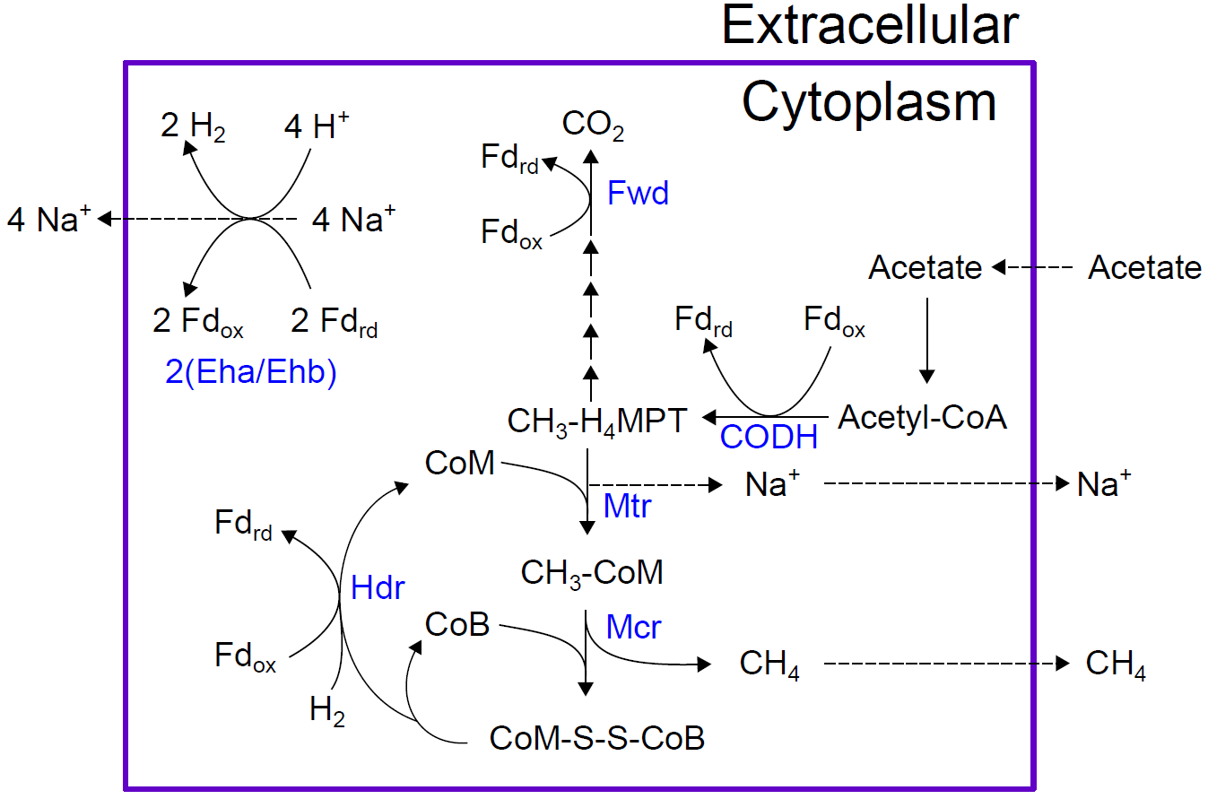
Anaerobic Bioconversion of Methane to Methanol
Progress on core technology development
Protected Data – For DOE ARPA-E Use Only

Slide 4
Anaerobic Bioconversion of Methane to Methanol
Progress on core technology development
0.1X
Constraining Eha/Ehb flux prevents our model from predicting growth on acetate alone
X
Protected Data – For DOE ARPA-E Use Only

Slide 5
Anaerobic Bioconversion of Methane to Methanol
Progress on core technology development
0.1X
The same constraint prevents growth through reverse methanogenesis and may have to be overcome to oxidize CH₄.
X
Protected Data – For DOE ARPA-E Use Only

Slide 6
Anaerobic Bioconversion of Methane to Methanol
Progress on core technology development
We’ve found a stoichiometric solution, but have not yet found an energetically-feasible one
Protected Data – For DOE ARPA-E Use Only

Slide 7
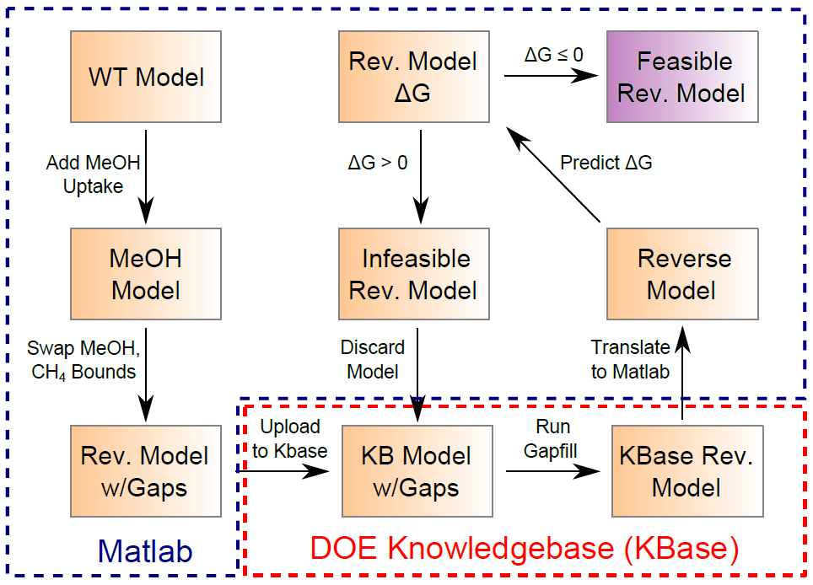
Anaerobic Bioconversion of Methane to Methanol
Progress on core technology development
Protected Data – For DOE ARPA-E Use Only

