Slide 1
Slides for January Update

Slide 2
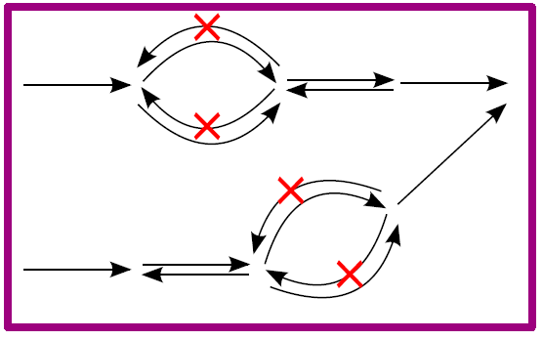
Reconstruction Advances
Expanded Usable Nitrogen Sources
Added Methanogenic Cofactors to Biomass
Amino Acids
Nucleotides
Coenzyme M
F420
…
NH₃
N₂
Ala
Eliminated Futile NAD/NADP Cycles
Notes:
These advances improve flux predictions by the model. We’ve eliminated NAD/NADP cycling in the model by updating reaction reversibilities. We also added the ability to consume either N2 or Alanine as a nitrogen source, reflecting the versatility of M. maripaludis to use either of these in place of ammonia. Finally, we’ve added some methanogen-specific coenzymes to the biomass definition to ensure that these are synthesized by the model.

Slide 3
Reconstruction Advances
Amino Acids
Nucleotides
Coenzyme M
F420
…
NH₃
N₂
Ala
Expanded Usable Nitrogen Sources
Added Methanogenic Cofactors to Biomass
Eliminated Futile NAD/NADP Cycles
Notes:
This is the same material as the previous slide, but in a different layout. Personally I like this one less, but you can use whichever you prefer

Slide 4



Compatibility Advances
M. maripaludis S2
Model
Rxn 1
Rxn 2
Rxn 3
Met A
Met B
Met C
Met D
4
1
2
Met E
ATP
ADP
Notes:
We added alternate identifiers (KEGG IDs and EC numbers) to the model so it’s easier to use in conjunction with these databases or to compare with other models that use these identifiers. We also added confidence scores to our reactions that make it easier for us to pinpoint areas of metabolism that require further investigation and provide a clearer record of this information for others to follow.

Slide 5
Growth Yield Predictions
Notes:
Early on, we added ability to grow and produce methane on formate. In between July and August, we fixed incorrect cofactor production in the electron transport chain that was driving up the yield. We minorly improved between August and November by cutting out NAD/NADP cycling and making some other small changes. The current model improves the prediction by adding non-growth associated maintenance, the same value used in the M. barkeri model (another CO2/H2 metabolizer). Predicted yield is now about 3.7 for both cases as opposed to 2.3 predicted for H2 and 2.9 predicted for Formate. We may still measure these ourselves, but we’re happy with where they are right now.

Slide 6
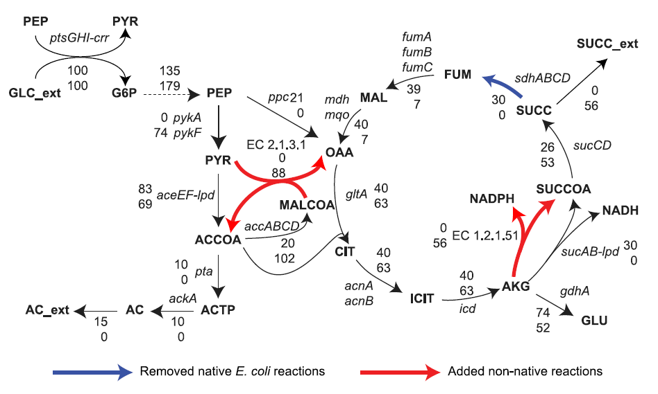
Moving Forward
Running targeted metabolomics with LC-MS
Predicting engineering solutions with SimOptStrain:
Kim et al. (2011) PLoS One
Notes:
Coming up, we have 3 main objectives. Most importantly, we are adapting the SimOptStrain method created by the Reed lab to suggest designs for generating methanol from methane. We are also working to get more data; we’re starting up a chemostat at the end of January and the Raftery group will run the targeted metabolomics for us at the end of February. In the meantime, we’re going to get more yield measurements as validation data. Finally (and least importantly to this meeting I think), we’re outlining a manuscript that presents our model.
The graphic is meant to illustrate the process used in SimOptStrain. The graphic on the right is from that paper and shows how they were able to insert non-native reactions for glycerol production and delete native reactions to increase that production. They used KEGG in their particular implementation, so I included it here

