Slide 2
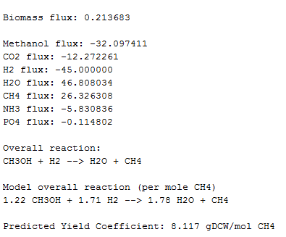
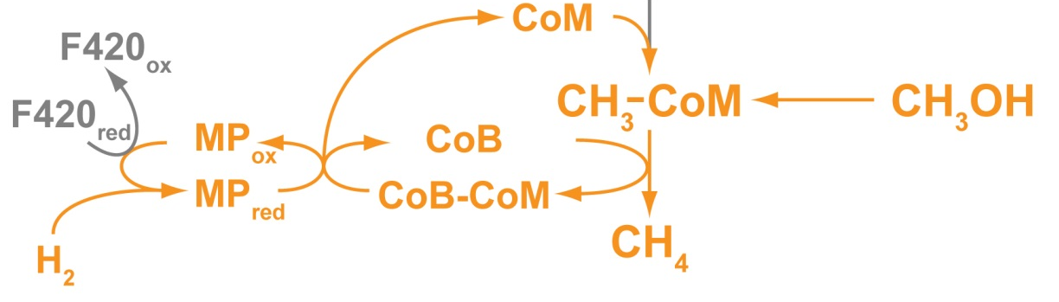
Predicting Methanol Consumption
Welander P. et al. PNAS (2005)
Notes:
Of course, the reason we built this model in the first place was so that we could help with engineering MM to turn methane into methanol. So can we do that? The short answer is: not yet, but we’re on our way there. The first step in this project, if you remember, is to give MM the ability to eat methanol. We’ve used our model to predict whether or not simply adding the methyl transferase to complete this reaction will work, from a purely metabolic standpoint, and our model shows no metabolic obstacles. Right now, our biologist friends are working to make this transformation actually happen, but our model points to the idea that there’s no stoichiometric reason why this shouldn’t work.

