Slide 1
Model Updates
September, 2014

Slide 2
Overview
Important model changes
New/altered reactions
Mass and charge balancing
Monitoring progress
Gene coverage
Growth yield comparisons
Comparing to other models
Previous methanogens
Other M. maripaludis model

Slide 3
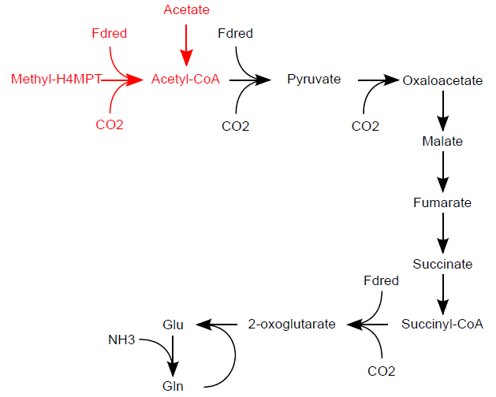
Added reactions for acetate assimilation

Slide 4
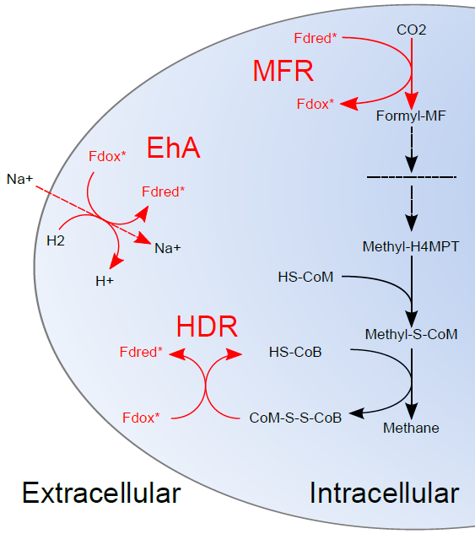
Added Ferredoxin Specificity
(* indicates these ferredoxins are specific to these three reactions)
Notes:
Adding specific (*) ferredoxins links these 3 reactions together

Slide 5
Elemental Matrix
ADP + Acetyl-Phosphate → H⁺ + Acetate + ATP
 | ADP | AcP | H+ | Ac | ATP | …
C | 10 | 2 | 0 | 2 | 10 | …
H | 13 | 4 | 1 | 3 | 13 | …
O | 10 | 5 | 0 | 2 | 5 | …
N | 5 | 0 | 0 | 0 | 13 | …
P | 2 | 1 | 0 | 0 | 3 | …
⁞ | ⁞ | ⁞ | ⁞ | ⁞ | ⁞ | …
E =
Notes:
To check mass balance, we can create the elemental matrix. Here’s an example for a reaction in the model.

Slide 6
 | ADP | AcP | H+ | Ac | ATP | …
C | 10 | 2 | 0 | 2 | 10 | …
H | 13 | 4 | 1 | 3 | 13 | …
O | 10 | 5 | 0 | 2 | 5 | …
N | 5 | 0 | 0 | 0 | 13 | …
P | 2 | 1 | 0 | 0 | 3 | …
⁞ | ⁞ | ⁞ | ⁞ | ⁞ | ⁞ | …
 | Rxn 1 | …
ADP | -1 | …
AcP | -1 | …
H⁺ | 1 | …
Ac | 1 | …
ATP | 1 | …
⁞ | ⁞ | …
ES =
 | Rxn 1 | …
C | 0 | …
H | 0 | …
O | 0 | …
N | 0 | …
P | 0 | …
⁞ | ⁞ | …
ES =
Rxn 1 is mass balanced
Notes:
Just as in this example, we’ve mass balanced ALL reactions in the model.
We can do something similar for charge and we have…all reactions are charge balanced.

Slide 7
Tracking Model Evolution
Notes:
Genes have mostly increased, reactions and metabolites have stayed about the same (graphical version)

Slide 8
Growth Yield Progress
Notes:
Added ability to grow and produce methane on formate. In between July and August, we fixed incorrect cofactor production in the electron transport chain that was driving up the yield. Growth yields are the correct order of magnitude and we haven’t adjusted ATP maintenance requirements yet.

Slide 9
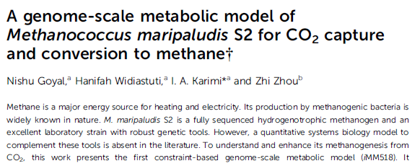
Feature | iMM518 | Our Model
Total reactions | 570 | 736
Protein coding genes (ORFs) | 518 | 461
% ORF coverage | 30 | 27
Reactions associated with genes | 464 | 483
Reaction not associated with genes | 106 | 254
Intracelluar/extracellular metabolites | 556/49 | 699/41
Transport Reactions | 49 | 44
Notes:
Here’s how we compare to the model that came out this year, just on a numerical standpoint. There were issues with that model, namely that it didn’t have methanogenesis correct.

Slide 10
Reaction/Gene Essentiality
Model | Genes | Rxns | Substrate | Essential Rxns/Genes | Essential Rxn/Gene %
M. maripaludis | 488 | 737 | CO₂+H₂ | 381/26 | 52%/5%
 |  |  | CO₂+Formate | 382/27 | 52%/5%
M. acetivorans | 745 | 825 | Acetate | 307/170 | 37%/23%
 |  |  | CO | 307/170 | 37%/23%
 |  |  | Methanol | 303/170 | 37%/23%
M. barkeri | 750 | 816 | Acetate | 291/152 | 36%/20%
 |  |  | CO₂+H₂ | 288/151 | 35%/20%
 |  |  | Methanol | 291/152 | 36%/20%
Notes:
Full table of comparisons

Slide 11
Essentiality Percentages

Slide 12
Logistical Updates
We’ve had 3 combined meetings with the Leigh lab since May 2014
Next phase will involve gathering experimental data for model validation
After validating the wild type model, we can begin predicting engineering solutions

Slide 13
Open Questions
What is causing the low gene essentiality?
Over-abundance of OR relationships?
Poor gene coverage?
What is the best way to validate our model?
What gene knockouts would make most sense to knockout in experiments?
How essential are specific ferredoxins to proper electron transport chain?

Slide 14
Alternate Versions

Slide 15
Tracking Model Evolution
May
724 metabolites
708 reactions
June
412 genes
735 metabolites
July
459 genes
743 metabolites
388 genes
730 reactions
736 reactions
Aug
461 genes
740 metabolites
736 reactions
Sept
488 genes
740 metabolites
736 reactions
Notes:
Genes have mostly increased, reactions and metabolites have stayed about the same (long version)

Slide 16
Feature | iMM518 | Our Model
Total reactions | 570 | 736
Protein coding genes (ORFs) | 518 | 461
% ORF coverage | 30 | 27
Reactions associated with genes | 464 | 483
Reaction not associated with genes | 106 | 254
Intracelluar/extracellular metabolites | 556/49 | 699/41
Transport Reactions | 49 | 44
Notes:
Alternative slide with the other model article heading at the top.

