Slide 1
Updates for May 2015
Matt Richards

Slide 2
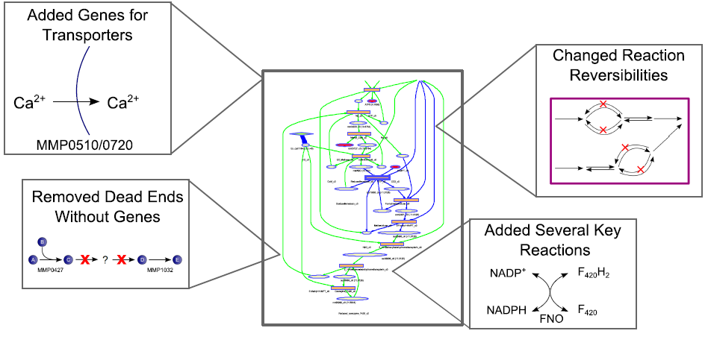
Minor Model Adjustments
Notes:
Model adjustment specifics are basically what I sent in my email:
-Added lots of transporter genes from TransportDB
-Removed all dead end reactions that lack genes
-Added and subtracted, a handful of internal reactions to better reflect what we know to be true.
-Changed bounds on some reactions to remove constraints we didn't have great justification for and added a couple of new ones, generally based on literature

Slide 3
Current Model Statistics
Protein Coding Genes | 524
% ORF Coverage | 30.4
Internal Reactions | 545
Exchange/Transport Rxns. | 53/68
Gene-Associated Rxns. | 489
Dead End Reactions | 219
Int./Ext. Metabolites | 646/45
Dead End Metabolites | 268
Added 35% genes to original draft
Dead ends present opportunity for continued curation
Notes:
We’ve added some more information, including a lot of genes from TransportDB. Our current model is over 1/3 larger than the original draft and all of those genes are things we added based on literature and experimental knowledge, not on annotation databases or gapfilling. We do have a good number of dead ends, but those aren’t necessarily a bad thing; all of them actually are gene-associated. Even though we may not know their full synthesis/consumption pathways, these metabolites are key to expanding our model and pointing to areas of metabolism where our knowledge is currently lacking.

Slide 4
Growth Yield Validation
Model Error: 36%
Model Error: 68%
Notes:
We’re still moving toward our <20% error goal here, and there’s some work to do here. The error I’m showing is compared to the measured value, but if you include the experimental error (error bars on the graph), then we’re within range for H2 (13% error) and not all that far away for formate (50%). We actually expect these experimental growth yields to change because we’re unsure of the data we were using for our dry cell weight measurements. We’re in the process of starting up a chemostat so that we can re-measure dry cell weight by filtration. We expect to get those numbers within the next few weeks, depending on how well the cells adapt and how quickly the filters dry. Early estimates based on a less precise experiment indicated that our dry weight measurements may be somewhat low, suggesting that our experimental values should in fact be closer to what our model is predicting.

Slide 5
Gene Knockout Validation
Phenotype | H₂ | Formate | H₂ + Formate | Formate + CO
∆hmd | N | N | N | N
∆mtd | N | N | N | N
∆frcA | N | N | N | N
∆fruA | N | N | N | N
∆frcA∆fruA | N | N | N | N
∆vhcAU∆vhuA | N | N | N | N
∆hdrB2 | N | N | N | N
∆fdhA1 | N | N | N | N
∆fdhA2 | N | N | N | N
∆fdhA1∆fdhA2 | N | L | N | L
∆fdhA2∆fdhB2 | N | N | N | N
∆ehbF | N | N | N | N
∆3H₂ase | N | N | N | N
∆5H₂ase | L | N | N | N
∆6H₂ase | L | N | N | N
∆6H₂ase∆cdh | L | N | N | N
∆6H₂ase_{supp} | L | N | N | N
∆7H₂ase_{supp} | L | N | N | N
Total Correct: | 10 /10 | 14/16 | 2/2 | 1/2
Accuracy: 90%
MCC: 0.67
Notes:
As another part of our continued curation, we have started measuring gene knockouts to validate our model. Using 6 papers from the Leigh lab, we have simulated a panel of knockouts corresponding to 30 experimental gene knockouts, mostly including hydrogenases in central carbon metabolism. Our predictions of gene knockout lethality correlate strongly with the experimental data, indicating that our portrayal of central metabolism is consistent with what we would expect. The 3 cases where our predictions differ from experiments represent regulatory effects, where the GAPOR cycle is upregulated in our model by default. This is a limitation of using a strictly metabolic model, but it should not affect our ability to use our model to stoichiometrically guide our metabolic engineering efforts.

Slide 6
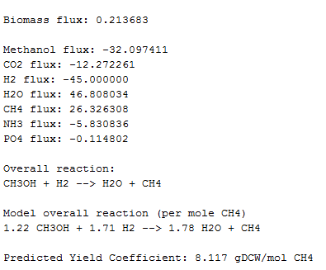
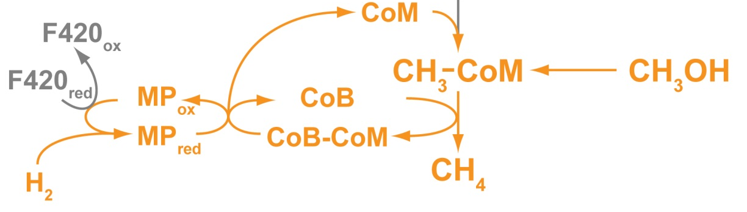
Predicting Methanol Consumption
Welander P. et al. PNAS (2005)
Notes:
Corresponding to what we’re doing biologically, we can predict methanol consumption with our model by simulating metabolism with the addition of the methanol methyltransferase (mta). Adding this conversion between methanol and methyl-CoM allows our model to uptake methanol and use it to produce methane and cell mass. This simulation suggests that adding the methyl transferase shows no metabolic obstacles. Right now, our biologist friends are working to make this transformation actually happen, but our model points to the idea that there’s no stoichiometric reason why this shouldn’t work. We’re also working manually with the model to predict the pathways for reverse methanogenesis, but this is somewhat more challenging because of the bevvy of possible options.

Slide 7
Milestones Update
Milestone | Description | Targeted Finish Date | Status
M2.1 | Deliver first genome-scale metabolic model capable of simulating growth and byproduct section with >75% accuracy | 10/1/14 | Completed
M2.2 | Deliver improved model that enables predictions with >85% predictive accuracy for knockout lethality, and <20% error for wildtype growth and byproduct yield predictions | 6/1/15 | Nearing Completion
M2.3 | Deliver top 5-10 strain design predictions based on methanol yield to team for implementation | 6/1/15 | In Progress
M2.4 | Provide 3 best engineered strains with highest methanol production based on metabolic modeling | 10/31/16 | In Progress
Notes:
A caveat on this slide: I don’t think I’ve seen the official revised milestones, so this is just off of what I sent your way a month or two ago regarding what we should do. As far as progress, we’ve clearly completed the top one. The second goal is nearly met, as we’re above our knockout lethality threshold and we’re working on getting more dry cell weight data that will likely get us to the yield prediction threshold. Delivering the 5-10 strain design predictions is basically hinging on getting SimOptStrain to work, and that’s something I’m actively working on. However, there’s so much space between that milestone and the final one that I’m not too worried. Once we achieve the third milestone, I think the fourth milestone is really just dependent on our wet lab results. I don’t know of any milestone related to the metabolomics, so I haven’t included one here.

Slide 8
Moving Forward
Awaiting results of targeted metabolomics (June 2015)
Submitted samples to Bob White for methanogen-specific metabolomics
Predicting metabolic engineering strategies with SimOptStrain
Notes:
A lot of my time the last few months has been spent running a chemostat to get samples for metabolomics; those were submitted to the Raftery lab at the beginning of April and we’re expecting those back soon (they said 2 months). We also sent cells to Bob White, an expert in methanogen-specific metabolites, so that he can perform similar analyses on our methanogenic intermediates and coenzymes. These data should give us much more validation information and also a basis for us to implement some thermodynamic constraints (using the procedure from Vassily’s lab, assuming we move forward with that). Simultaneously, we’ve adapted SimOptStrain to our model and are working to get some metabolic engineering strategies. The trick here is that we’re somewhat limited by the size of the reaction database we can use. I’m working to get a proposed manual solution so that we can start slowly scaling it up, but that’s quite challenging. I’m hoping that in the next couple of months, I’ll be able to put together a handful of possible strategies

