Slide 1

Project Presentation of FSE - ETE
InterviewIQ
Maridul Walia 2310991897
Michael Dhiman 2310991902
Mohd Sufiyan 2310991904
Naman Mittal 2310992588
Supervised By
Ms. Gaganpreet Kaur
Department of Computer Science and Engineering,
Chitkara University, Punjab
1
Name of the faculty [Group: G00] [Sem:2nd]

Slide 2
Introduction
• InterviewIQ is a resume-aware AI interview preparation platform created for students and job seekers.
• The system starts with the candidate’s uploaded PDF/DOCX resume and uses extracted resume text as interview context.
• Instead of only showing fixed question-bank content, it generates personalized technical, HR, behavioral and aptitude questions.
• Users can choose target role, difficulty level, practice mode/mock mode and category-wise question count before starting.
• Mock mode adds a timer to simulate interview pressure, while normal practice mode allows self-paced preparation.
• Each answer is evaluated by AI with a score, feedback, missing concepts and clear improvement suggestions.
• Stored answer records are used to build analytics, helping users track progress and identify weak areas over time.
• The project demonstrates a complete MERN-style full-stack workflow with authentication, APIs, database and AI integration.
2

Slide 3
Problem Statement
• Many interview preparation systems provide common questions, but they do not understand the candidate’s real resume.
• Students often prepare from generic lists, so they may miss questions related to their own projects, skills and selected role.
• A candidate with React, Node.js, MongoDB and AI projects needs a different question set from a candidate focused on SQL or OS.
• The problem is to design a secure full-stack application that converts resume data into personalized interview sessions.
• The system must support resume upload, text extraction, role/difficulty selection and AI-based question generation.
• It must also evaluate user answers immediately and store score, feedback, missing points and suggestions for later review.
• Historical data should be available through analytics so improvement is measurable across multiple attempts.
• The application should remain modular, scalable and easy to run locally for development, testing and future extension.
3

Slide 4
Objectives
• Build a secure authentication module with signup, login, bcrypt password hashing and JWT-protected API routes.
• Allow users to upload PDF/DOCX resumes and extract clean text that can be passed safely to the AI service.
• Generate interview questions using resume context, target role, selected difficulty and category-wise question distribution.
• Support both timer-based mock interview mode and normal practice mode for different preparation styles.
• Evaluate every submitted answer using AI and return structured score, feedback, missing points and improvement suggestions.
• Persist users, resumes, interview sessions, questions, answers and analytics-related records in MongoDB.
• Reuse matching InterviewSession records to reduce duplicate AI calls, prevent storage growth and improve response time.
• Display analytics through charts and summaries so candidates can understand weak categories and preparation progress.
• Maintain a clean controller-service-route backend and reusable React frontend components for future development.
4

Slide 5
Software Requirements
• Frontend is built using React 18, TypeScript and Vite to create a fast single-page application.
• Tailwind CSS, shadcn/ui and Radix UI provide responsive layout, reusable components and accessible interface behavior.
• React Router v6 manages navigation between login, dashboard, resume management, interview and analytics pages.
• React Hook Form and Zod are used for form handling and input validation on the client side.
• TanStack React Query with Axios handles API calls, server-state caching and smoother frontend data flow.
• Backend uses Node.js and Express.js with route, controller, middleware, model and service separation.
• MongoDB with Mongoose stores flexible documents such as resumes, generated questions, answers and session configurations.
• Gemini 1.5 Flash is used for AI question generation and answer evaluation using structured prompts.
• Supporting libraries include multer, pdf-parse, mammoth, Joi, express-validator, bcryptjs and jsonwebtoken.
5

Slide 6
Hardware Requirements
• Minimum hardware includes a dual-core processor, 4 GB RAM, 1 GB free storage and a modern browser.
• Recommended hardware includes a quad-core processor, 8 GB RAM, 5 GB storage and a full HD display for smooth testing.
• A stable internet connection is required because Gemini API calls are used during generation and evaluation.
• Node.js v18 or higher is required for running backend and frontend development servers.
• MongoDB can be installed locally or replaced with MongoDB Atlas using the MONGO_URI environment variable.
• Developers must configure backend .env values such as PORT, JWT_SECRET, JWT_EXPIRES_IN and GEMINI_API_KEY.
• The project can run with separate frontend/backend terminals or through root scripts if configured.
• The browser environment is used to test dashboard actions, resume upload, interview flow and analytics charts.
6

Slide 7
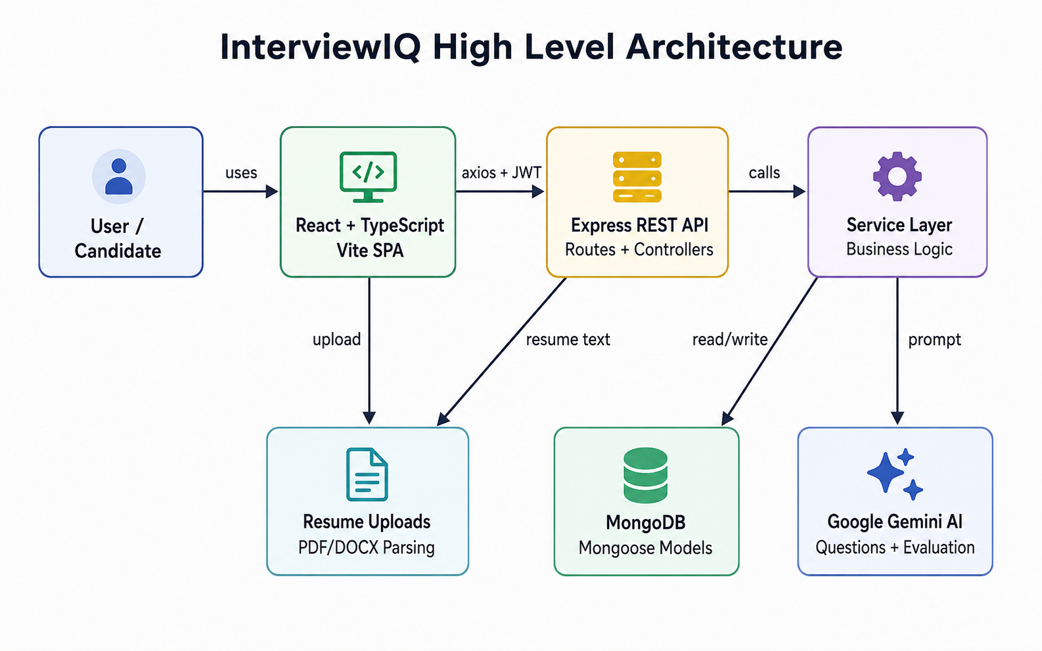
System Architecture
• Frontend sends Axios requests to Express API routes, while JWT middleware protects private operations.
• Controllers call service functions for resume parsing, AI prompts, analytics and database work.
• MongoDB stores persistent records; Gemini AI is called only when generation or evaluation is required.
7

Slide 8
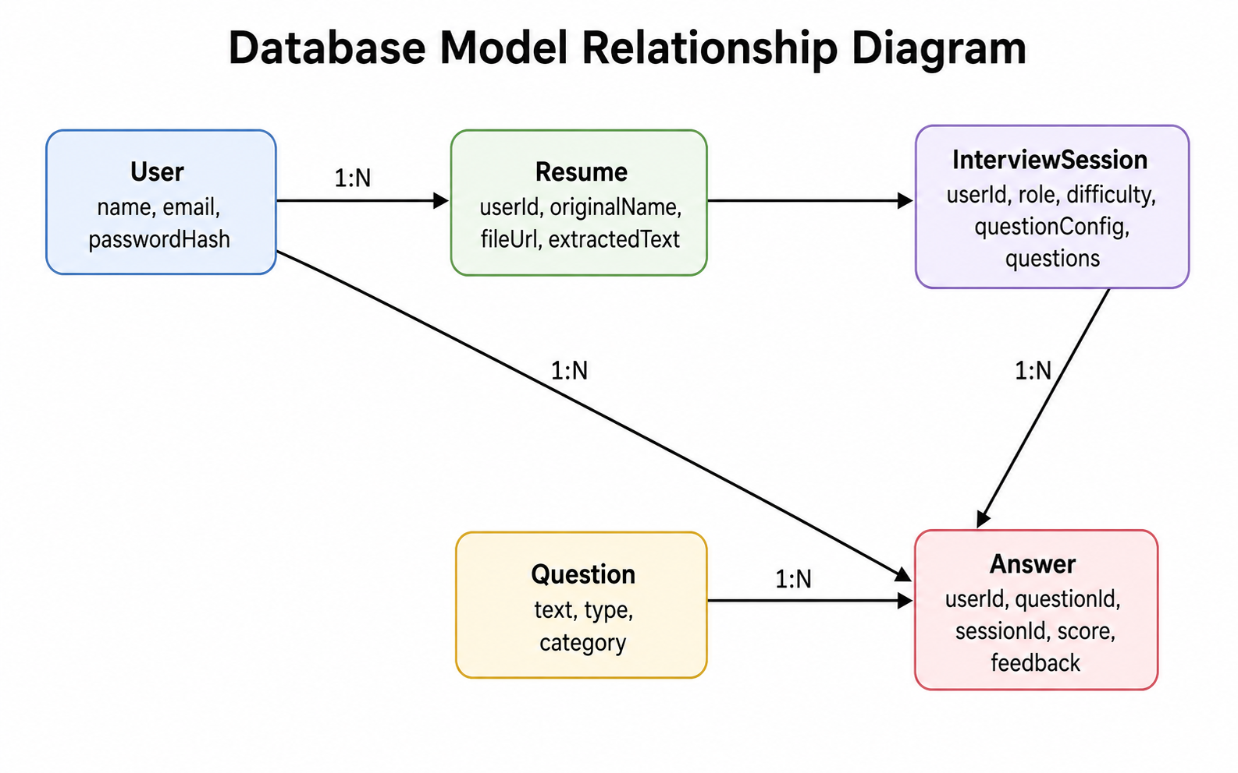
Database Design
• The database uses MongoDB because InterviewIQ stores flexible semi-structured data such as resumes and AI feedback.
• User collection stores candidate identity details and hashed authentication credentials.
• Resume collection stores uploaded file metadata and extracted resume text used as AI context.
• Question collection can hold predefined fallback questions for reliability when AI generation fails.
• InterviewSession stores role, difficulty, question configuration, generated questions and generatedByAI status.
• Answer collection stores every submitted answer with score, feedback, missing points and improvement suggestions.
• userId connects resumes, sessions and answers to the authenticated user for privacy and data separation.
• Indexes on userId and session configuration improve lookup speed and help reuse already generated sessions.
• This design supports analytics because stored answer records become the source for progress tracking and weak-area detection.
8

Slide 9
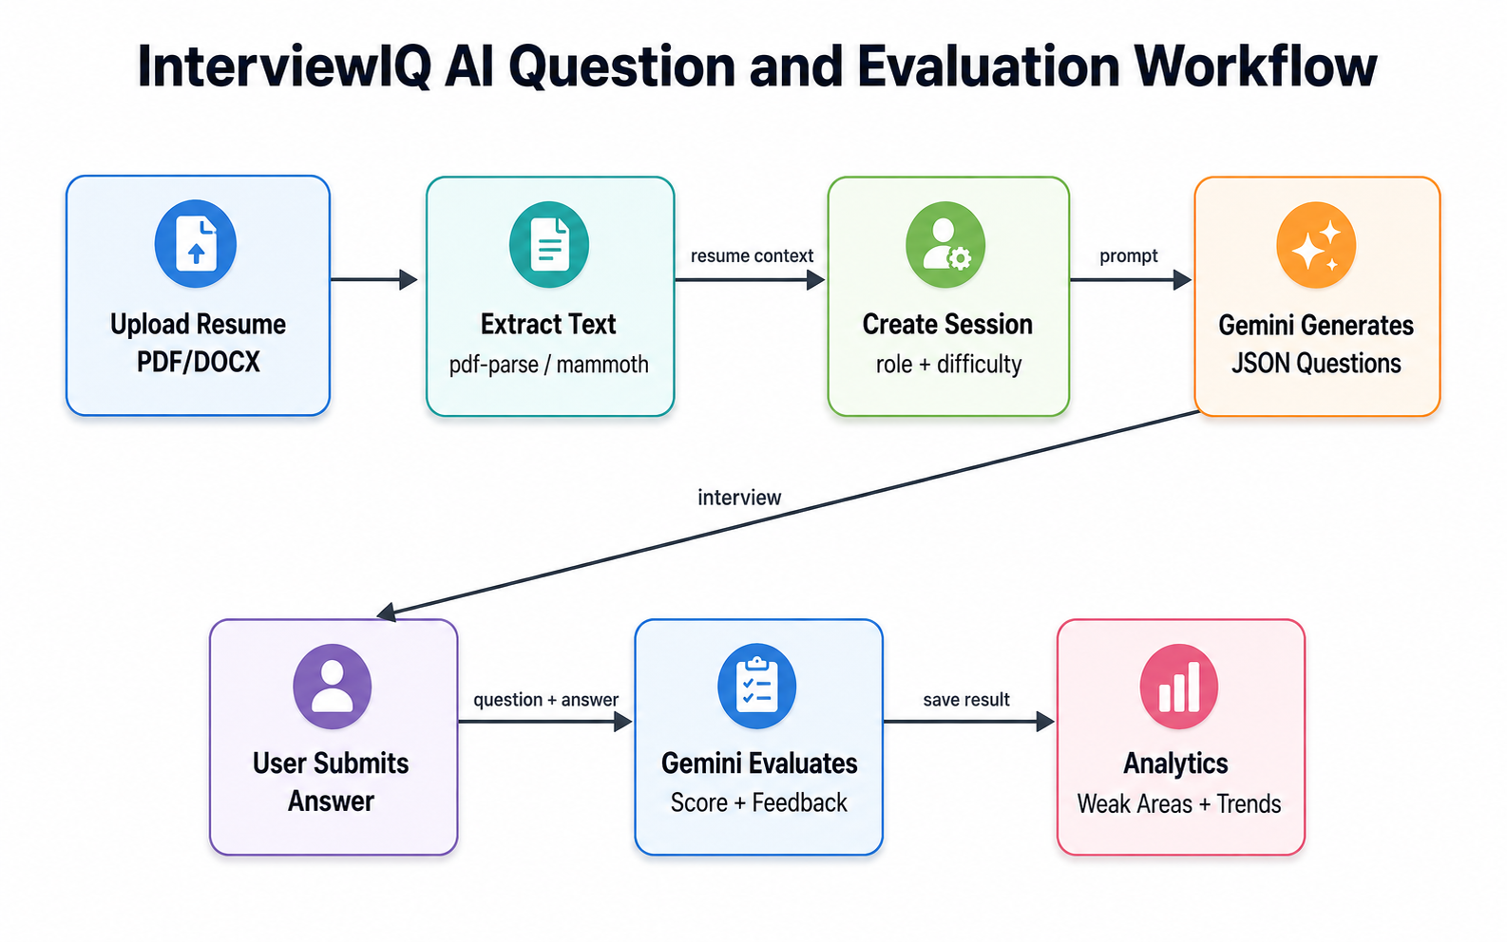
AI Question and Evaluation Workflow
• The workflow begins with resume upload and interview configuration, then moves to AI generation.
• User answers are evaluated immediately and saved with structured feedback fields.
• Saved evaluations become analytics data for score trends, weak categories and recommendations.
9

Slide 10
Program Structure
Frontend
React + Vite
Pages, hooks and services
Handles UI, forms and routing
Backend
Express.js
Routes, controllers, services
Validates JWT and calls AI
Database
MongoDB
User, resume and answer models
Stores sessions and analytics
• The root project contains separate backend and frontend folders with a root package file for combined execution.
• Backend folders are organized into config, controllers, middleware, models, routes, services, uploads and server entry point.
• Frontend folders include components, hooks, lib utilities, pages, services, App.tsx and main.tsx.
• This separation keeps UI logic, API communication, business logic and database models easier to maintain and test.
10

Slide 11
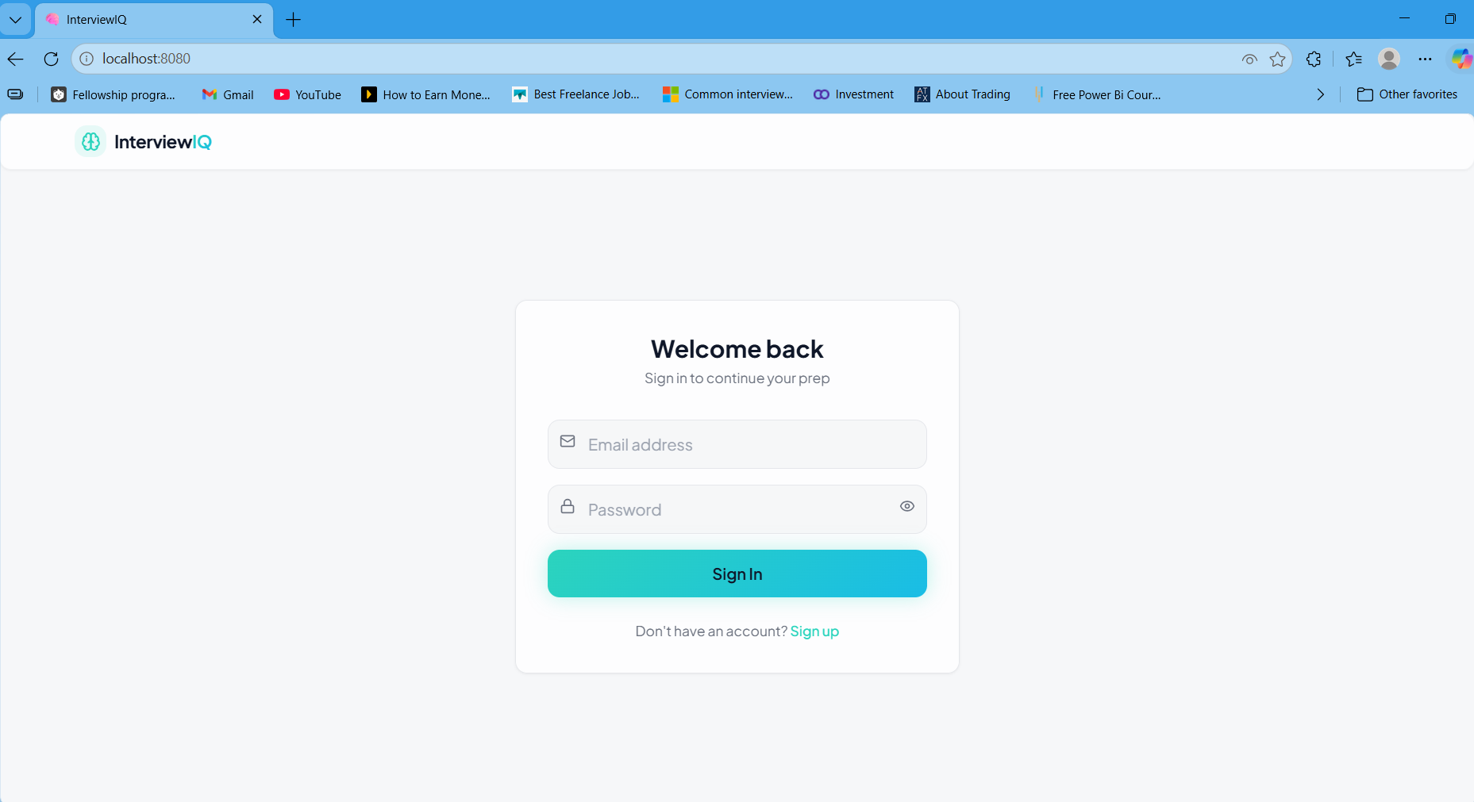
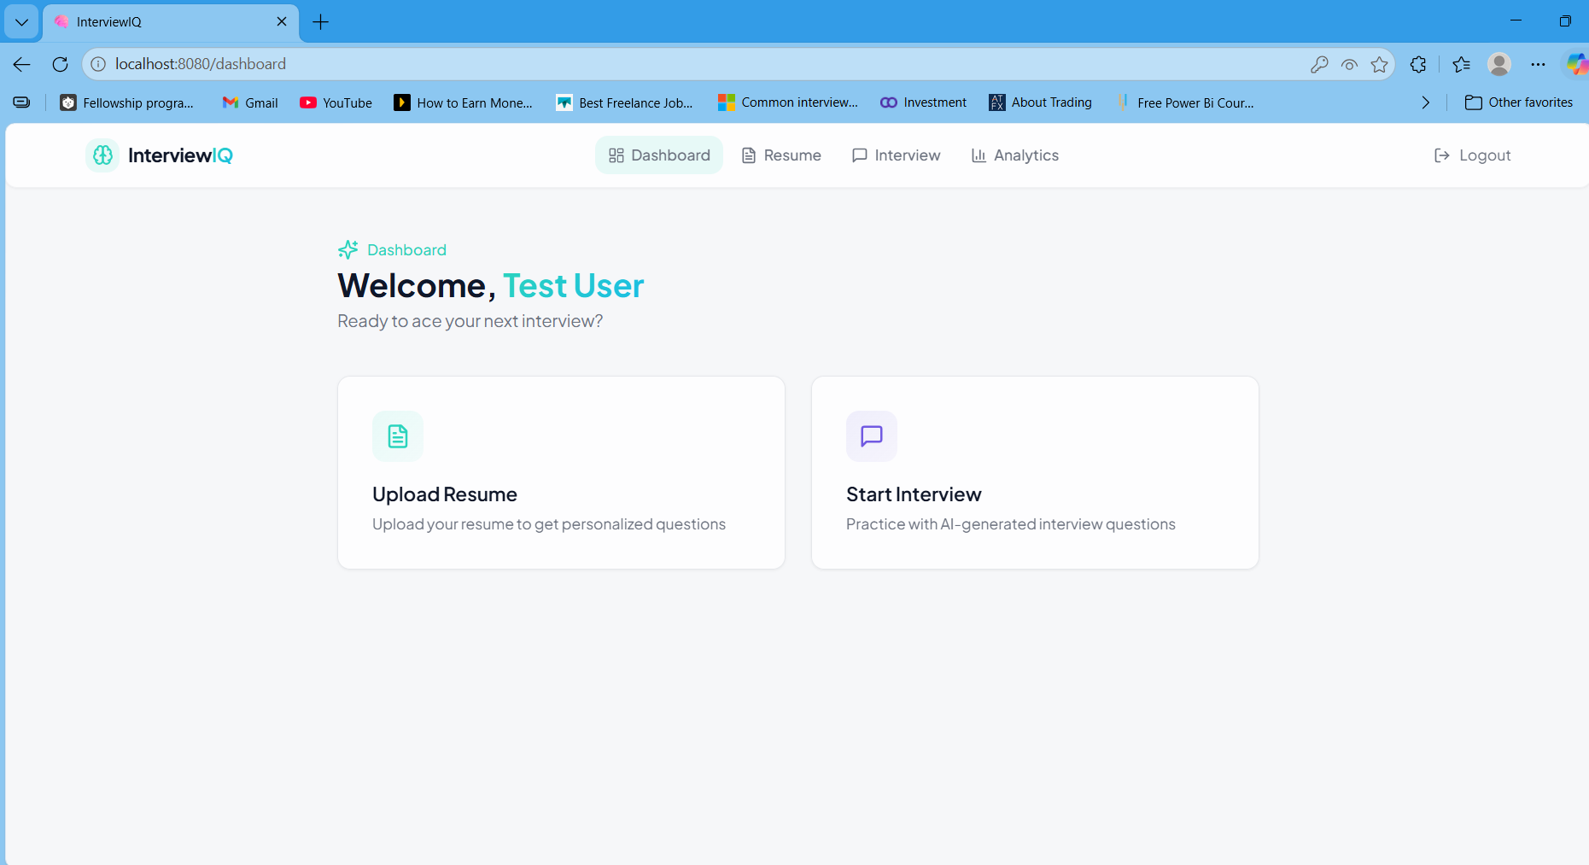
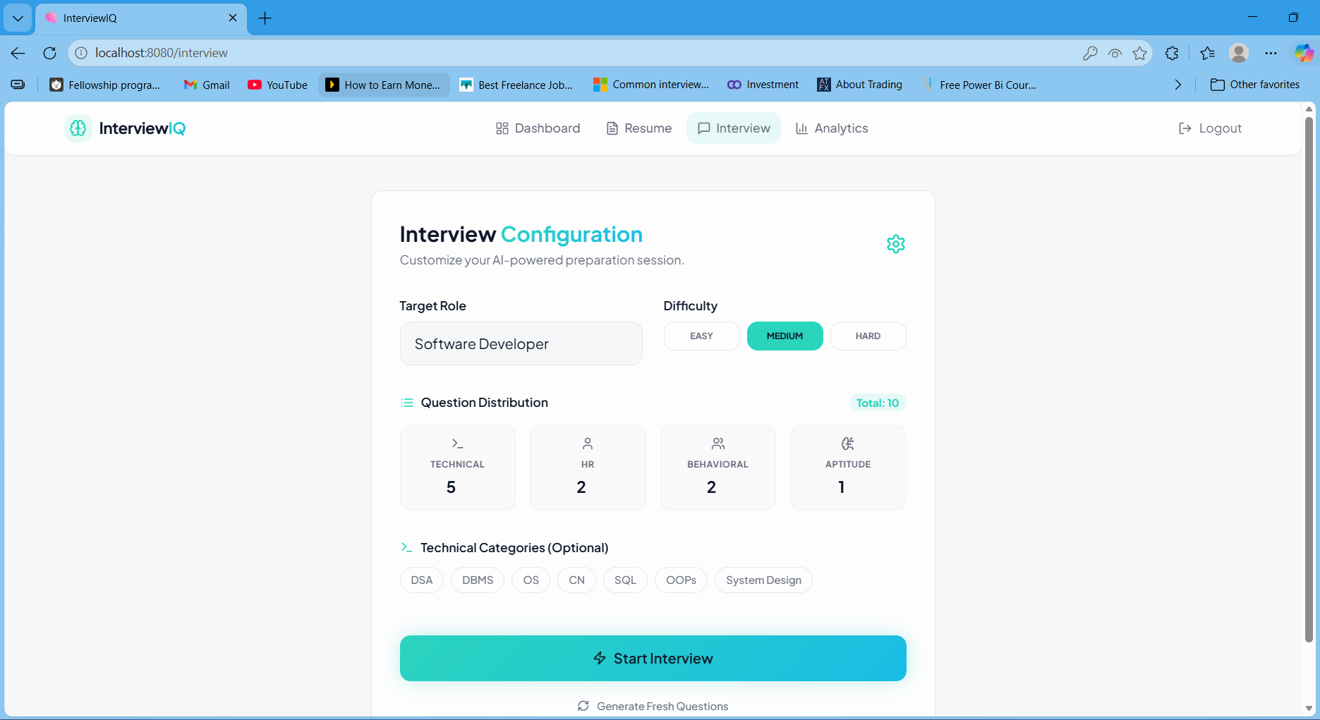
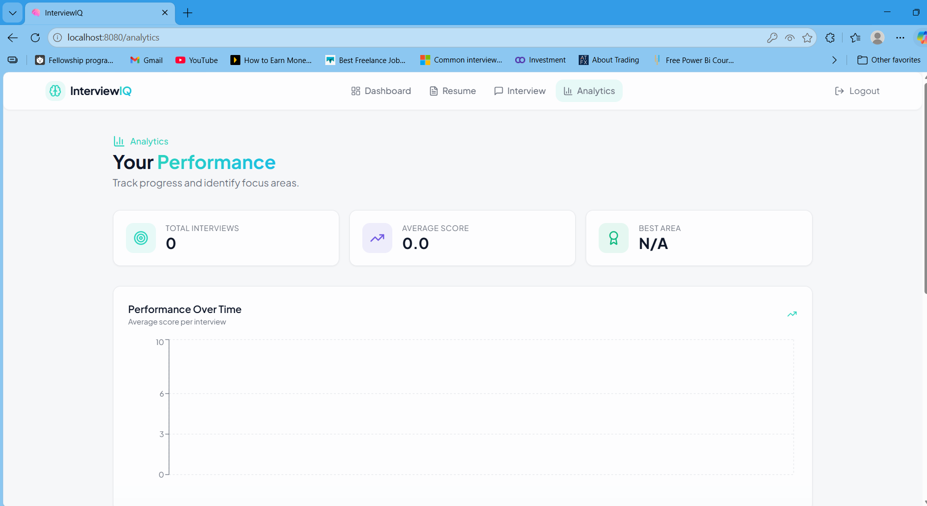
GUI Construction
The GUI is divided into clear user modules: authentication, dashboard configuration, interview execution and
analytics review.
Login
Dashboard
Interview Configuration
Analytics
11

Slide 12
Implementation Details
• Authentication begins with signup/login, where passwords are hashed with bcryptjs before storage.
• After successful login, the backend returns a JWT that is sent with protected requests using Authorization: Bearer token.
• Resume upload uses multer for multipart/form-data and accepts supported PDF/DOCX files only.
• pdf-parse and mammoth extract text from uploaded resumes, which is saved in the Resume model.
• Question generation builds a prompt using resume text, selected role, difficulty and question distribution.
• The AI service expects strict JSON and includes parsing safeguards to handle code fences or malformed AI output.
• Answer evaluation sends the question and user answer to Gemini and stores score, feedback and improvement data.
• Mongoose connects to MongoDB using MONGO_URI and separates schemas into User, Resume, Question, Answer and InterviewSession models.
• API modules cover authentication, resume handling, question generation, answer submission and analytics retrieval.
• Error handling covers invalid credentials, missing JWT, unsupported files, AI parsing failure and database exceptions.
12

Slide 13
System Testing
• Testing verifies that authentication, protected routes, resume upload, AI generation, answer submission and analytics work together.
• Login tests confirm that valid credentials generate a token and invalid credentials return an expected error.
• Token persistence tests ensure the user remains authenticated while switching between protected frontend routes.
• Resume upload tests validate PDF/DOCX acceptance, unsupported-file rejection and extracted-text storage.
• Questions API tests check whether protected endpoints return generated or fallback questions correctly.
• Answer submission tests verify that answers are saved with score, feedback, missing points and suggestions.
• Analytics tests confirm that historical records can be retrieved and shown in performance charts.
• Manual testing covers dashboard navigation, interview configuration, mock timer behavior and evaluation display.
• Further production testing should include AI quota failures, file-size boundaries, rate limits and concurrent session requests.
13

Slide 14
Limitations and Future Scope
• AI answer quality depends on resume clarity, selected role, prompt structure and Gemini API availability.
• Scanned PDF resumes may not parse correctly because OCR support is not included in the current version.
• The platform currently supports text-based interviews only and does not yet include microphone or video features.
• Local upload storage is suitable for development but should be replaced with secure cloud storage in production.
• Analytics become more meaningful after multiple sessions because they depend on stored historical answer records.
• Future scope includes speech-to-text answers, video interview mode and a real-time conversational voice agent.
• Adaptive difficulty can be added so question difficulty changes according to the user’s average performance.
• Dockerization and docker-compose can simplify local setup and deployment across machines.
• Additional features may include admin dashboard, role-specific templates, PDF interview reports and expanded technical categories.
14

Slide 15
Conclusion
• InterviewIQ successfully demonstrates a full-stack AI-powered interview preparation platform.
• It combines resume parsing, configurable interview sessions, AI-generated questions, answer evaluation and analytics.
• The project applies core full-stack engineering concepts such as REST APIs, authentication, validation and database design.
• A modular backend separates routes, controllers, services, middleware and models for maintainability.
• The React frontend uses reusable components, routing, API services and chart-based analytics for a clean user flow.
• Resume-aware question generation makes preparation more personalized than static interview question banks.
• Stored evaluations help candidates convert feedback into measurable progress over time.
• Session caching reduces repeated AI calls and supports reuse of generated questions for the same configuration.
• With production hardening, monitoring, cloud storage and future voice/video features, it can become a stronger career preparation tool.
15

Slide 16
Thank You
16

