Slide 1


PROJECT 2
STEPHANIE DAVIS, TIMOTHY OSMOND & MARIE DEL BORRELLO

Slide 2
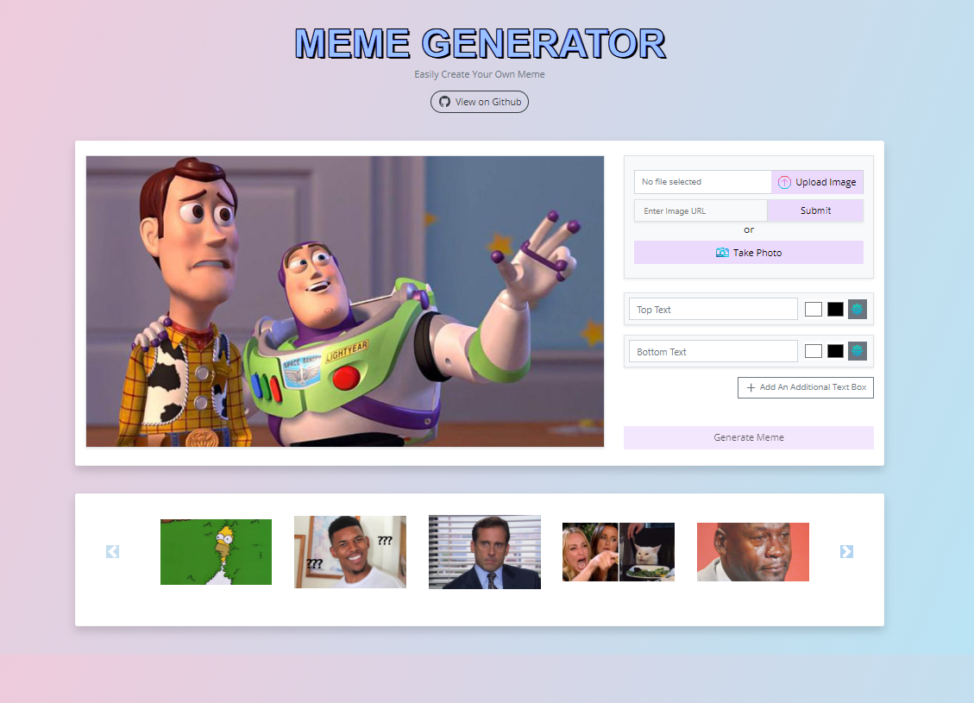

Slide Title
link

Slide 3
AGENDA
OVERALL CONCEPT OF OUR APPLICATION
MOTIVATION FOR DEVELOPING THIS APP
OUR DESIGN PROCESS
TECHNOLOGIES USED
DEMO OF APP’S FUNCTIONS
DIRECTION FOR FUTURE DEVELOPMENT

Slide 4
overall concept
Our meme generator web application allows any user to create their own personalized meme.
It operates in HTML5 canvas, so your images are created instantly on your own device.
The app allows the user to either upload their own image, enter an image URL, take a photo or choose a template from the carousel below.
The user is able to personalize their meme by adding text to the image.

Slide 5
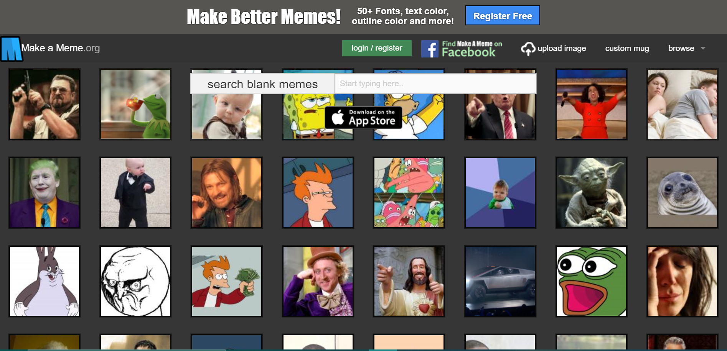
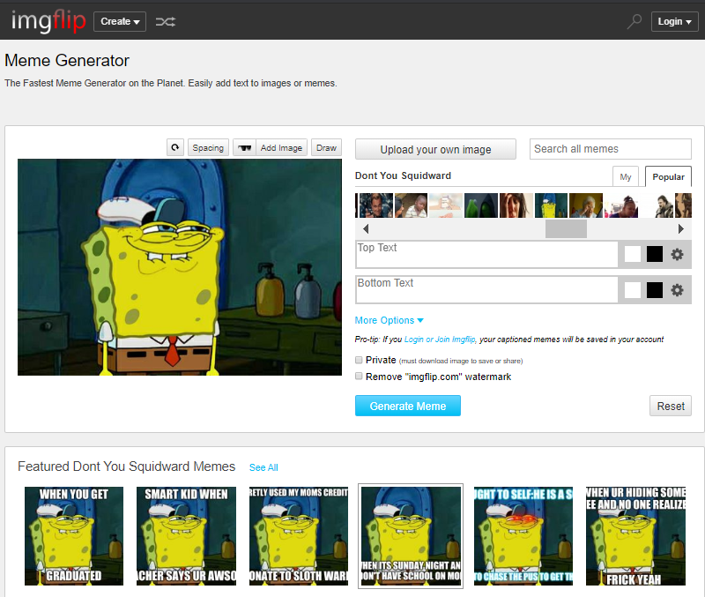
motivation
We decided to make a meme generator to challenge ourselves as well as make a fun application that anyone can use.
We had looked at many different examples online such as Meme generator by Imgflip and makeameme.com.
We wanted to differ ourselves from those websites as they both weren't very appealing to the eye, were cluttered with ads and were difficult to use.

Slide 6
Our Design process
We took inspiration from many different meme generator websites and wanted to incorporate certain aspects that we thought would be important.
We wanted our application to be easy on the eyes, so we chose a simple gradient color scheme from GRAPAD.
We wanted to allow the user to upload their own image from the device, enter an image URL, take a photo or use the image templates.
We wanted to allow the user to be customize their font, color, size of font, shadow and alignment of text.
We wanted to make this app as a flexible tool to use, by adding custom images and using all the customization options provided to the user.

Slide 7


Technologies used
WHAT WE USED
Library – Multer
Packages – Sequelize, prettier & eslintric.
Technology – AWS
We also used,
HTML5 Canvas, bootstrap
HOW IT WORKS
Multer was used for uploading files and is a node.js middleware for handling form-data.
Prettier enforces a consistent code style.
Eslintric is used to define config for prettier.
AWS is a cloud solution for MySQL, so it is all hosted remotely.
Canvas was used to draw the graphics on the webpage and is used along with Javascript.

Slide 8
Direction for development
Have a login page allowing the user to save and reuse their own memes.
Allow people to instantly share to Facebook, Instagram and messages.

Slide 9
DIFFICULTIES
Deploying to Heroku.
Converting a Base64 image to BLOB, I gave up on that and saved it as BASE64.
Getting AWS configured and working, I.E outbound and inbound rules.
There was a character limit to TEXT in sequelize, the limit is 65,535 and BASE64 exceeds that. We ended up using TEXT(LONG).

Slide 10


THANK YOU
Heroku
GitHub

