Slide 1
GNU/Linux is not SCARY!
by Maryam Behzadi

Slide 2

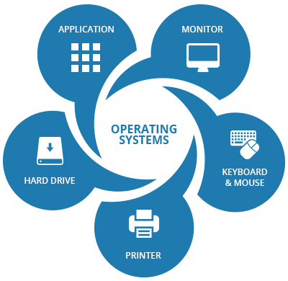
What is an Operating System?

Slide 3
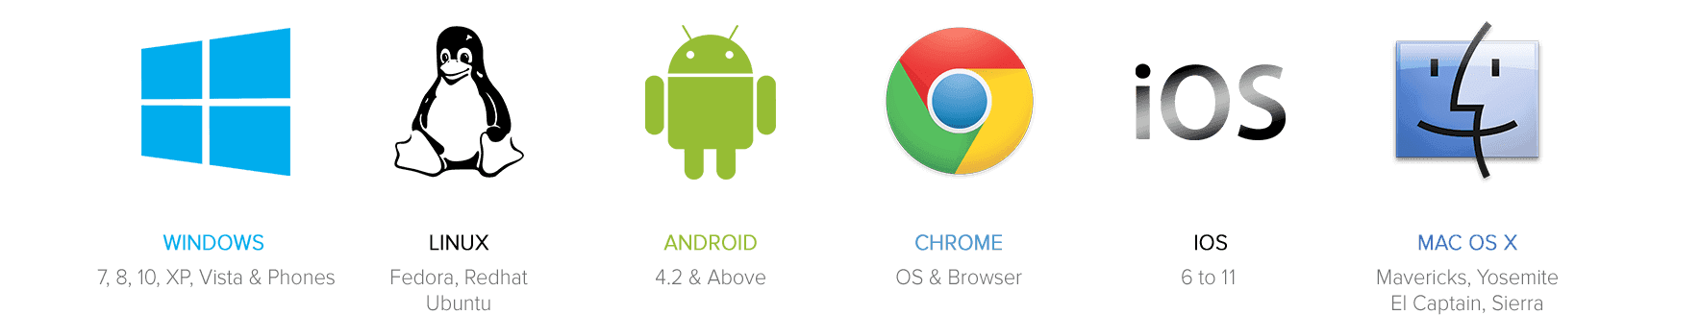
Operating Systems

Slide 4

What is Linux?
Open-source
Unix-like
Operating System Kernel
by Linus Torvalds
first released 1991
GPLv2

Slide 5
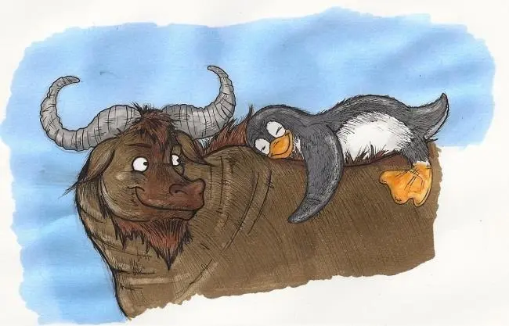

Linux or GNU/Linux?

Slide 6

Linux Distros

Slide 7

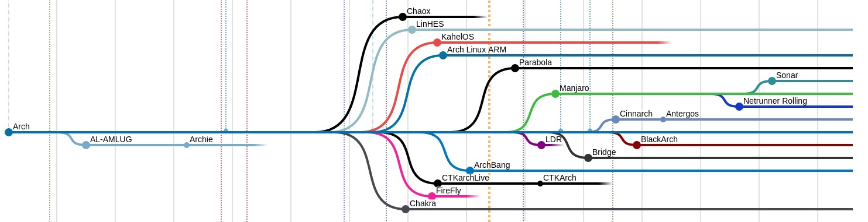
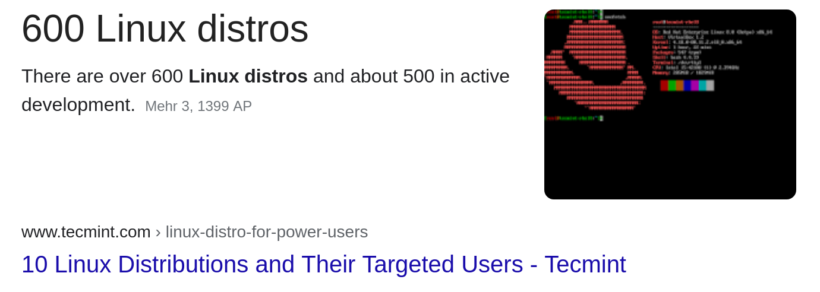
Linux Distros
Linux Distributions

Slide 8
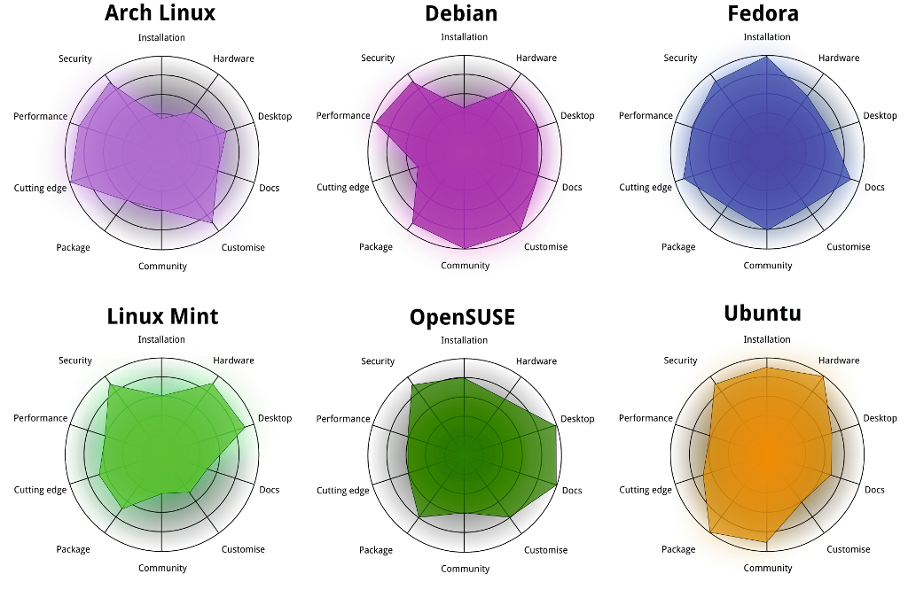
Comparison of Linux Distributions

Slide 9
10 Myths about Linux
by Maryam Behzadi

Slide 10


Myth #1: Linux is hard to install

Slide 11

Myth #2: Linux is very difficult to use

Slide 12
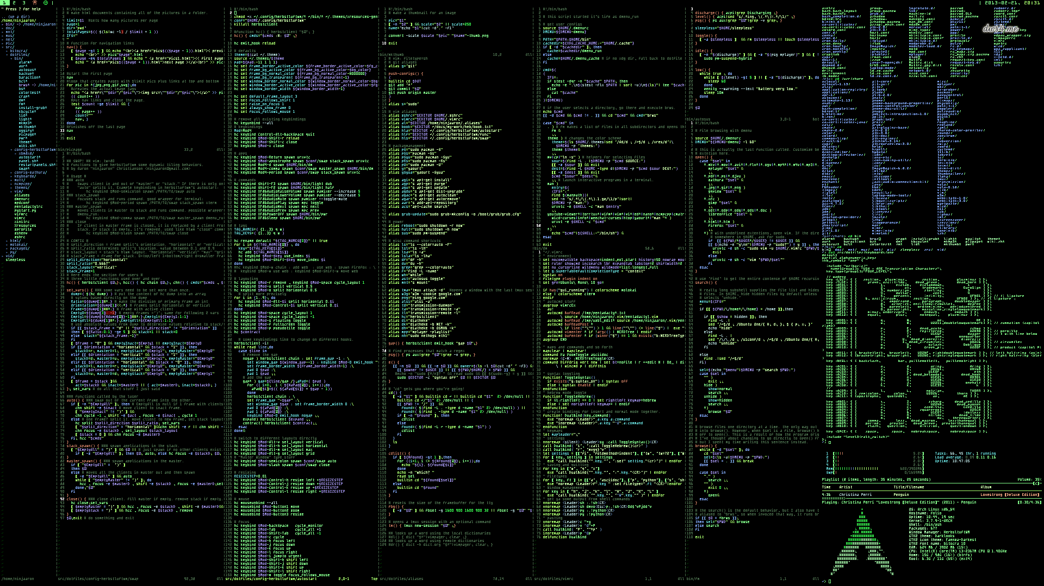
Myth #3: You need to know commands

Slide 13
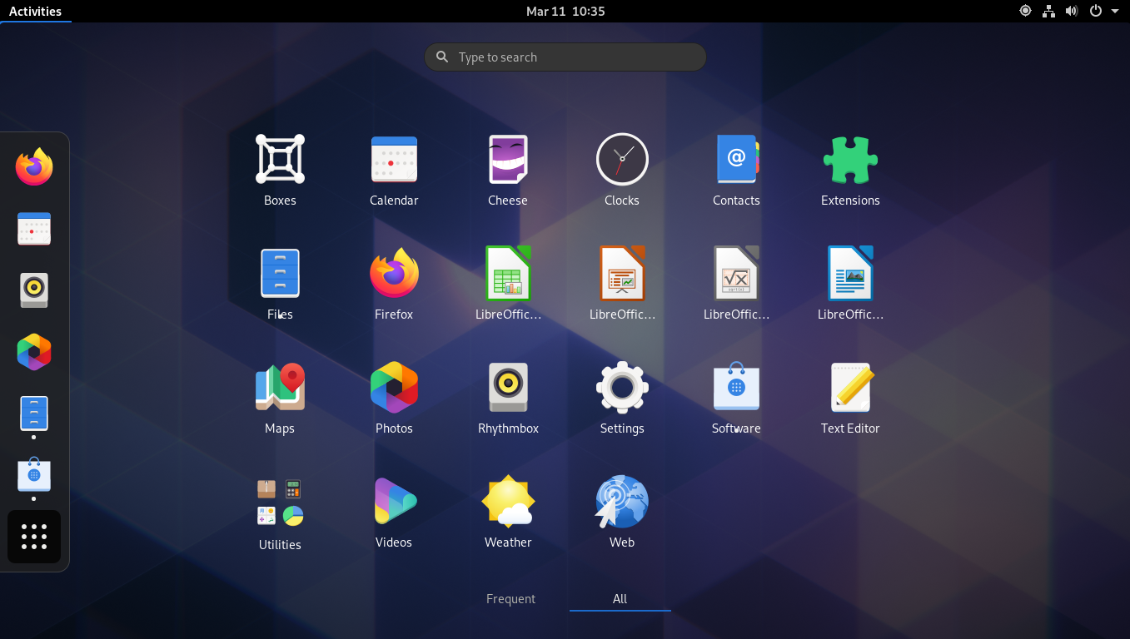
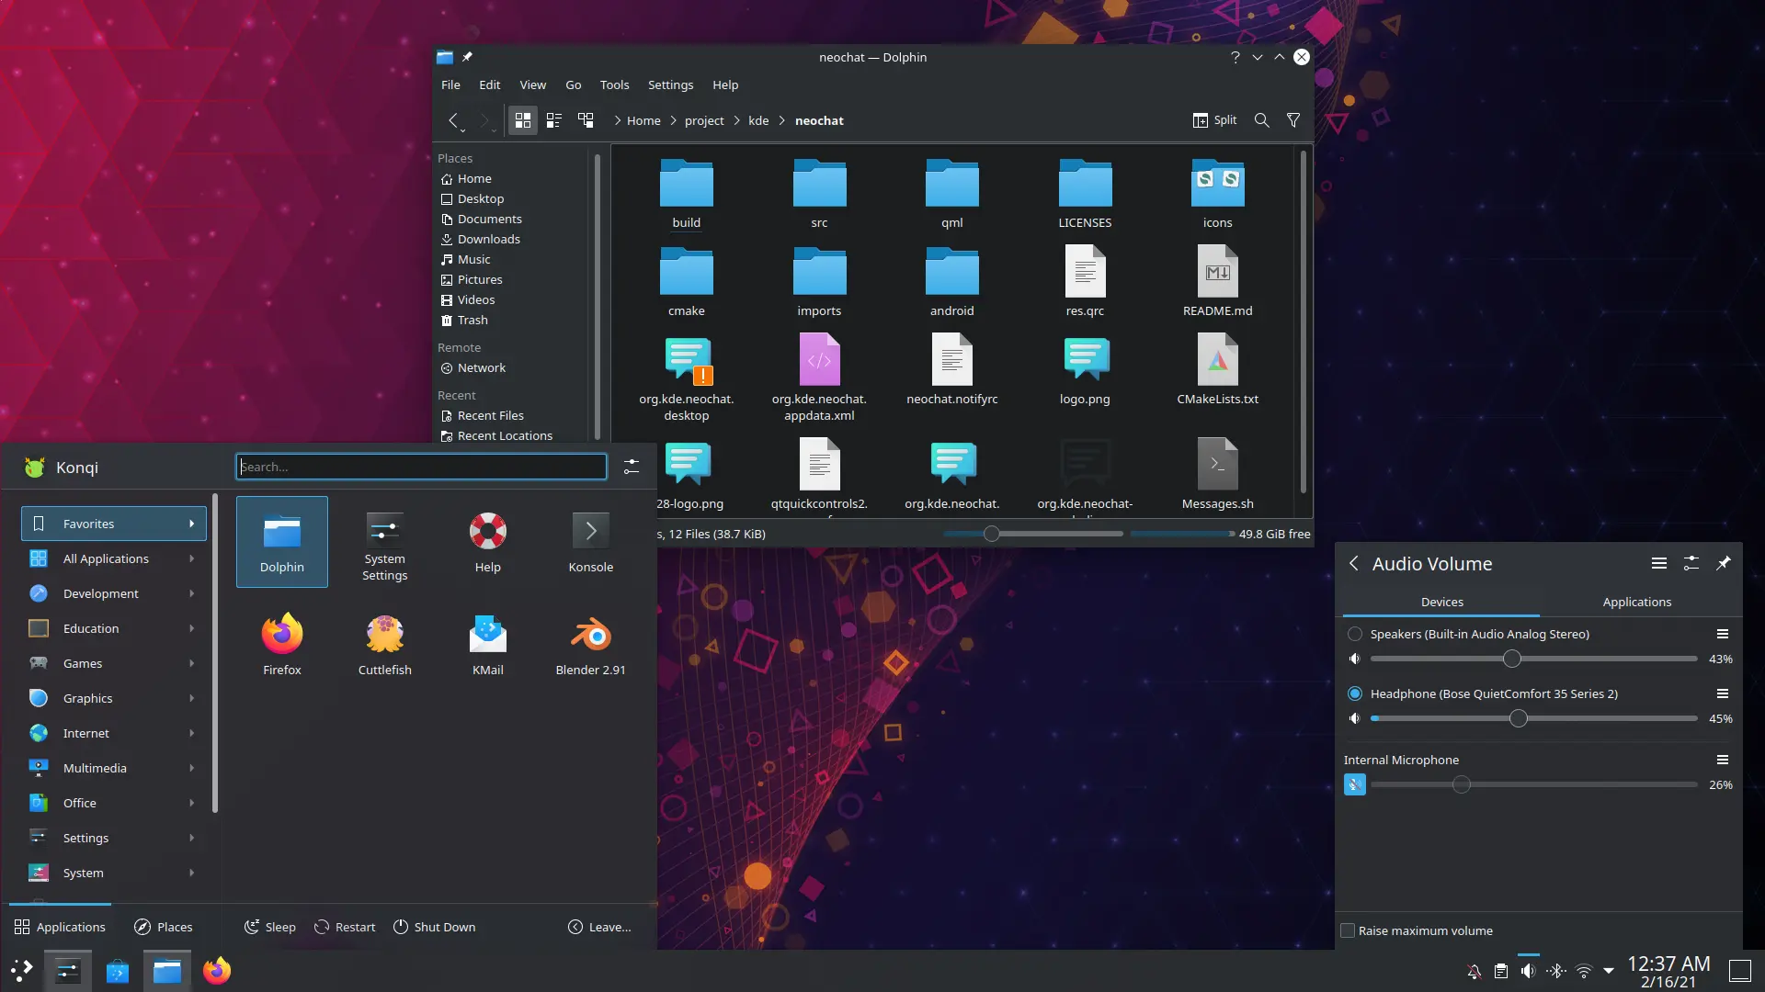
Myth #4: Linux does not have a desktop GUI

Slide 14
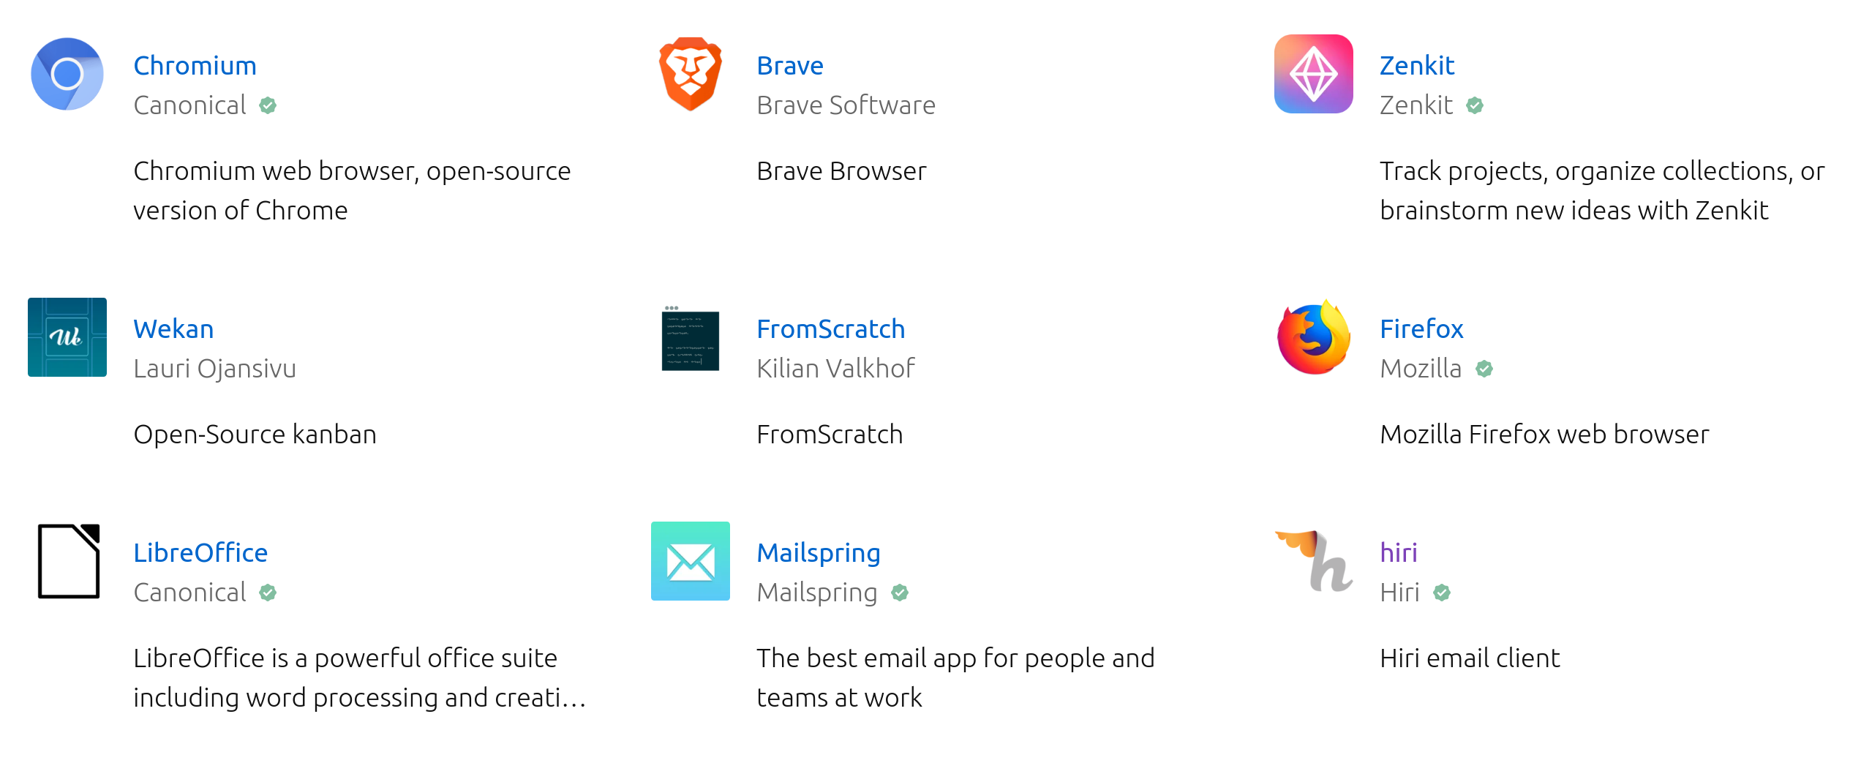
Myth #5: Linux does not have enough Apps

Slide 15
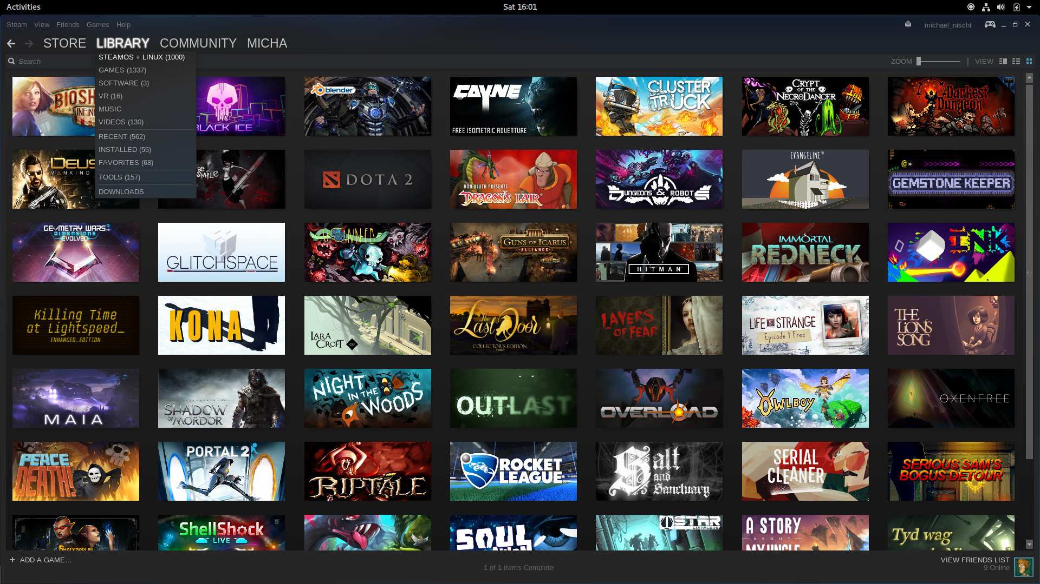
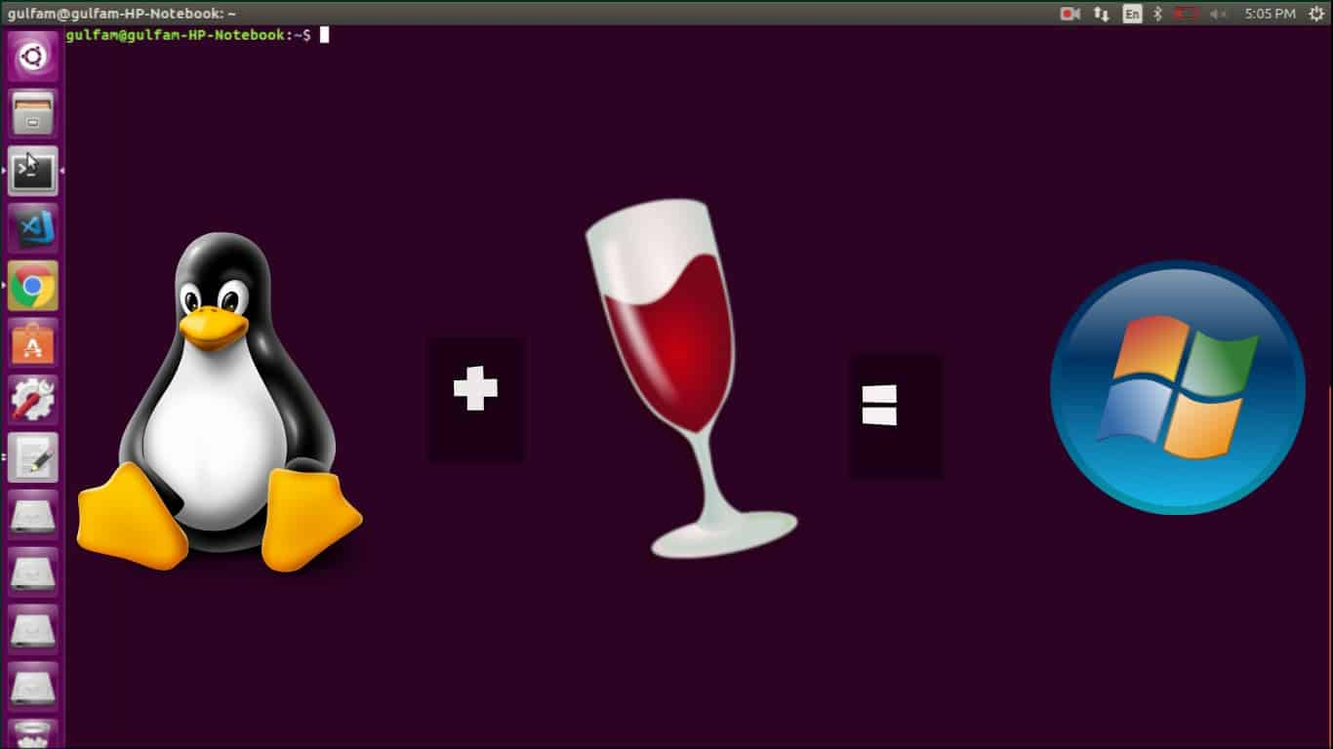

Myth #6: Linux is not for Gamers
Play on Linux

Slide 16
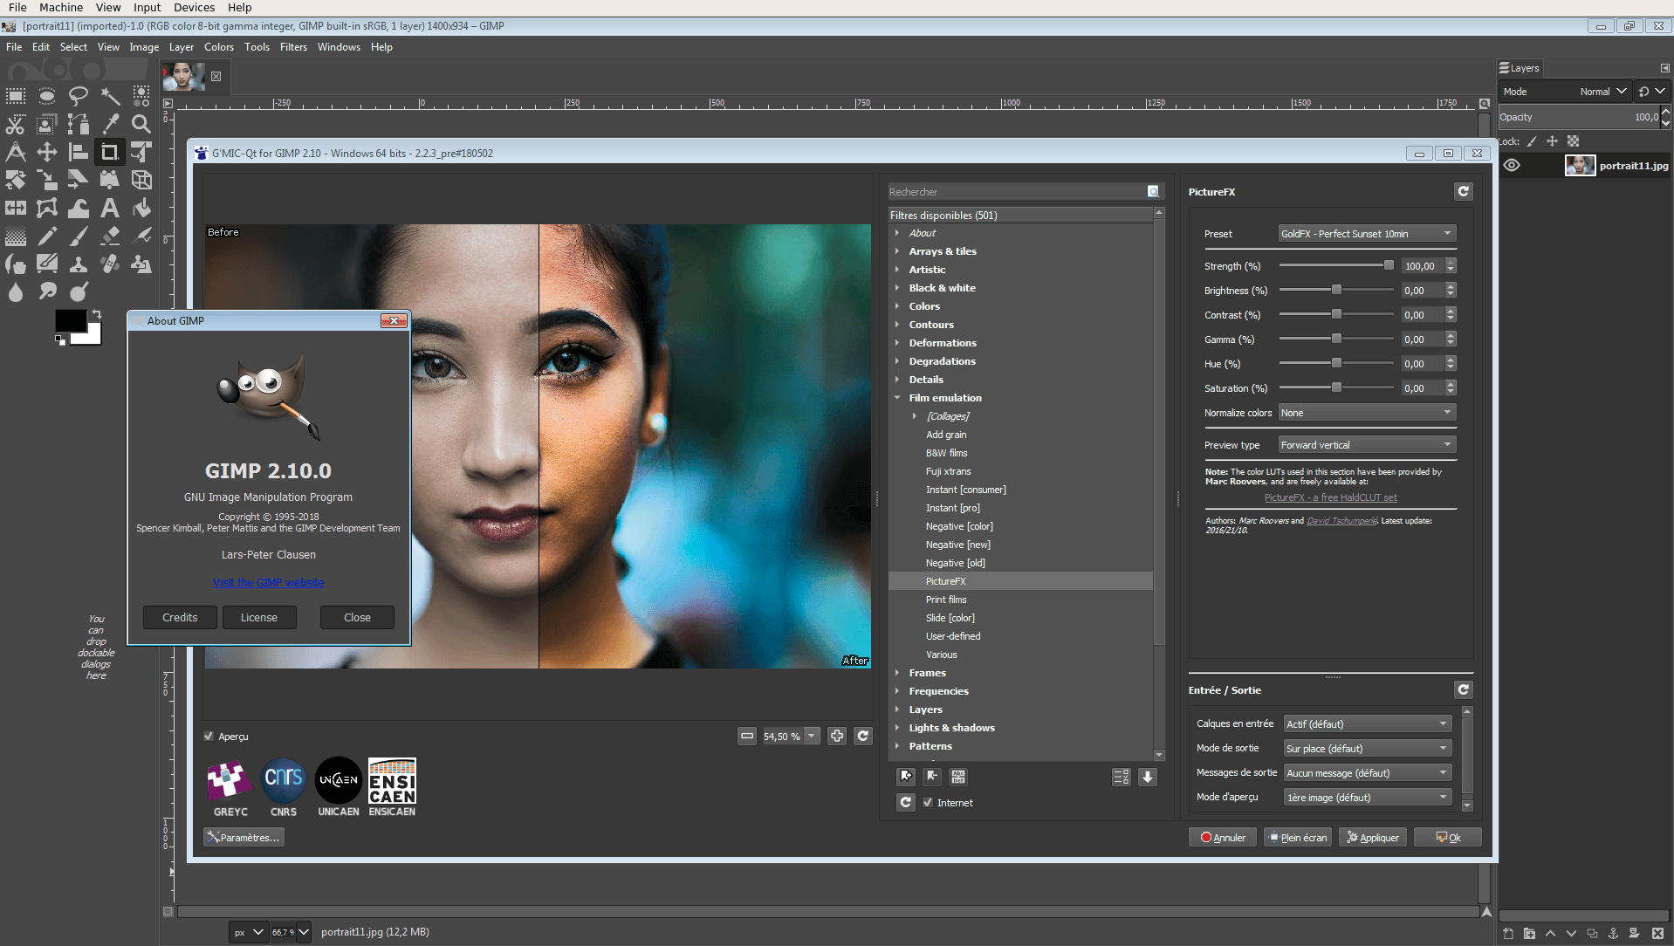
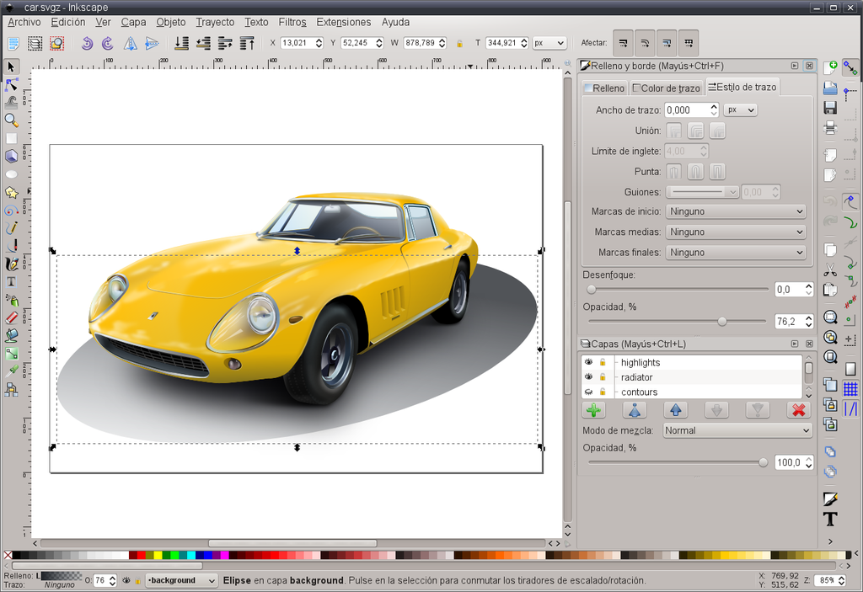
Myth #7: Linux is not for Designers

Slide 17
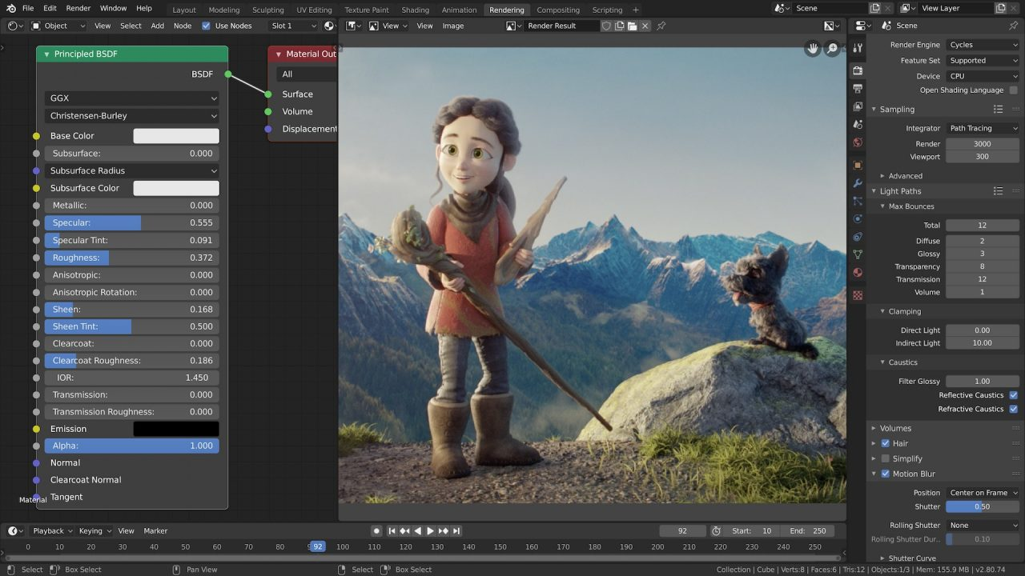
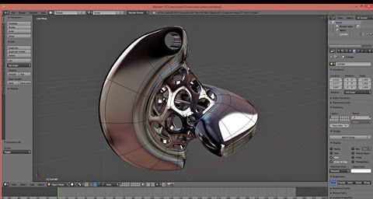
Myth #8: Linux is not for video editing and 3D

Slide 18

Myth #9: Linux is not secure

Slide 19

Myth #8: Linux is secure

Slide 20

Myth #10: Linux is just for Servers

Slide 21
Where to Begin?
by Maryam Behzadi

Slide 22







Get to know Free Softwares

Slide 23
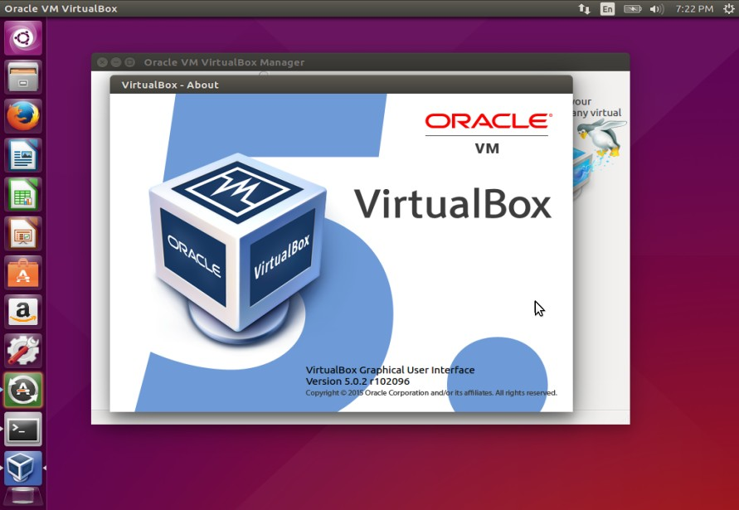
Install Linux Virtually

Slide 24
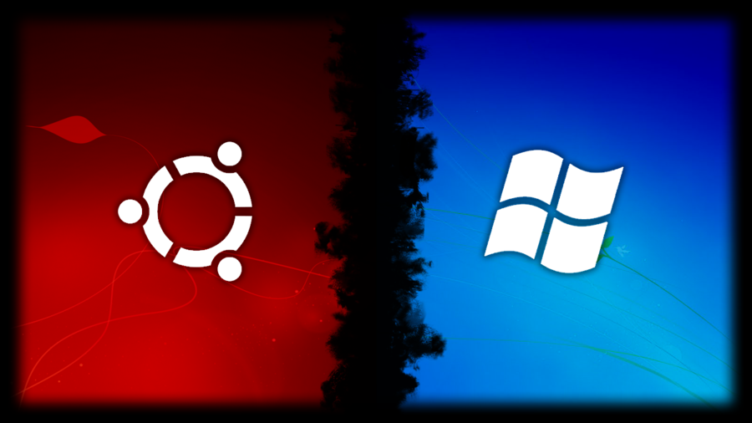
Install Linux in Dual Boot Mode

Slide 25
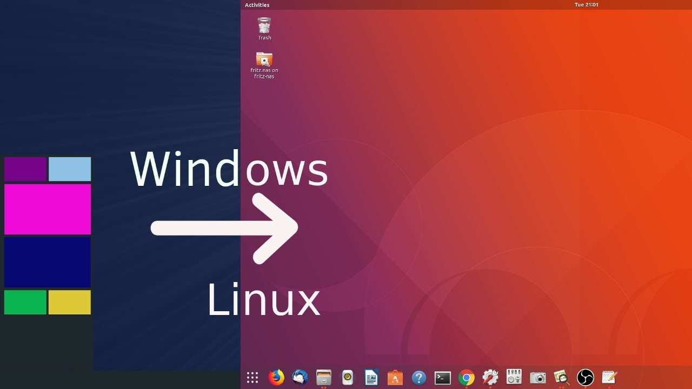
Successful Migration

Slide 26

mariebehzadi@gmail.com
https://hiva-iot.com

