Slide 1
GNU/Linux Workshop
by Maryam Behzadi

Slide 2
What did we talk about?
Linux is NOT SCARY!
  Operating Systems
  Free Software
  Linux and GNU Project
  Linux Distros
  10 Myths about Linux
  Where to Begin?
    Get to know Free Softwares
    Install Linux Virtually
    Install Linux in Dual Boot Mode
    Successful Migration
  Installation of Ubuntu in VirtualBox

Slide 3
What are we going to say today?
Ubuntu in Action
  Review Ubuntu Installation on VirtualBox
  MBR vs GPT
  BIOS vs UEFI
  Linux FHS
  History of Ubuntu

Slide 4
Ubuntu Installation
Installing Ubuntu on Oracle VirtualBox

Slide 5
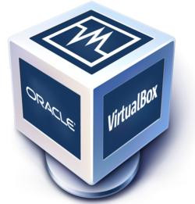
VirtualBox | Introduction
x86 and Virtualization Product
Free Software
Open Source
Free Price
Oracle Corporation
Initial Release: 2007
Stable Release: 2 months ago
Active Development Community
Cross Platform (Linux, MacOS, Solaris, Windows)
GPLv2
General Purpose (server, desktop, embedded use)

Slide 6
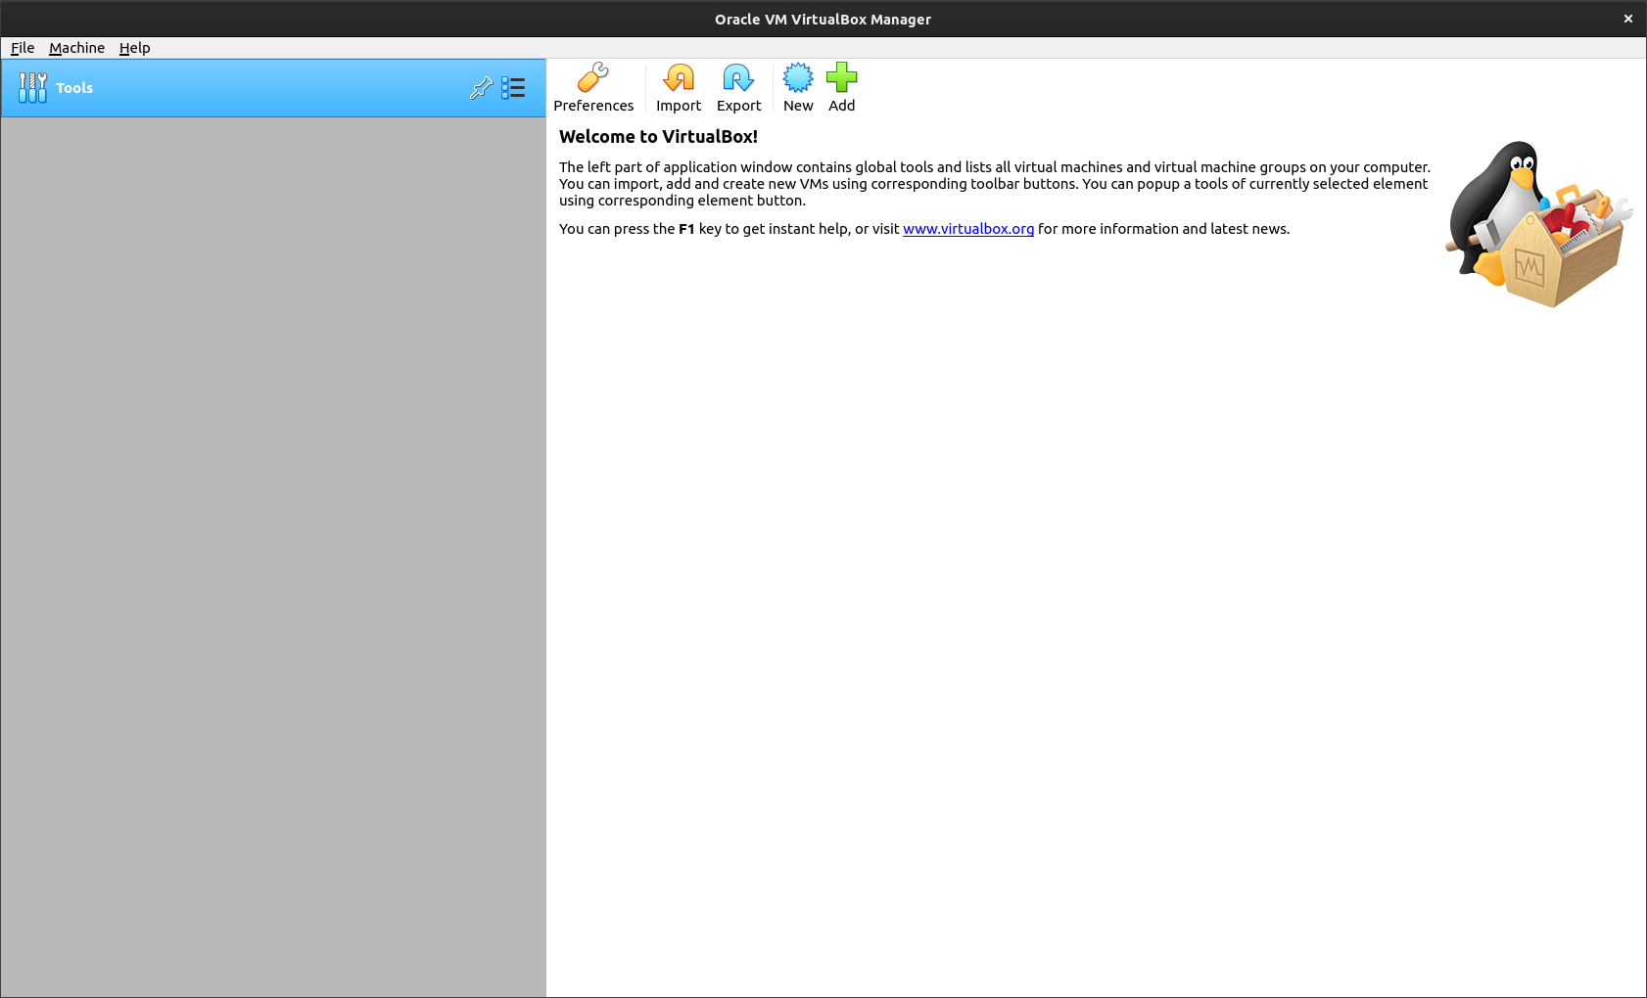
VirtualBox | Creating VM

Slide 7
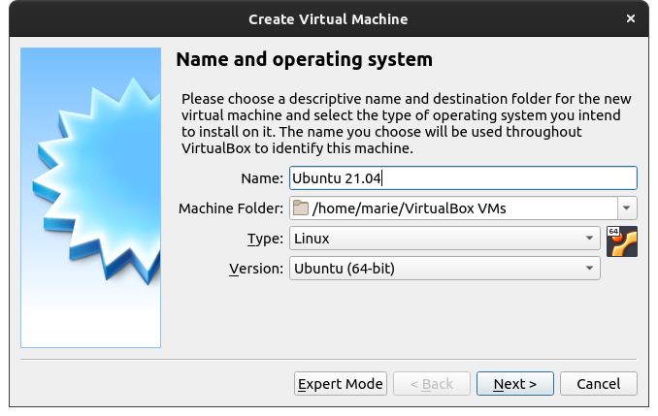
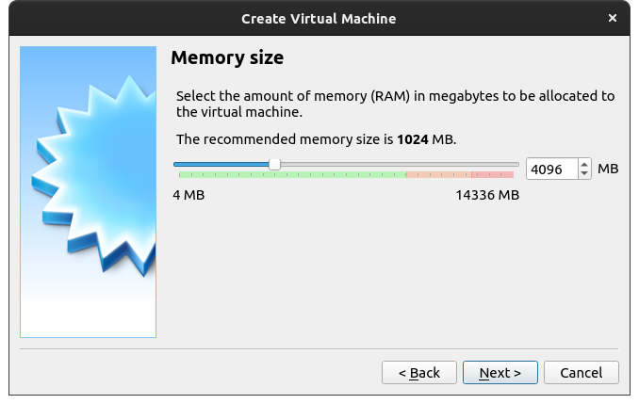
VirtualBox | Creating VM

Slide 8
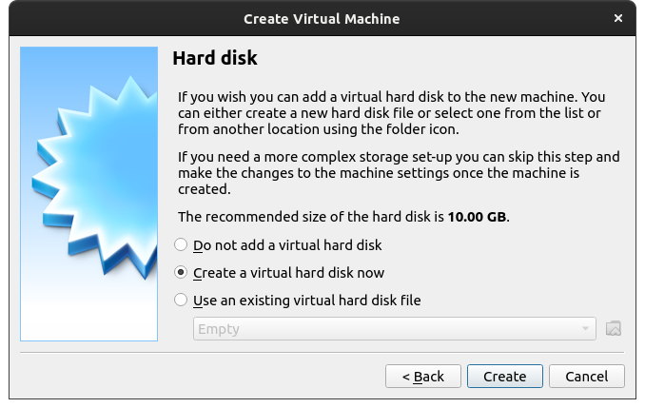
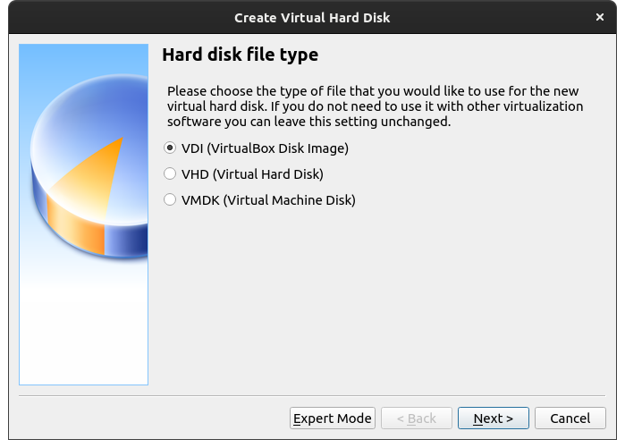
VirtualBox | Creating VM

Slide 9
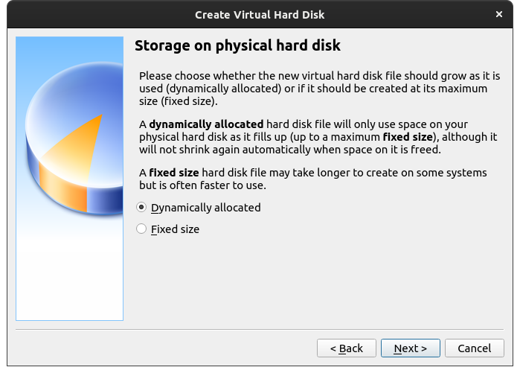
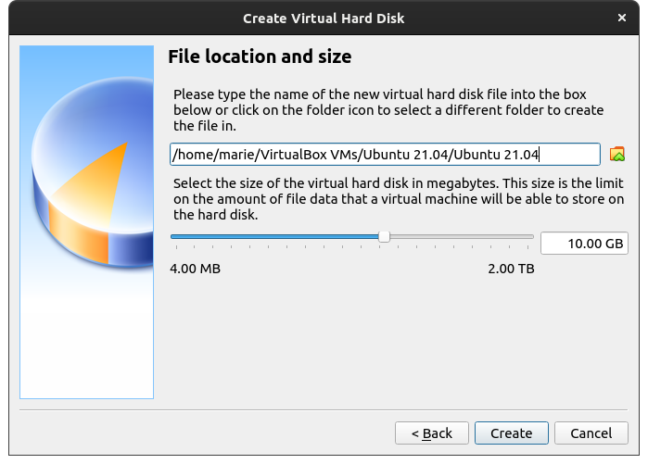
VirtualBox | Creating VM

Slide 10
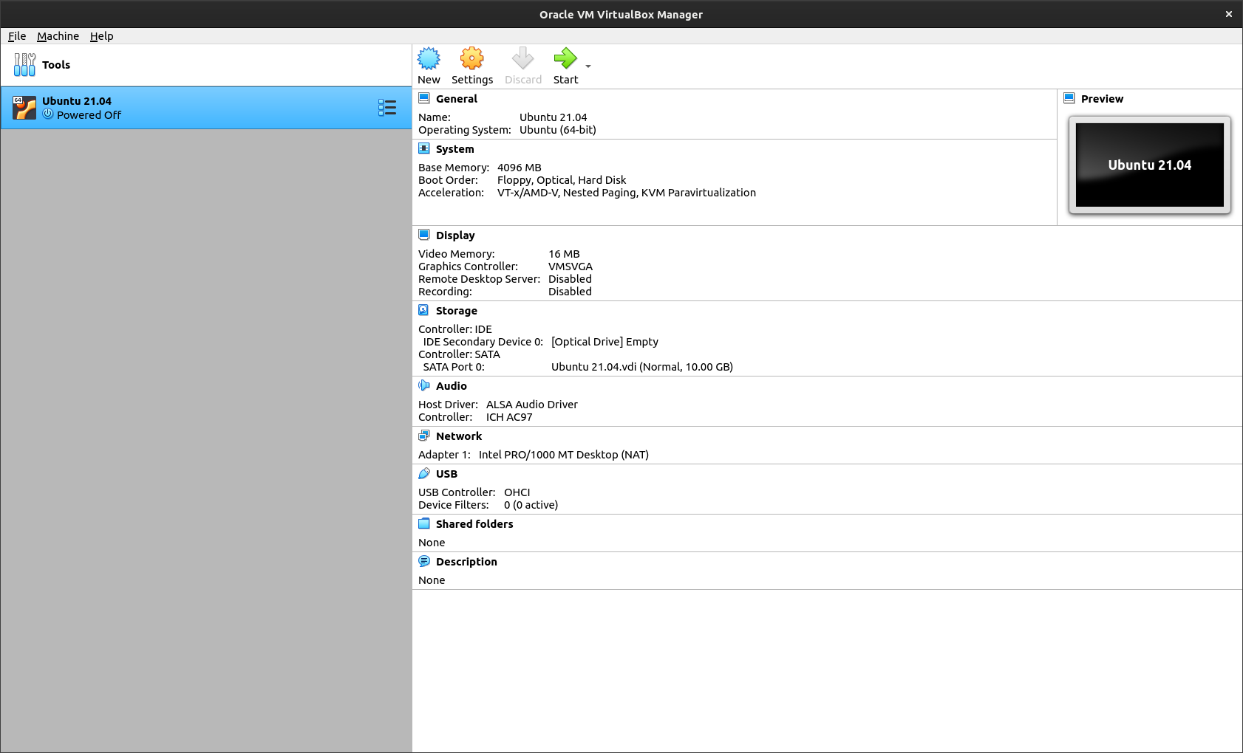
VirtualBox | Creating VM

Slide 11
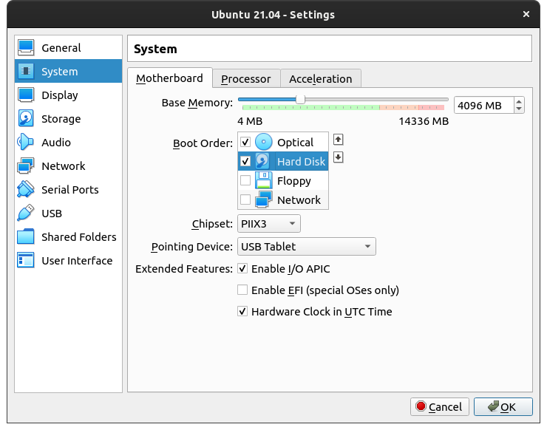
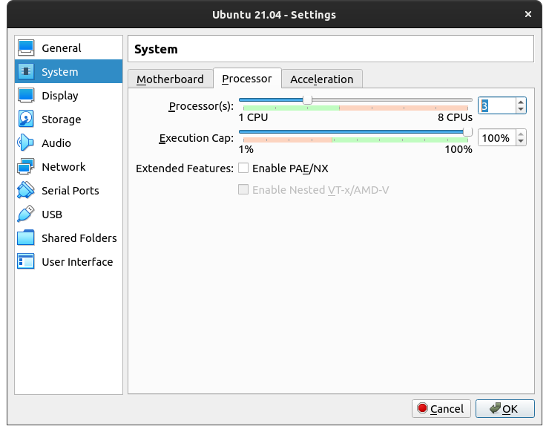
VirtualBox | Creating VM

Slide 12
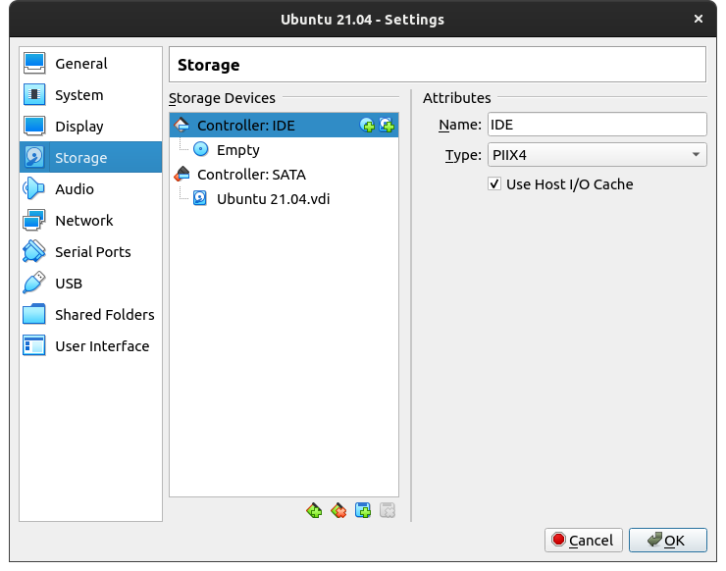
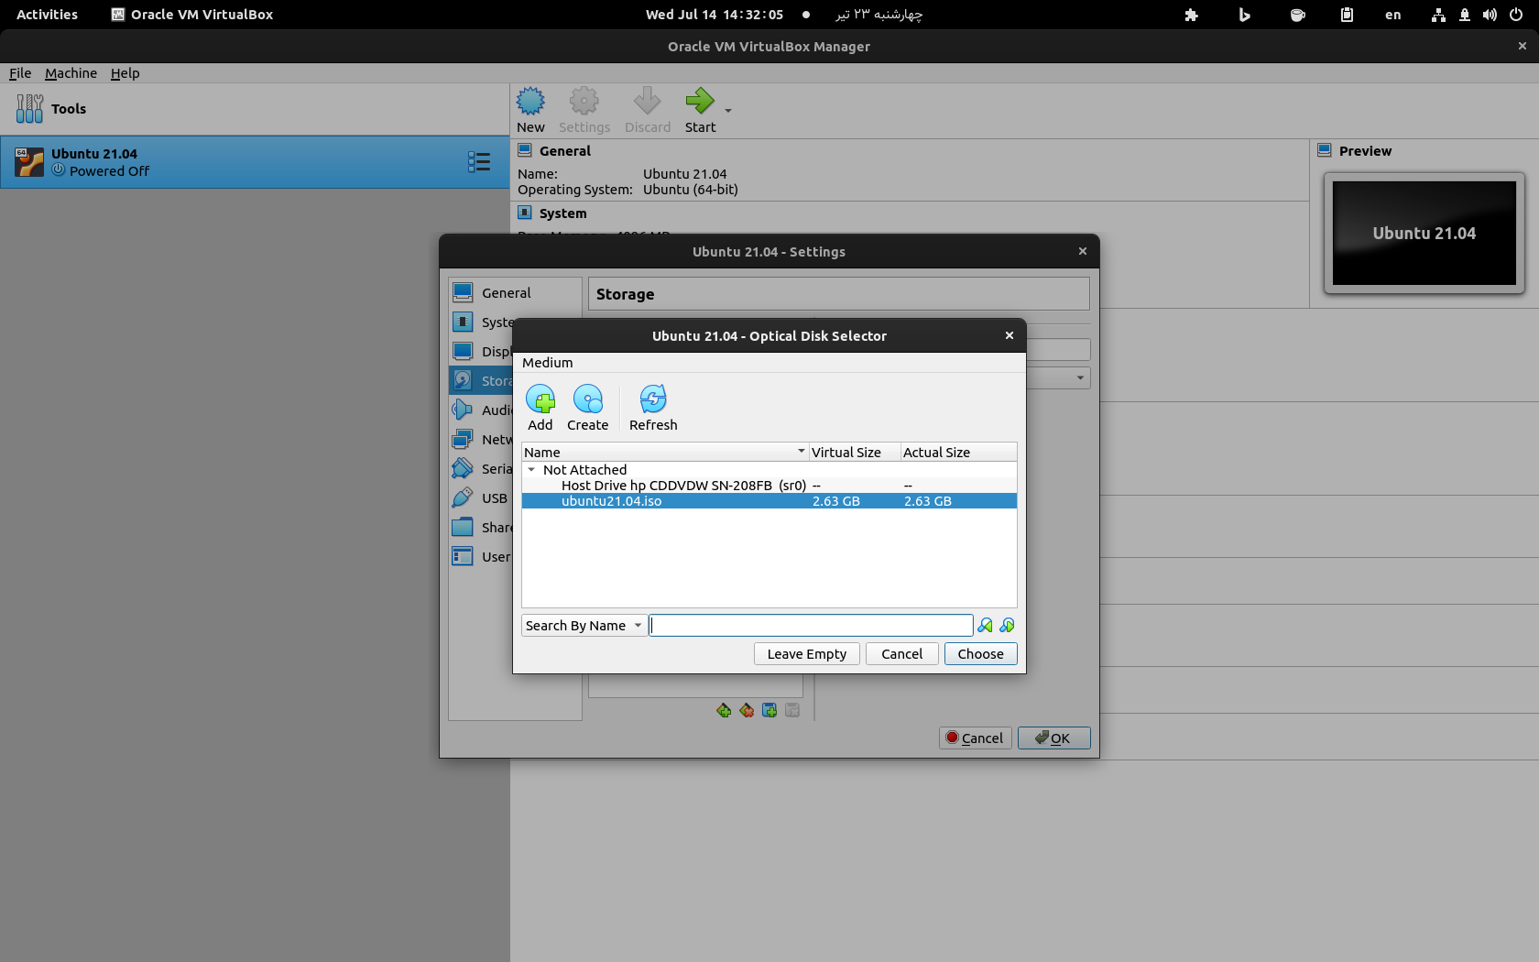
VirtualBox | Creating VM

Slide 13
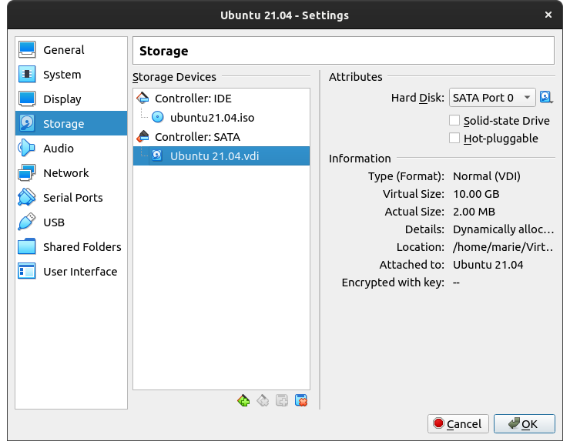

VirtualBox | Creating VM

Slide 14
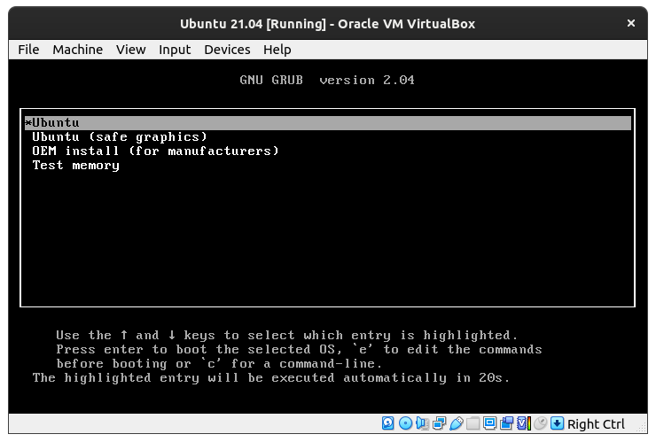
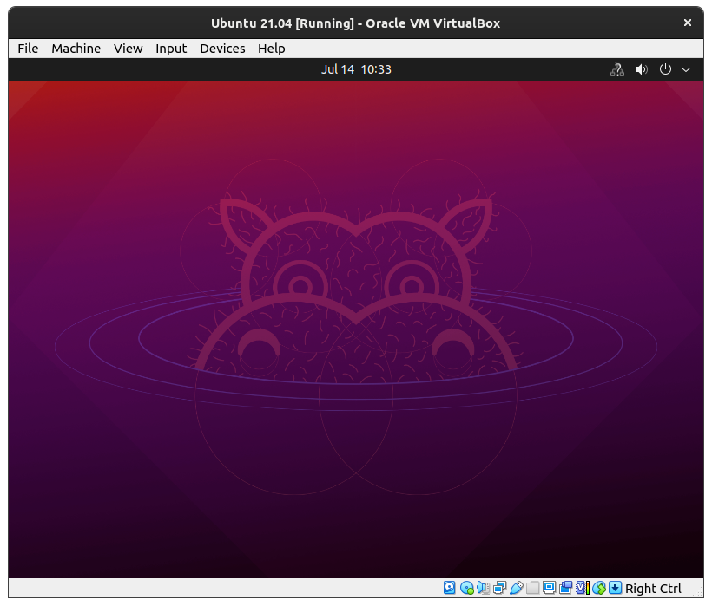
VirtualBox | Creating VM

Slide 15
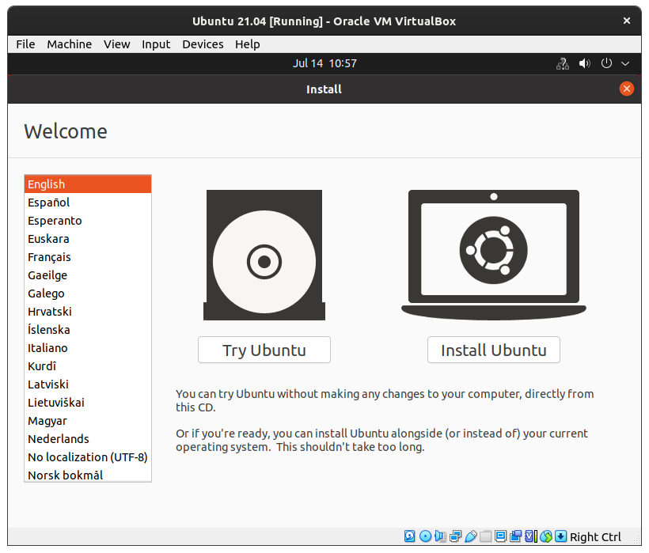
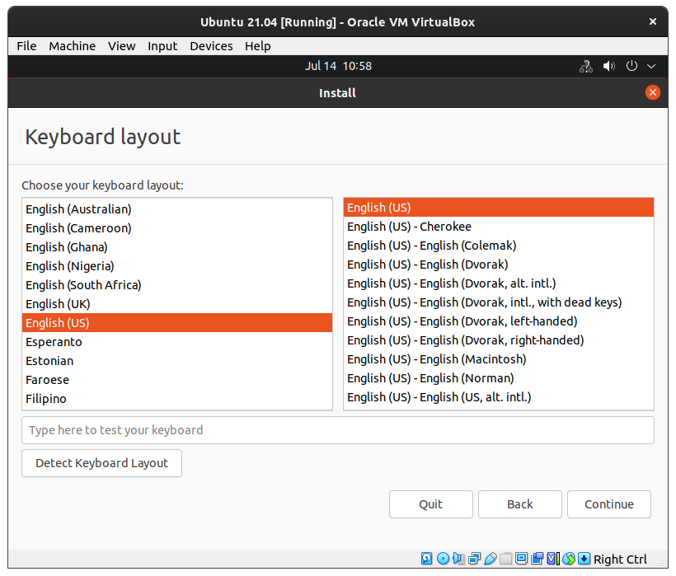
VirtualBox | Creating VM

Slide 16
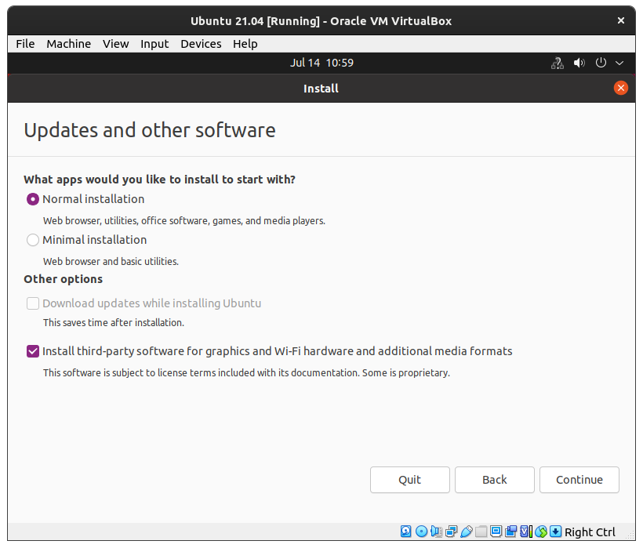
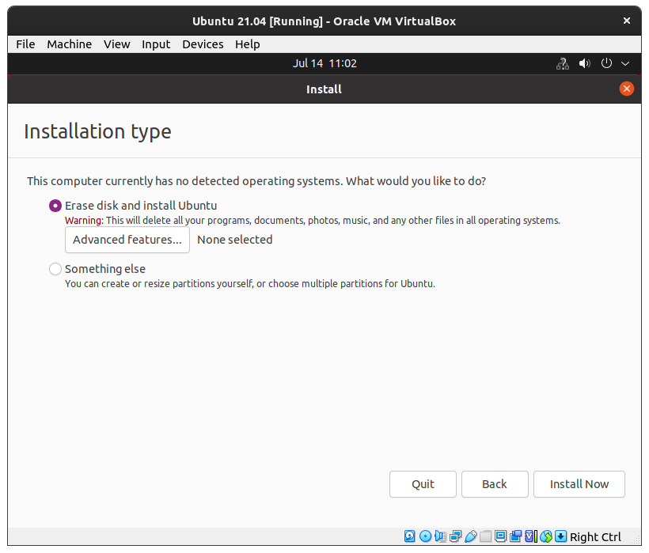
VirtualBox | Creating VM

Slide 17
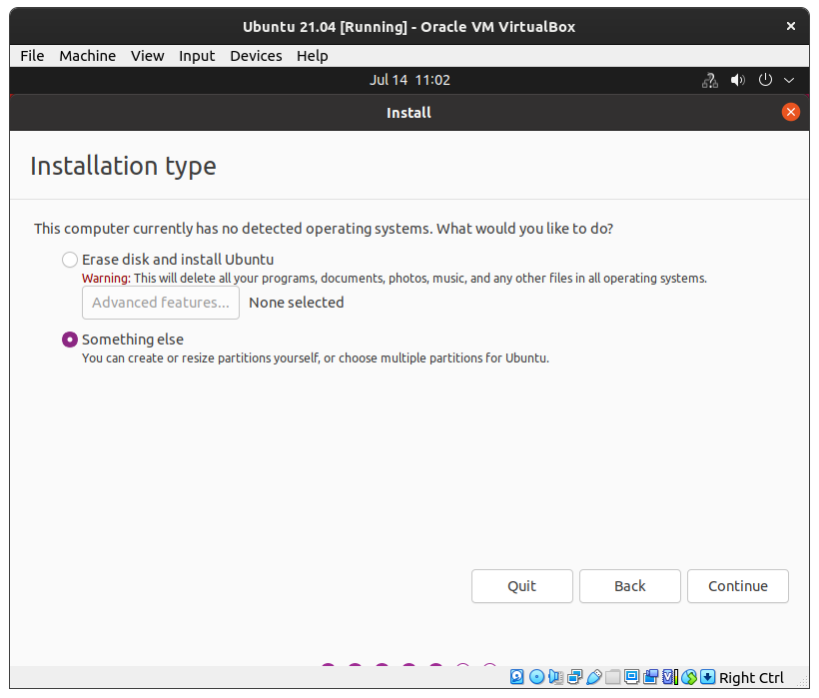
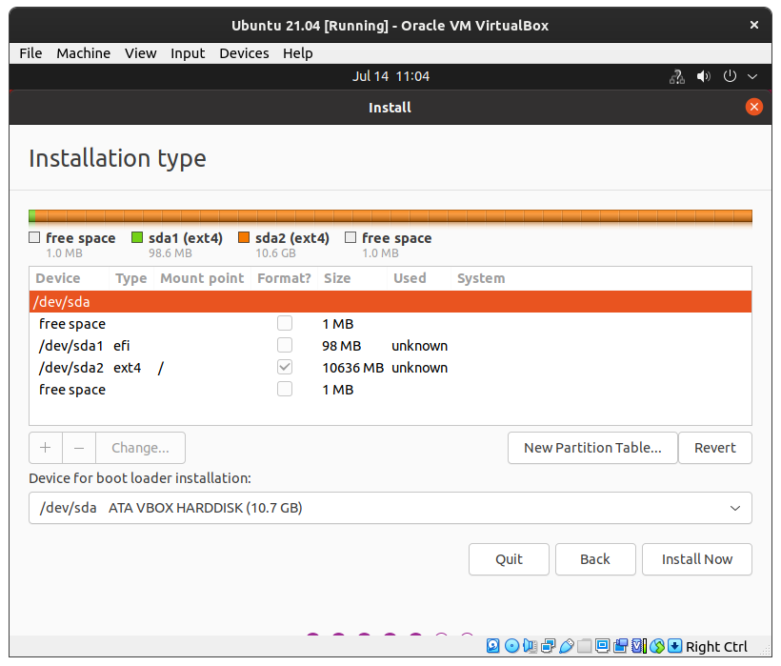
VirtualBox | Creating VM

Slide 18
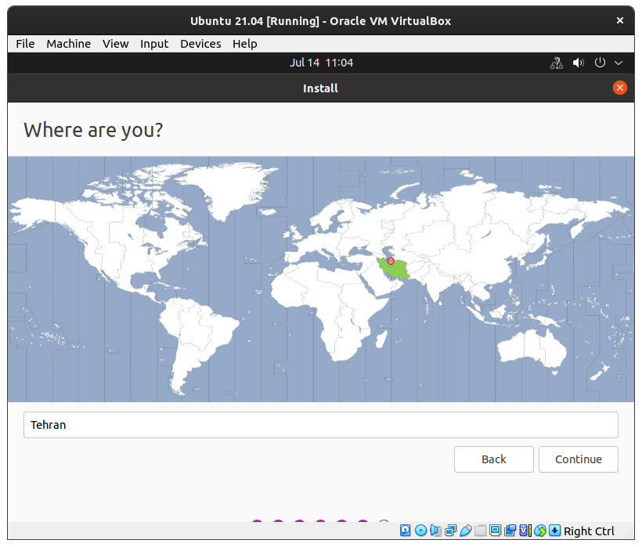
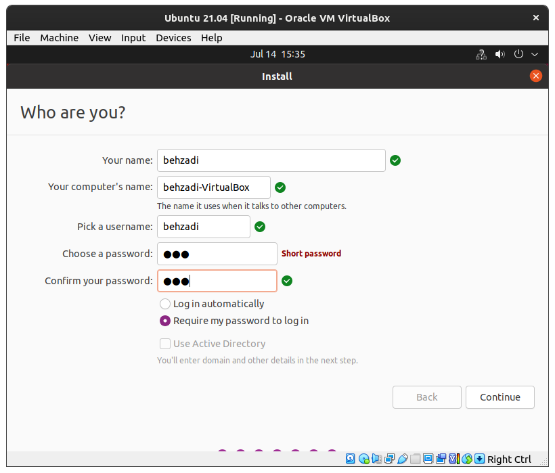
VirtualBox | Creating VM

Slide 19
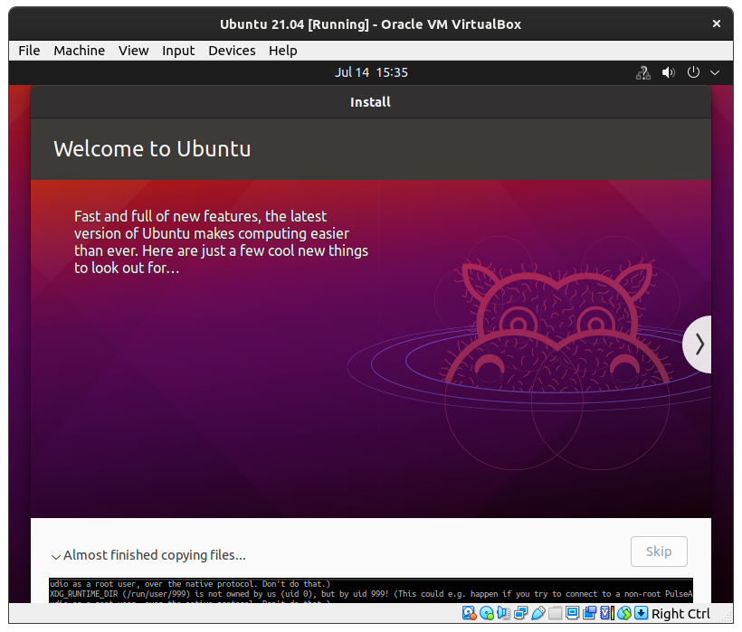
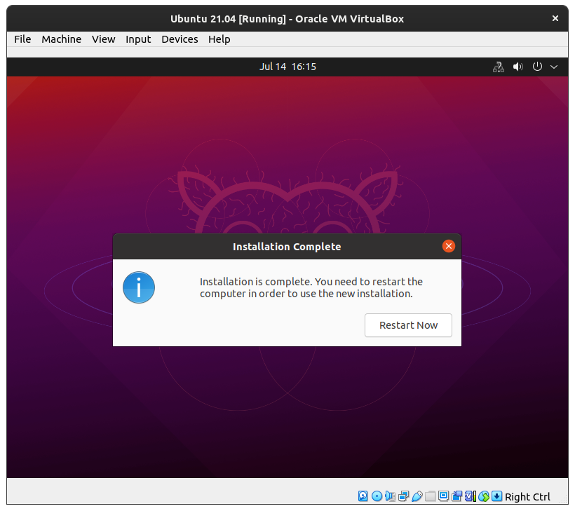
VirtualBox | Creating VM

Slide 20
BIOS vs UEFI
What’s The Difference?

Slide 21
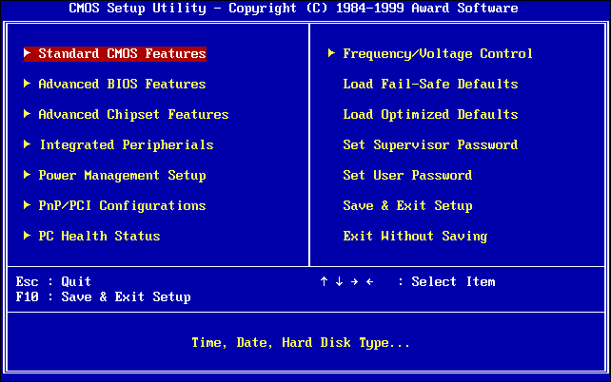
BIOS
Basic Input/Output System
The BIOS is where hardware meets software for the first time, and where all the boot magic begins.
The BIOS is used to perform hardware initialization during the booting process (power-on startup), and to provide runtime services for operating systems and programs.
The BIOS code is baked into the motherboard of your PC, usually stored on what is called an EEPROM 1 and is considerably hardware-specific.
The BIOS will soon be dead.

Slide 22
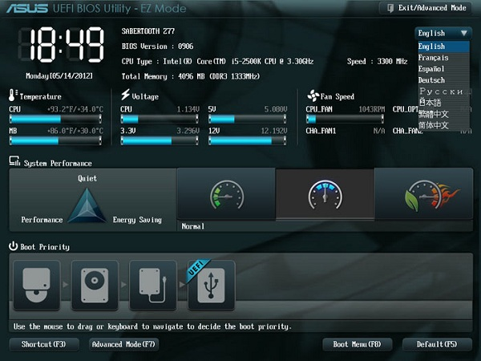
UEFI
Unified Extensible Firmware Interface
UEFI is a more modern and enhanced solution for BIOS.
UEFI Supports larger hard drives, faster boot times, more security features, and—conveniently—graphics and mouse cursors.
Most UEFI implementations provide BIOS emulation so you can choose to install and boot old operating systems that expect a BIOS instead of UEFI, so they’re backwards compatible.
UEFI Supports Secure Boot.

Slide 23
GPT vs MBR
Partition Tables: What’s The Difference?

Slide 24
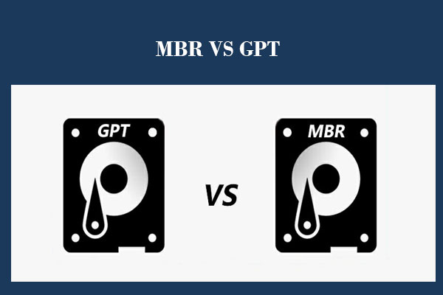
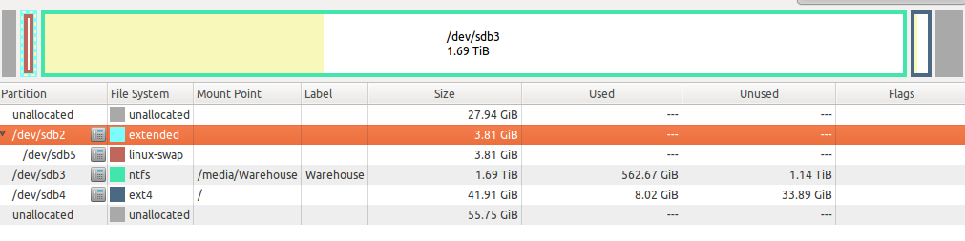
What is Partition Table?
A partition table is a table maintained on a disk by the operating system.
If the partition table is lost, users can not normally write data on disk.
It outlines and describes the partitions on that disk.
Partition table can describe the partitions on disk.
[Info on Partitions, Begin and End Point, Bootable]

Slide 25
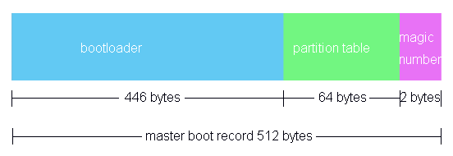
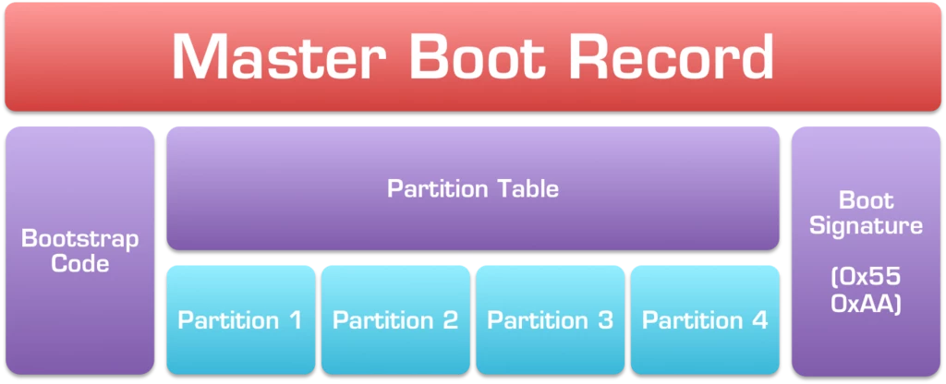
MBR Partition Table
Master Boot Record
  The MBR is a special type of boot sector
  The MBR is located at the very beginning of partitioned computer mass storage devices
  The MBR holds the info on how the logical partitions, containing file systems, are organized on that medium.
  The MBR also contains executable code to function as a loader for the installed operating system (Boot Loader).

Slide 26
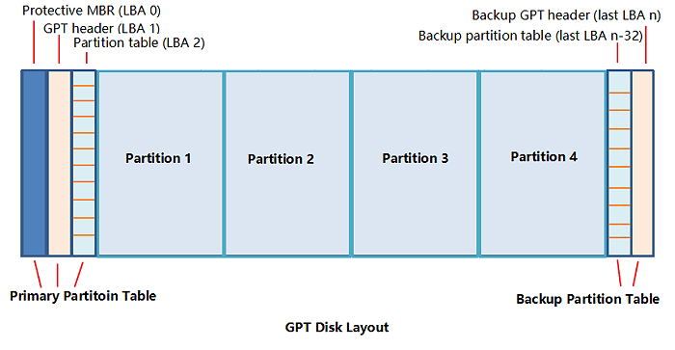
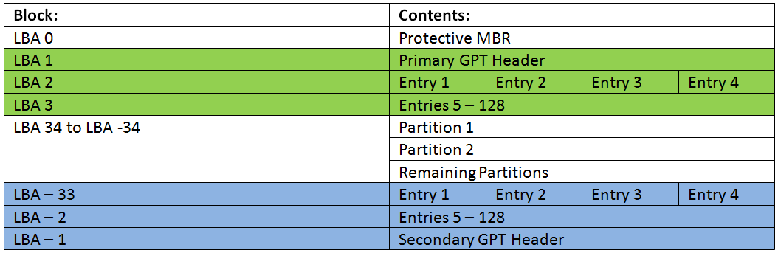
GPT Partition Table
GUID Partition Table
  The GPT is the new standard for the layout of partition tables of a physical storage device.
  The GPT is a part of UEFI Standard, yet it is also used for some BIOS systems.
  All Modern computers and Operating Systems support GPT. Some of them, including macOS and Windows may support GPT partitions only on systems with EFI support, but FreeBSD and most Linux Distros can boot from GPT Partitions with either BIOS or EFI.

Slide 27
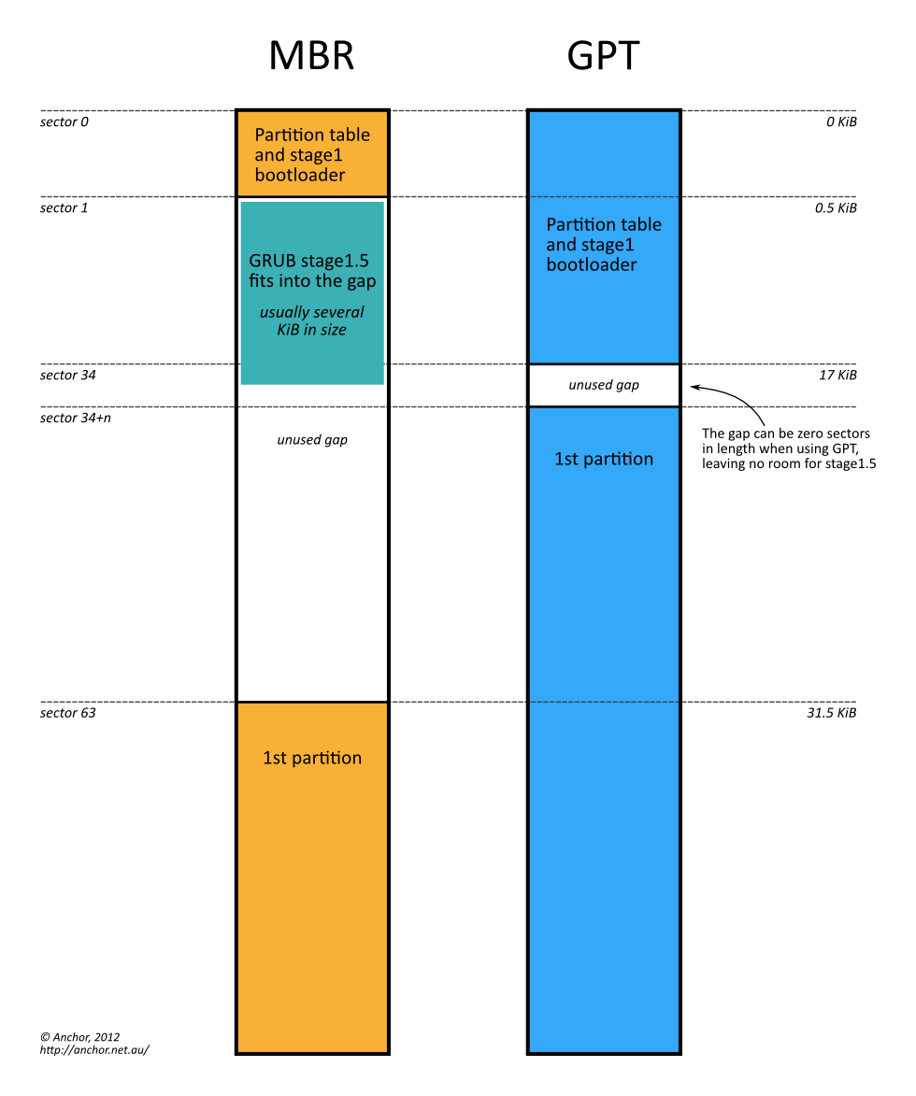
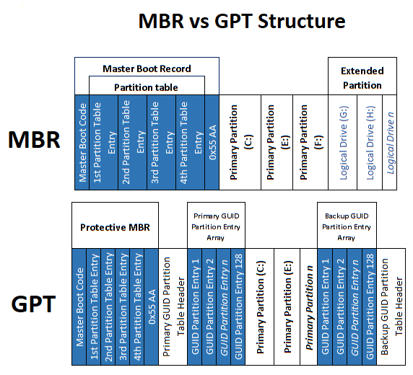
GPT vs MBR

Slide 28

GPT vs MBR
GPT
  - GPT-based drives can be much larger
  - GPT also allows for a nearly unlimited number of partitions:
    The Only Limitation Would be your OS
    Windows allows up to 128 partitions on a GPT drive
  - GPT is more Robust and can recover if the data is corrupted
MBR
  - only works with disks up to 2 TB in size
  - only supports up to four primary partitions
  - the partitioning and boot data is stored in one place
    If this data is overwritten or corrupted, you’re in trouble

Slide 29
Linux FHS
Linux Filesystem Hierarchy Standard

Slide 30
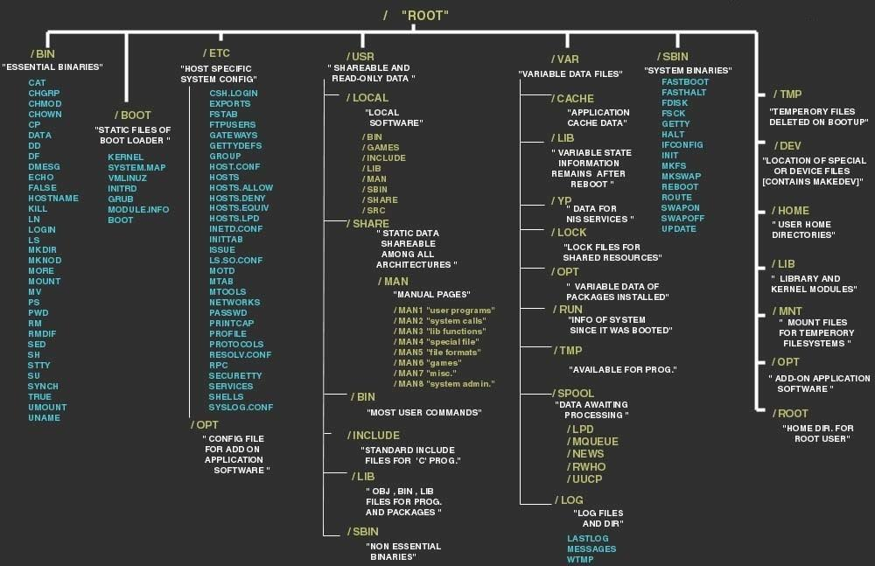

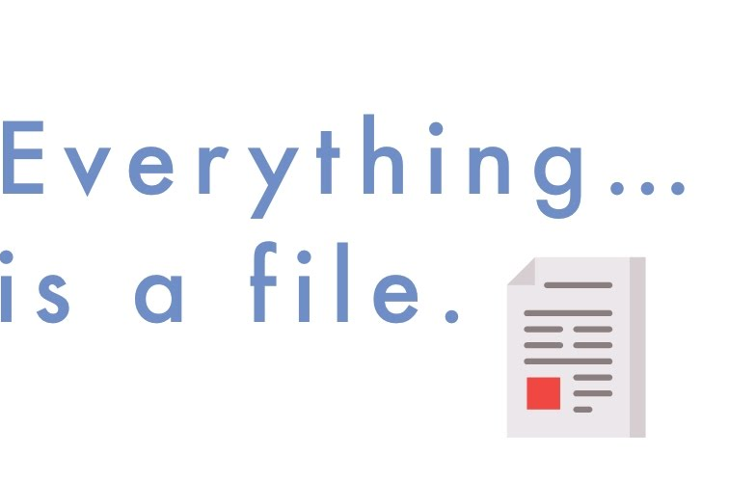
Filesystem Hierarchy Standard

Slide 31
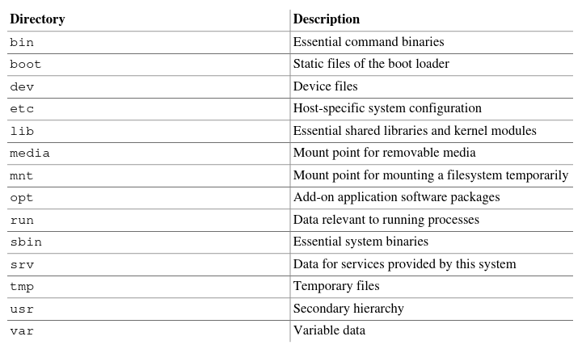
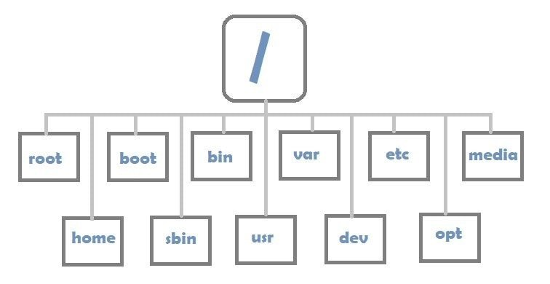
Filesystem Hierarchy Standard

Slide 32
Ubuntu
Humanity to Others

Slide 33
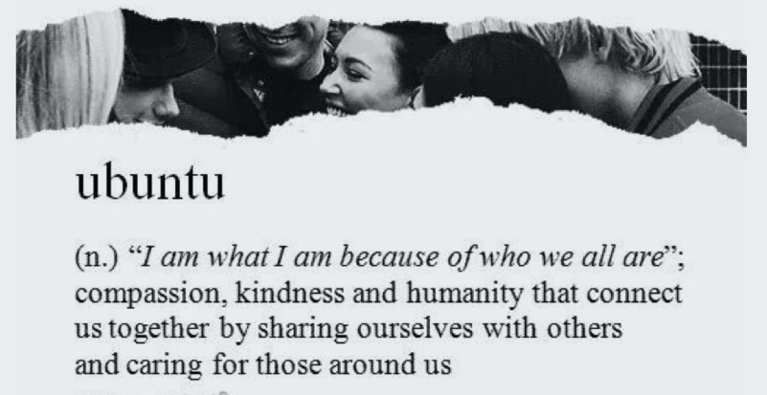

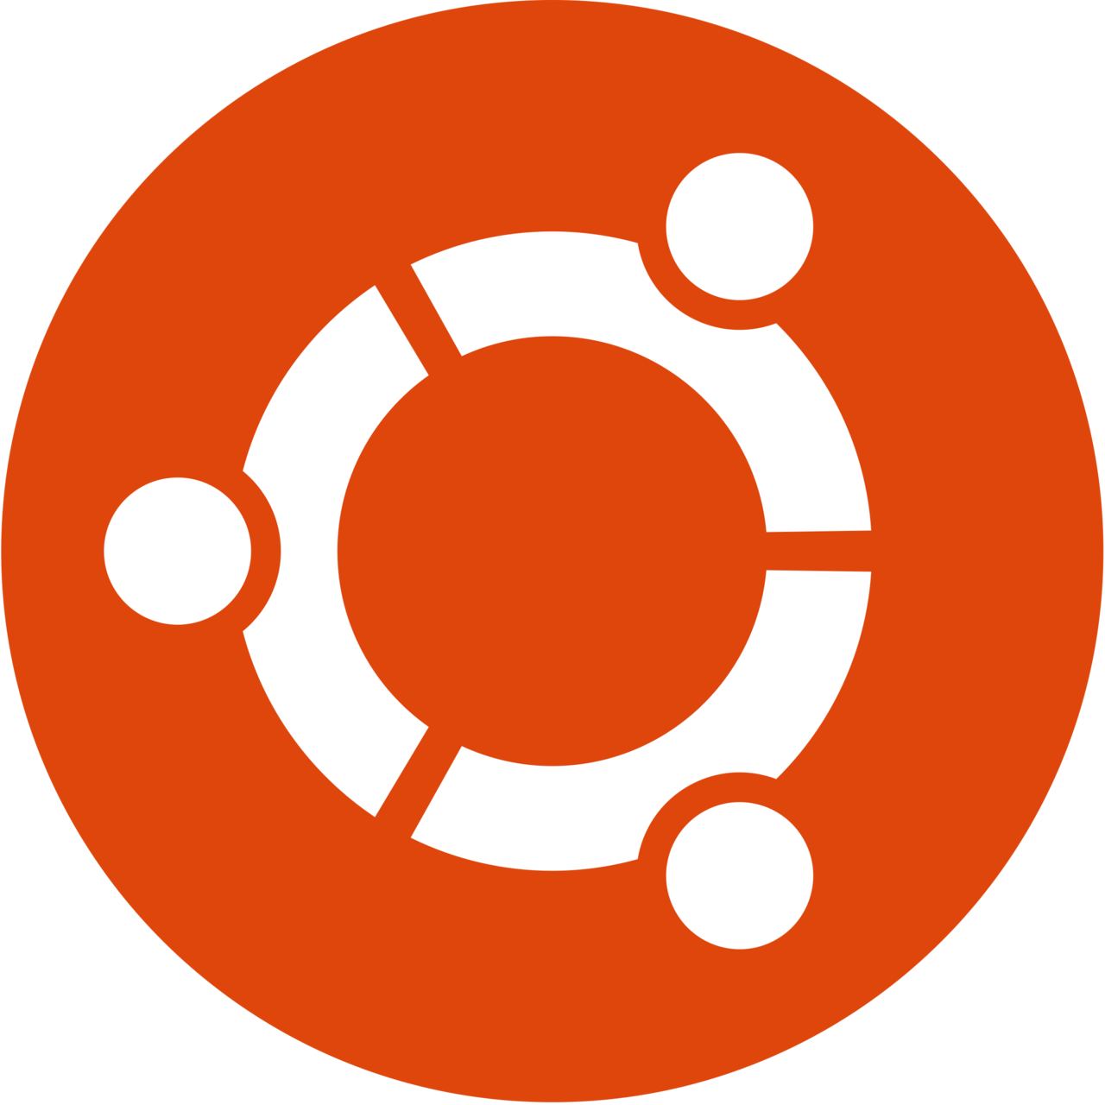
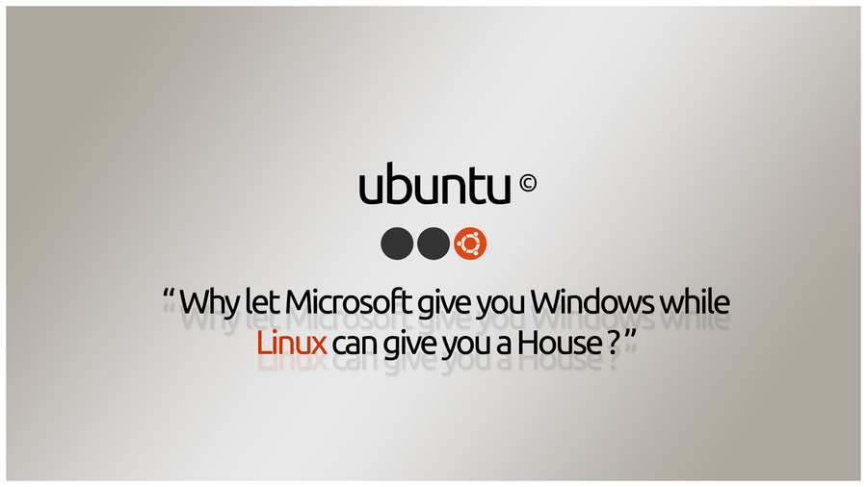
Ubuntu Meaning

Slide 34
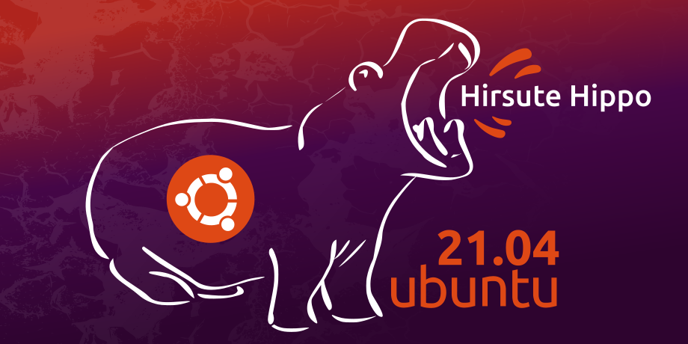
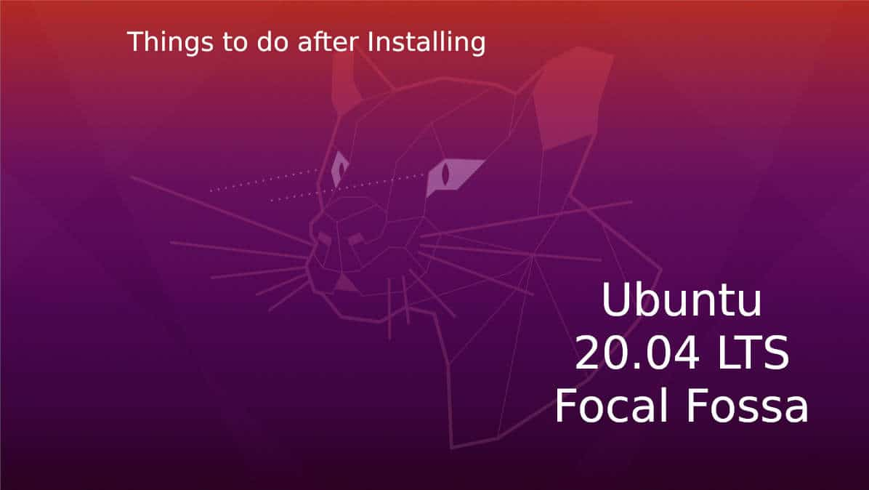
Ubuntu Background
One of the most popular Linux Distributions
Free and Open-Source
Based on Debian
Developed by Canonical + other developers
Three different editions: Server, Desktop, Core
Two different release types:
  Standard (release every 6 months, support for 9 months) and LTS (release every 2 years, support for 5 years)

Slide 35
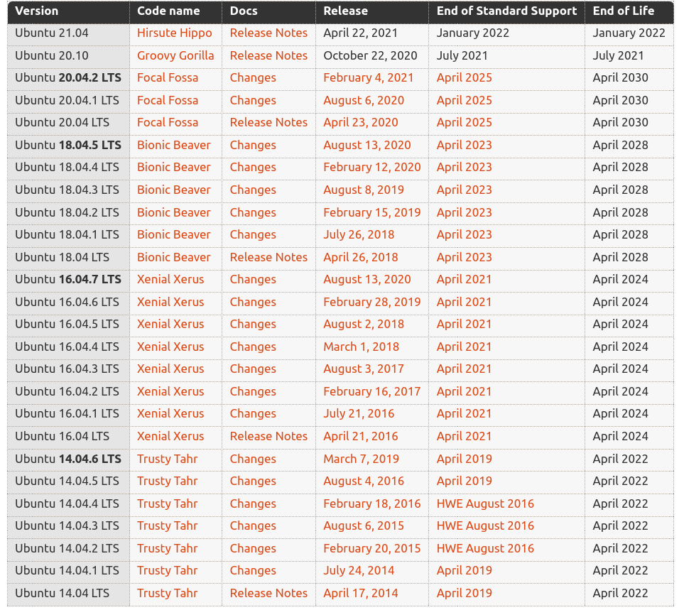
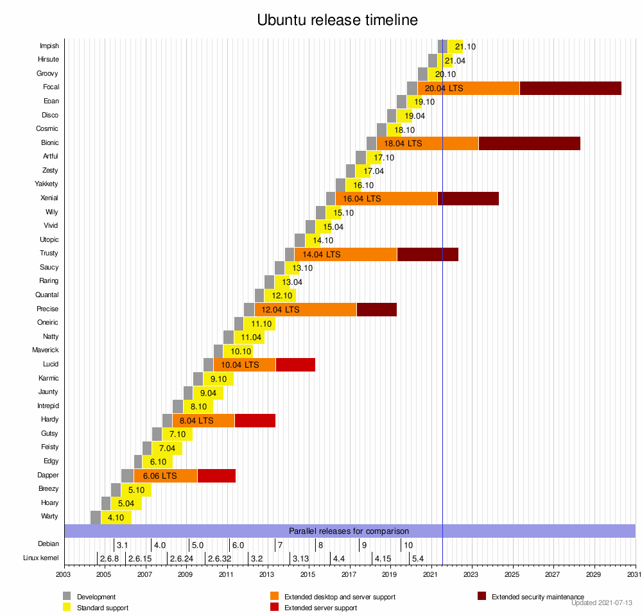
Ubuntu Releases

Slide 36
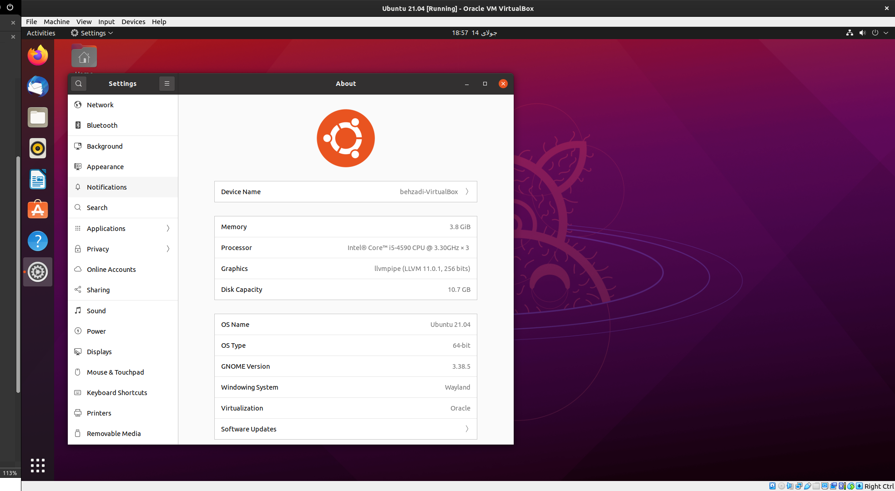

Gnome Desktop

Slide 37

mariebehzadi@gmail.com
https://hiva-iot.com

