Slide 1
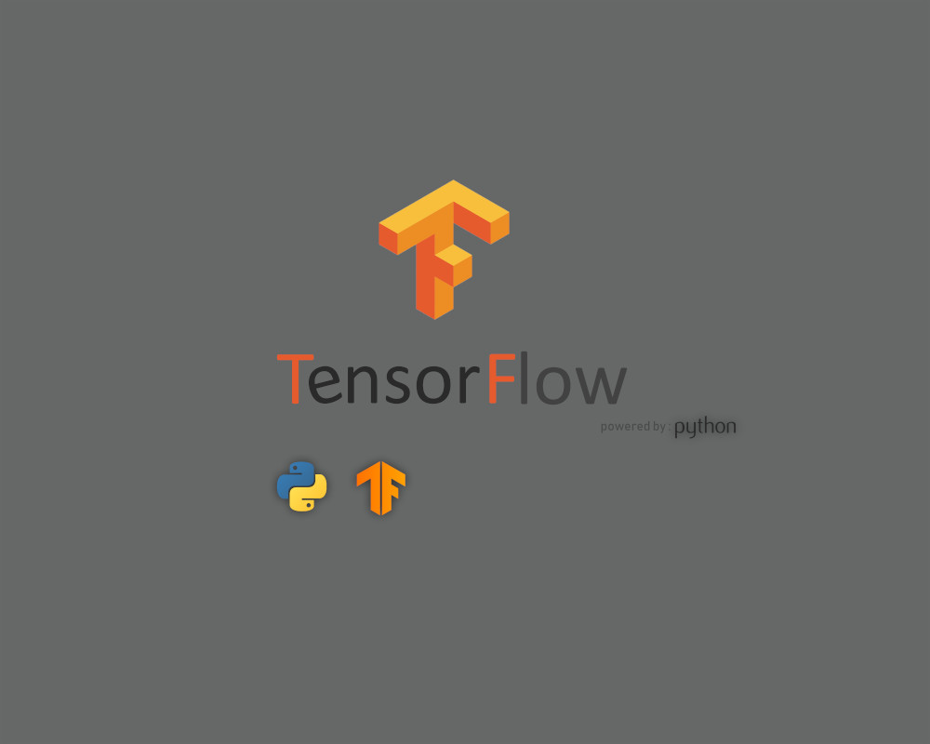





by M. Behzadi
9/6/19

Slide 2
Introduction

Slide 3


What is Tensorflow?
Open-source
Library
Created by Google Brain Team
Numerical Computation
Machine Learning
Deep Learning
High Performance (C++)
Convenient front-end API
(Python, JavaScript, C++, Java, Go, C# and Julia)
CPU/GPU/TPU Support

Slide 4
History
Created by Google Brain Team
Was part of a Google Product named DistBelief
Open Sourced in late 2015
Under Apache License
(Use, Modify, Redistribute, Sell)
First Stable version in 2017
Latest Release: Tensorflow 1.13.2
TensorFlow 2.0 RC released on Aug 23

Slide 5











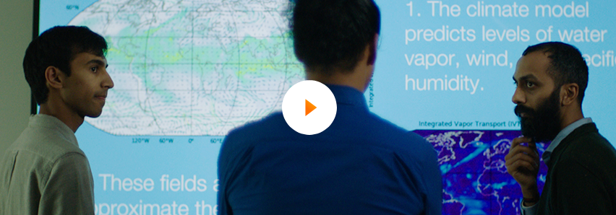






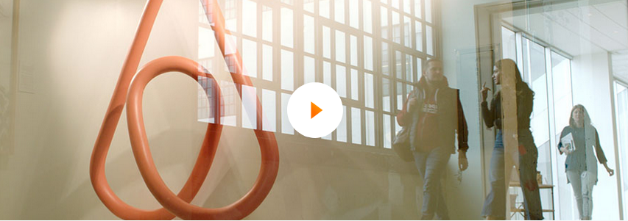



Who is using Tensorflow?
Researchers
Data Scientists
Programmers
Notes:
Google: search engine, translation, recommender system, photo captioning, google cloud
Airbnb: photo captioning, image classification, object detection
Coca cola: OCR and read product codes
Paypal: Fraud Detection
Qualcomm: Hexagon 682 DSP (DSP better results than CPU on mobile)
Sinovation Ventures: Detecting Disease on OCT images of Retina
GE Healthcare: identify specific anatomy during a brain MRI exam
Twitter: Ranking tweets on Timeline

Slide 6
Where can Tensorflow run?
Development Phase (Training)
  Your Desktop or laptop
  Multiple machines
Run Phase (Test)
  Desktop running Windows, macOS or Linux
  Cloud as a web service
  Mobile devices like iOS and Android

Slide 7
Language Support
C++ as TF core
Python 2.7/3.4-3.7
JavaScript (tensorflow.js)
Rust
R
Golang
Java
C#
Julia

Slide 8











Other Rivals

Slide 9

Deep Learning Framework Power Scores (2018)
Kaggle Kernel
Article

Slide 10
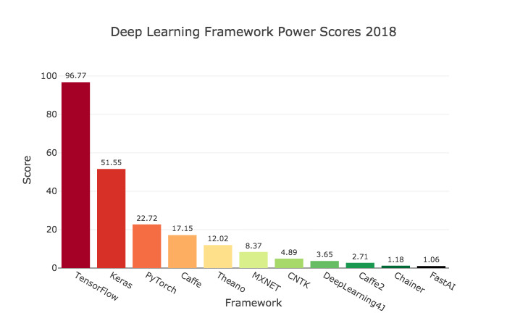
Comparison (2018)

Slide 11
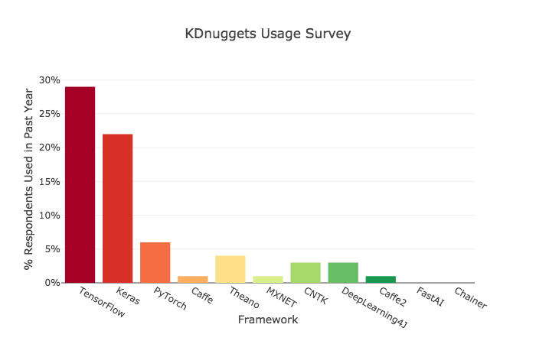
Comparison (2018)

Slide 12
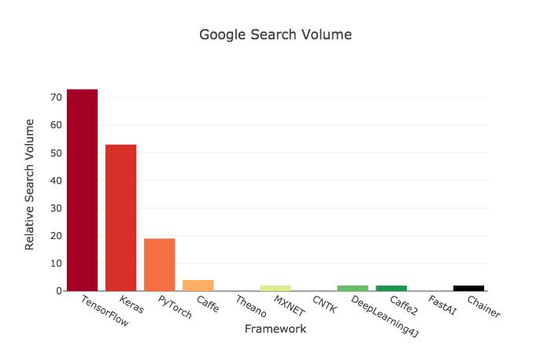
Comparison (2018)

Slide 13
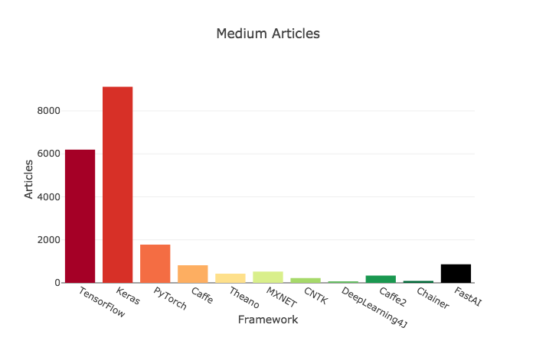
Comparison (2018)

Slide 14
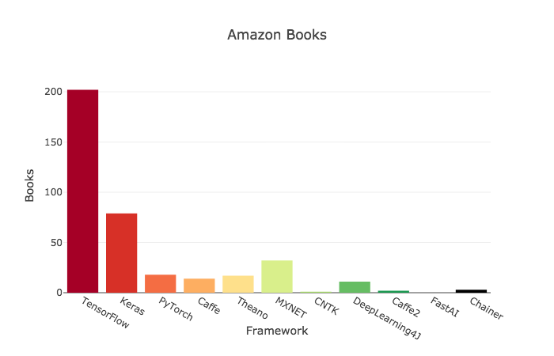
Comparison (2018)

Slide 15
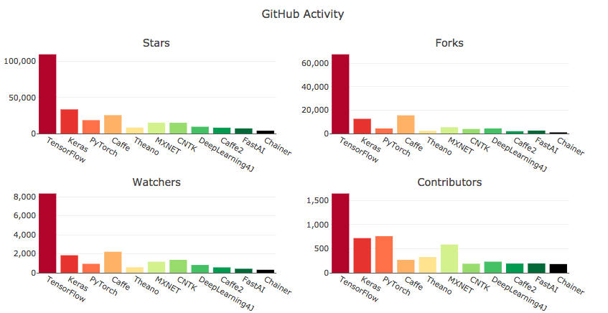
Comparison (2018)

Slide 16
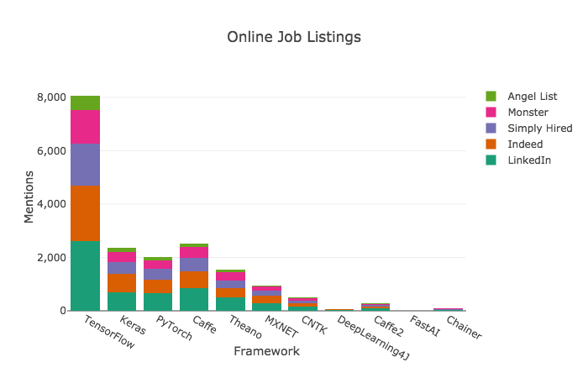
Comparison (2018)

Slide 17
Which Deep Learning Framework is Growing Fastest?
(2019)
Kaggle Kernel
Article

Slide 18
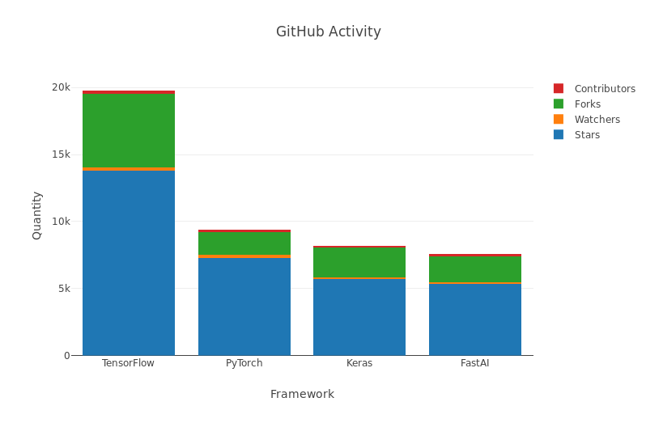
Comparison (2019)

Slide 19
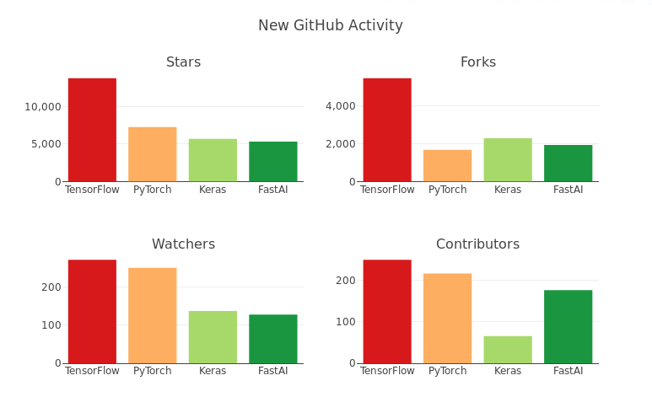
Comparison (2019)

Slide 20
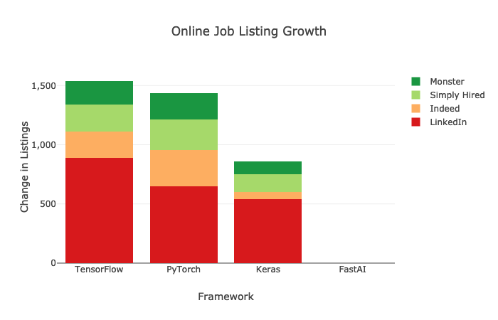
Comparison (2019)

Slide 21
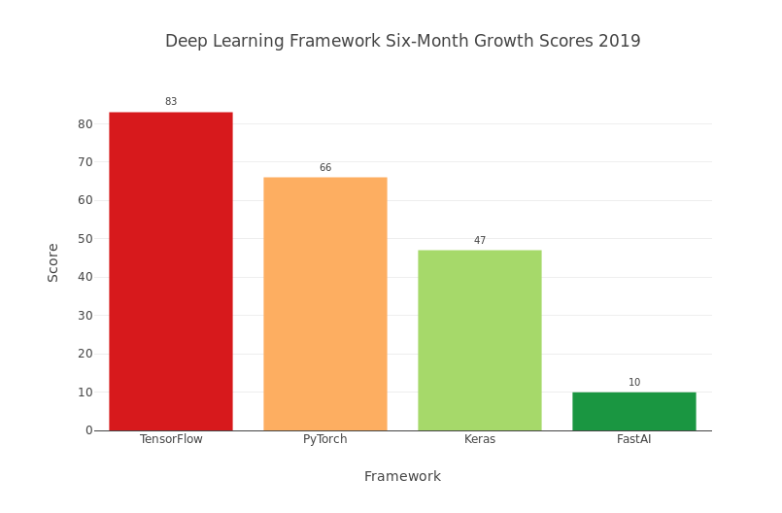
Comparison (2019)

Slide 22
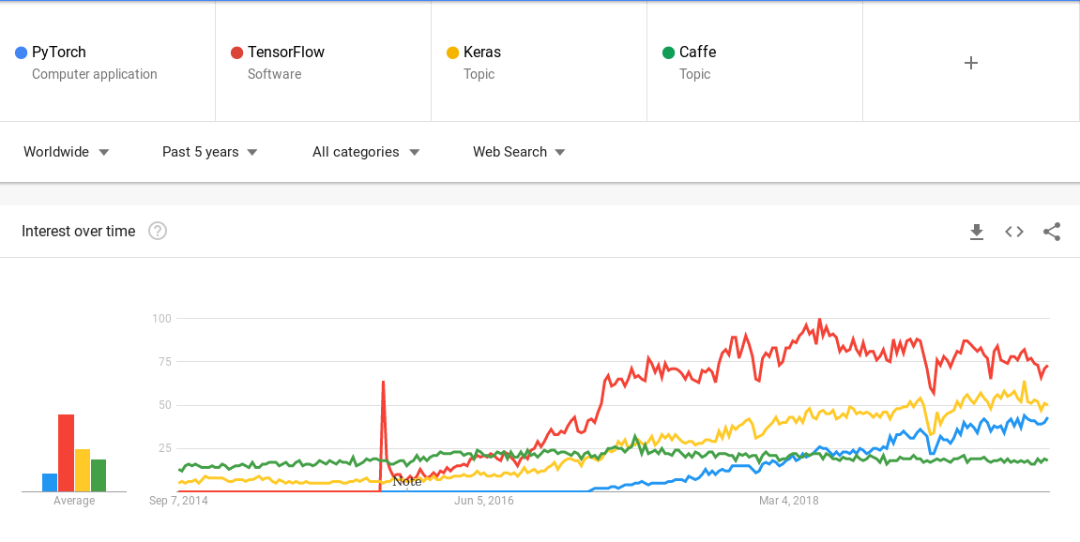
Comparison (2014-2019)

Slide 23
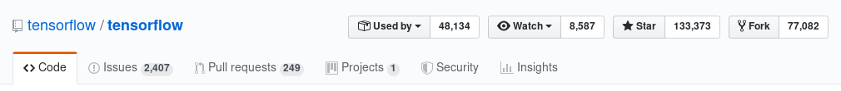
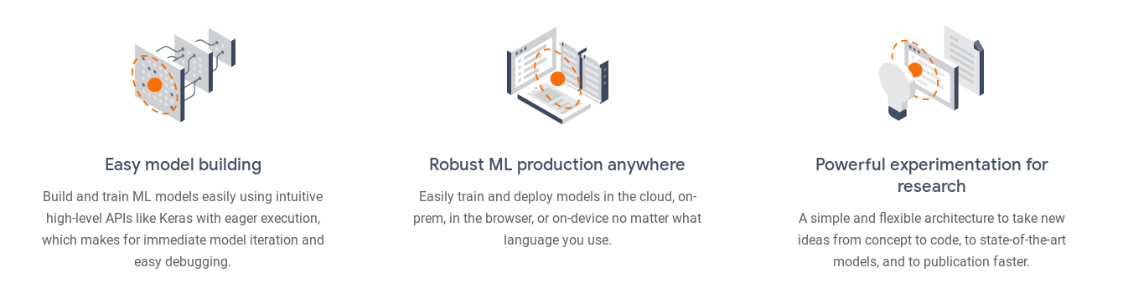
Why Tensorflow?

Slide 24


Features of Tensorflow
Open source
Easy Model Building
Popularity
Good support of ML and DL concepts
Multiple CPU/GPU computing
High Scalability
Fast Compile
Documentation
Tensorboard for Visualization
Data and model parallelism
Multi-Language Support
Large Community
Production ready
Only supports Nvidia GPUs
Static computational graph
(in comparison with PyTorch)
Debugging
(in comparison with PyTorch)
Steep Learning Curve
(in comparison with PyTorch)
Speed
(in comparison with PyTorch)

Slide 25
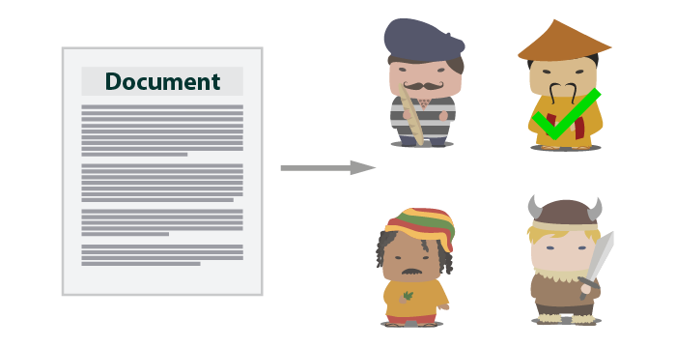

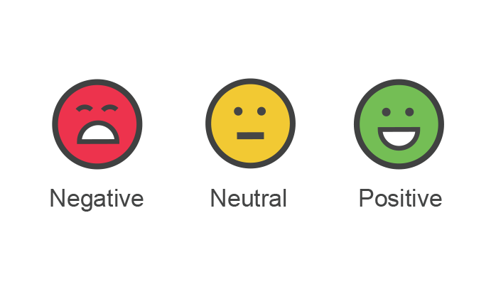
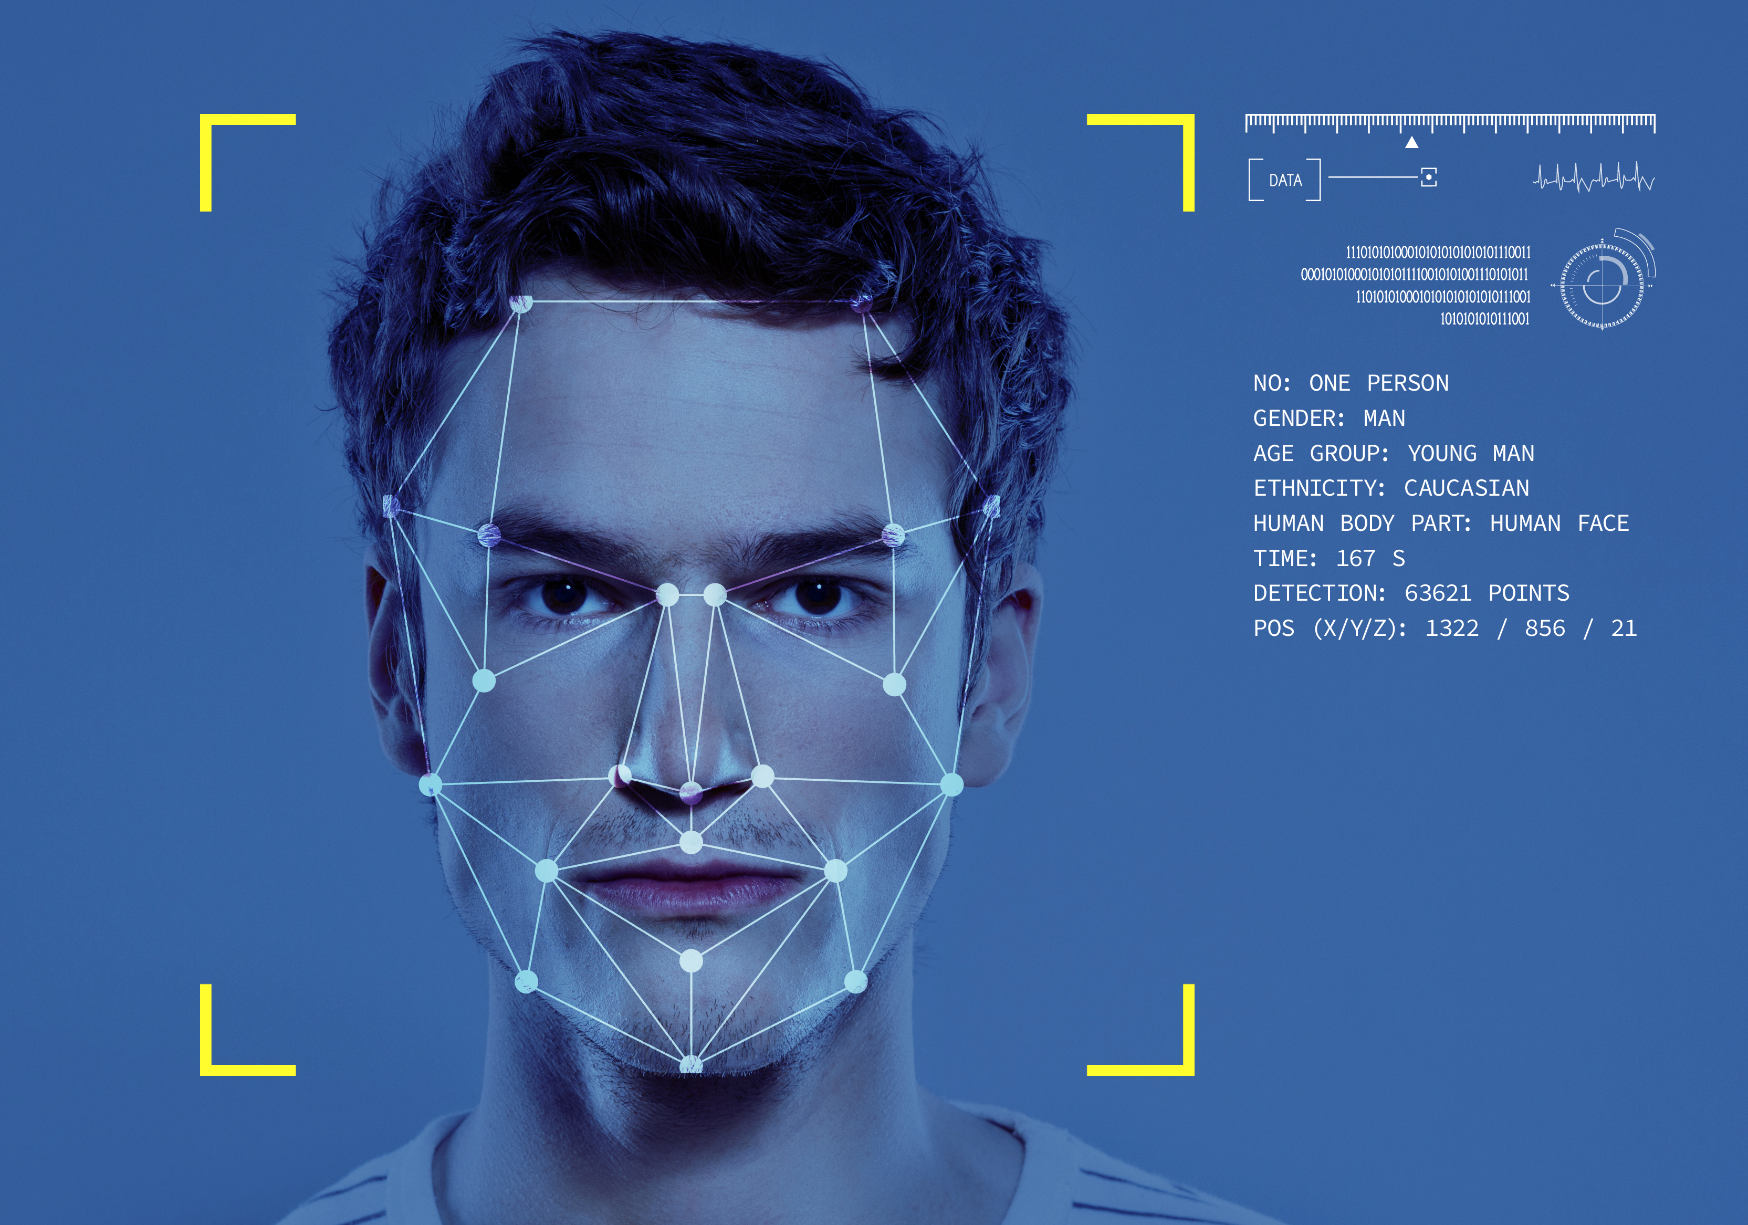

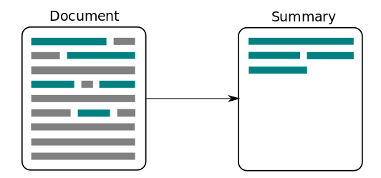


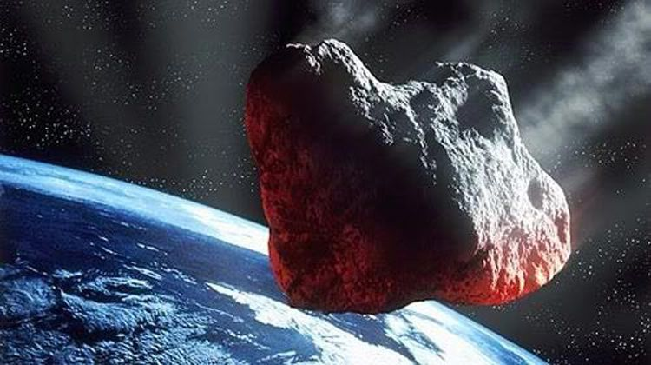
Applications of Tensorflow
Notes:
Voice Recognition and Detection:
Apple’s Siri, Google Now, Microsoft Cortana
Flaw Detection (engine noise)
Sentiment Analysis in CRM
Text-Based Applications
Language Detection (google over 100 lang)
Sentiment Analysis in CRM
Threat detection (social media, government, …)
fraud detection (insurance and finance)
text summarization
Image Recognition
Face Recognition
Image search
Feature detection (disease, pattern, object, …)
Time Series
Prediction (Stock Market, weather, crisis, …)
Recommendation Systems
Video Detection
Real-time (game, airports, ux/ui, …)
NASA (predict NEOs)

Slide 26
Tensorflow Installation

Slide 27
How to Install/Use Tensorflow?
Install Tensorflow Manually
  Ubuntu 16.04 or later
  macOS 10.12.6 (Sierra) or later (no GPU support)
  Windows 7 or later
  Raspbian 9.0 or later
Run a Tensorflow Container
  Tensorflow Docker Images in Docker Hub
Google Colab

Slide 28
Tensorflow Requirements
Hardware requirements for CPU
  Starting with TensorFlow 1.6
  binaries use AVX instructions which may not run on older CPUs.
Hardware requirements for GPU
  NVIDIA® GPU card with CUDA® Compute Capability 3.5 or higher
  See the list of CUDA-enabled GPU cards
Software requirements for GPU
  NVIDIA® GPU drivers —CUDA 10.0 requires 410.x or higher.
  CUDA® Toolkit —TensorFlow supports CUDA 10.0 (TensorFlow >= 1.13.0)
  CUPTI ships with the CUDA Toolkit.
  cuDNN SDK (>= 7.4.1)
  (Optional) TensorRT 5.0 to improve latency and throughput for inference on some models.

Slide 29
Tensorflow Basics

Slide 30
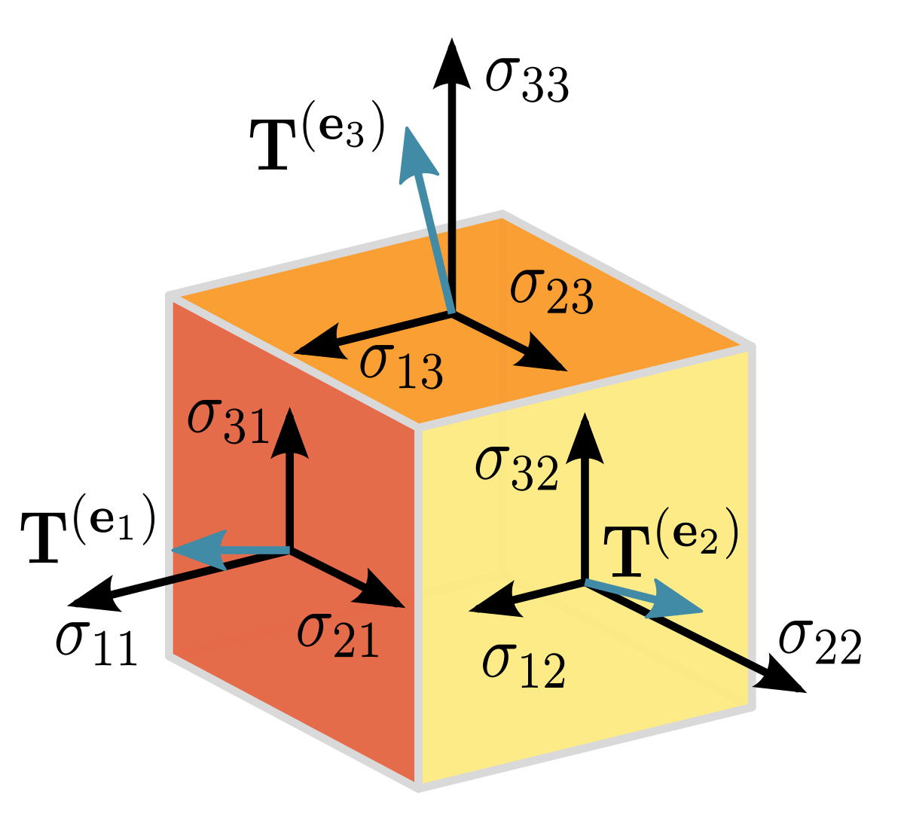
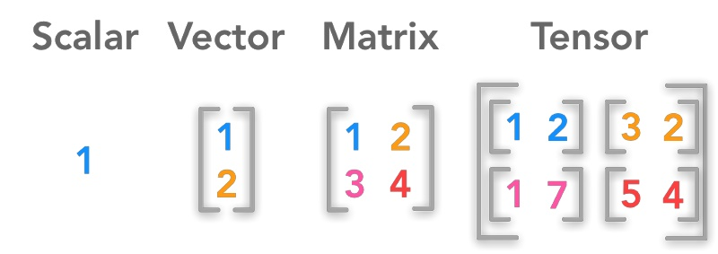
What is a Tensor?
The basic data structure in Tensorflow
A Mathematic (linear algebra) concept
Generalization of vectors and matrices
Typed
Multidimensional array
With additional operations
Modeled in tensor object

Slide 31
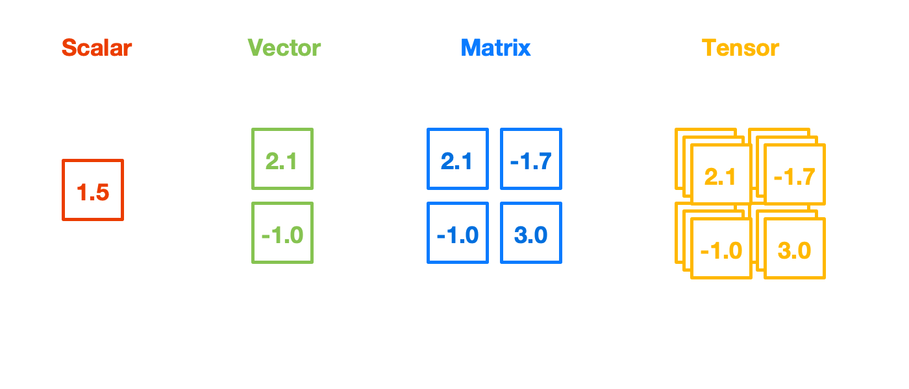
What is a Tensor?

Slide 32
Tensor Properties
Rank | Entity | Shape | Example
0 | Scalar | [] | 4.5 | shape=( ) | dtype=float32
 |  |  | ‘hi’ |  | dtype=string
1 | Vector | [D₀] | [1,2,3] | shape=(3, ) | dtype=int32
2 | Matrix | [D₀, D₁] | [ [1,2,3,4], [5,6,7,8] ] | shape=(2, 4 ) | dtype=int32
3 | 3-tensor | [D₀, D₁, D₂] | [ [ [1,2], [3,4] ], [ [5,6], [7,8] ]] | shape=(2, 2, 2) | dtype=int32
n | n-tensor | [D₀, D₁, …, D_{n-1}] | ... | ...

Slide 33
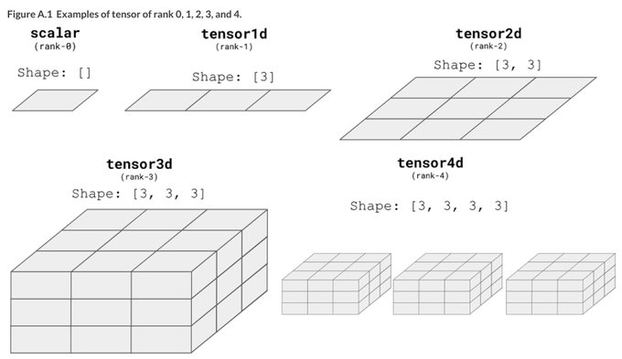
Tensor Properties
Rank
Shape
Type

Slide 34
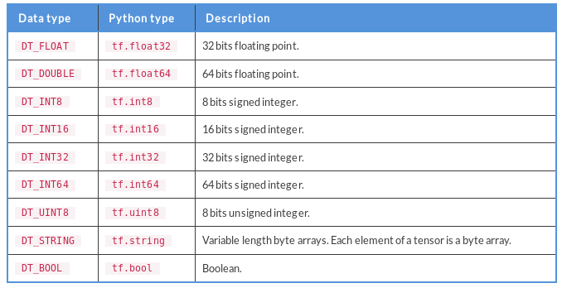
Tensor Data Types

Slide 35
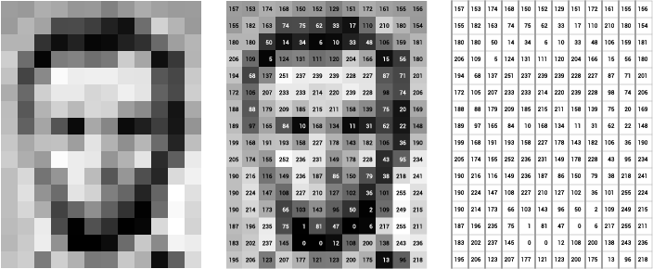
Tensors are Everywhere!
height
height
width
width

Slide 36
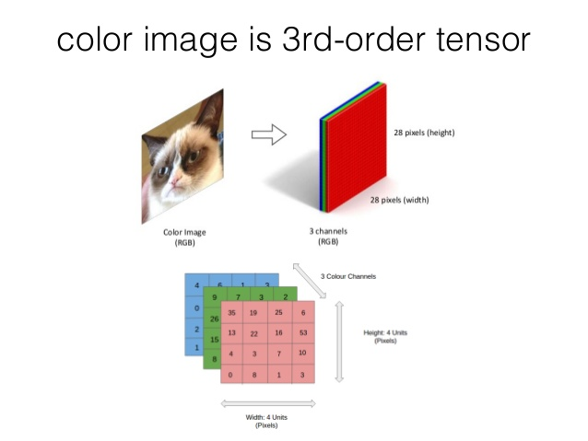
Tensors are Everywhere!

Slide 37
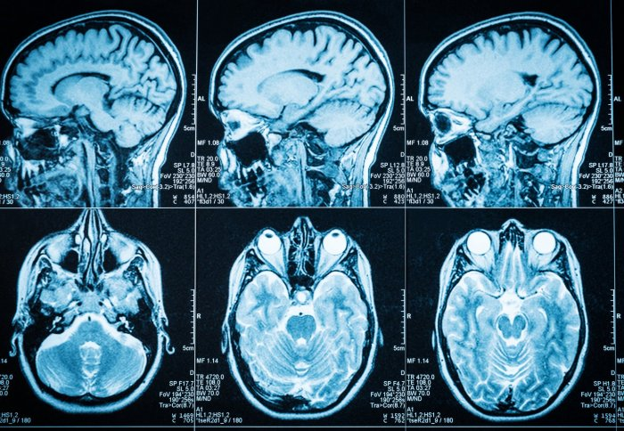
Tensors are Everywhere!

Slide 38
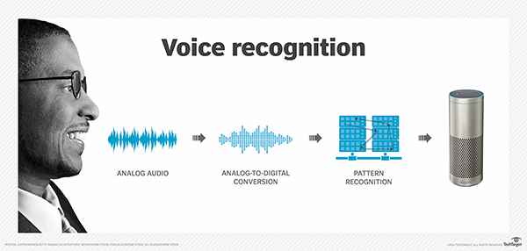
Tensors are Everywhere!

Slide 39
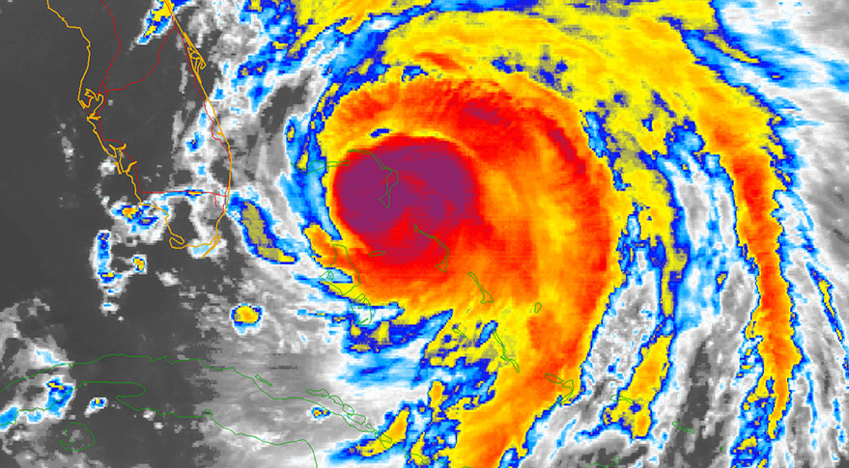
Tensors are Everywhere!

Slide 40
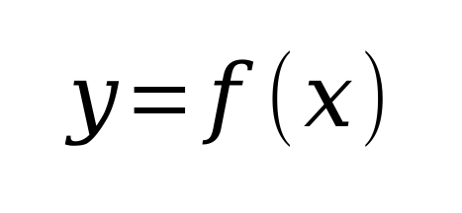
Operations or Ops
Anything you can do with a Tensor is an Operation
Operation
x
f
y
Operation Node
Output Tensor
Input Tensor

Slide 41
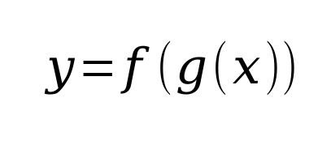
Computational Graph
Composition of Operation nodes
Every equation in linear algebra could be demonstrated as graph
x
y
g
f
Notes:
Linear Algebra covers almost everything in Machine Learning

Slide 42
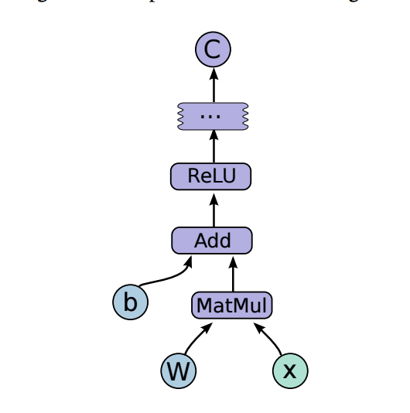
Computational Graph

Slide 43
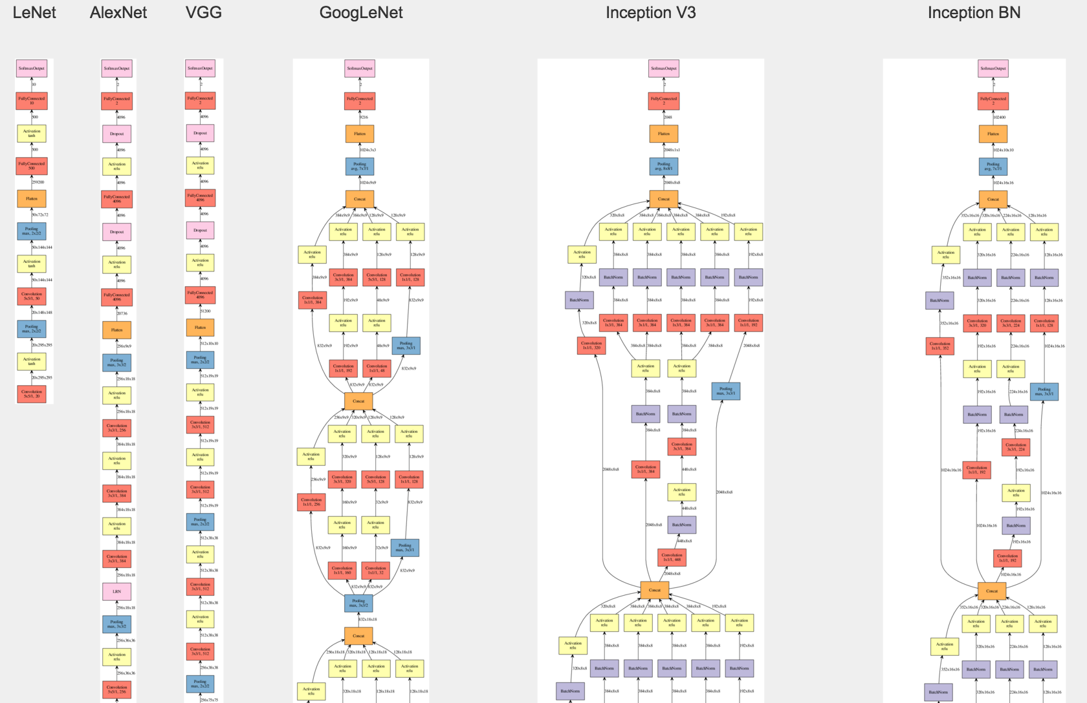
Computational Graph

Slide 44
Complicated Computational Graph
Needs a powerful framework
  Algorithmic Optimization
  Parallel/Distributed Support
  Memory Efficient
  Multi-Device
  Fast Op Implementation
  Visualization

