Slide 1
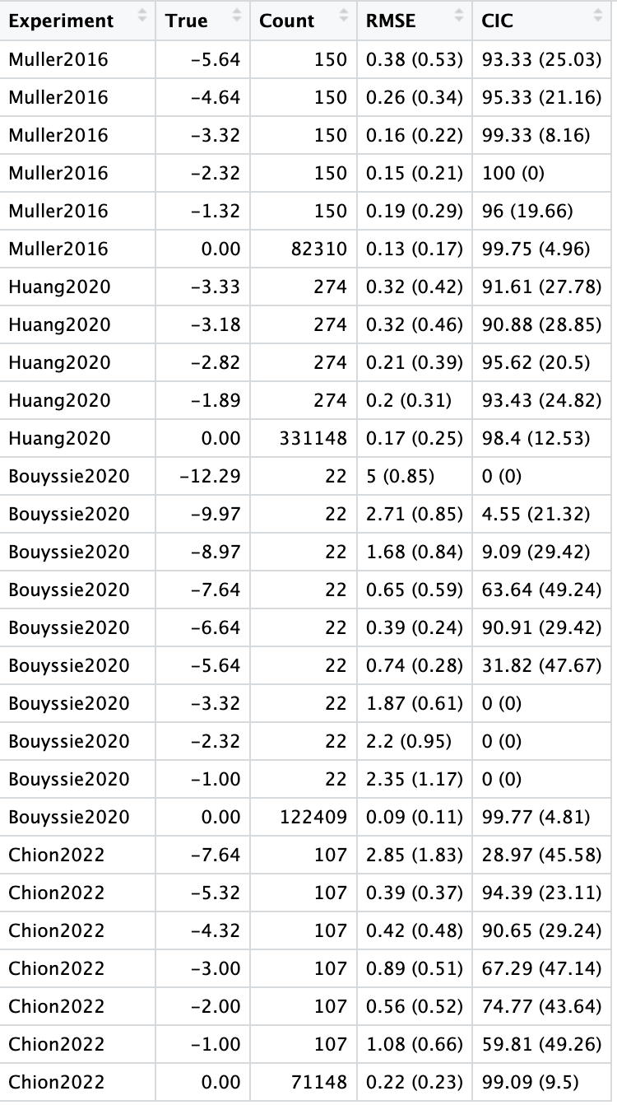
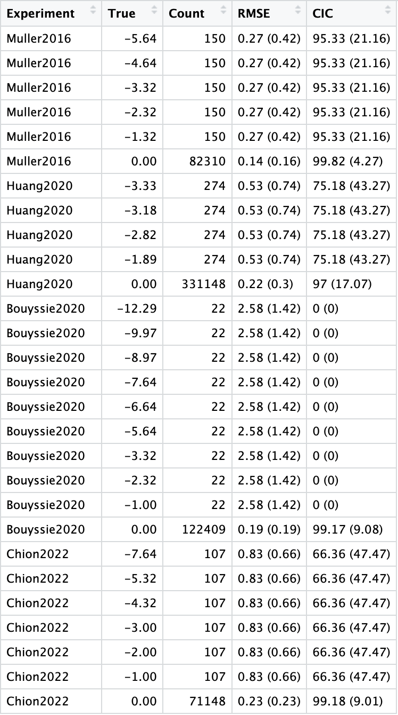
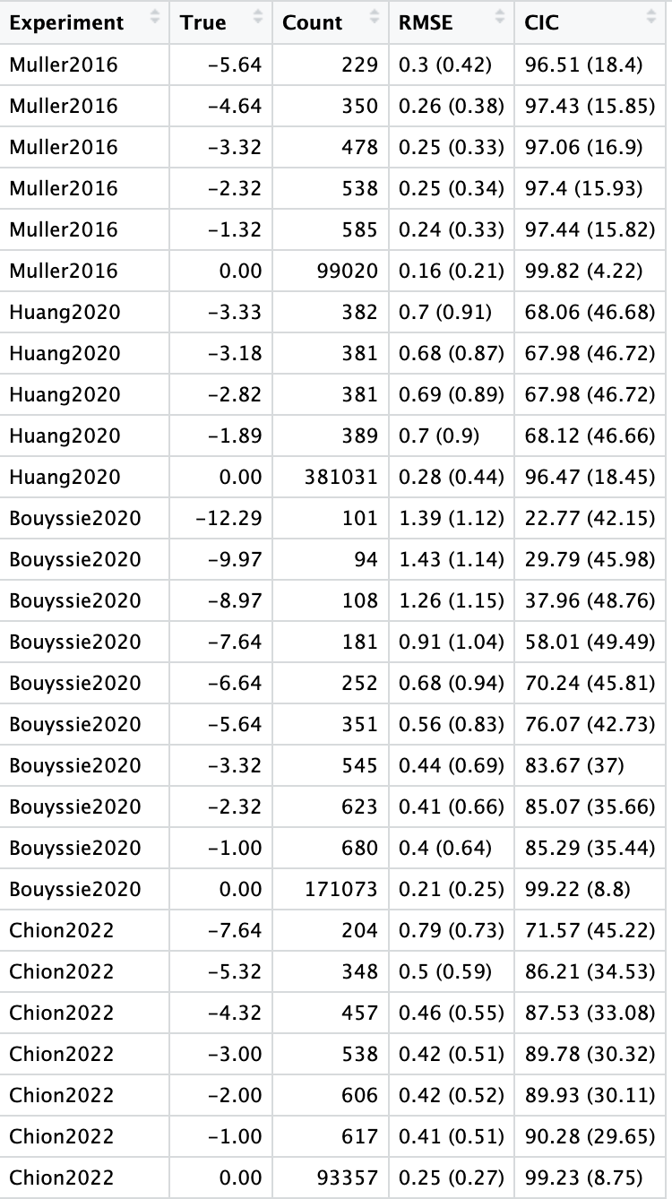
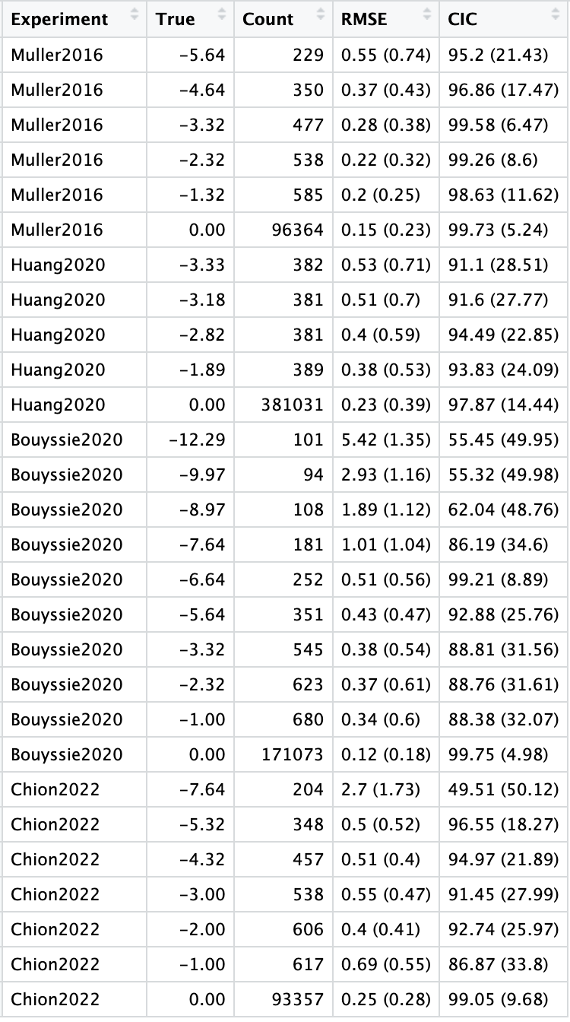
maxNA = 0.2, Mean to mu1
maxNA = 0.2, Mean to mu2
maxNA = 1, Mean to mu2
maxNA = 1, Mean to mu1

