Slide 1
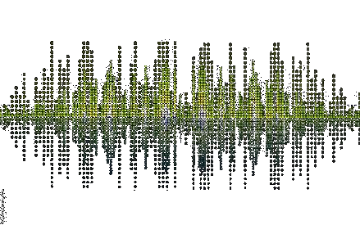
Music Genre Classification using Soft-SVM and Mel-Frequency Cepstrum Coefficients
Elizabeth Chin and Kevin M. Stangl

Slide 2
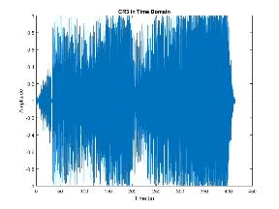
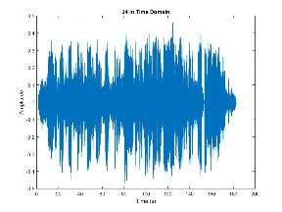
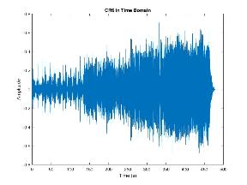
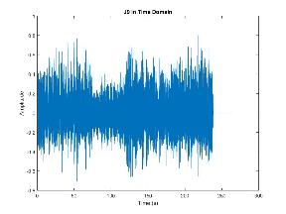
Goal: music genre classification
Applications: automatic content retrieval algorithms i.e. tunes, semantic search
Why its hard: these are the SAME genre of music, yet the structure is very diverse. We get more regularity in frequency domain, but still hard to classify

Slide 3

What we did
Initially wanted to model using an HMM , ran into issues with dimensionality and how to assign songs to the correct classes
Solution: Same as everybody and their mom, SVM!
Final Goal: Train a sequence of 2 class SVM’s to separate a data set of M-songs into N-classes
What we actually did: experimented with a variety of SVM based methods to classify a 2-class problem
Use SVM as a weak learner for Adaboost

Slide 4
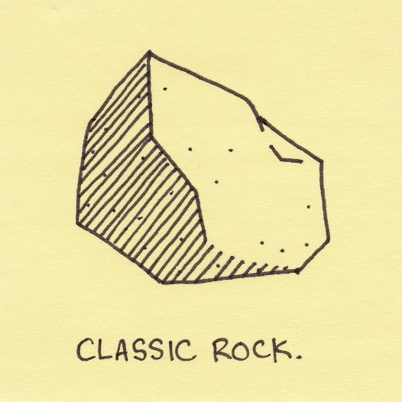

Data
40 total songs:
20 Jazz
20 Classic Rock
Split into testing and training (10 of each genre in each dataset)

Slide 5
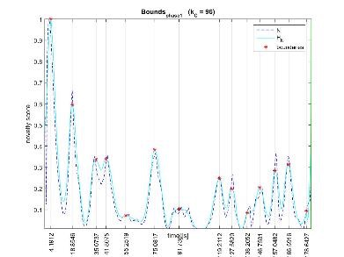
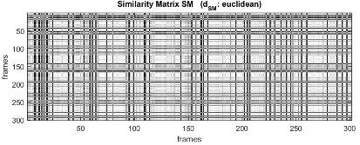
Method: (1) Segmentation
Music has structure and repetition. We segment by non-fixed lengths to extract intrinsic rhythmic structure and features
Calculate self-similarity matrix and compare with Gaussian kernel
matrix to find novelty score
Peiszer E. et al. Automatic Audio Segmentation: Segment Boundary and
Structure Detection in Popular Music

Slide 6
Method: (2) Feature extraction
Mel-frequency Cepstrum Coefficients (MFCCs): short-time spectral decomposition of an audio signal that conveys the general frequency characteristics important to human hearing
Take the Fourier Transform within each segment
Smooth the frequencies and map the spectrum obtained above onto the mel scale
Take the logs of the powers at each of the mel frequencies
Take the discrete cosine transform of the list of mel log powers, as if it were a signal
The MFCCs are the amplitudes of the resulting spectrum
Log-Energy
Delta and Delta-Delta: differential and acceleration coefficients.
Notes:
Mel equation: mel(f)=1125*ln(1+f/700)
The MFCC feature vector describes only the power spectral envelope of a single frame, so delta and delta-delta models trajectories of the MFCC coefficients over time

Slide 7
Why SVM?
reasonable flexibility
good computationally complexity which is important given the large size of the data i.e 10,000 x 42
a-priori we would expect significant non-linearities which SVM can handle
We train SVM on 500 observations from each song
classification for song is naive sum of all classified observations from that song
Performs shockingly well!
Notes:
Mel equation: mel(f)=1125*ln(1+f/700)
The MFCC feature vector describes only the power spectral envelope of a single frame, so delta and delta-delta models trajectories of the MFCC coefficients over time

Slide 8
Experiments
1a: Train with first 500 MPCC from the first segment of each song using the soft-SVM (same code as we used in Lab #7).
1b: Same as Method 1a but we use a more random sampling method
2a. use the same sampling method as problem 1a. but train the model uses `fitcsvm’
2b: Use the same training method as Experiment 2a. but using the random sampling method from Experiment 1b.

Slide 9
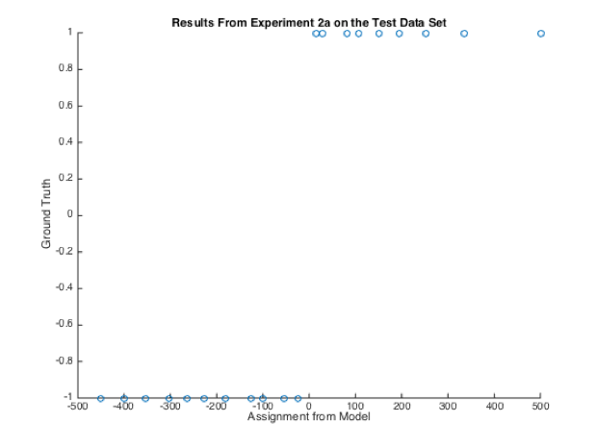
Results from non-linear svm
Notes:
Mel equation: mel(f)=1125*ln(1+f/700)
The MFCC feature vector describes only the power spectral envelope of a single frame, so delta and delta-delta models trajectories of the MFCC coefficients over time

Slide 10
Conclusions
Shockingly good classification rates on test data.
100,95,100,95% classification rate for songs-this is really very surprising
When we backtested the model on the training, only 66% of features were correctly classified, so we can probably associate this to the 500 features contributing to the final classification
Notes:
Mel equation: mel(f)=1125*ln(1+f/700)
The MFCC feature vector describes only the power spectral envelope of a single frame, so delta and delta-delta models trajectories of the MFCC coefficients over time

Slide 11
Further Work
Expand our analysis to use HMMs, since they analyze sequential data. We believe that a well designed HMM would be the “state-of-the-art” method
Test on more music genres, and possibly sub-genres as well (i.e. pop-rock, folk-rock, smooth-jazz, ect.)
Notes:
Mel equation: mel(f)=1125*ln(1+f/700)
The MFCC feature vector describes only the power spectral envelope of a single frame, so delta and delta-delta models trajectories of the MFCC coefficients over time

Slide 12
Acknowledgements
Thank you to Ewald Peiszer for his code and assistance with segmentation
Thanks Professor Zosso! Good luck at Montana
Thank you for being a great audience! Good luck with finals.
Notes:
Mel equation: mel(f)=1125*ln(1+f/700)
The MFCC feature vector describes only the power spectral envelope of a single frame, so delta and delta-delta models trajectories of the MFCC coefficients over time

