Slide 1
Joy Cast
Capture the moments that make you happiest

Slide 2
The Idea
Capture all the best moments of your life
They can be fleeting and ephemeral or special everyday moments
Measure when you are happiest, take a picture of the moment and save it for posterity

Slide 3
The Execution

Slide 4
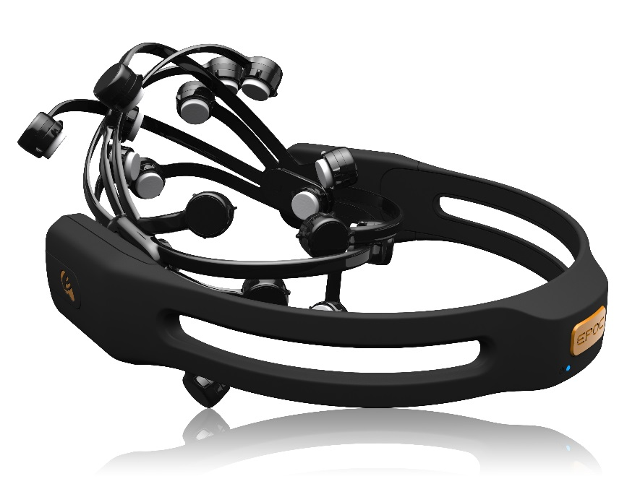
Data Capture
Capture Laugh, Smile and Smirk data through the EMOTIV EPOC and calculate a happiness factor

Slide 6

Capture

Slide 7

Share – #TakenWithASmile

Slide 8
Impact/ The Future
Enhance Happiness metric to include Engagement, Excitement and Valence data
Develop an app and use the camera on your phone or your GoPro
Interface with wearable headsets like the next gen Emotiv Insight

Slide 9

Camera
Android / iPhone
Google Glass
Emotive Insight v2
Emotion
Facial Expression
GoPro
Engagement
Webcam
Excitements
Laugh
Valence (Positive)
Smile!
Mental Command
Magic!
“Snap” to take photo
Smirk
Happiness Metric
“Push” to Twitter
“Save” to save
Filters
Classifier

