Slide 1
Joy Cast
Capture the moments that make you happiest
Marie Huynh, Nick Fotopoulos, derek solven, joan solven

Slide 2
The Idea
Capture all the best moments of your life
They can be fleeting and ephemeral or special everyday moments
Measure when you are happiest, take a picture of the moment and save it for posterity

Slide 3
The Execution
Smile → Snapshot → tweet!

Slide 4
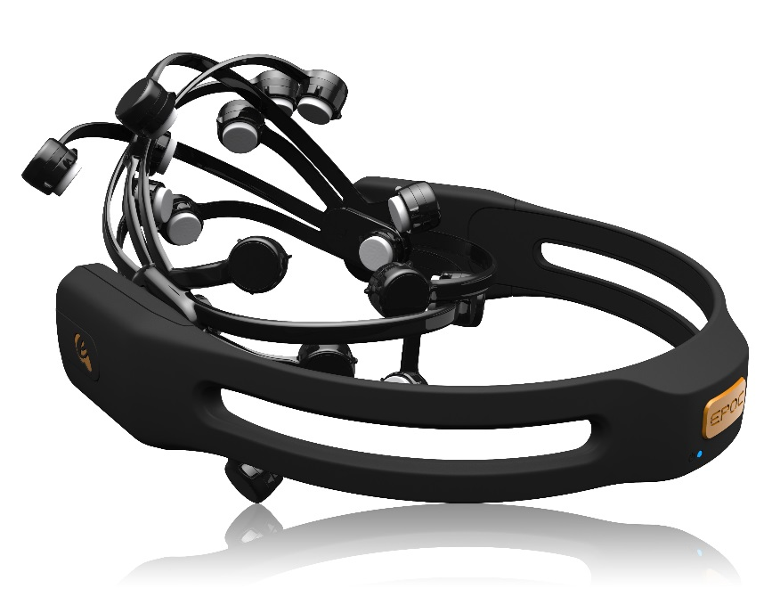
Data Capture
Capture Laugh, Smile and Smirk data through the EMOTIV EPOC and calculate a happiness factor

Slide 6

Camera
Android / iPhone
Google Glass
Emotive Insight v2
Emotion
Facial Expression
GoPro
Engagement
Webcam
Excitements
Laugh
Valence (Positive)
Smile!
Mental Command
Magic!
“Snap” to take photo
Smirk
Happiness Metric
“Push” to Twitter
“Save” to save
Filters
Classifier

Slide 7
Thank you!
EMOTIV for lending us the headsets
Pivotal for hosting
all the sponsors and organizers for feeding us!

