Slide 1
Medicare Advantage Plan: New Food Access Locations

Slide 2
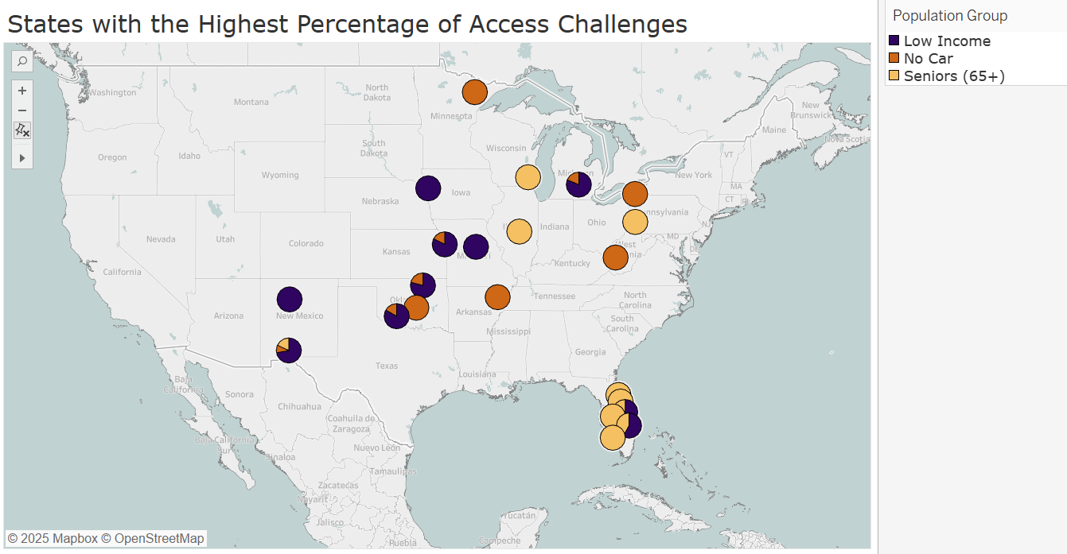

Slide 3
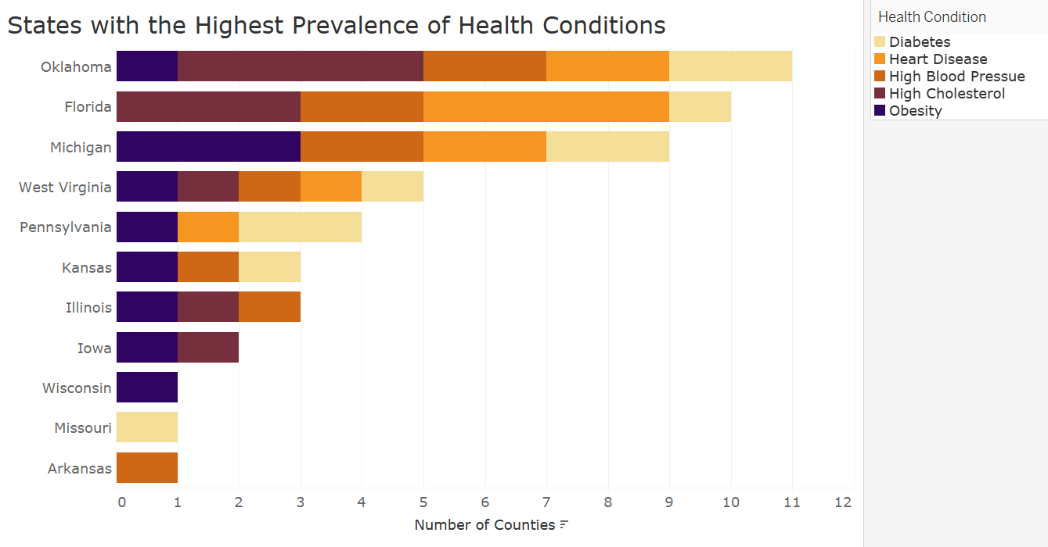

Slide 4
Repeated Counties: Access Challenges and Health Conditions
State | County | Instances
Oklahoma | Osage | 7
West Virginia | Kanawha | 6
Kansas | Wyandotte | 5
Oklahoma | Pottawatomie | 5
Florida | Flagler | 4
Florida | Lee | 3
Florida | Polk | 3
Florida | St. Lucie | 3
Illinois | Macon | 3
Pennsylvania | Erie | 2

Slide 5
Next Steps
Percentage change in low-access groups
Health condition prevalence in future populations
Association analysis with repeated counties

