Slide 1
IBM CAPSTONE PROJECT – The Battle of Neighborhoods: Cluster Analysis of London Boroughs Based on Crime Rates

Slide 2
Business Problem section
Crimes in London:
The number of crimes in London is on the rise based on media reports
The crime rate is different in different parts of the city

Slide 3
Business Problem
Aiming to move to London, what are the safest boroughs that are also close to popular venues like restaurants, schools, etc?

Slide 4
Solution
Clustering London boroughs in order to recommend boroughs based on their proximity of popular venues and on their crime rate during the last two years.

Slide 5
Data and Methodology
Data: merging data on London crime rates from ‘https://data.london.gov.uk/dataset/recorded_crime_summary’ and data on amenities and essential facilities surrounding such properties from FourSquare API interface.
Mehodology:
Collecting Inspection Data;
Exploring and Understand Data;
Data preparation and preprocessing;
Modeling

Slide 6
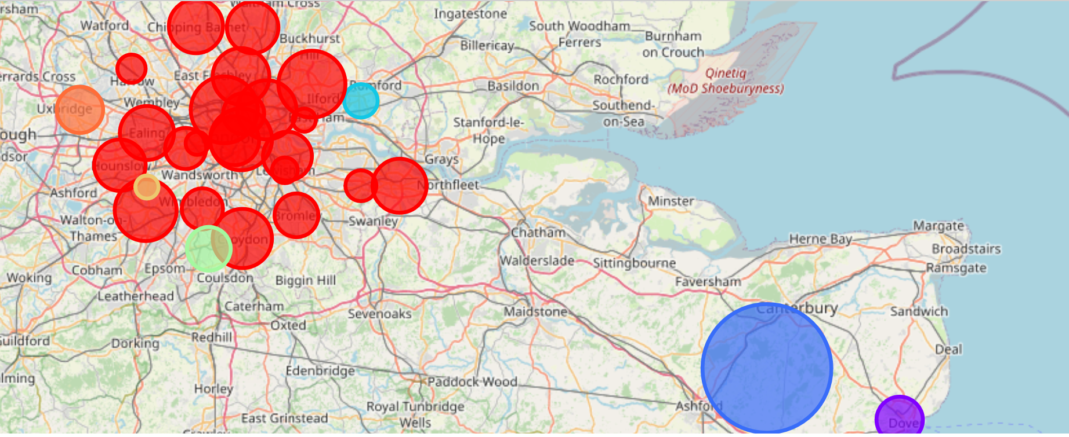
K-Means clustering

Slide 7
Outcome:
Clustering boroughs in London according crime rates and pupular nearby venues to gain insights on best boroughs to live
Boroughs in central London are similar in terms of crime rate and nearby venues and hence belong to the same cluster
'Waltham Forest, UK ‘ is the borough where the most crimes were committed. It is a popular destination for tourists.
‘Richmond upon Thames, UK’ is relatively safe with good nearby venues hence is a good option for living

