Slide 1

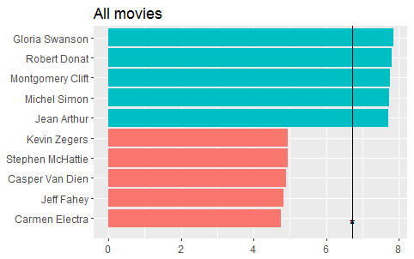
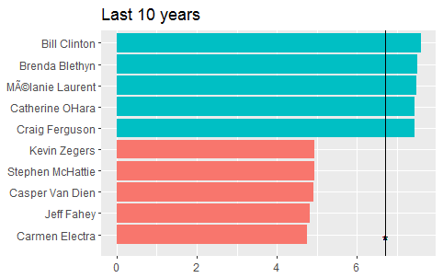
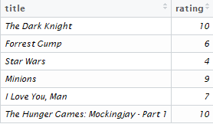
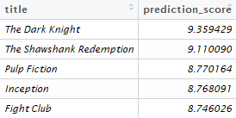
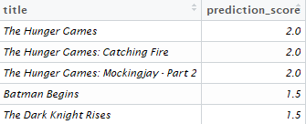
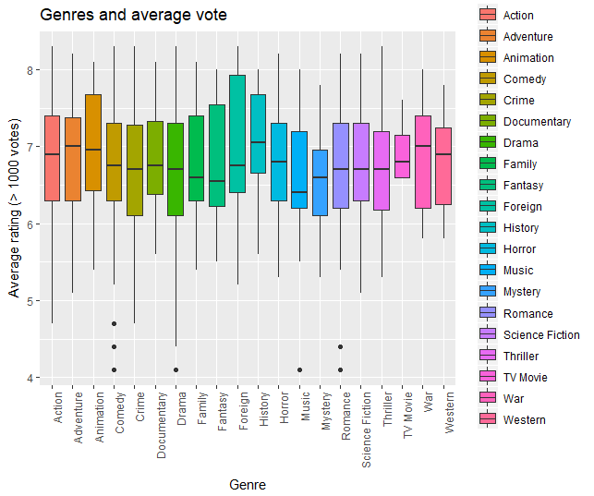
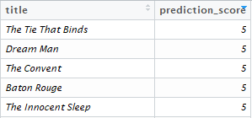
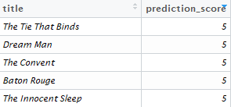
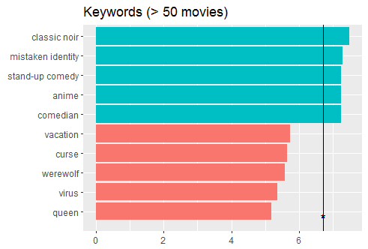
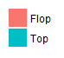
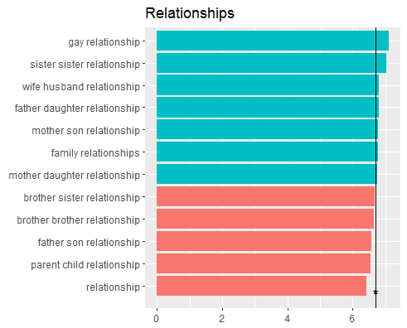
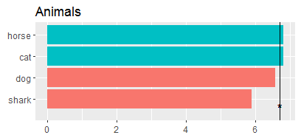
Movie-stars
- Success Factors and Recommender System
Introduction
Actor/Actress
Recommender system
The Internet has become more and more a platform for user-generated content. Especially the movie industry is interesting for many users and there are different platforms which offer exchange of information about movies or rating systems, e.g. IMDb. The aim of this project is to use this user generated-content to build a recommender system and to figure out which factors lead to a good user rating.
For determining top actors and actresses, we took these, who appear in more than 10 movies. The top 5 actors of all movies had already been dead for several years. That’s the reason we made another ranking considering just movies of the last 10 years.
We have built 4 separate recommender systems. All the systems use different parts from our data. They base on self declared distances from other movies for recommendations and you can find more information about each system below. There’s also one additional system, which connects all the other systems and it should give the best recommendations.
Data
Most of the systems are using information, how you have persnonally rated seen movies. In the right you can see sample movie ratings that are used by the systems. Below you can also see, systems’s recommendations
Our project is based on datasets from 2 sources. The first part is gathered from kaggle-website. It contains metadata about movies, actors, genres, keywords and single user ratings. The size is about 900 MB and it has over 45.000 movies. Additionally we collected data from IMDb and got rating data with more than 45.000 entries.
All in one, our dataset is an ensemble of data collected from TMDB, IMDb and GroupLens.
Genre
System 1 – It’s the only system that isn’t using your ratings. It recommends you movies that have recieved good ratings wring many people, have recieved many critics and reviews and are popular in general.
There are 20 genres in total inside the dataset. For this analysis we just used movies with over 1000 votes to get a more evaluable result. The following plot shows, that the median of history movies is the highest and the median of the music genre the lowest. Foreign movies have a wide range which reaches high average ratings, but the median is quite low.
Success factors
To figure out which factors might implicate good or outstanding user ratings, first of all the mean rating of the different rating systems had to be calculated for each area such as keywords, actors etc.. Therefore the average rating from all movies where e.g. a single keyword appears was calculated. Afterwards the mean rating was used to create a ranking of top 5 and worse 5 ratings.
System 2 – It’s recommending movies based on actors. It gives higher scores to the movies that have actors, whose movies you have liked before.
System 3 – It’s recommending you movies based on genres. Movies with genres that you have given better ratings than other genres will come up in the top with this system.
Keywords
For the evaluation, we just took keywords, which occurs in more than 50 movies. We also used them to generate a top/flop ranking of relationships and animals.
System 4 – it’s recommending you movies based on it’s story content. There are avilable keywords for every movie and this system recommends movies with similar story keywords
Conclusion
Movies containing the keyword “classic noir” got the best mean rating result, which is reinforced by the fact that all top 5 actors are already dead. Movies with horses and cats got outstanding rating results, while movies with dogs and sharks got under-average ratings. Gay and sister-sister relationships might be more interesting for users than parent-child relationships.
https://github.com/mariellee/datamining2017

