Slide 1

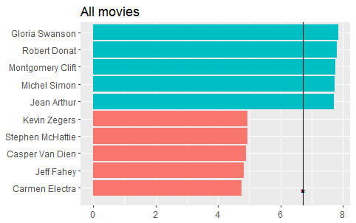
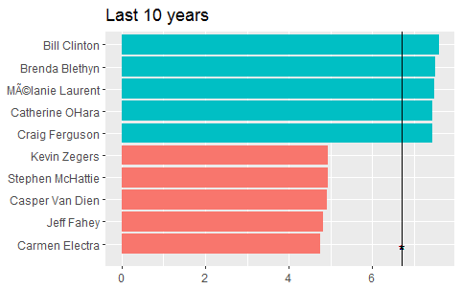
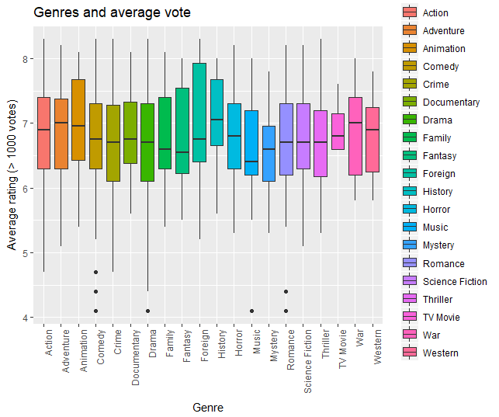
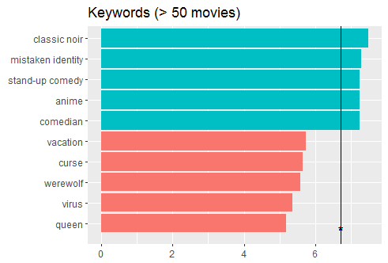
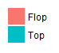
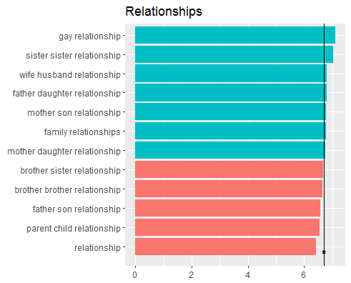
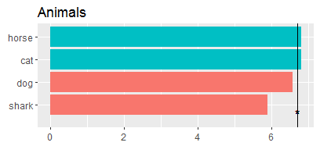
Movie-stars
- Success Factors and Recommender System
Introduction
Actor/Actress
Recommender system
The Internet has become more and more a platform for user-generated content. Especially the movie industry is interesting for many users and there are different platforms which offer exchange of information about movies or rating systems, e.g. IMDb. The aim of this project is to use this user generated-content to build a recommender system and to figure out which factors lead to a good user rating.
For determining top actors and actresses, we took these, who occur in more than 10 movies. The top actors of all movies had already been dead for several years. That’s the reason we made another ranking considering just movies of the last 10 years.
Sdsds dsdsdsd lask döka ösldkö laskd öka sdölkasdöl kölas kklj kjkjasd lkjks lkjdse lkerkjasd sadlkmsd salkdjkj sad sadklkjsad klasdlkj asdkjl kas jdklsa klasjdkjasdlkj dsadk lkasdjlaksjd Sdsds dsdsdsd lask döka ösldkö laskd öka sdölkasdöl kölas kklj kjkjasd lkjks lkjdse lkerkjasd sadlkmsd salkdjkj sad sadklkjsad klasdlkj asdkjl kas jdklsa klasjdkjasdlkj dsadk lkasdjlaksjd
Data
Our project is based on datasets from 2 sources. The first part is gathered from kaggle-website. It contains metadata about movies, actors, genres, keywords and single user ratings. The size is about 900 MB and it has over 45.000 movies. Additionally we collected data from IMDb and got rating data with more than 45.000 entries.
All in one, our dataset is an ensemble of data collected from TMDB, IMDb and GroupLens.
Genre
There are 20 genres in total inside the dataset. For this analysis we just used movies with over 1000 votes to get a more evaluable result. The following plot shows, that …
Success factors
To figure out which factors might implicate good or outstanding user ratings, first of all the mean rating of the different rating systems had to be calculated for each area such as keywords, actors etc.. Therefore the average rating from all movies where e.g. a single keyword appears was calculated. Afterwards the mean rating was used to create a ranking of top 5 and worse 5 ratings.
Keywords
For the evaluation, we just took these keywords, which occurs in more than 50 movies. We also used them to generate a top/flop ranking of relationships and animals.
Perfect Movie
Sdsds dsdsdsd lask döka ösldkö laskd öka sdölkasdöl kölas kklj kjkjasd lkjks lkjdse lkerkjasd sadlkmsd salkdjkj sad sadklkjsad klasdlkj asdkjl kas jdklsa klasjdkjasdlkj dsadk lkasdjlaksjd Sdsds dsdsdsd lask döka ösldkö laskd öka sdölkasdöl kölas kklj kjkjasd lkjks lkjdse lkerkjasd sadlkmsd salkdjkj sad sadklkjsad klasdlkj asdkjl kas jdklsa klasjdkjasdlkj dsadk lkasdjlaksjd

