Slide 1

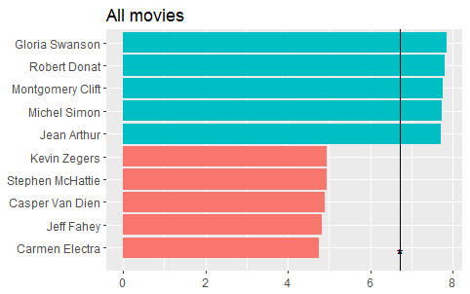
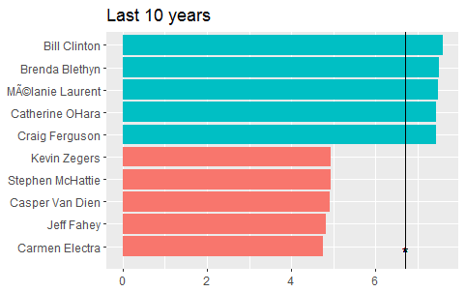
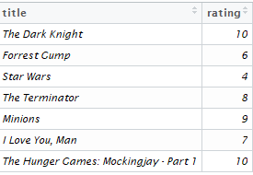
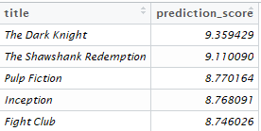
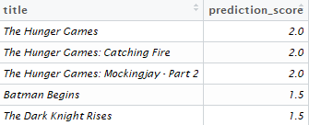
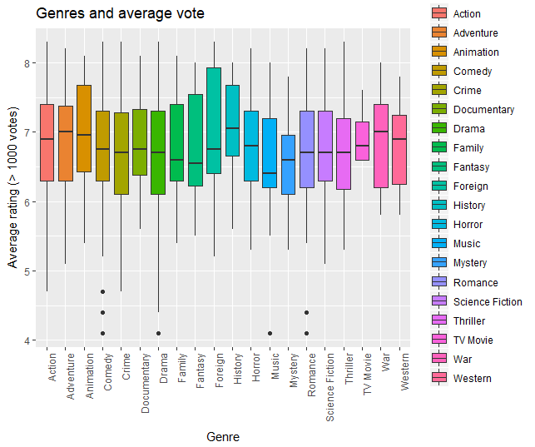
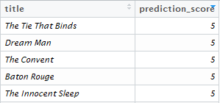
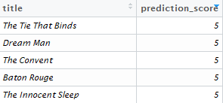
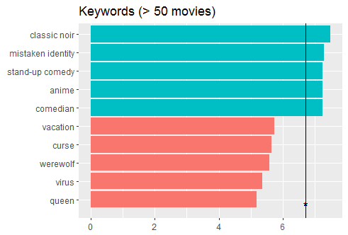
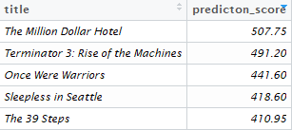
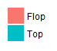
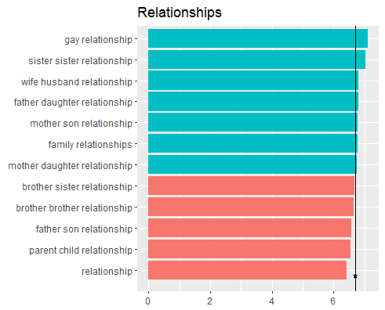
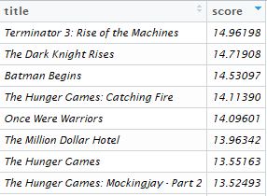
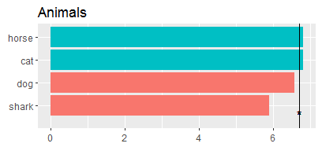
Movie-stars
- Success Factors and Recommender System
Introduction
Actor/Actress
Recommender system
The Internet has become more and more a platform for user-generated content. Especially the movie industry is interesting for many users and there are different platforms which offer exchange of information about movies or rating systems, e.g. IMDb. The aim of this project is to use this user generated-content to build a recommender system and to figure out which factors lead to a good user rating.
For determining top actors and actresses, we took these, who appear in more than 10 movies. The top 5 actors of all movies had already been dead for several years. That’s the reason we made another ranking considering just movies of the last 10 years.
We have built 5 separate recommender systems, which use different parts from our data. They base on self declared distance measures. It’s possible to find more information about each system below. There’s also one additional system, which connects all the other systems and it should give the best recommendations in general.
Most of the systems are using information, how you have persnonally rated seen movies. In the right you can see sample movie ratings that are used by the systems. Below you can also see, systems’s recommendations.
Data
Our project is based on datasets from 2 sources. The first part is gathered from kaggle-website. It contains metadata about movies, actors, genres, keywords and single user ratings. The size is about 900 MB and it has over 45.000 movies. Additionally we collected data from IMDb and got rating data with more than 45.000 entries.
All in one, our dataset is an ensemble of data collected from TMDB, IMDb and GroupLens.
System 1 – It’s the only system that isn’t using your ratings. It recommends movies that have recieved good ratings from many people, many critics, many reviews and are popular in general.
Genre
There are 20 genres in total inside the dataset. For this analysis we just used movies with over 1000 votes to get a more evaluable result. The following plot shows, that the median of history movies is the highest and the median of the music genre the lowest. Foreign movies have a wide range which reaches high average ratings, but the median is quite low.
System 2 – It’s recommending movies based on actors. It gives higher scores to the movies that have actors, whose movies you have liked before.
Success factors
To figure out which factors might implicate good or outstanding user ratings, first of all the mean rating of the different rating systems had to be calculated for each area such as keywords, actors etc.. Therefore the average rating from all movies where e.g. a single keyword appears was calculated. Afterwards the mean rating was used to create a ranking of top 5 and worse 5 ratings.
System 3 – It’s recommending movies based on genres. Movies with genres that you have given better ratings than other genres will come up in the top with this system.
System 4 – it’s recommending movies based on it’s story. In the data, there are avilable keywords for every movie and this system recommends movies with similar keywords that have been liked by the user before.
Keywords
For the evaluation, we just took keywords, which occurs in more than 50 movies. We also used them to generate a top/flop ranking of relationships and animals.
System 5 – This recommender system will find other people who have been rating movies in commn way like you and then recommends movies that the similar persons have liked.
Conclusion
General system uses all previous systems with self defined weights for every systems’s score.
Movies containing the keyword “classic noir” got the best mean rating result, which is reinforced by the fact that all top 5 actors are already dead. Movies with horses and cats got outstanding rating results, while movies with dogs and sharks got under-average ratings. Gay and sister-sister relationships might be more interesting for users than parent-child relationships.
Marielle Egert, Andreas Bau
https://github.com/mariellee/datamining2017

