Slide 1


Graduation Project
Log files analysis and features extraction to deduce the behaviour of logged systems
Presented By :
Sirine Dhouib & Mariem Sfaxi
Reviewed By :
Mr. Mohamed Tmar President
Mrs. Inès Kammoun Fourati Member
Mr. Tarek Zlitni Academic Supervisor
Mr. Firas Feki Professional supervisor

Slide 2

Our Team
Sirine Dhouib
Mariem Sfaxi
Notes:
avant tout nous tenons à vous présenter notre équipe mon collègue TALBI Omar et je suis AMMAR Nour , c’est avec un grand plaisir que nous allons vous présentez aujourd’hui notre projet de fin d’études,

Slide 3
Credits
Special thanks to all the people who contributed to the
Realization of this presentation.

Slide 4
ROADMAP
General Project Context
Proposed Solution
Conclusion
1
3
5
Outlook
2
4
3
State of the Art
Experimental Results and Discussion

Slide 5
General Project Context
1
Let’s discover the First Chapter

Slide 6
HOST COMPANY
Since 2010, Primatec Engineering has become a prominent offshore outsourcing company, specialized in the test and development of electronic controllers.
Headquartered in Sfax, Tunisia, it consists of the businesses of customized, innovative and cost-efficient IT solutions to the automotive industry.

Slide 7
General Context of Work
We have developed a tool dedicated to the analysis of a large number of log files" that consists of extracting useful information from these files to infer the behavior of logged systems.

Slide 8
Problematic
Traditionally, several experts analyze the error logs and find the solutions according to their expertise and knowledge database, and sometimes solving one issue, may lead to another issue on a related server. This issue occurs when the analysts do not have complete knowledge of the system.
How can we overcome these problems ?

Slide 9
Proposed Solution
Our project is to develop a tool dedicated to the analysis of a large number of log files" consists of extracting useful information from these files to infer the behavior of logged systems.
It focuses on developing a proof of concept for server log analytics through text analysis and machine learning algorithms.

Slide 10
Research Methodologies
In our Project, the following steps have been proposed for log data analysis along with topic modelling :
1. Data Acquisition and Pre-processing:
includes removing duplicates, symbols, and handling system security information
2. Generating the sequence of events:
includes converting the data into binary form for faster execution.
3. Error language Model Techniques:
includes low-frequency data or unseen data in the error messages.

Slide 11
Project Contributions :
reduce the time and efforts for server’s error log analytics, which improve the productivity of the analysts
remove the duplicate server log messages
insight to low-frequency data which is commonly get ignored

Slide 12
State of the art
2
Let’s discover the Second Chapter

Slide 13
Machine Learning For Anomaly Detection
Machine learning is a branch of Artificial Intelligence for data analysis that gives computers the ability to learn and improve from experience.
Its Utilization options are almost endless and can be used in practically every aspect of our lives. In our case, we have used it for Anomaly Detection through machine learning Algorithms.
Our Project deals with the implementation of these algorithms and compares them to others.

Slide 14
Machine Learning Algorithms
In our project , a range of different machine learning algorithms are used to analyze and interpret the channel outcrop statistics from our Dataset:
Supervised Learning
Unsupervised Learning
Deep Learning

Slide 15
What is Supervised Learning ?
It is defined by its use of labeled datasets to train algorithms that to classify data or predict outcomes accurately.

Slide 16
How Supervised Learning Works?
1. It uses a training set to teach models to yield the desired output.
2. This training dataset includes inputs and correct outputs, which allow the model to learn over time.
3. The algorithm measures its accuracy through the loss function, adjusting until the error has been sufficiently minimized.

Slide 17
Based on the problems the algorithm is dealing with, Supervised Learning can be divided into two groups :
Regression :
is a supervised learning algorithm used to predict continuous responses.
For example, it can be used in finding the relationship between the price of a flat and its location, number of bedrooms, etc.
Classification :
is a supervised learning algorithm, which is grouping a given set of data points into classes.
Sometimes classes are called also categories, labels, or targets.
A basic example of classification is spam detection in emails. A classifier trains to understand how given datasets are associated with labels spam and non-spam.

Slide 18
What are Supervised Learning Algorithms that we have used?
Logistic Regression (LR)
K-Nearest Neighbors (KNN)
Naïve Bayes
Decision Tree
AdaBoost Algorithm

Slide 19
Logistic Regression
Logistic regression is one of the most popular Machine Learning algorithms, which comes under the Supervised Learning technique.
It is used for predicting the categorical dependent variable using a given set of independent variables.
It predicts the output of a categorical dependent variable.
Its Implementation is shown on Chapter 4 Section XXX.

Slide 20
K-Nearest Neighbors
K-nearest neighbors (KNN) algorithm is a type of supervised ML algorithm which can be used for both classification as well as regression predictive problems.
However, it is mainly used for classification predictive problems in industry.
Its Implementation is shown on Chapter 4 Section XXX.

Slide 21
Naïve Bayes
Naïve Bayes Classifier is one of the simple and most effective Classification algorithms which helps in building the fast machine learning models that can make quick predictions.
It is a probabilistic classifier, which means it predicts on the basis of the probability of an object.
Its Implementation is shown on Chapter 4 Section XXX.

Slide 22
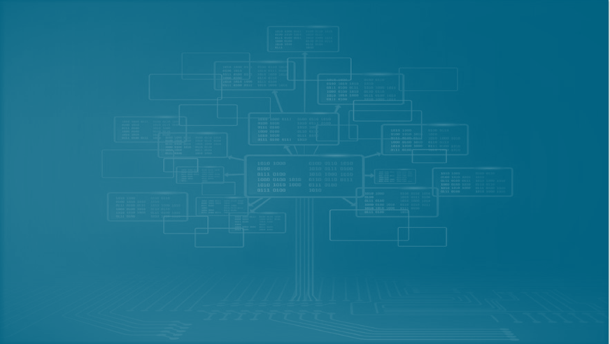
Decision Tree
Decision Tree is a Supervised learning technique that can be used for both classification and Regression problems, but mostly it is preferred for solving Classification problems.
It is a tree-structured classifier, where internal nodes represent the features of a dataset, branches represent the decision rules and each leaf node represents the outcome.
Its Implementation is shown on Chapter 4 Section XXX.

Slide 23
AdaBoost Algorithm
The AdaBoost classifier is a meta-estimator that begins by fitting a classifier on the original dataset and then fits additional copies of the classifier on the same dataset but where the weights of incorrectly classified instances are adjusted such that subsequent classifiers focus more on
difficult cases.
Its Implementation is shown on Chapter 4 Section XXX.

Slide 24
What is UnSupervised Learning ?
also known as unsupervised machine learning, uses machine learning algorithms to analyze and cluster unlabeled datasets.
Its algorithms discover hidden patterns or data groupings without the need for human intervention.

Slide 25
How UnSupervised Learning Works?
It works by analyzing the data without its labels for the hidden structures within it, through determining the correlations, and for features that actually correlate two data items.
It is being used for clustering, dimensionality reduction, feature learning, density estimation, etc.

Slide 26
What is UnSupervised Learning Algorithm that we have used?
Word2Vec

Slide 27
Word2Vec
Word2vec is a two-layer neural net that processes text by “vectorising” words.
Its input is a text corpus and its output is a set of vectors: feature vectors that represent words in that corpus.
While Word2vec is not a deep neural network, it turns text into a numerical form that deep neural networks can understand.
Its Implementation is shown on Chapter 4 Section XXX.

Slide 28
What is Deep Learning ?
Deep learning is a type of machine learning and artificial intelligence (AI) that imitates the way humans gain certain types of knowledge.
It can be thought of as a way to automate predictive analytics. While traditional machine learning algorithms are linear, deep learning algorithms are stacked in a hierarchy of increasing complexity and abstraction.

Slide 29
What is Neural Network?
A neural network is a method in artificial intelligence that teaches computers to process data in a way that is inspired by the human brain.
It is a type of machine learning process, called deep learning, that uses interconnected nodes or neurons in a layered structure that resembles the human brain.

Slide 30
How Deep Learning Works?
Deep learning networks learn by discovering intricate structures in the data they experience.
By building computational models that are composed of multiple processing layers, the networks can create multiple levels of abstraction to represent the data.

Slide 31
Proposed Solution
3
Let’s discover the Third Chapter
Notes:
Now we come to the Proposed Solution. In this part, we will show and explain the Process of Log Analysis and Log Analysis Tools.

Slide 32
The process of log analysis:
1. Data Log collection:
Collecting and storing logs is a central part of log analysis. Therefore log collection is the first step in detecting anomalies in logs.
2. Log parsing:
To enable log analysis based on techniques such as machine learning, logs need to be transformed into structured events with the same type of fields in each log message.
For example, by parsing log messages, different event templates can be created based on the constant parts and the variable values are passed along with the template.
3. Features extraction:
In order to run anomaly detection algorithms on the log data, features that will be fed into the algorithm need to be extracted. The combined features aim to answer the four following questions, who, where, when, and what.
Notes:
As you can see the process of log analysis has four important elements.
The first element is Data Log Collection which is the first step in detecting anomalies in logs,
The second is Log Parsing used to transform logs into events with the same type of fields to enable log analysis based on techniques like the machine learning.
Third we should extract features in order to run anomaly detection algorithms on the log data,

Slide 33
4. Pre-processing:
Standardizing features
Machine learning models may perform poorly if the features are not somehow normally distributed, therefore standardization may be important for constructing an accurate model.
If a feature is much larger than other features, this feature might dominate and the algorithm may be unable to interpret other features in a correct way.
A feature is therefore standardized compared to how many times this feature occurs in other event vectors.
Normalizing features
Normalization gives the attributes in the dataset equal weights which can decrease redundancy and prevent "noisy" samples from taking over.
Notes:
And the last is the Pre-processing. Let’s discover this element by starting with Standardizing features which is an important step for constructing an accurate model.
The next step is Normalizing features to give the attributes in the dataset equal weights which can decrease redundancy.

Slide 34
Data Pre-processing
Data pre-processing is crucial for data before being applied to machine learning models. It contains many steps like Tokenization, removing stop-words, and Normalization (Stemming and Lemmatization).
Moreover, it also contains feature extraction (Word Embedding) where the data are encoded into numerical feature vectors.
Data pre-processing is handled by NLP(Natural Language Processing):
All machine learning algorithms are based on certain mathematical calculations. In order for the algorithm to be able to process the dataset as a text, then this text has to be tokenized.
Moreover, these tokens need to be normalized and then transformed into numbers.
Notes:
Let’s go now to the Data Pre-processing, it is crucial for data before being applied to machine learning models. It contains many steps like Tokenization, removing stop-words, and Normalization. It is also handled by the Natural Language Processing.
NLP is a field that focuses on making natural human language usable by computer programs,
In order for the algorithm to be able to process the dataset as a text, then this text has to be tokenized. Moreover, these tokens need to be normalized and then transformed into numbers

Slide 35






Log Analysis Tools
Python
Anaconda Navigator
Jupyter Notebook
Flask
Sklearn
Gensim
Notes:
In the second part we are going to present the Log Analysis Tools like:
the Anaconda Navigator which is an open-source distribution of the Python and R programming Languages for data science,
the open-source web application Jupyter Notebook ,
Python the language that we worked with through it in our project,
Flask the Python module that lets you develop Web applications easily.
The libraries Sklearn for the Python Programming Language,
Gensim for unsupervised topic modelling,
Pandas for data manipulation and analysis,
Keras for artificial neural networks,
Matplotlib for embedding plots into applications and
Tensorflow for machine learning and artificial intelligence.

Slide 36



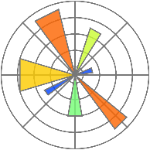


Natural Language Processing ( NLP )
Pandas
Keras
Matplotlib
TensorFlow
Bootstrap
Notes:
And finally, Bootstrap; It contains HTML, CSS and JavaScript-based design templates.

Slide 37
Experimental Results and Discussion
4
Let’s discover the Fourth Chapter
Notes:
That covers the Proposed Solution chapter. The next thing we’d like to talk about is Experimental Results and Discussion.

Slide 38
Unsupervised ML Model Result
Notes:
Moving to the Unsupervised ML Algorithm

Slide 39
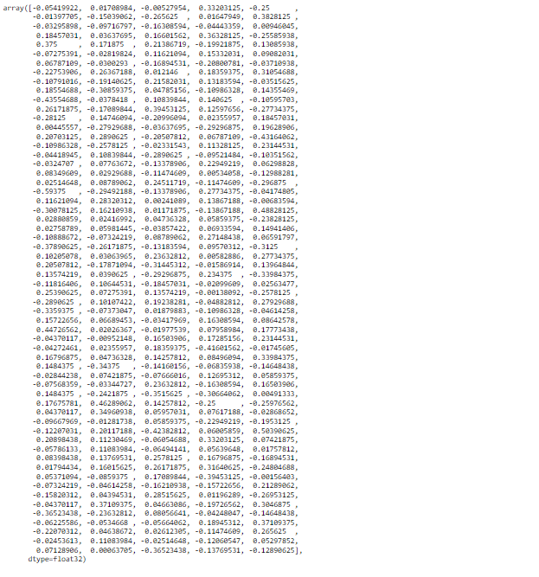
1. Word2vec:
Given a large corpus of text, word2vec produces an embedding vector associated with each word in the corpus.
These embeddings are structured such that words with similar characteristics are in close proximity to one another.
Notes:
Let's discover the Word2vec model and illustrate its result.
word2vec produces an embedding vector associated with each word in the corpus.
These embeddings are structured such that words with similar characteristics are in close proximity to one another.

Slide 40
Supervised ML Models Results
Notes:
Then let’s discover the results of the second algorithm Models.

Slide 41
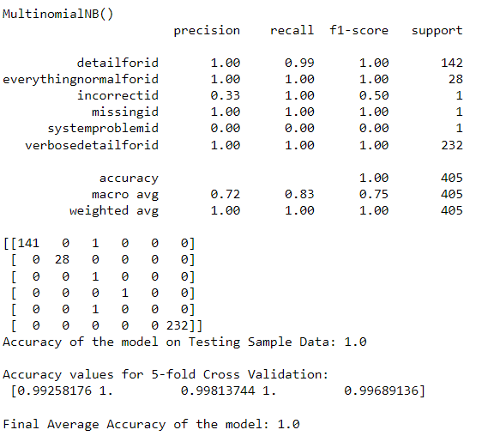
2. Naives Bayes:
Here are the results of metrics for Naives Bayes Model
Notes:
The first Supervised ML model is Naives Bayes which presents the values of the four ML metrics which are precision, recall, f1-score and accuracy.

Slide 42
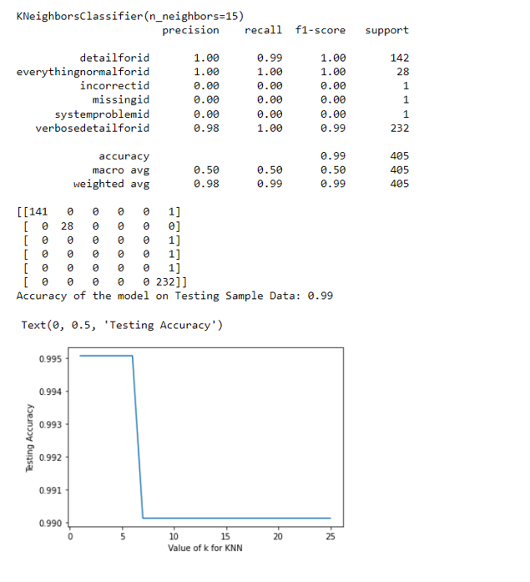
3.KNN:
Here are the results of metrics for KNN Model And the Plot of the relationship between k and Testing Accuracy
Notes:
Second Supervised ML Model is KNN. It presents the results of metrics and the plot of the relationship between K and Testing Accuracy.

Slide 43
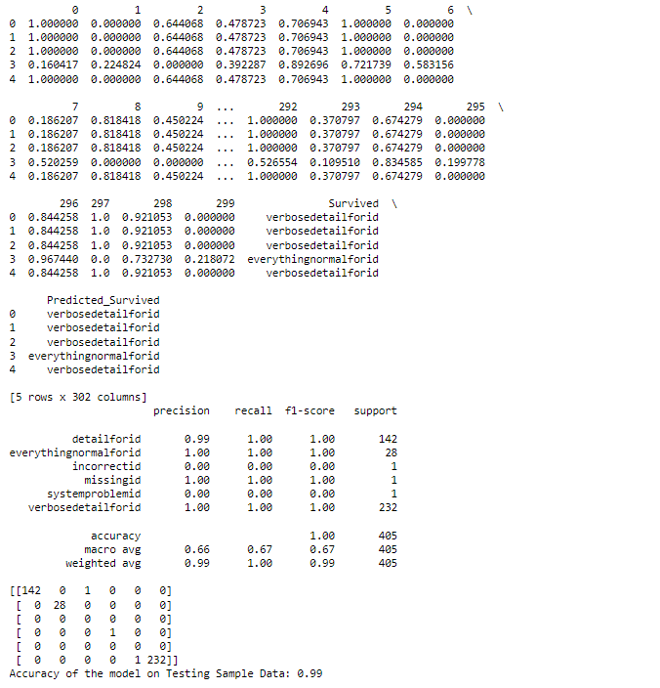
4.Logistic Regression:
Here are the results of metrics for Logistic Regression Model
Notes:
Here are the results of metrics for Logistic Regression Model

Slide 44
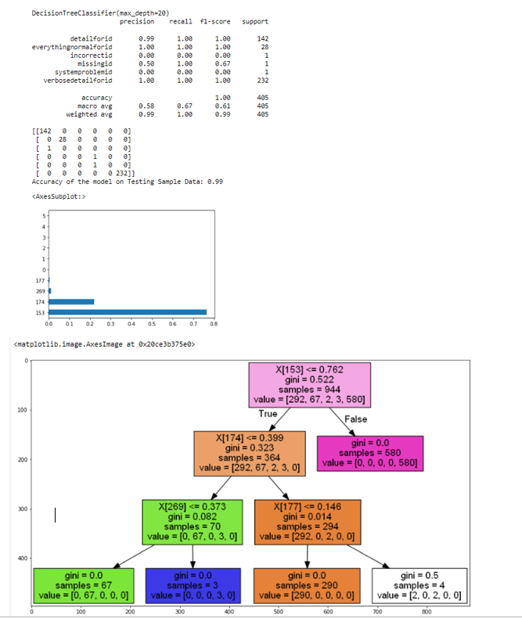
5.Decision Tree:
Here are the results of metrics for Decision Tree Model And the Image of the Decision Tree
Notes:
Here are the results of metrics for Decision Tree Model And the Image of the Decision Tree .

Slide 45
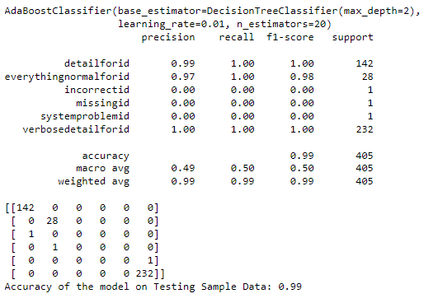
6.AdaBoost:
Here are the results of metrics for AdaBoost Model
Notes:
Here are the results of metrics for AdaBoost Model

Slide 46
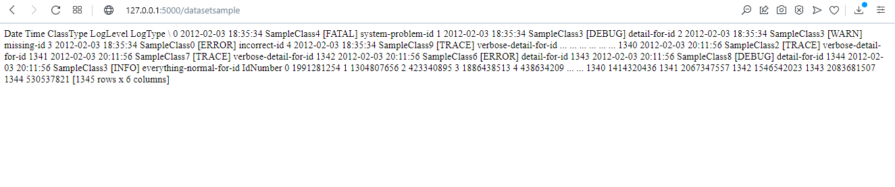
Displaying Dataset Web Interface
Notes:
we will now move to the next point, this part aims to present the displaying of different Web Interfaces.
Let’s begin with Displaying Dataset Web Interface

Slide 47
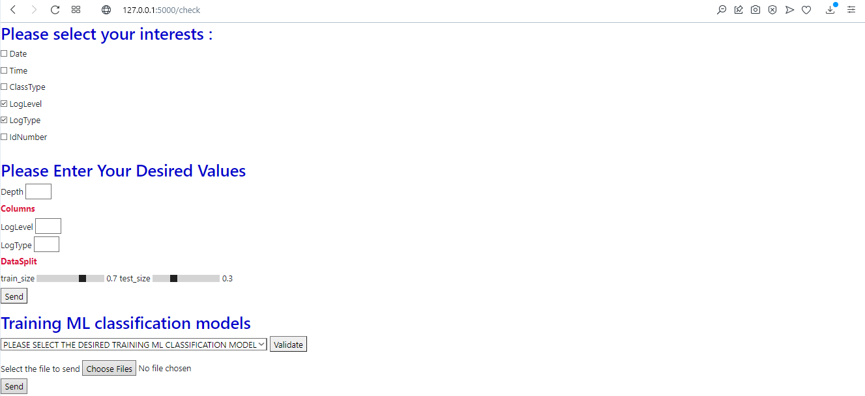
Home Page Web Interface
Notes:
Moving to Home page Interface.
The first part represents the chosen columns of our Dataset necessary for the ML Model.
Second part represents the parametrs of Decision Tree ML Model.

Slide 48
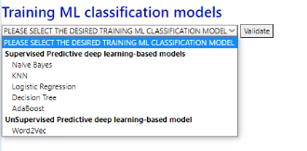
ML Model Choice Interface
Notes:
Here, we can select the supervised or the unsupervised model desired .

Slide 49

File Uploaded Web Interface
Notes:
By clicking on choose Files, we can select one or more files from our laptop.
And as soon as we send the file the message ”File uploaded successfully” appears.

Slide 50
Machine Learning Metrics and Performance:
Notes:
After these postings let's talk about Machine Learning Metrics and Performance.

Slide 51
Metrics
The metrics used to evaluate the performance of the approaches used are mentioned below:
  Accuracy
  Accuracy is the most intuitive performance measure and it is simply a ratio of correctly predicted observation to the total observations.
Precision
Precision is the ratio of correctly predicted positive observations to the total predicted positive observations.
Recall
Recall is the ratio of correctly predicted positive observations to the all observations in actual class.
F1 Score
F1 Score is the weighted average of Precision and Recall. Therefore, this score takes both false positives and false negatives into account.
Notes:
To evaluate the performance of the approaches used, we present the four different metrics.
Here we have the Accuracy , the Precision , the Recall and F1 Score.

Slide 52
Results of Machine Learning Performance and Discussion

Slide 53
Performance results of Machine Learning Models on dataset
 | Accuracy | Precision | Recall | F1-Score
Naïve Bayes | 1.0 | 0.721 | 0.937037 | 0.75
AdaBoost | 0.99 | 0.493 | 0.933333 | 0.496
Decision Tree Classifier | 0.99 | 0.581 | 0.929630 | 0.611
KNN | 0.99 | 0.49 | 0.914815 | 0.49
Logistic Regression | 0.99 | 0.665 | 0.874074 | 0.666
The most important metric for anomaly detection is Recall. The results show that the most accurate predictions were made by supervised machine learning models. Almost 100% accurate was model Naives Bayes, followed closely by models AdaBoost and Decision Tree Classifier.
And Finally, KNN and Logistic Regression Models. All were able to predict almost all anomalies correctly.
Discussion:
Notes:
To compare the performance of Machine Learning Models on our dataset, we put the values of the metrics of each model in this table.
And we noticed that The most important metric for anomaly detection is Recall and The most efficient (performing) model is Naïve Bayes.

Slide 54
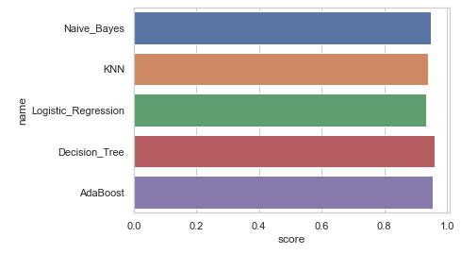
Accuracy’ Scores results of Machine Learning Models on dataset
Notes:
This figure presents the Accuracy’ Scores results of Machine Learning Models on dataset and illustrates the performance of Naïve Bayes Model.

Slide 55
Conclusion
5
The goal of our End of Studies Project is to develop a Tool dedicated to analyzing a large number of log files consisting of extracting useful information from these files to infer the behavior of logged systems.
To conclude, The realization of our project allowed us to integrate more into the machine learning field and helped us to further develop our creativity.
It also allowed us to learn new Machine Learning tools like Flask, Gensim and TensorFlow, and we're pretty sure that what we've learned during this time will come in handy in the future.
Notes:
To conclude, we present you the objective of this project: It was to develop a Tool dedicated to analyzing a large number of log files consisting of extracting useful information from these files to infer the behavior of logged systems.
Thus, this project gave us the opportunity to discover new Machine Learning tools like Flask, Gensim and TensorFlow, allowed us to integrate more into the machine learning field and helped us to further develop our creativity.

Slide 56
6
OUTLOOK
As future work, developing a method or tool that might actually take the useful part of the log files and then prioritize based on whether the log file which is generated after successful execution of hardware or software tests. Providing a solution on how to avoid the anomalies occurred after finding where they have caused would be a better improvement for this work.
Notes:
Finally, we present to you the perspectives:

Slide 57

THANKS!
ANY QUESTIONS?
Notes:
Thank you for your attention.

