Slide 1
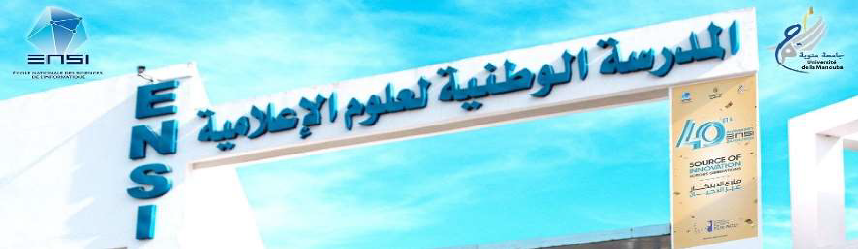

Scientific Domain:
Information and Communication Technologies
Specialty:
LR99ES26
Computer Science
Laboratory of Research in software engIneering & Applied, Distributed and Intelligent informatics
Original name at creation: Research laboratory in Arabized and Integrated Informatics - Documental and Software Engineering
Directors:
Prof. Mohamed BEN AHMED | 1999 - 2005
Prof. Henda HAJJAMI BEN GHEZALA | 2008 – 2021
Prof. Narjès BELLAMINE BEN SAOUD | Since 2021
1999 - 2025

Slide 2
RIADI an evolving force …
+ 200 researchers
2025 | Researchers | Number | Total
 | Emeritus Professors | 2 | 24
 | Professors | 10
 | Associate-Professors | 12
 | Assistant Professors Having University Habilitation | 1 | 85
 | Assistant Professors | 69
 | Doctors /Post Doc | 15
 | Thesis (in progress) | 70 | 70
 | Master & Engineering Final Projects | 20 | 20

Slide 3
From ~20 To ~200 Researchers with
Significantly improved Teacher-to-Student Ratio

Slide 4
+25 years of RESPONSIBLE Research
+1700 National & International publications

Slide 5
+25 years of EDUCATION through RESEARCH
+700 diplomas awarded including 25 University Habilitation and + 180 doctorates

Slide 6
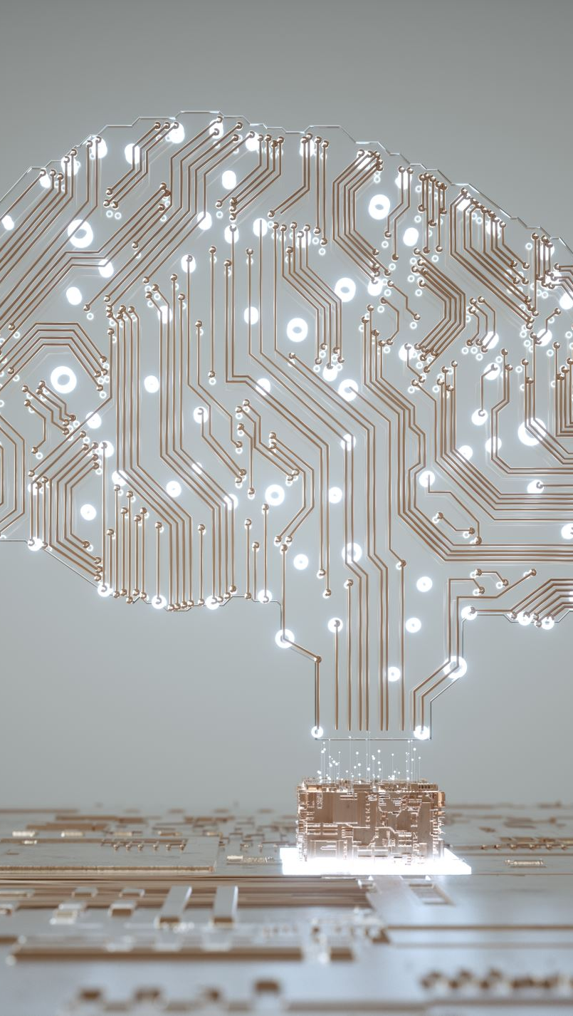
Complementary Thematic Axes
Intelligent systems engineering
Computing for services and cybersecurity
Multimedia data, information research
Knowledge engineering and artificial intelligence

Slide 7
Main topics
Software Engineering & Intelligent Systems Engineering Intelligent Information Systems & Governance Utility Computing & IoT (Cloud, fog, etc.) Big Data & Data Analytics Data Quality Engineering Web 4.0 (Semantic Web, Social Networks, Cooperative Work) | Artificial Intelligence: AI & ML & GenAI Quantum AI Agentic AI Natural Language Processing: Arabic, multi-lingual Agent-based Modeling & Simulation Intelligent Imaging and Remote Sensing Computer Systems Security & Blockchain

Slide 8
Application Domains
Digital transformation and intelligence
Health
Education
Smart cities
Industry 4.0
Security and protection of systems and data
Agriculture, water
Transports
Environment, …

Slide 9
Partnership
NATIONAL LEVEL:
INTERNATIONAL LEVEL:
National Civil Protection Office
National Zoosanitary Surveillance Center
National Cartography and Remote Sensing Center
Farhat Hached Hospital, Sousse
Razi Hospital, Manouba
BIMS Laboratory, Pasteur Institute of Tunis
...
France: Multiple institutions including Sorbonne University, ESEO Engineer School, IMT Business School, IRIT Toulouse, LAAS Toulouse, Laboratoire LIG Grenoble, LIRIS INSA Lyon, LORIA Nancy, University of Orléans
Canada: Laval University, University of Quebec in Montreal, ETS Montreal
Spain: University of Jaén
India: Amity University, Uttar Pradesh
Oman: Sultan Qaboos University
Morocco, Senegal, Lebanon, Turkey, etc. ….

Slide 10
RIADI
Rich experience in funded collaborative projects
PHC (+ de 20 years,…) , PRF (E-gov 2009, PACTE 2015), Appels COVID (2 VRR et un PRF), PR2I, AUF…

Slide 11
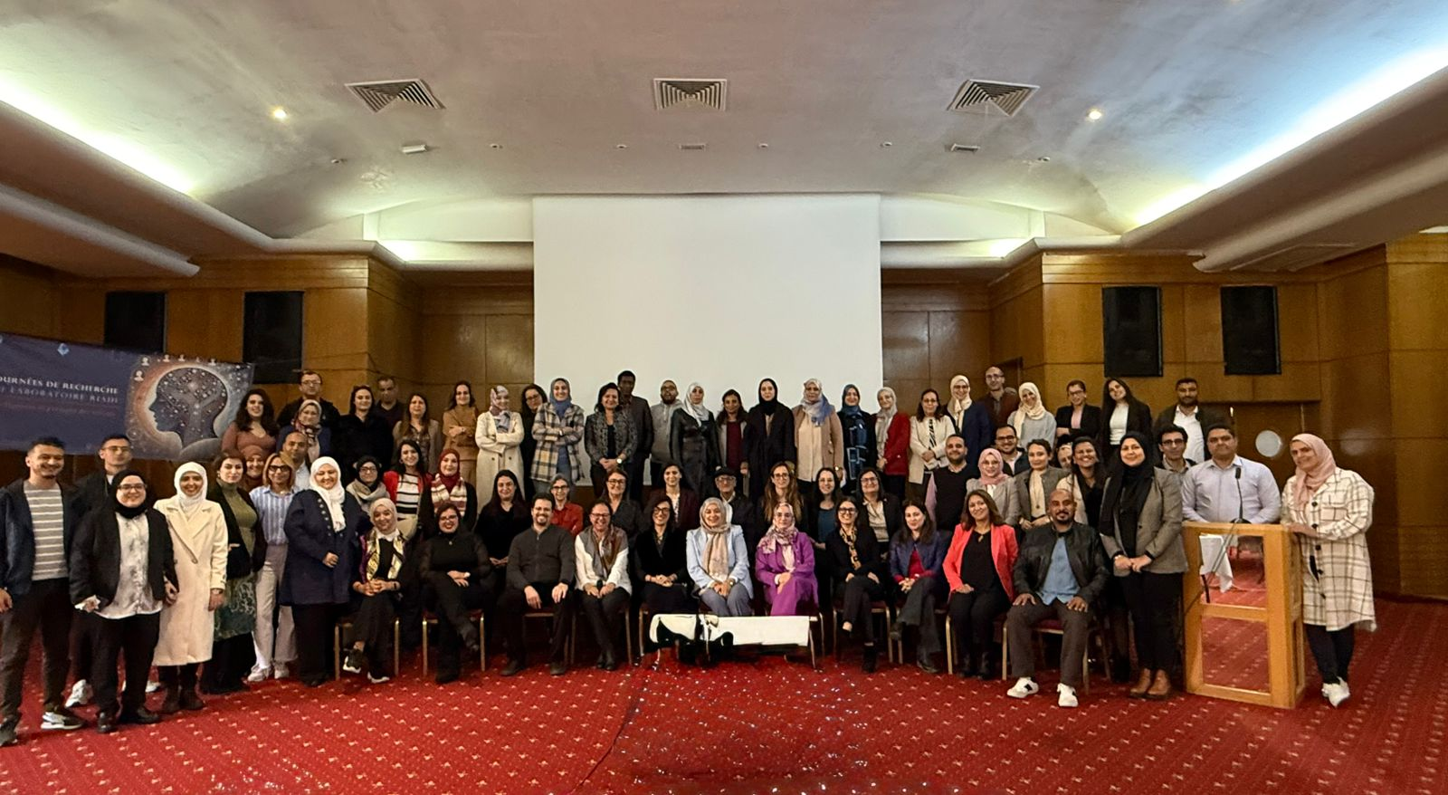
Photo taken on the 29th November 2024, “Annual RIADI laboratory research days »

Slide 12
Contact : narjes.bellamine@ensi.rnu.tn
Recherche Responsable
Excellence,
Networking,
Sustainability,
Innovation

