Slide 1

タイトル：ゲノムで紐解くヒトの進化・多様性
2021年度 生命科学概論I/II (5.11.2021)
ノルウェー生命科学大学
齊藤真理恵

Slide 2
Learning Outcomes
We will learn about:
Human evolutionary history
The role of genetic mechanisms in evolution
Methods and significance of functional genomics
Challenges of human genomics
How genetics is related to societal issues

Slide 3
4.2 Functional genomics
Transcriptome anslysis – gene expression in a genome-wide manner
eQTL analysis – connect genetic variants and gene expression

Slide 4
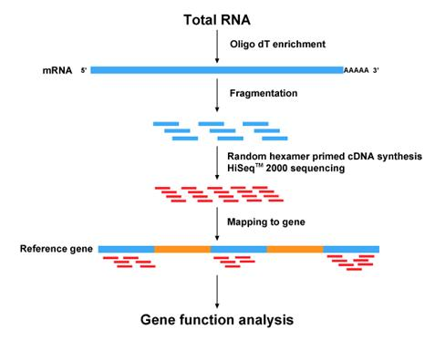
RNA-sequencing Examine the gene expression pattern in a genome-wide manner
http://bio.lundberg.gu.se/courses/vt13/rnaseq.html

Slide 5
Fold change vs p-value
Fold change is
(expression _{treated} − expression _{non-treated})
expression _{non-treated}
p-value is the probability of obtaining results as extreme as the observed results of a hypothesis test, assuming that the null hypothesis is correct.

Slide 6
Case study:
Observed expression of gene A
Observed expression of gene B
expression
expression
un-treated
treated
un-treated
treated
High fold change – high p-value
Low fold change – low p-value

Slide 7
Functional categorization of genes (Gene Ontology Analysis)

Slide 8
Transcripts Per Million (TPM) Unit of gene expression
Let’s assume that we got the following read count table.
https://www.youtube.com/watch?v=TTUrtCY2k-w&t=7s

Slide 9
geneA (2kb)
geneB (4kb)
geneC (1kb)
(1) Normalize the read counts by gene lentgh
sample1
10 reads
20 reads
5 reads
sample2
12 reads
28 reads
8 reads
sample3
30 reads
60 reads
15 reads

Slide 10
geneA (2kb)
geneB (4kb)
geneC (1kb)
(2) Normalize the read counts by total read counts
sample1
10 reads
20 reads
5 reads
sample2
12 reads
28 reads
8 reads
sample3
30 reads
60 reads
15 reads

Slide 11
geneA (2kb)
geneB (4kb)
geneC (1kb)
(3) total read counts will be one
(In reality, 1 Million)
= transcripts per million
sample1
10 reads
20 reads
5 reads
sample2
12 reads
28 reads
8 reads
sample3
30 reads
60 reads
15 reads

Slide 12
eQTL (expression quantitative trait locus) analysis
historically... QTL analysis: Conventional analysis based on limited number of genetic markers
two parental breeds are crossed
the resulting F₁ generations are self-fertilized for several generations, resulting in inbred lines
use genetic markers (100-) to distinguish between parental lines
the phenotypes and genotypes of the offspring are scored
Parent1
Parent2
DNA Marker
Actual variants
Crop genomics: advances and applications
Offspring

Slide 13
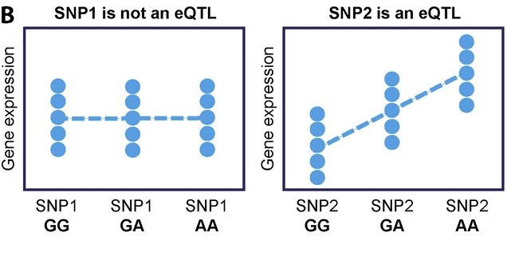
Expression Quantitative Trait Loci analysis
Variant -> Gene expression -> Phenotype
J Exp Med (2017)

Slide 14
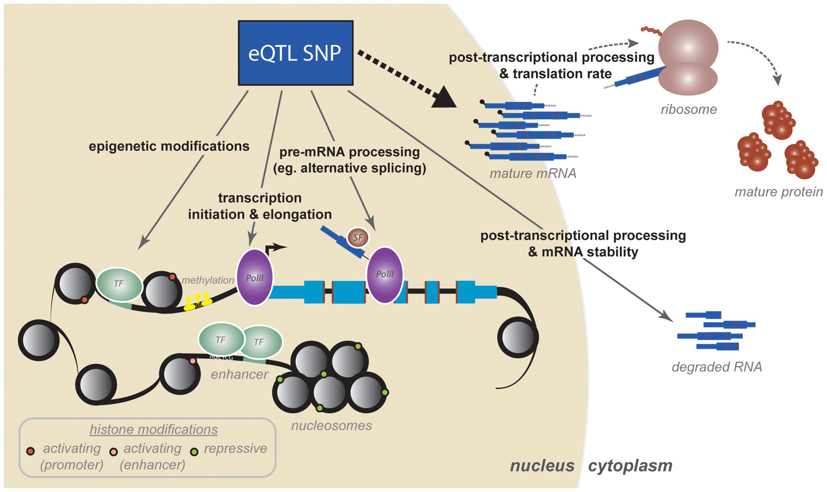
How eQTL SNPs work
Pai et al., 2015

Slide 15
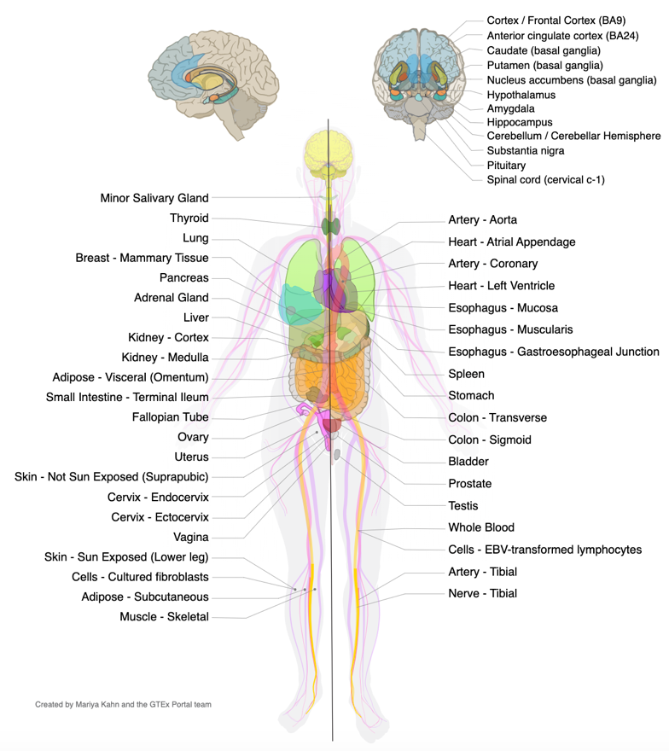
Let’s explore the GTEx Portal... Human Gene expression/splicing/eQTL database
54 tissues, 948 Donors, 17382 samples

Slide 16
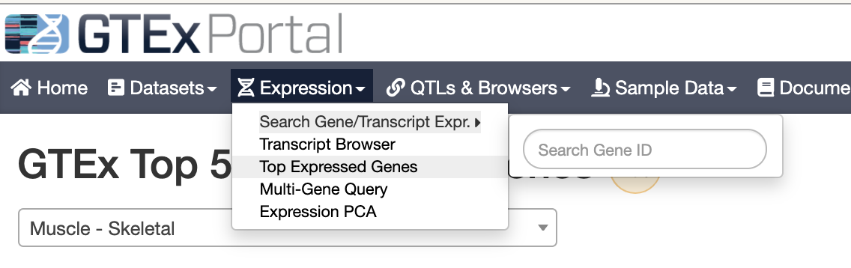
Let’s explore the GTEx Portal...
https://gtexportal.org/home/

Slide 17
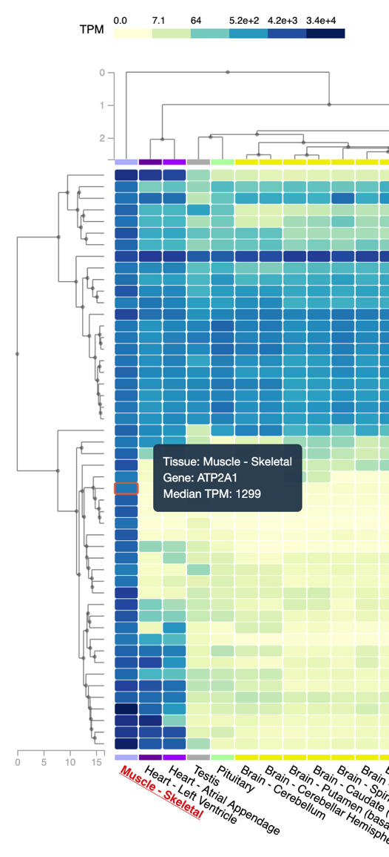
Example: highly expressed genes in muscle
TPM – blue=high expression
Housekeeping genes
(expressed everywhare)
Genes
Muscle-specific highly expressed genes
Muscle and heart -specific highly expressed genes
CKM gene
Tissues

Slide 18
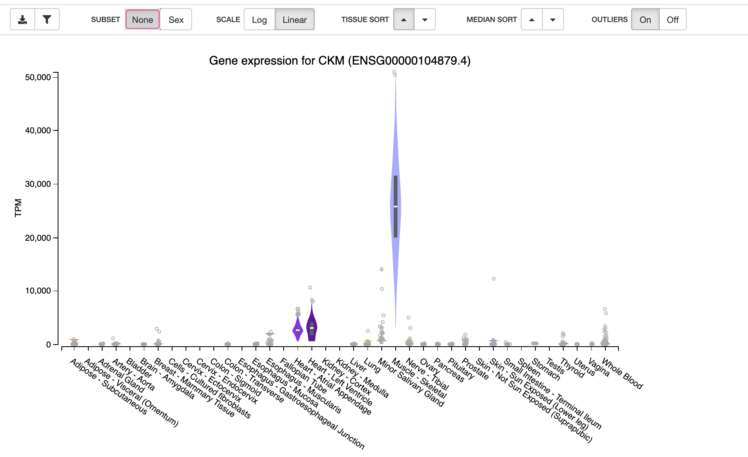


Slide 19
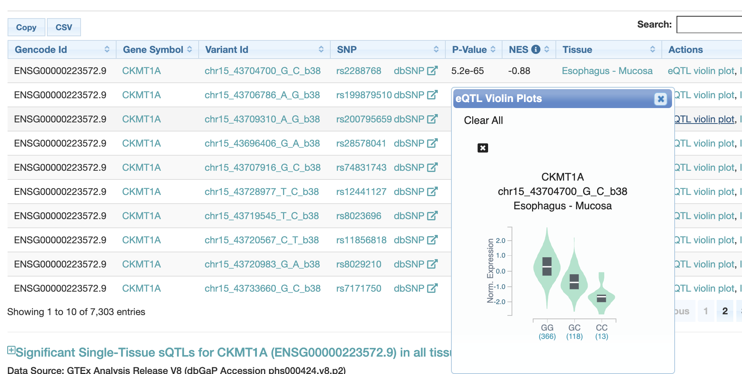
Example – CKMT1A gene expression and a variant at chr5:43504700

Slide 20
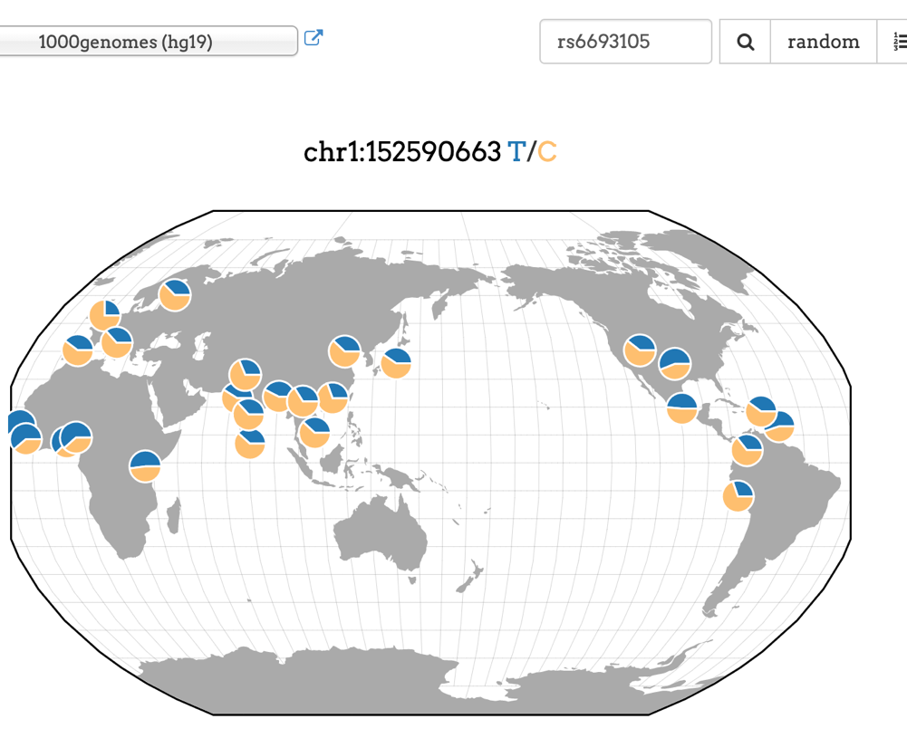
Quiz2
Your Mission:
Search for the association between
a variant rs6693105 and neighbouring gene LCE3C expression in skin on GTEx portal
LCE3C (Late Cornified Envelope): psoriasis (乾癬) and skin microbiome
https://gtexportal.org/home/

Slide 21
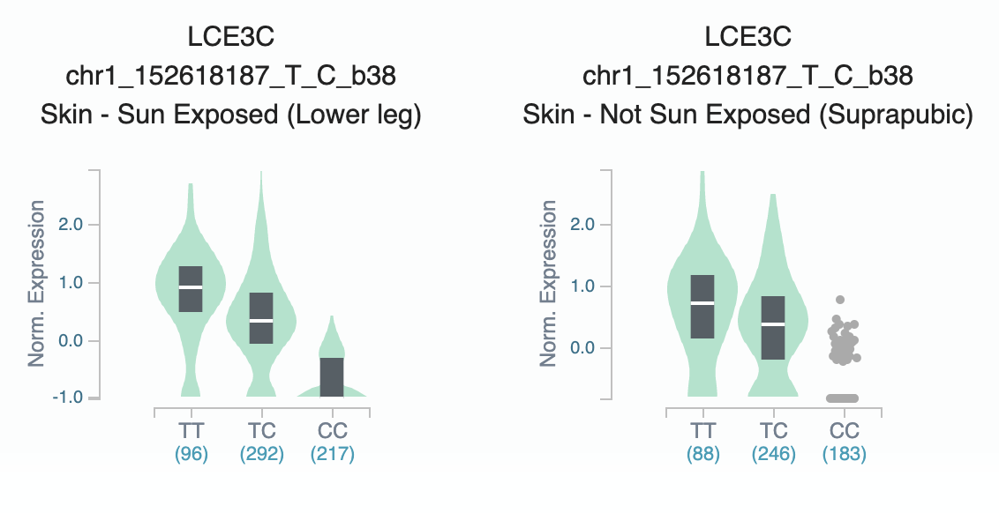
The association between a variant rs6693105 and neighbouring gene LCE3C expression in skin

