Slide 1
Today’s schedule:
[Lecture 12:15-12:50] Review of the genome analysis Go over the RNA-seq analysis
[Group work 12:50-13:40] Do the analysis by yourself (take a break when you get tired)
[Lecture13:40-14:00] Discussion, summary, Q and A

Slide 2
RNA sequencing workflow
Sequence reads FASTQ format
Tool: Fastp
Trimming of low-quality reads
Quantify abundances of transcripts using the reference transcriptome
Tool: Kallisto
Tool: tximport
Summarize transcript-level estimates for gene-level analysis
Deseq2
Multiple Web Tools
Differencially expressed gene analysis

Slide 3
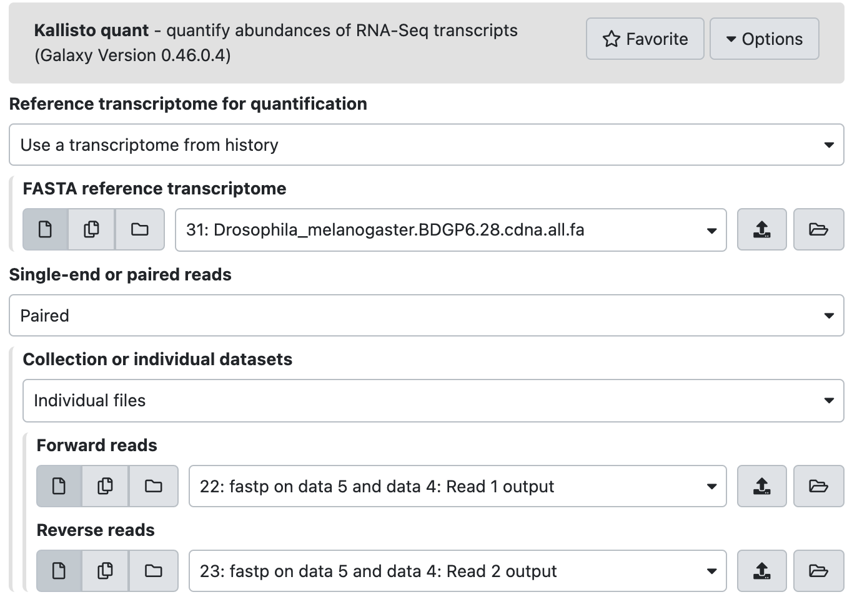

Slide 4
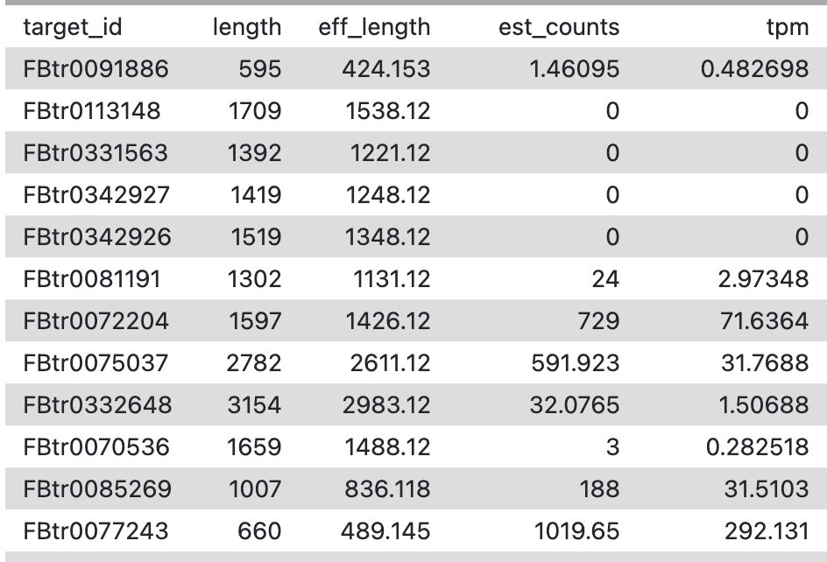
Kallisto output (abundance of transcripts)
transcript/its length/estimated counts/normalized abundance (transcripts per million)

Slide 5
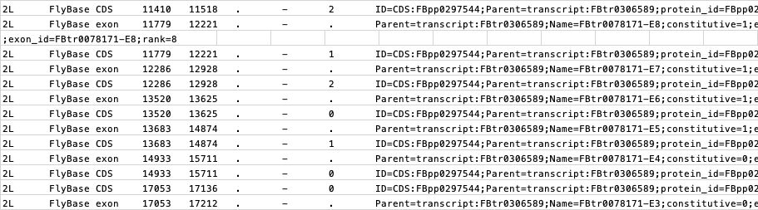
gff3 file – genome region annotation
chromosome / data source / type / region / strand...
More info: http://gmod.org/wiki/GFF3

Slide 6
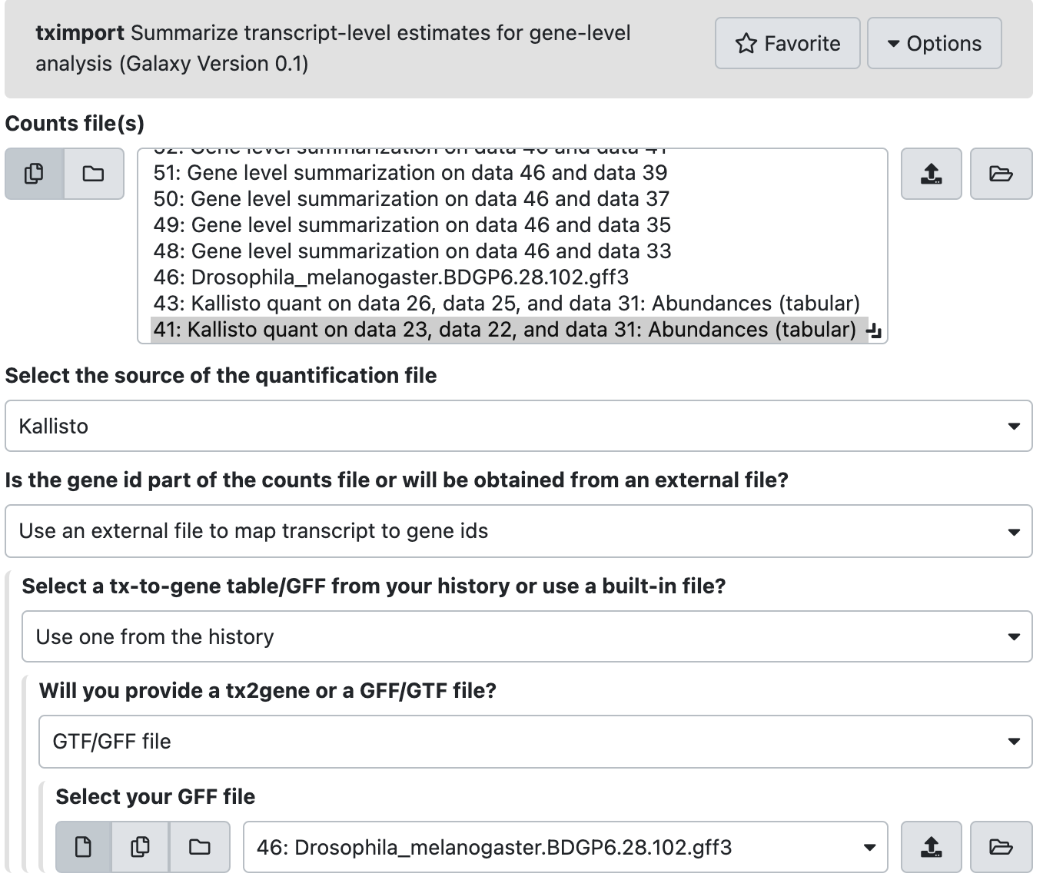

Slide 7
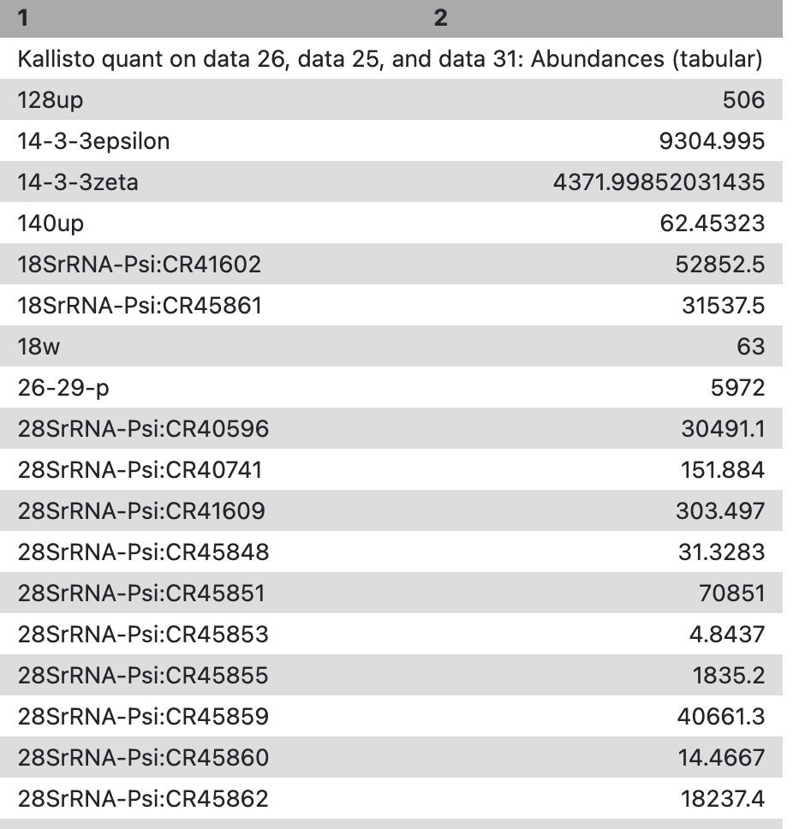
Gene expression abundance

Slide 8
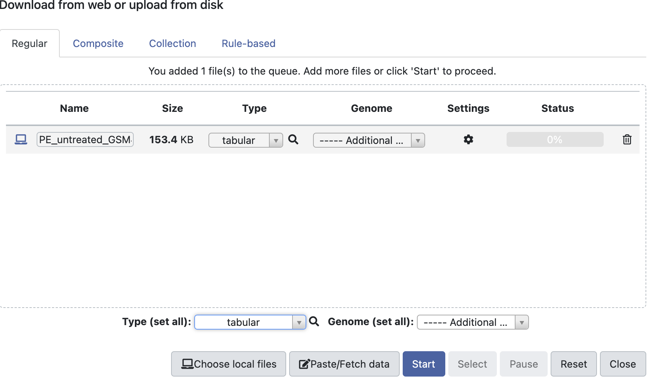

Slide 9
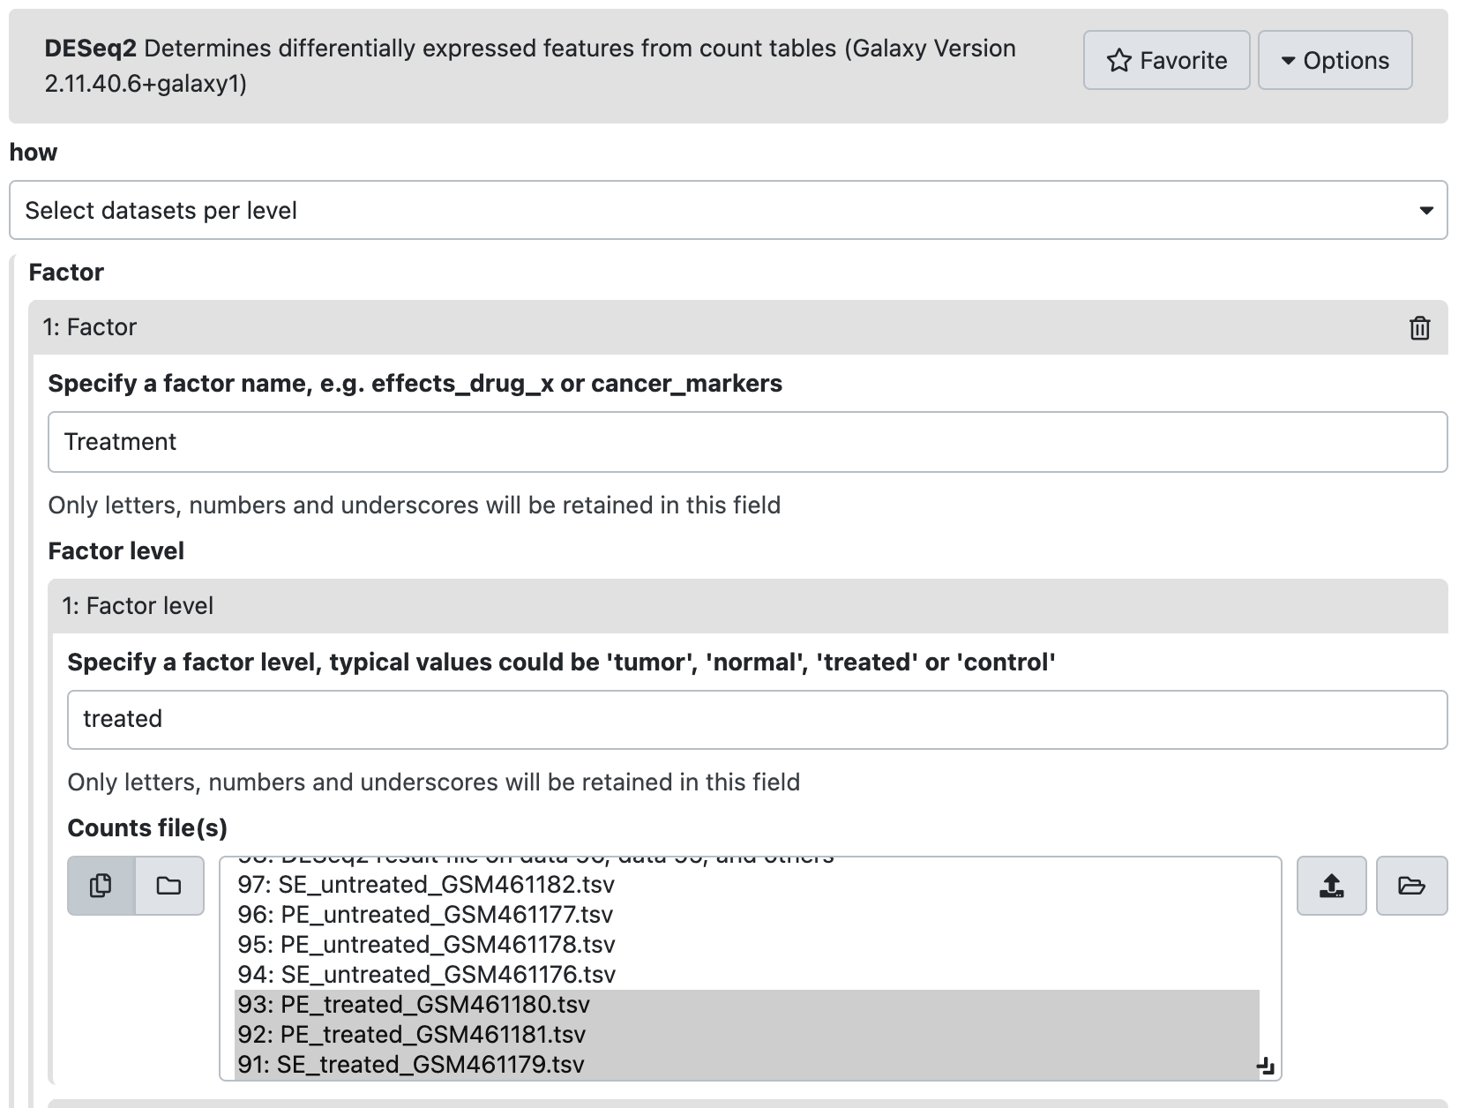

Slide 10
DESeq output
FC: fold change
+: upregulated
-: downregulated
P-value
adjusted for
multiple comparisons
average gene expression

Slide 11
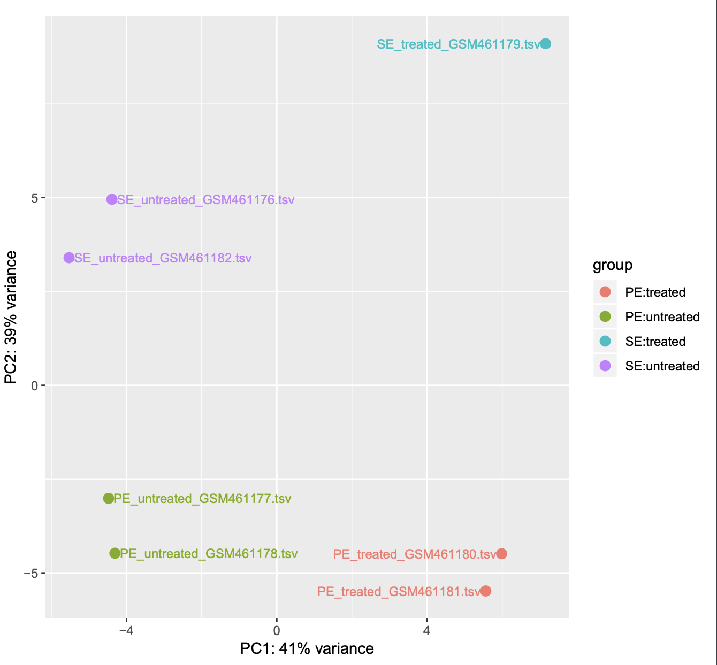
Principal Component Analysis - Compresses a large set of variables into a smaller one maintaining most of the information

Slide 12
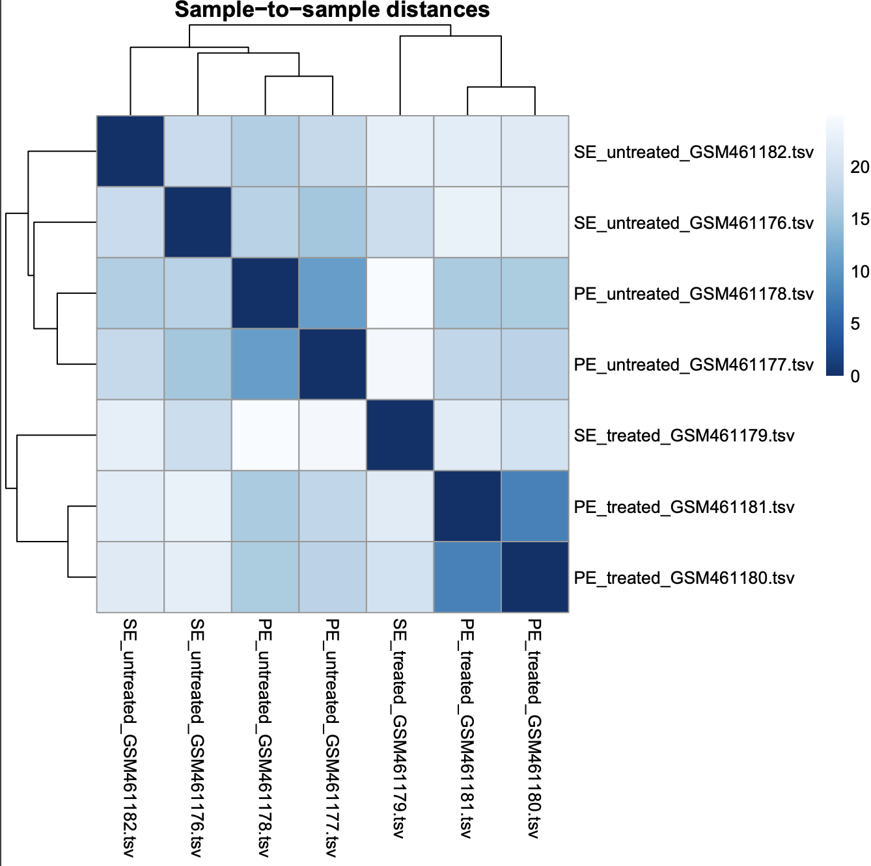
Clustering Analysis
Transcriptome similarlity of each sample

Slide 13
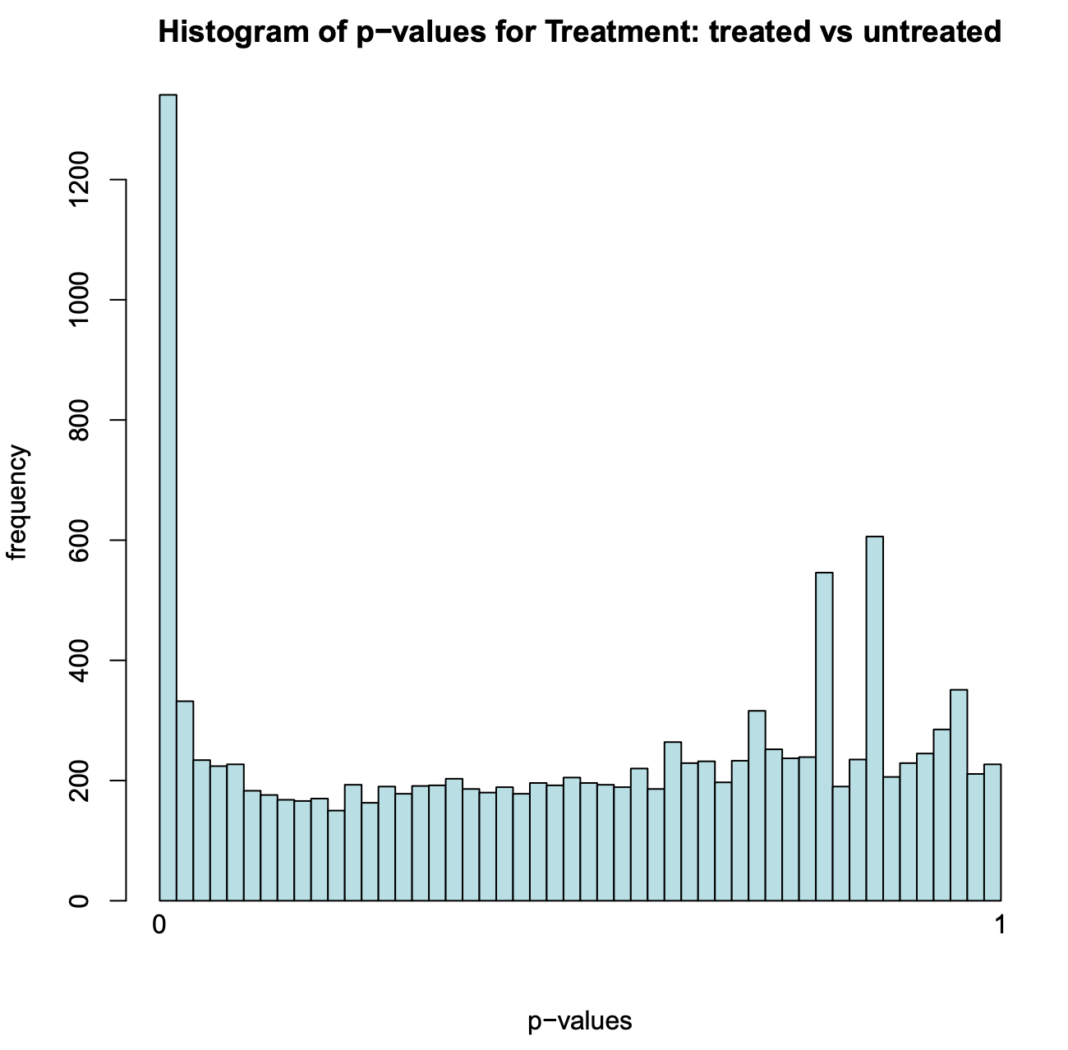
The numnber of
statistically supported
differencially expressed genes

Slide 14
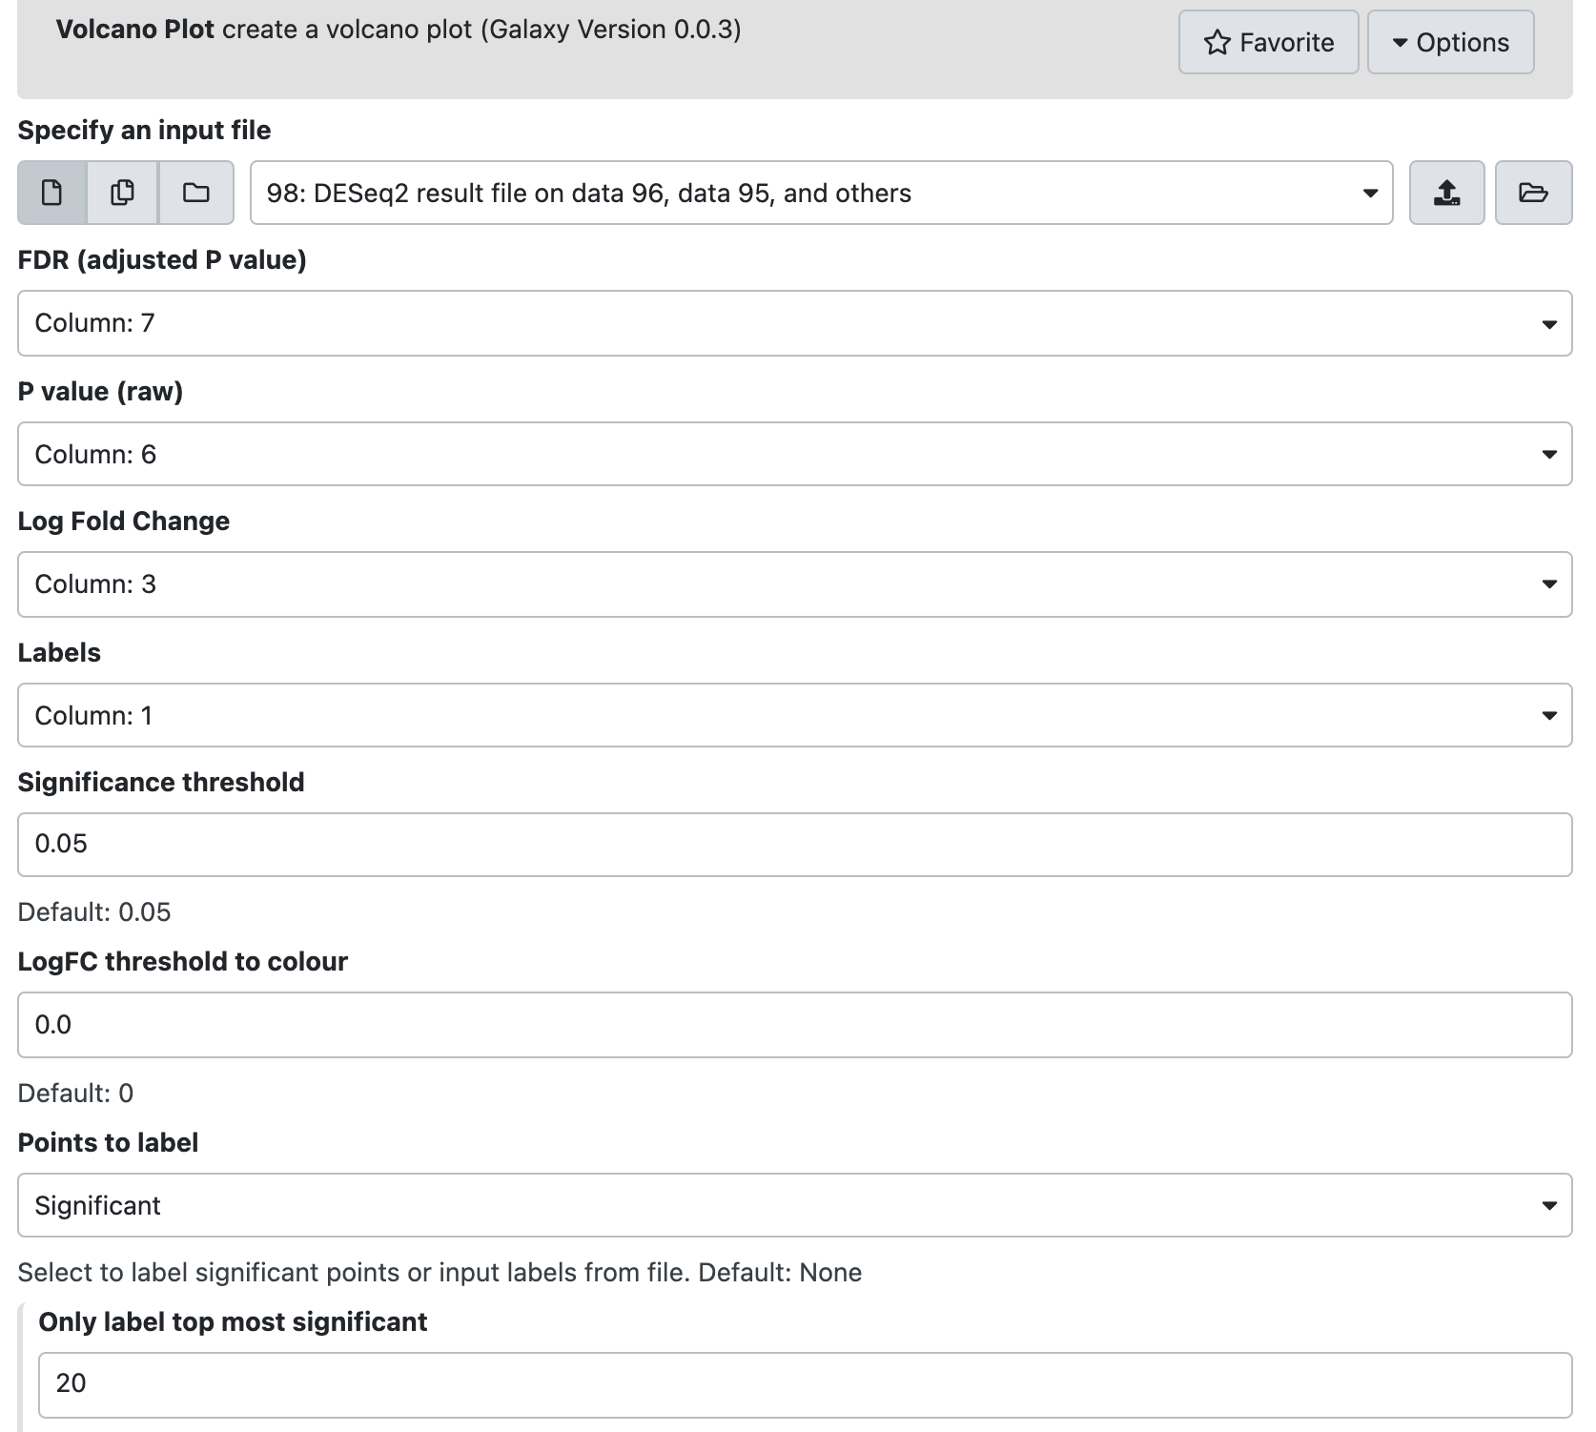
Volcano plot

Slide 15
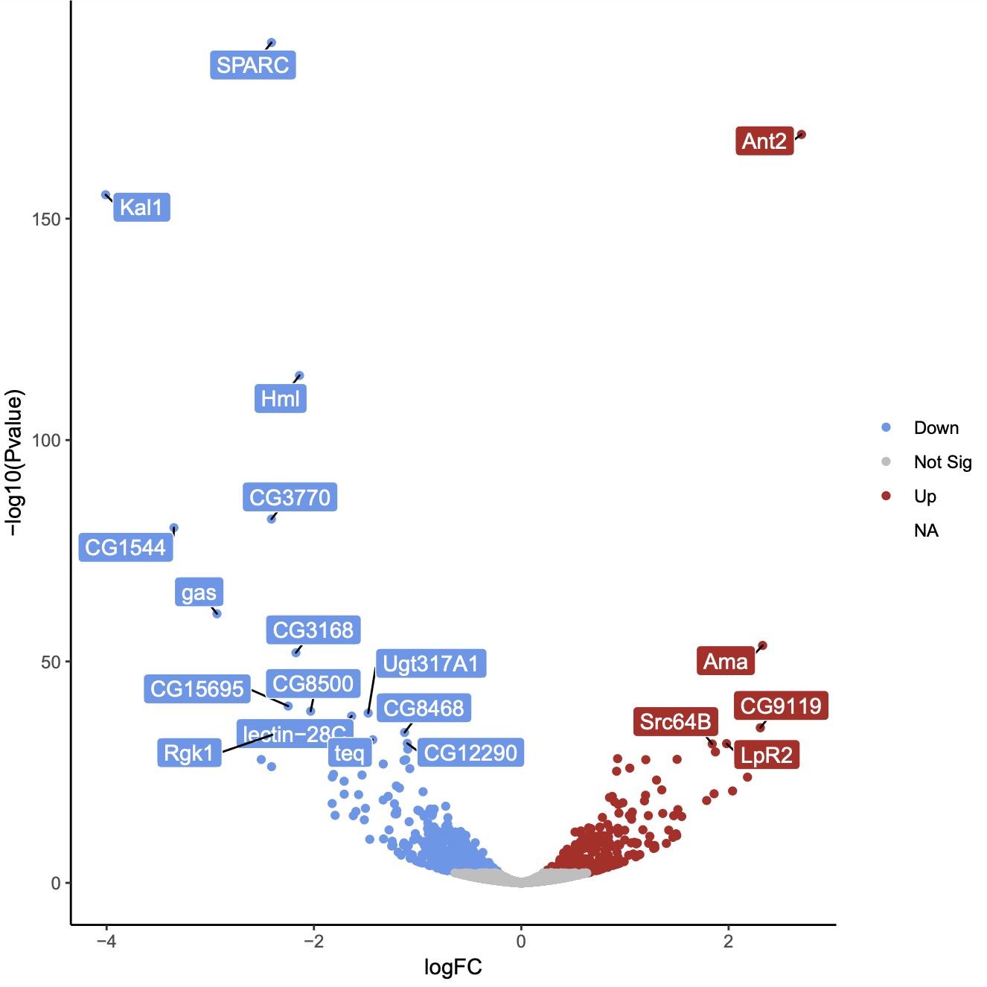
Volcano plot
Statistically significant ->
Downregulated <- Fold Change
Fold Change -> Upregulated

Slide 16
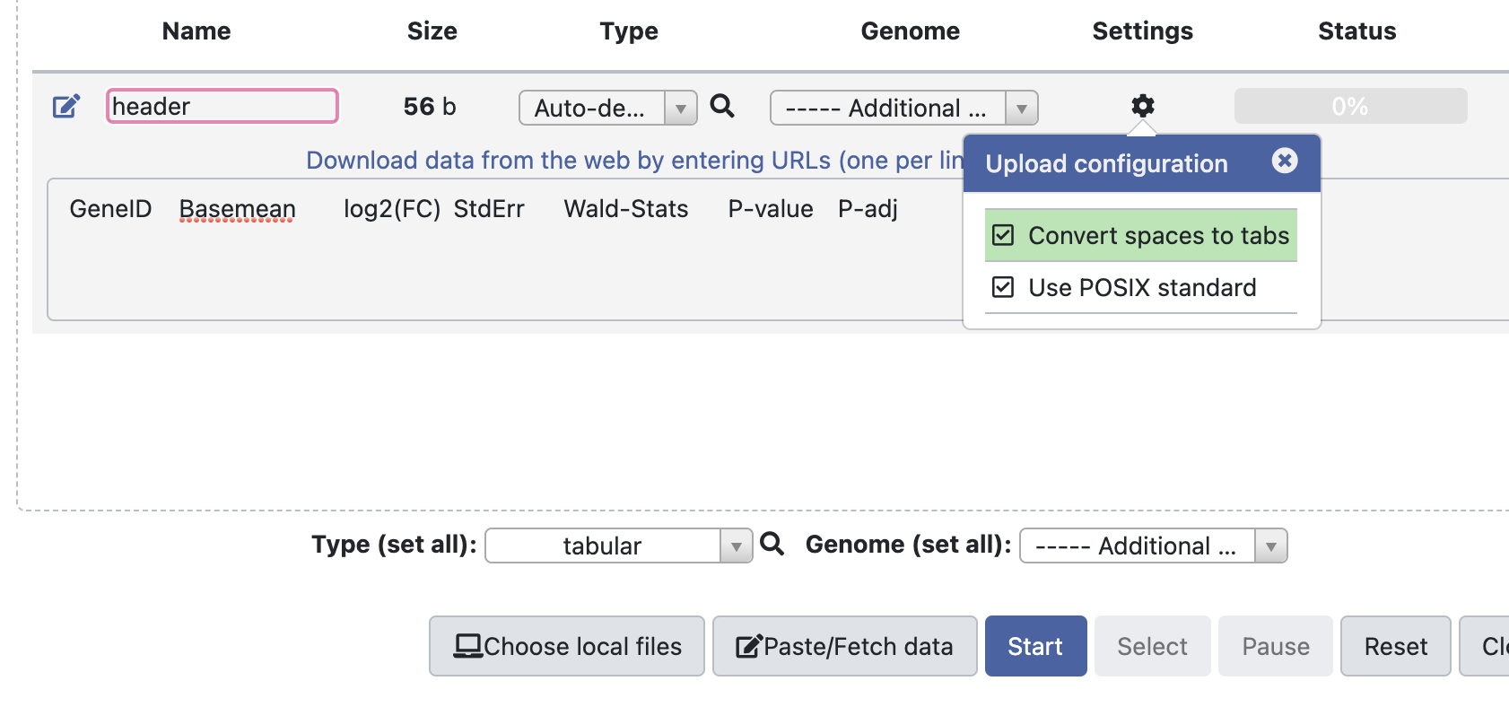
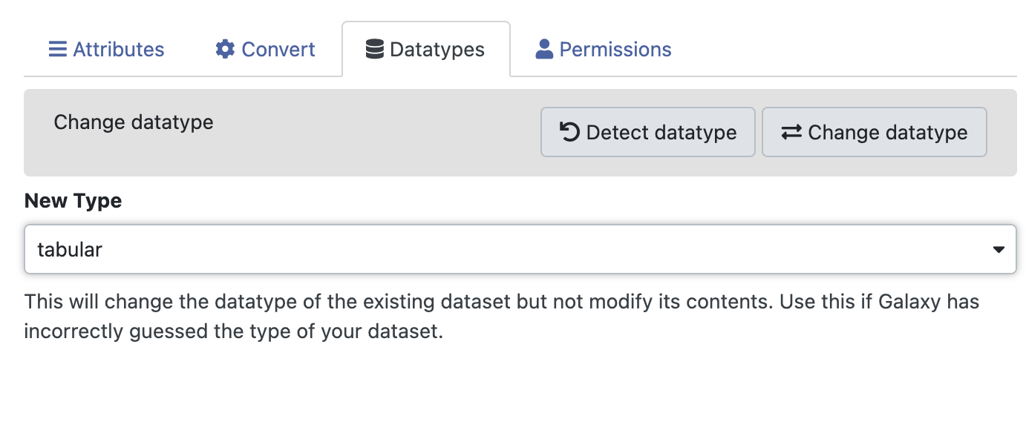
First, make a header.
Click the right pencil icon -> Edit attributes, make sure that your header data type is “tabular”

Slide 17
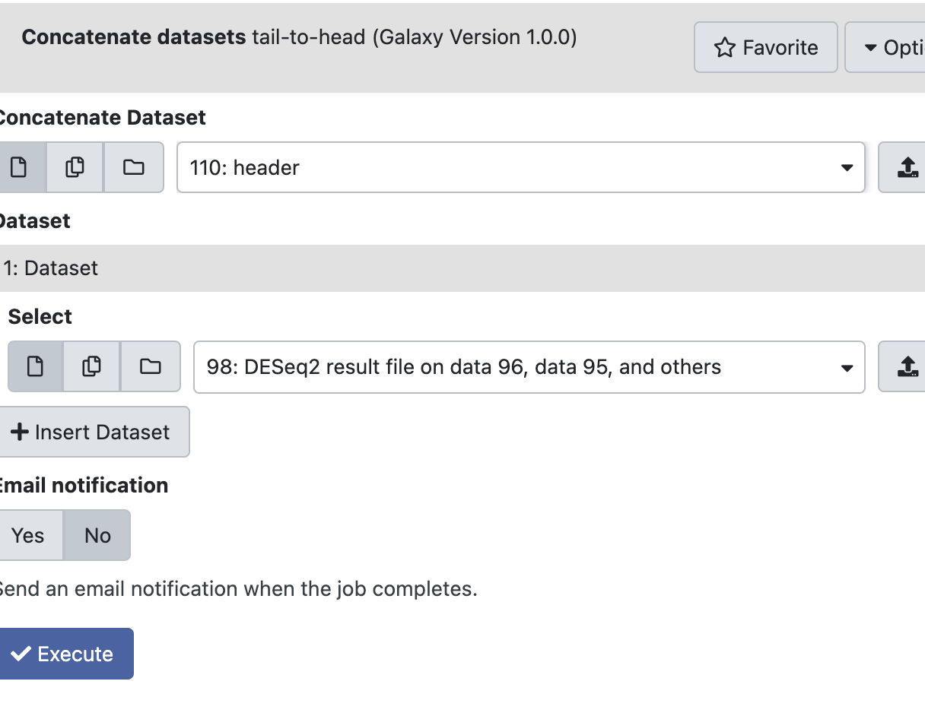

Slide 18
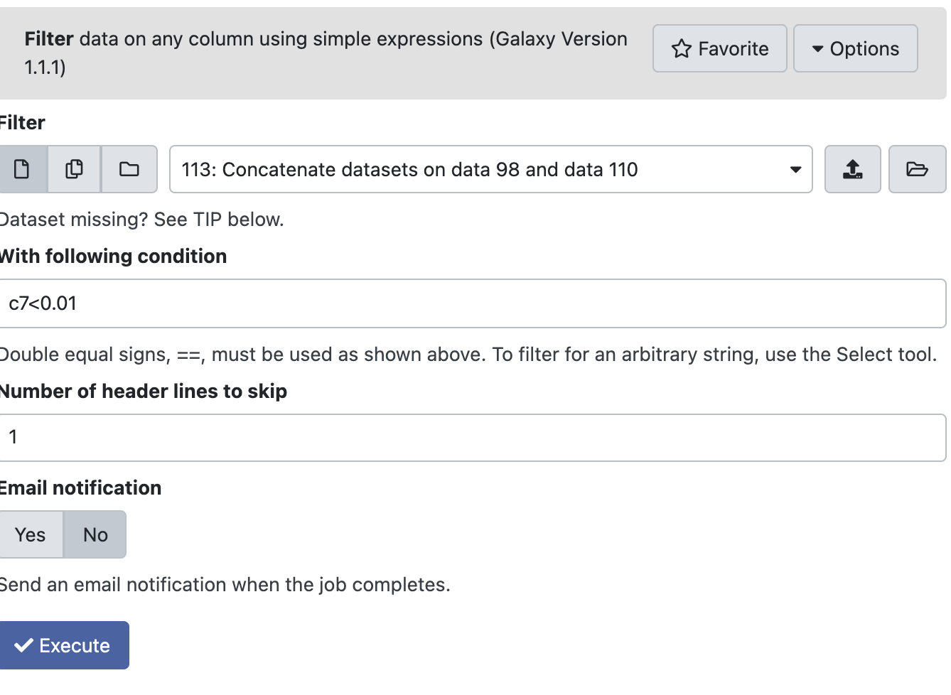
Extract differencially expressed genes

Slide 19
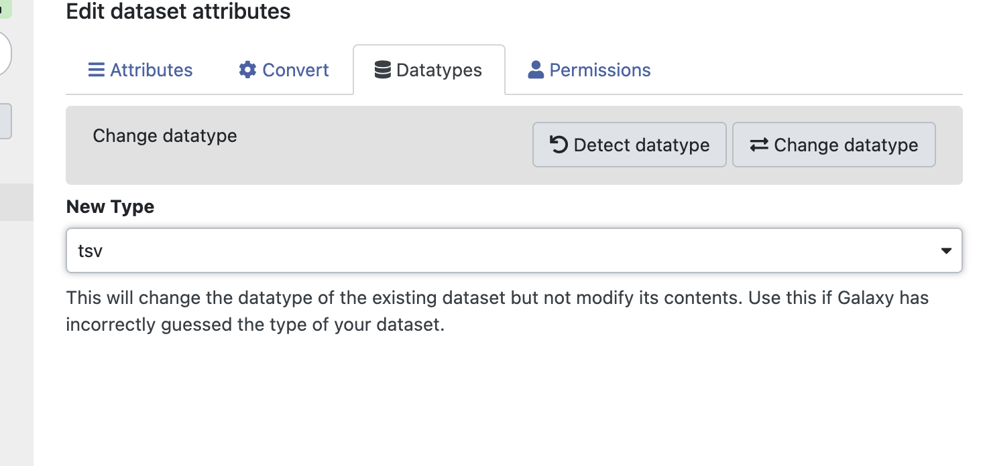
Extract differencially expressed genes
Change the data type to tsv.
You should be able to download it and open it with MS Excel!

Slide 20
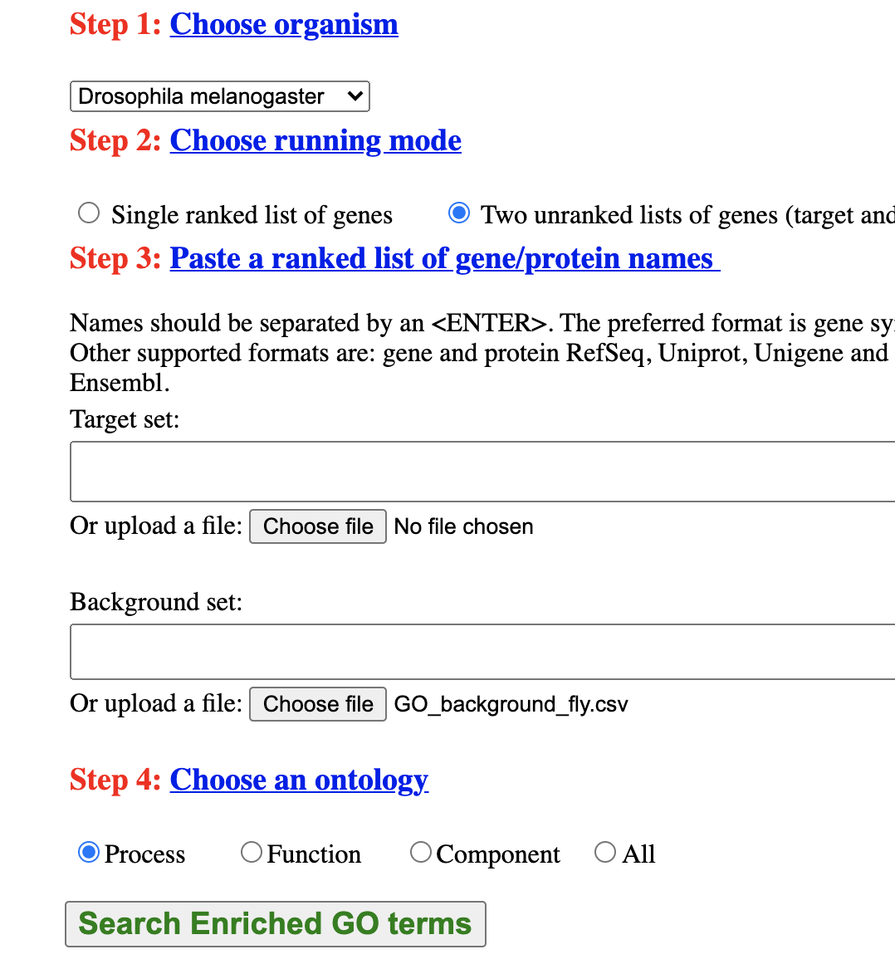
GOrilla – Gene ontology
Copy and paste your genes (gene names ) here
Put bachground gene file here

Slide 21
