Slide 1
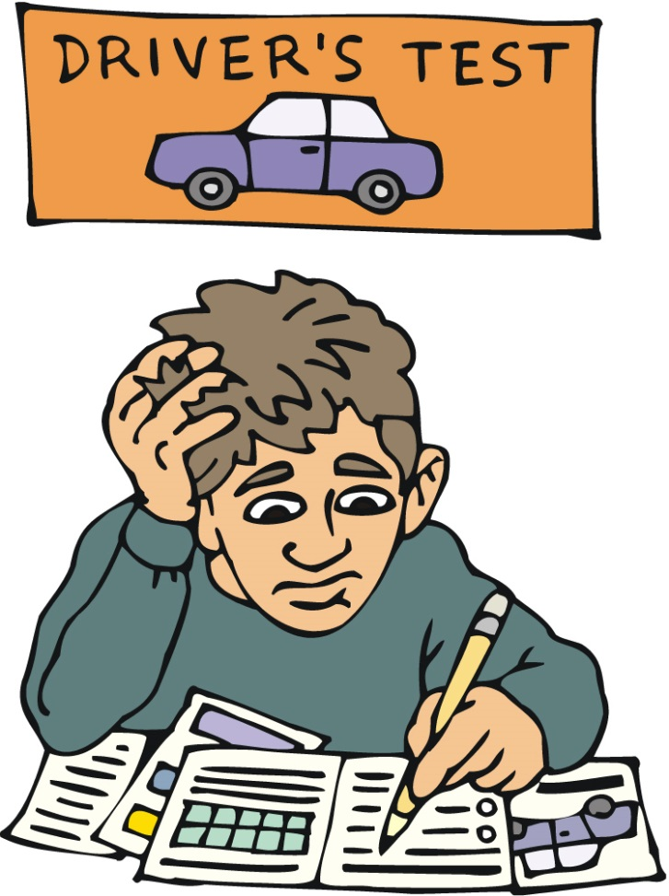
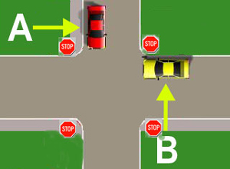
Driver’s Test
Java Script Applications
Raspberry Team
Telerik students

Slide 2
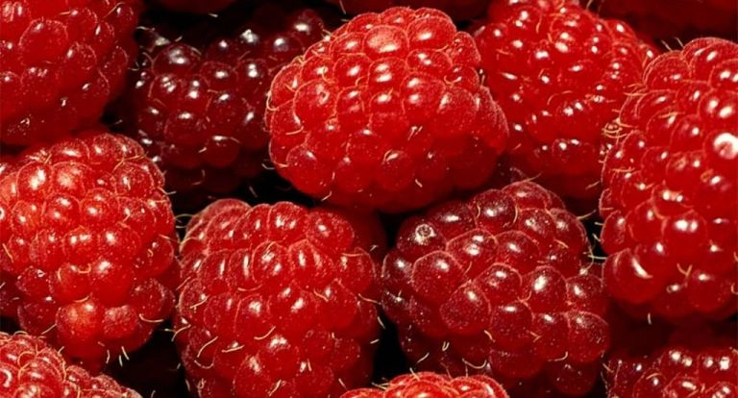
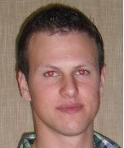
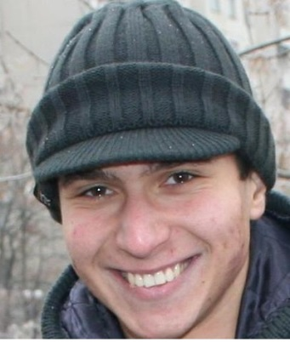

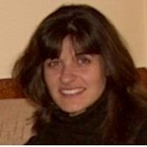
Raspberry team members
Мартин Иванов
Добромир Кралев
Ивайло Въчков
Мариета Георгиева

Slide 3
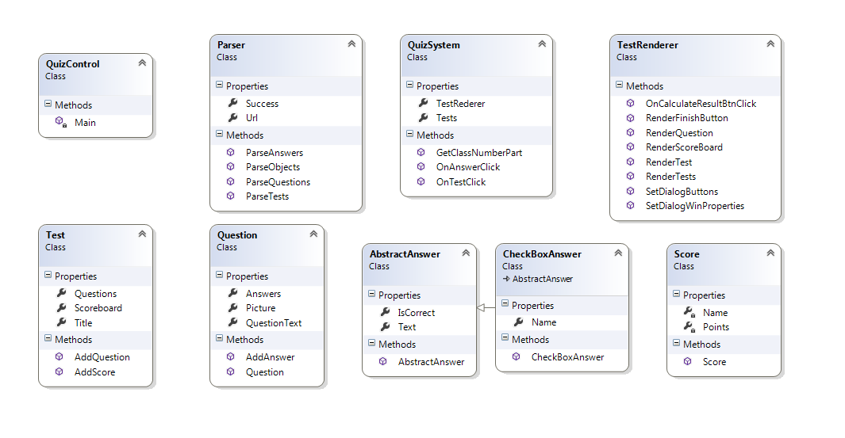
Class Diagram

Slide 4
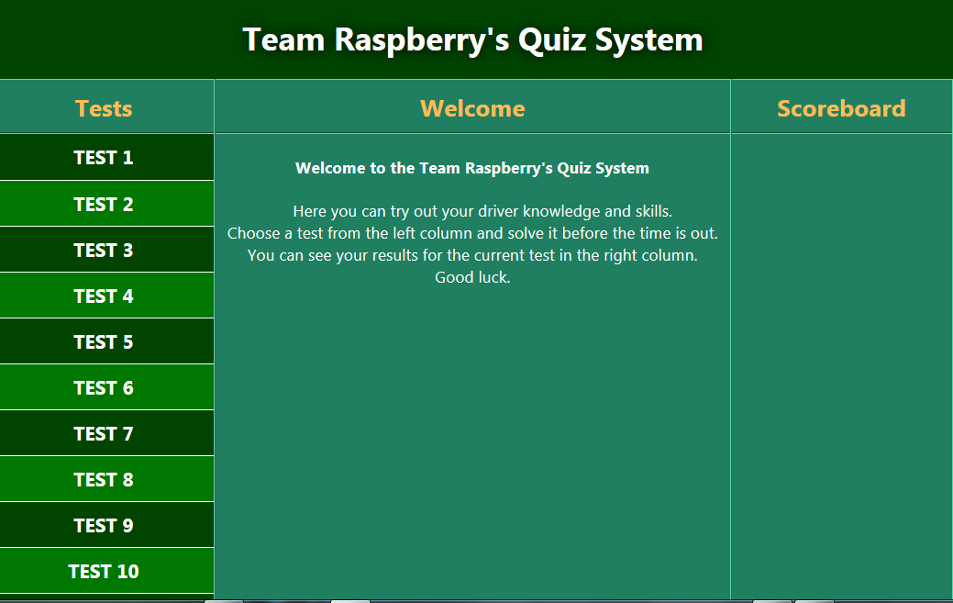
Basic Screen

Slide 5
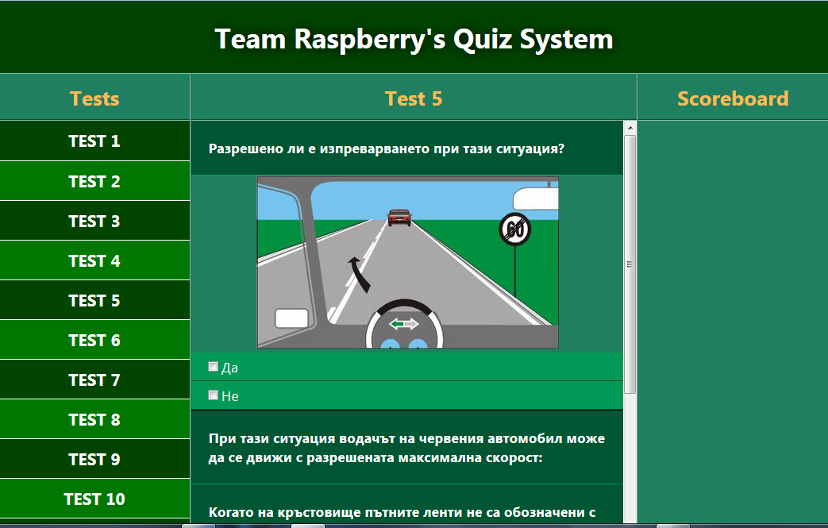
Tests Screen

Slide 6
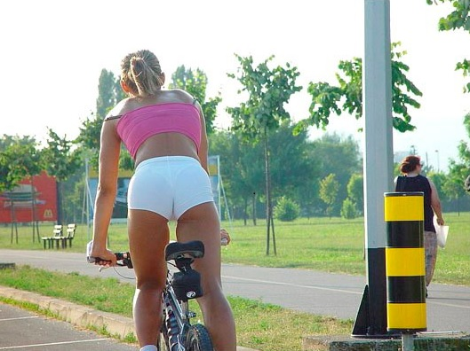

Sample question
You are driving your car.
Are you allowed to stay behind this bike?

Slide 7
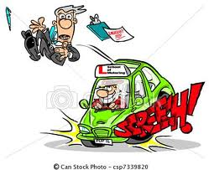
Show Results
Sorry!
You failed!

Slide 8

Show Results
Congratulations! You passed!

Slide 9
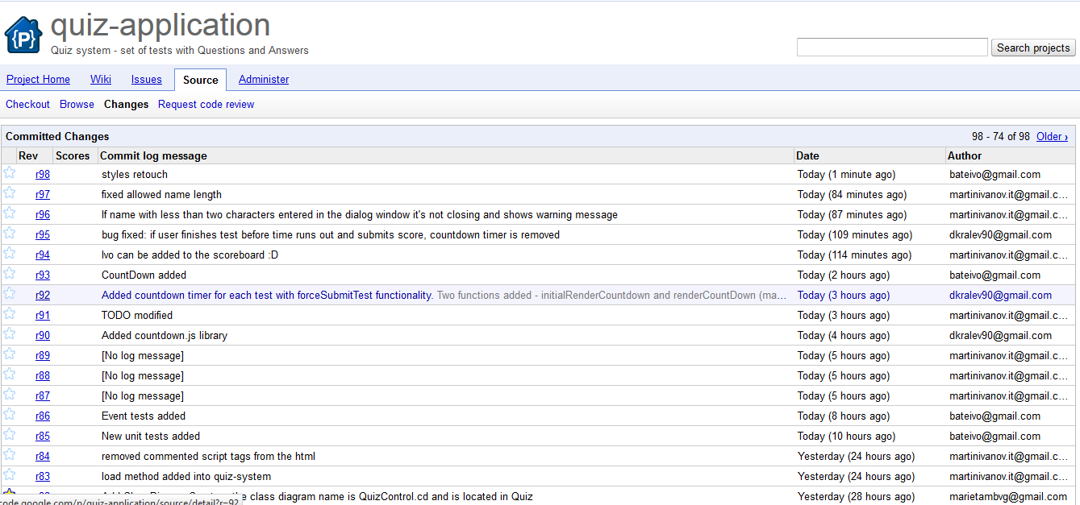
Coogle Code Commits
http://code.google.com/p/quiz-application/source/list

Slide 10
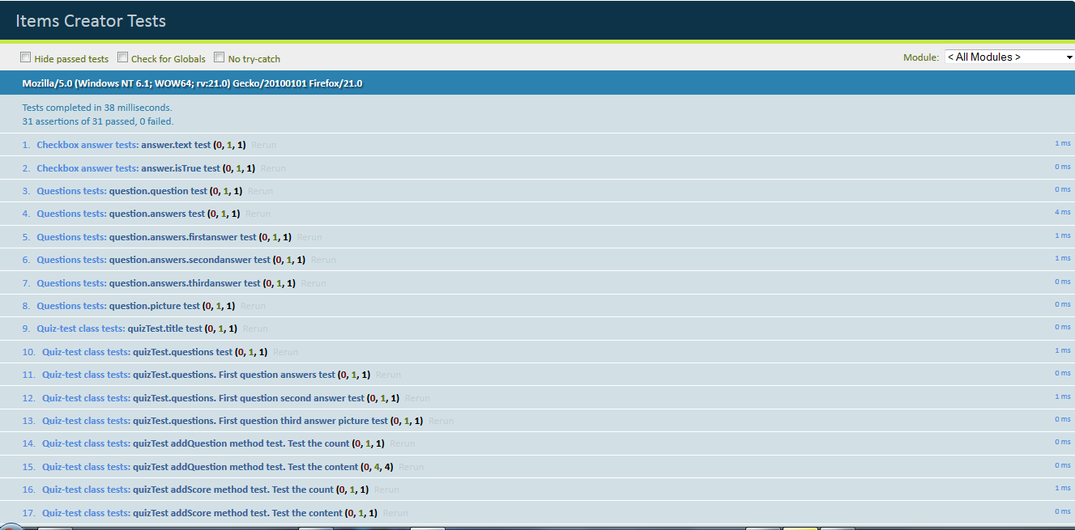
Unit Tests

Slide 11
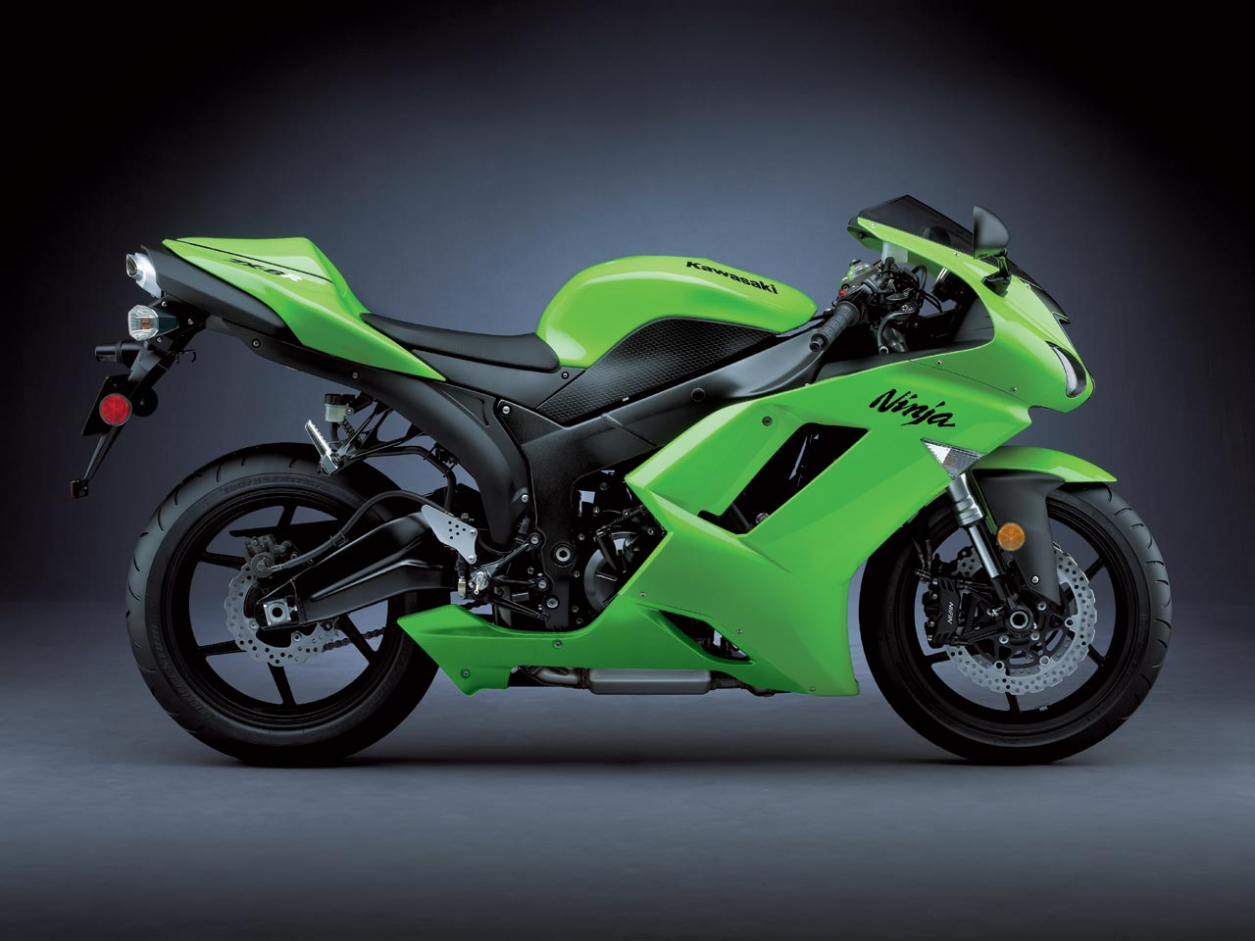
Wish you lucky drive!

