Slide 1
Credit Risk Management in OFS
A Detailed Summary of Lending through Ola Money Postpaid (OMPP)

Slide 2
Index
Credit Principles
Underwriting
Process Flow
Fraud and Risk Policy
Segmentation
Credit Risk Modeling
Line Assignment
Reporting and Monitoring
Current Performance
Life Cycle Management
Process Flow
Risk Policy
Reporting and Monitoring
Current Performance
Collections
Strategy
Operations
Capabilities
Reporting and Monitoring
Current Performance
Enabling Entities
Team Profile and Skills
Data Sources
Tools
Infrastructure

Slide 3
Section 1
Credit Principles
Applied to Postpaid Lending

Slide 4
Credit Lifecycle and pillars of lending - Application to OMPP
Life Cycle of Lending
Pillars of Lending
Feedback
Feedback
Intent to pay
Ability to pay
Contactability
Past behaviour in lending and clean intent
Income to repay loan and acceptable credit leverage
Able to contact and recover dues when default
Underwriting (U/W)
Life Cycle Management (LCM)
Collection
Impact
On OMPP
U/W is driven primarily by loyalty, cabs need, risk proxies from Ola
Initial Lines - 500 to 4000 in increments of 500
Adoption rates vary for cashless (40%) vs. cash (10%) in first 1 Mon
LCM & Line increase follows low and grow. User proves good risk first to get higher line as reward.
Line focused on cabs need majorly for now which keeps getting updated as per usage on Ola
Collections driven by cabs usage → subject to mobility demand and cabs supply variations
On OMPP
1. Intent to Pay factored into models used for enablement
Deterrent: Essential factor in Lending is less intense. Late Fee from Jan 19 added muscle
2. Ability to Pay is derived as proxy of cabs GMV
Bureau data being used from Jun 18 for income proxies and “off Ola” net worth
3. Contactability is phone based identity
Verification is contingent on cabs usage. Alt contact info sourced from bureau

Slide 5
Section 2
Underwriting

Slide 6

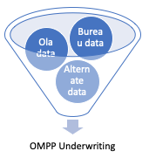
Underwriting in OMPP
WHY
Lending is balancing risk and revenue → Quality of books to achieve this right mix is determined by underwriting
Customer acquisition is biased usually towards high risk (credit hungry will adopt fast). Keeping off such unwanted early adopters is key to manage customer acquisition cost (CAC) as eventual losses constitute CAC
Lack of a strong deterrent in OMPP (viz. bureau reporting, interest charges) gives little room for risk control
Credit worthiness keep evolving in customer lifespan. U/W waits for right signals in recent past and predicts potential performance in future.
External factors like macroeconomics and cabs business fluctuations in Ola are difficult to predict → Baked into worst case scenarios of enablement campaigns
WHAT
OMPP enablement is completely data-driven that combines the pillars of credit risk in Ola cabs use case
OFS uses a mix of Ola data (focus on cashless, loyalty, ride need)+ Bureau data for U/W. Alt data in exploration stage
Underwriting strategies are constantly monitored, investigated and restructured → Catching up with new risk trends
Line assignment manages early adopters risk (CAC) which has to get offset by returning customer’s business
Process for constant feedback loop from both LCM and Collections in place for robust strategy refinement
Marketing cost is non-existent other than product interventions in the initial phase of campaign launch
Customers’ show great loyalty if credit product is offered to them at right time, also many customers prefer the lending product for convenience

Slide 7
Section 2.1
Process flow

Slide 8
Underwriting Process Flow
1. Ola Customer base
2.Fraud Rule Check
Yes
3. Policy Rule Check
Yes
4. User Segmentation
Feedback
No
No
5a) Underwriting ML-Model at segmented level
Reject
No
6. Risk Cut-off based on 5a & 5b Models
9. Reporting and Monitoring
(Track, Learn & Improve)
5b) Empirical model based test on new segment
Yes
Feedback
8. Enable
7. Risk based Postpaid Line assignment
For Pilots, Approval by Risk+Business head
No
Each month there are multiple U/W campaigns that get launched based on experimentation (new segments) and BAU churn (proved segments) which go through the same rigour every time.

Slide 9
Section 2.2
Fraud and Risk Policy

Slide 10
Fraud policy (exclusions)
Fraud type and Definition | Example in lending | Example in Ola
1. First party fraud: An individual or group misrepresents their identity or gives false information when applying for a product or services to get more favourable deals or have no intention of repayment | Individual is aware that (s)he can not get the loan amount as per her/his need, fakes salary or applies for multiple loan (at diff lenders) to get the higher loan amount | Individual uses dual sim phone and log-in, defaults on 1 account and they start using ola new account/ log-in with 2nd account
2.* Second party fraud: An individual knowingly gives their identity/PII to another individual to commit fraud | Individual uses the credit card >> throws the credit card >> informs the lender that the spend on card is not done by the user, someone has taken over the account | Individual uses the Ola services and says that (s)he had paid in cash, so, will not return the cashless (CC/DC/OMPP etc.) dues.
3. Third party fraud: An individual creates or uses another person’s identity to takeover the account | Hackers mimic PIIs of customers who can get good credit lines and apply for loans. | Drivers ask for A/C log-in from customers and take-over the account
Note: 2.* Identifying 2nd party and 3rd party fraud is really difficult. Generally, lenders/customers either toggle between “legal proceedings” or “customers experience” (ex: Amex write-offs the amount, or account is reinstated back to the customer based on minimum post mortem of fraud”)

Slide 11
Fraud policy applied on OMPP
First party fraud (misrepresent):
To avoid 1st party fraud, customers with dual logins (using device fingerprinting), are not being offered Ola postpaid.
Rule is more severe than cabs fingerprinting as the use cases and impact are disproportionate b/w cabs and OMPP
Risk performance of such customers, shown in slide 13.
Second party fraud (PII given):
To avoid 2nd party fraud, customers with recent time disputes on cabs platform are avoided.
Push notification for all rides in 1st cycle that create awareness about cash paid to driver for OMPP (cashless) rides
Third party fraud (hacked PII):
New device login OTP made 6 digit (ride 4 digit) to minimize intentional account takeover attempts by driver

Slide 12
Risk Policy overview
Why is it needed?
Example in lending
Example in Ola
Reduce Loss
Reduce cost of acquisition
Reduce ops cost
Regulatory requirements
Maintain homogeneity for better decisioning
Reject if
Particular geography, due to high operation cost or collection cost (outskirts of metro viz. howrah)
Income < 5 lakhs.per.annum
Particular professions (ex: lawyers, gym owners)
Bureau red flags: Disputes, write-off, bankruptcy
Bureau score (ex: CIBIL/Experian score < 710), risky loans (Ex: gold loans, Krishi loans)
Age<25
Reject if
If customer is frequenting educational institutes (potential student who can discard phone identity easily)
Fingerprinting that detects dual login on 2 different numbers
Users outside Top 7 cities getting high limits (field ops for collections take time to be live there)
Customer with disputes on Ola might prompt intentional default
Previously due on other payment instruments (CC/DC/UPI)
Blocked by OM due to suspicious activity on wallet

Slide 13
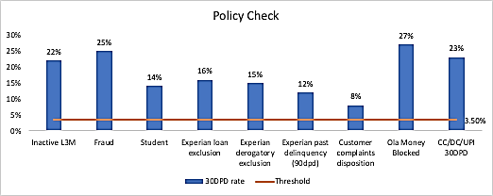
Risk Policy in OMPP
Following are the controls used as policy exclusions:
Inactive in L3m - Low or No need for mobility solutions from Ola
Student - Data driven student indicator that minimizes exposure to people with high tendency to skip payments
Bureau exclusion - External bureau data driven risky profiles of people taking loans with high defaults: gold, MFI, commercial
Experian derogatory info exclusion - suit filed, wilful default, written-off, etc
Experian past delinquency history - 90 dpd in last 12 m
Corporate users - potential to skip or delay payments due to nature of business using cabs for official purpose
Customer complaints - recent fall off with cabs and ola in general; unhealthy brand perception
Blacklist signals from internal payments - om blocked; CC/DC/UPI defaults in L6M (30 DPD+)
Impact of policy exclusions:
Policy exclusions are 4 times higher risk than portfolio avg. risk
Policy exclusions saves huge risk on a focused small population
Population getting excluded ~ 10%
30 dpd risk ~ 13% for policy exclusions vs.~ 3.3% for portfolio overall
Bureau information enhances policy exclusions further

Slide 14
Section 2.3
Segmentation

Slide 15
Segmentation
Why is it needed?
Example in lending
Segmentation in Ola
Customer segmentations are done so that specific needs of customers can be reached in targeted manner and also Business priority can be made accordingly. Mostly 2 types of approach are used:
Revenue driven: Revenue driven approach are used to create different strategy for different segment (Ex: CC repayment has high MDR so, can be dealt differently)
Data driven approach: It’s mostly done based on different behaviour across segment, data availability for predicting customers’ behaviour
Channel of acquisition driven, different acquiring channel have different activation rate and similarly different risk level
Age/profession/income driven
Past behaviour driven, for ex. if customer has shown loyal behaviour in some other product offered by the institutions etc.
Geography driven
Ola book segmentation is majorly based on customers’ behaviour on Ola cabs, Geography and performance of customers on other lending products (data from credit bureau (Experian))

Slide 16
OMPP Segmentation
Segmentation is about creating intra homogeneous persona (risk) pools and inter heterogeneous risk pools.
Leads to increase in accuracy of prediction
Aids in better control of each populations due to similarity of customers within that groups
Level 1 segmentation
First level is demarcation of utility from OMPP: Those who are regular on Ola Cabs and who are not.
Regulars are further divided into Cash and Cashless since OMPP has a better USP for one over the other.
Final segments: a) Regular user (UHF,HF,MF) Cashless, b) Regular user cash and c) Irregular user (LF/Inactive)
Segmentation provides risk ranking as well as adoption similarities
Ola Customer base
Cashless
Cash
LF/Inactive
1
Have CC
Have CC
Have CC
Level 2 segmentation
OMPP being a revolving credit (digital CC) users with exp in using credit cards will be natural targets
“Have CC” are better risk due to lenders’ due diligence prior to issuing cards
“No-CC” are bureau hits but without a card. They are basically those who don’t want traditional credit cards or those who want but did not get it yet
“No-CC” are much better risk than those not found with bureau history
Inactive/LF evaluated on “Off Ola” features hence no-hits are excluded
No-CC
No-CC
No-CC
2
No Bureau History
No Bureau History
No Bureau History
With increase in OMPP base, next level of segmentations are planned based on customers’ persona, spend behaviour across different merchants, push/pull factors (right now all are push>> OMPP is reaching out to customers)

Slide 17
Segmentation in OMPP Underwriting
Total - 305L*
(in 6m**)
Active L3M - 214L
Inactive L3M - 91L
Cashless - 32L
Cash - 182L
Whitelisted - 5L
Not-Whitelisted - 86L
Whitelisted - 20.7L
Not-Whitelisted - 11.5L
Whitelisted - 12.6L
Not-Whitelisted - 169.1L
Scrub - 4.7L
No-Scrub - 0.4L
Scrub - 18.2L
No-Scrub - 67.5L
Scrub - 9.7L
No-Scrub - 1.7L
Scrub - 54.7L
No-Scrub - 114.4L
Hit - 5.4L
No-Hit - 12.8L
Hit - 3.7L
No-Hit - 6.0L
LF - 1.40L
MF - 0.30L
HF/UHF - 0.06L
Hit - 16.6L
No-Hit - 38.1L
LF - 107.73L
MF - 6.16L
HF/UHF - 0.51L
LF - 2.04L
MF - 1.18L
HF/UHF - 0.52L
LF - 2.88L
MF - 1.97L
HF/UHF - 1.12L
LF - 11.13L
MF - 4.40L
HF/UHF - 1.03L
LF - 23.36L
MF - 11.47L
HF/UHF - 3.33L
* L is lac(s); L3M is last 3 month(s)
Scrub: Bureau pull attempt made; No- Scrub: Bureau data pull attempt was not made
Hit: Bureau pull attempt returns positive match; No-Hit: Bureau pull attempt is negative

Slide 18
Section 2.4
Credit Risk Modeling

Slide 19
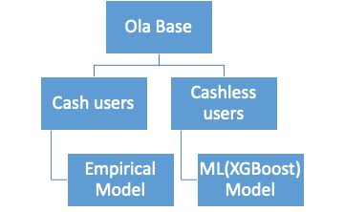
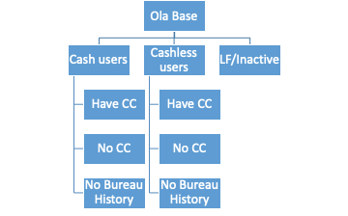
OMPP UW Modeling Transition
Early 2018
Late 2018 - 2019
2 segment level models
7 segment level models
UW Strategy post Bureau Data Availability (Late 2018)
 |  | UW Risk bucket
 |  | Very Low | Low | Medium | High | Very High
Experian Risk Bucket | Low
 | Medium
 | High
 | No-hit

Slide 20
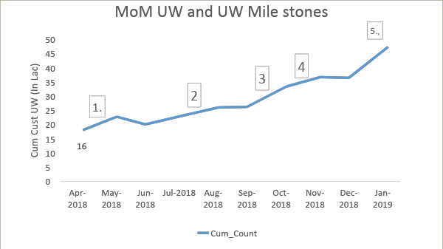
Journey of Cashless Model >> 2 ML models in place (5 more models under dev)
Evolution of Underwriting models
Stage 1: Business Expertise/Hypothesis based U/W
Stage 2: Preliminary model
Stage 3:
Machine Learning (ML) Models
Journey of Ola UW modeling - Chronological Order
1
Stage 3 model for cashless is built
2
Cashless U/W policy enhancement with bureau
3
Stage 1 U/W for Cash Bureau Hits (w and w/o CC)
4
Stage 2 model for Cash Bureau Hits (w and w/o CC)
Stage 3 models for cashless at segment level (Bureau Hits w, w/o CC, No Hits) using enhanced Machine Learning Algos
Stage 3 models for cash (Bureau Hits w, w/o CC, No Hits)
Stage 1 for LF/Inactive
5
Each step is required, so that performance can be observed at controlled volume and credit risk level

Slide 21
Journey of Cash Models >> Expertise based Pilot model (CC Seg)
Based on the framework explained below, 5% customers are being underwritten from each segment (i.e. alpha, beta etc.), and their performance is closely observed.
 |  | Global Segment
 |  | High | Medium | Low | Very_Low | No_tag | Not_known
Local Segment | HIGH | Alpha | Beta | Theta | Zeta
 | MEDIUM | Beta | Gamma | Delta | Zeta
 | LOW | Theta | Delta | Delta | Zeta
 | VERY LOW | Zeta | Zeta | Zeta | Zeta
 | Not-Known
CC Tag Segment:
High: CC_Mnth_Spend >30k & CC_MOB > 1Y
Medium: CC_Mnth_Spend >10k & CC_MOB > 6M
Low: CC_Mnth_Spend >2k & CC_MOB > 3M
Very Low: Rest
Affluent Score Segment:
High: Score>=22 (top 10% of ola base)
Medium: Score>=16 (next 10% of ola base)
Low: Score>=9 (50%-80% of ola base)
Very Low: Rest
Loyalty (Max L3M ride*3/Sum L3M ride):
High : >=70%
Medium : 70%>x>=55%
Low : 55%>x>=35%
Very Low : <35%
Mobility (#L3M Rides):
High : >=11
Medium: >=6 and <11
Low : 3<=x<6
Very Low : <3
Behaviour Segment
 |  | CC Tag segment
 |  | High | Medium | Low | Very_Low | No_tag | Not_known
Affluent Score Segment | HIGH | H | H | M
 | MEDIUM | H | M | L
 | LOW | M | L | L
 | VERY LOW
 | Not-Known
Global Segment
 |  | Mobility Tag segment
 |  | High | Medium | Low | Very_Low | No_tag | Not_known
SOW Segment | HIGH | H | H | H
 | MEDIUM | M | M | M
 | LOW | M | L | L
 | VERY LOW
 | Not-known
Local segment

Slide 22
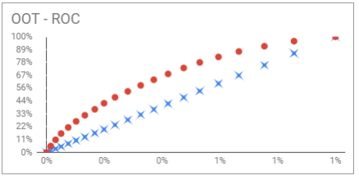
Journey of Ola Cash Model>> Stage 2 Model (Cash - CC Seg)
Based on performance observed from enablement (based on Business expertise), initial ML model is being developed. This model rank orders on broad buckets. It has been built on very small sample (owing to low activation of Cash customers in the start). The model was mostly built on Credit Bureau data.
Model will be able to segregate risk but not able to beat industry benchmark by high margin (GINI benchmark for UW in emerging companies/stable banks, b/w 25-30)
Objective of Underwriting model is to predict if the customer will/will not be paying back OMPP bill in next 30 days
Key features in the model:
Month since 1st lending product
Maximum days past due in last 6 months
Age of customer (in yr)
Risky loan
No of time 30 days past due in past 12 months
Avg. Utilization of credit card (Bal in 6 m/Line in 6 m)
KS | Gini
25.7 | 36.3%
Since performance of more than 10K customers is observed. A new ML model is being developed, using Bureau data and Ola data. By end of Feb’19 Model will be mature models

Slide 23
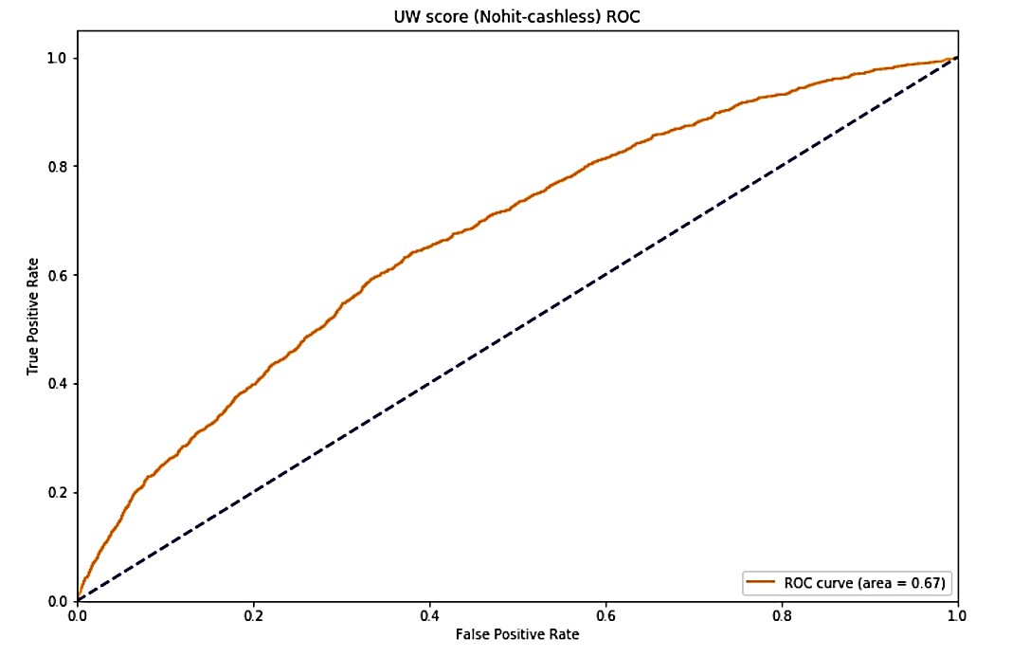
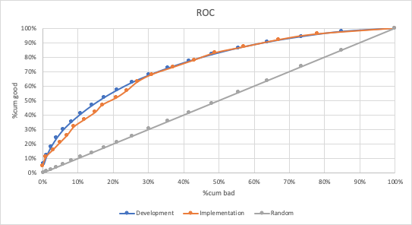
Cashless mature models performance Stage 3 redevelop
Usual Top Features in cashless models
Cash penetration | pg_amount_o_l3m
Age on Ola | Airport ride GMV spent
Zone score | OM gmv spent
OM transactions | Percentage of non-peak hour rides
True demand vs Ride demand | Ride score
Loyalty | Cashless ATS
Cash Extraction | Category - Auto, Micro, Non-share
 | Gini | KS
Model Metrics | 0.34 | 24
 | Gini | KS
Model Metrics | 0.4 | 31
Gini chart of Cashless no hit - Feb 2019
Gini chart of overall Cashless - May 2018

Slide 24
Section 2.5
Line assignment

Slide 25
Initial Credit Line (ICL) strategy
Fundamentals of line assignment
Function of 3 major dimensions.
Risk (Using UW models rule)
Ability to pay (Income/Salary)
Organisation’s risk appetite
Revenue growth targets
Loss threshold targets
Intent to Pay | Ability to Pay | Line
Low | Low | Block Line
 | Medium
 | High** | Low Line
Medium | Low | Block Line
 | Medium | Medium Line
 | High | Medium
High | Low** | Low Line
 | Medium | Medium Line
 | High | High Line
OMPP broad level strategy:
Cross tab between the 2 pillars of credit lending are the bedrock of line magnitude in U/W
Within the eligible cells of the cross tab, net revenue and long term value play a role on exact amount of line assigned
Every cell comes with a cap on limit that restricts over exposure at such an early stage (adoption) of a customer
Presence of collection ops also in taken into consideration for max credit lines for eg. field ops feasibility in T7
**Note: Override of BAU strategy is done majorly in 2 case, if customers’ income is too high or customers’ risk is too low

Slide 26
Underwriting Line assignment - Process
Ola line assignment is function of credit risk, spend behaviour on Ola, portfolio segment
Different risk behaviour >> less predictive power >> conservative line
Line assignment needs Model cap (or risk guard rails), this is done to control the exposure at different risk level
The Suggested Structure is for Top-7 Cities
Segment Name | With CC | Line = [Min ( Guardrails, Max{ Least integer in '500 (Multipliers * 15 day GMV), Floor of the Column }]
Product Min Line | 500
Product Max ICL | 4,000
 | Model Cap (Or Guardrails)
Ola Bureau Score | Bureau Score (Experian )
 | (860, +) | (810-860] | (760-810] | (710-760] | (690-710] | (660-690] | (-, 660]
1 | 4000 | 3500 | 2500 | 1500 | 1000 | Outside Ola Risk Appetite | Outside Ola Risk Appetite
2 | 4000 | 3500 | 2500 | 1000 | 500
3 | 3500 | 3000 | 2000 | 1000 | 500
4 | 3000 | 2500 | 1500 | 500 | Outside Ola risk appetite
5 | 3000 | 2000 | 1500 | 500
6 | 2500 | 2000 | 1000 | Outside Ola risk appetite
7 | 2000 | 1500 | 1000
8 | 1500 | 1000 | 500
9 | Outside Ola Risk Appetite
10 | Outside Ola Risk Appetite
Floor of the Column | 1000 | 1000 | 500 | 500 | 500 | 500
Multiplier (Avg. Spend in 15 days)
Bur-Score | MF | HF-UHF
[860, +) | 1.1 | 2
[810-860) | 1.1 | 1.75
[760-810) | 1 | 1.5
[710-760) | 0.9 | 1.1
[690-710) | 0.75 | 0.9
[660-690) | 0.5 | 0.5

Slide 27
Section 2.6
Reporting and Monitoring

Slide 28
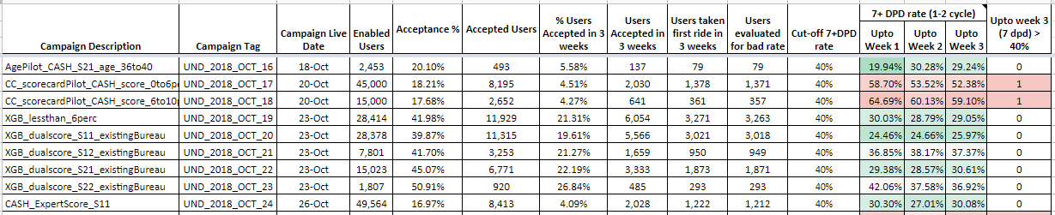
U/W measurement framework
U/W is tracked at campaign level - every campaign followed till its decommissioned on app since there is no expiry. Yet to evaluate expiry of 3-6 months in future.
Measurement focuses on
Early risk indicators (7DPD instead of waiting till 30 DPD) and
Fastest signals (1st 3 weeks of adoption for stability and volumes) that can be relied upon
Early indicators are closely monitored by Underwriting and Leadership team (Specially in case of new tests).
Tracking at early level (specially for hypothesis based underwriting) shows initial risk readings (callout 2) as huge. Quick actions taken on enabled but not accepted by de-whitelisting the remaining base
All other segments have performed better (callout 1) where first 3 weeks of adopted customers show initial risk measured by 7 DPD) are within the threshold of 40%
1
2

Slide 29
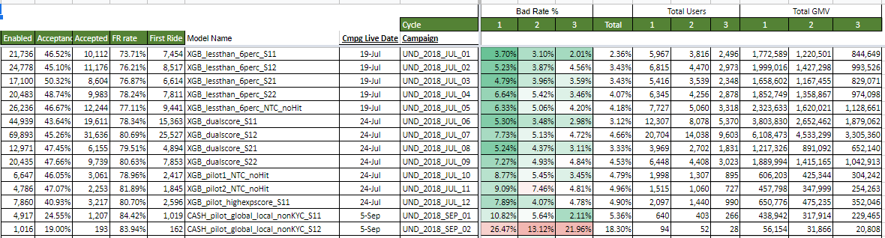
UW measurement framework (Contd.)
Second set of reports monitors campaigns after the initial sign off. This is done to account for macro factors in economy or within cabs platform.
This report tracks the health by each cycle cohort and ensures that returning customer (completed cycles >2) when given 30 days to pay have a desired curing rate.
The learning of such go-ahead campaigns both good risk as well as bad -risk are taken into consideration in the next gen model development process.
30 days past due as bad rate

Slide 30
Section 2.7
Current Performance

Slide 31
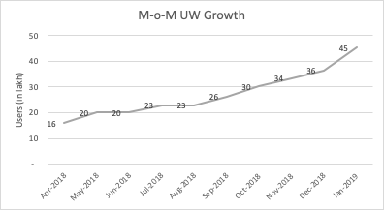
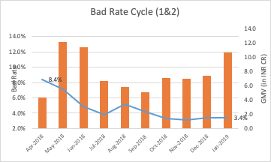
OMPP Portfolio Current State
1
MoM number of users whitelisted for OMPP have increased (from 16L in April’18 to 45L till date)
GMV contribution by new customers, is consistently growing over time. Spike in May and June’18 is due to New cashless ML model development in May.
30DPD bad rate has gone done over the period. It has been consistent in the recent months (Oct-Jan’18), to maintain the growth.
2

Slide 32
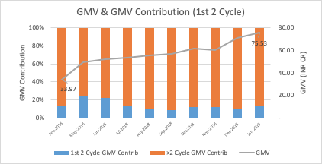
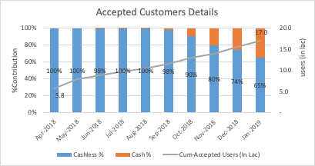
OMPP Portfolio Current State (Contd.
3
Portfolio mix of new customers (cycle 1&2) and old customers (cycle 3+) continue to remain constant, helping us keeping overall portfolio risk under control
4
Adoption of cash customers is increasing overtime consistently. Conversion of Cash base to cashlees is done in controlled manner, so that risk of overall book can be made consistent

Slide 33
Section 3
Life Cycle Management (LCM)

Slide 34
Life Cycle Management (Overview from OMPP standpoint)
Line increase is required to increase spend and enhance customer experience by meeting their mobility needs through OMPP (one bill for all rides)
Limit increase is typically carried out when customer's OMPP utilization exceeds 50%. The idea is to minimize limit exhaustion
By balancing the spend or need with the intent to pay and ability to pay
WHY
WHEN
HOW
LIMIT INCREASE MAGNIFIES GOOD GMV AND KEEPS PORTFOLIO BAD RATE IN CONTROL!!
OMPP Line increase framework uses “Low and Grow” as its bedrock.
Line increase has to be build after measuring the worthiness rather than in sudden jumps of limit. At the same time exhaustion due to spike in temporary need has to be addressed.
Dynamic authorisation is the ideal solution but increasing limit on a timely basis will arrest attrition.
As and when the customer builds their profile on Ola (behavior), the account is evaluated for credit worthiness
Bureau data and ompp repayment data using in-house customer behavior model.
Exhaustion at portfolio level, Avg limit of portfolio, extraction, proportion of population getting limit increase are key metrics

Slide 35
Reasons and TG for doing Life Cycle Management
Account management is one major lever, for following reasons:
Actively manage exposure (or asset) of the book
Actively manage customers’ changing need/ Macroeconomic scenario
Actively manage retention of customers
Actively monitor customers' behavior to make better decisions
TG within OMPP customers:
Active customers:
Inactive customers:
Enabled Not Accepted customers:
a) Customers’ Need change/Macro – economic scenario change
b) Exposure Management
c) Retention of good customers
d) More observation points
For OMPP, the biggest macro-economic factor is mobility need of customer. Line management should cater for increasing/decreasing mobility need
Over the period customers’ risk and capacity to pay changes. Therefore, to manage the risk actively Line management is required.
Customers’ with low risk and increased capacity to pay should be given +ve treatment vis-a vis customers who are showing deterioration in risk should be given negative treatment (Credit line decrease/ Price Increase)
If customer is low risk and capacity to pay has remained same/ improved, then the customer may get many offers in the market. THis in-turn creates huge attrition risk.
Also, if these customers (good customers) attrite then good balance (or expenditure from low risky customers) decreases, which further increases the loss rate of portfolio {loss rate = bad Balance/(Good + Bad Balance)}
While underwriting, lenders have limited data points about customers’ profile and behaviour.
By observing customers’ interaction with the product leads to better predictive capability and hence better decisions can be made

Slide 36
Strategy for different OMPP segments
Segments
Active
Inactive
Enabled not accepted
Strategy
Exposure management – increasing exposure with better credit quality customers and reducing exposure with high risk customers
Activate customers – incentivizing customers to use their line of credit again
Activate customers – incentivizing customers to use OMPP
Treatment
Credit line increase
Credit line decrease
Dewhitelisting
Customers inactive for longer period
Credit line increase selectively
Credit Limit update
Credit Policy consideration
Internal behavior model score of a customer
Customers’ capability to repay
Need/Utilization of customer
External information including credit seeking behavior, bankruptcy information etc.
Customers’ capability to repay
External information including credit seeking behavior, bankruptcy information etc.
Customers’ capability to repay
External information including wallet share, credit seeking behavior, bankruptcy information etc.

Slide 37
Section 3.1
Process Flow

Slide 38
OMPP Credit Limit Increase (CLI) framework:
All users failing to qualify through policy checks are excluded
Cycle 1 & 2 users are usually not considered for limit increase, unless they are facing limit exhaustion
For Cycle 3+ users, high risk segments are not considered for limit increase, some of which are Customers:
With low activity (less number of cycles in last 3 mths) have high risk
With repetitive delinquency (DPD) behavior in past have high risk
For remaining cycle 3+ users considered as eligible for CLI basis:
If need on cabs > limit then these have need for higher limit, of which:
Users with regular need of cabs → significantly higher limit
Users with sporadic need of cabs → only to the extent of their need
If need on cabs < limit then reward high income users as limits should be sufficient for their sudden cab/external merchant need. High income segments are:
(Credit card limit >=2L or home loan>=20L or auto loan>=10L) + Score >810
>50% of rides with prime cabs or >3 airport/os/rental rides in last 3 month
Low and grow strategy:
Users are moved from lower limit to higher limit in stages
Users from ROI are capped to 5k limit and from T7 are capped at 10K limit
For Full KYC users, limit may go up and beyond 10K
OMPP Base
Policy Exclusions
Cycle 1&2 users
Cycle 3+ users
High Risk segment
Low Risk segment
Limit < Need
Limit >= Need
Steady Mobility Need
Bureau-hit
Bureau no-hit
Sporadic Mobility Need
High Income Users
High Income users
Low Income Users
Low Income users

Slide 39
Section 3.2
Risk Policy

Slide 40
Risk Policy and Exclusions
Fraud based on Ola fingerprint
Inactive on cabs
Past delinquent behavior on OMPP, CC, DC, UPI rides
Derogatory behavior or credit hungry behavior on bureau
Ola Money account blocked
Students
Disputes
Fraud Check
Profile Check
Ola Derogatory Check
Bureau Derogatory Check
All OMPP customers have to pass through following policies in order to be eligible for limit/line increase on OMPP:
Fraud Check:
Device Fingerprinting
OLA Money accounts are blocked for any user, if a fraudulent transaction is associated with that account and hence, are risky for OMPP
Profile Check:
Users not active on Ola Cabs for significant period of time (3 months)
Users who have high number of pickups or drops to college/universities (proxy for students) - low chances of clearing dues (inability to pay)
Users who have recently raised a concern related to safety, dispute with driver, trip abandoned, fare related issues - Recent unhappy OLA experience - high risk
Ola Derogatory Check:
Users who have high number of days past due (DPD) on other instruments like credit card, debit card, UPI or on OMPP
Bureau Derogatory Check:
Users who have filed willful default suit or are 90 days past due in last 12 months on bureau / very low bureau score (sub-prime)
Users with high risk loans like gold loan/student loan/microfinance loans - considered risky for credit product
Users whose score has deteriorated significantly in last 3 months is an early signal of credit risk (over-leverage or near to a delinquent trend)

Slide 41
Predictive Features used in CLI Strategy and Modeling
Number of times delinquent
Bureau Score
Number of times limit exhausted
Regular versus sporadic need of Ola Cab
prime/airport/rental/os rides
Days or Cycles since delinquent
Credit Card User
Monthly Spend on Ola
High limit on credit card, mortgage or auto loan
Ratio of limit spent to OMPP limit
No personal cash loan
Delinquent amount
Delinquent behavior on bureau
Share of wallet on Ola
OLA Delinquency features
Bureau features
OMPP Utilization features
OLA Mobility features
High income proxy features
Ola Delinquency features: Recency, Frequency, Severity
Users with repetitive delinquency (days past due) behavior in past have high risk
Users who have shown one incident of risk (DPD) long time back but good behavior in recent times have low risk
Bureau features:
Users with Experian score <710 are considered risky for any credit product
Users with credit card on bureau and clean history are credit-worthy
OMPP utilization features:
High continuous utilization on OMPP signals OMPP is the most preferred payment method for these users
Users exhausting their OMPP limits signals need for higher limit
Ola Mobility features:
Regular user of Ola month over month have high mobility need and is more likely to pay on time
High monthly spend on Ola again shows high mobility need and hence, is more likely to pay on time
High Share of wallet means user is loyal to Ola and hence, will not defer payment
Income proxy features:
Users with high % usage of airport/prime/rental/os rides are usually high income users and have high ability to pay
Users with high limit on credit card/mortgage/auto loans are high income users and hence, have high ability to pay
Recency
Frequency
Good predictive feature should ideally cover information from all three dimension – frequency, recency and severity
Severity

Slide 42
Section 3.3
Reporting and Monitoring

Slide 43
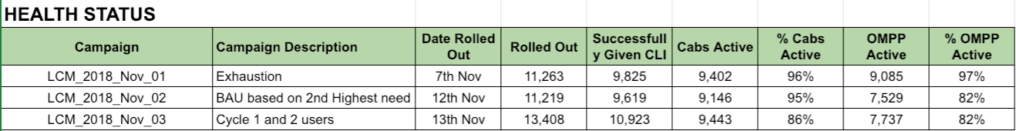
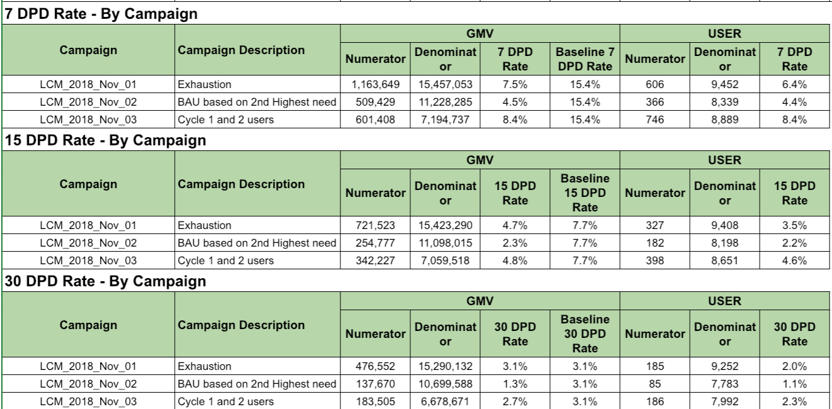
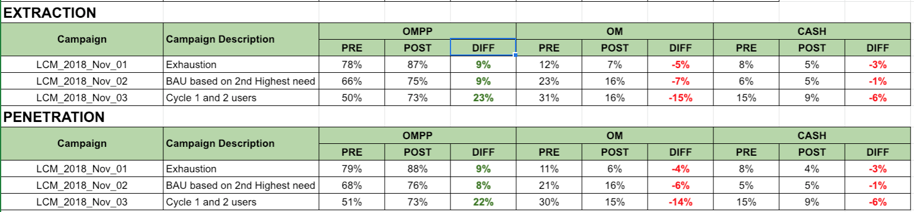
CLI reports
Each CLI campaign is monitored closely for any adverse results on following metrics:
% 7DPD GMV
% 30DPD GMV
OMPP Extraction (OMPP GMV/ Cabs GMV) is expected to increase after limit change
OMPP Penetration (OMPP rides/Cabs rides) is expected to increase after limit change
OMPP exhaustion (insufficient limit) is expected to continuously reduce
Extraction
Penetration
Exhaustion
GMV 7DPD
GMV 30DPD
Campaign monitoring metric

Slide 44
Section 3.4
Current performance

Slide 45
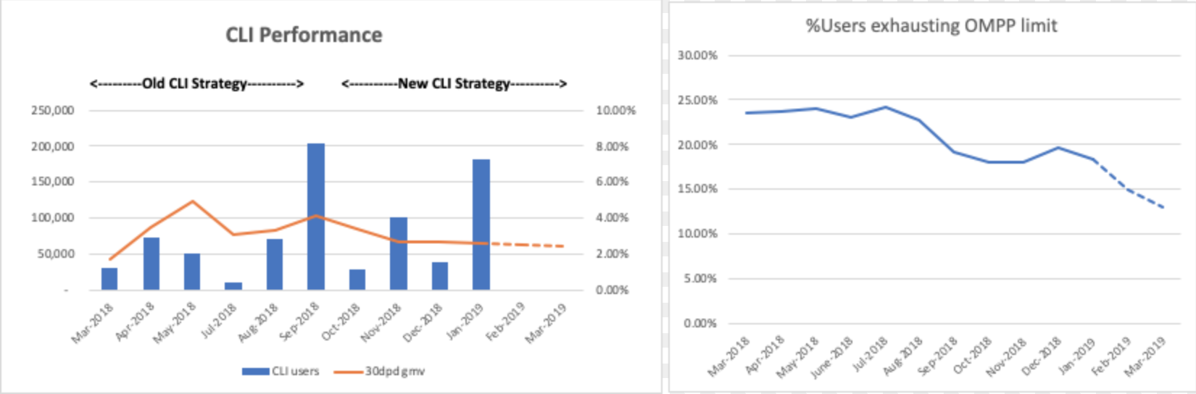
OMPP CLI - Impact on portfolio (1)
CLI Strategy:
Strategy has undergone major modifications on new risk insights.
Learnings implemented led to realized drop of 75-80 basis points in 30dpd GMV rate (see above chart) currently at (2.3%) - significantly lower than portfolio avg (3.5%)
% Users exhausting their OMPP (unmet credit need) has been consistently decreasing MoM.
Targeted 13% by March end. Currently at ~18%
"Best risk" users will get higher limits to enable them to use OMPP for potential external merchant needs
Automated bi-weekly CLI to be installed to reach steady state rule based line increases consistently every 2 weeks

Slide 46
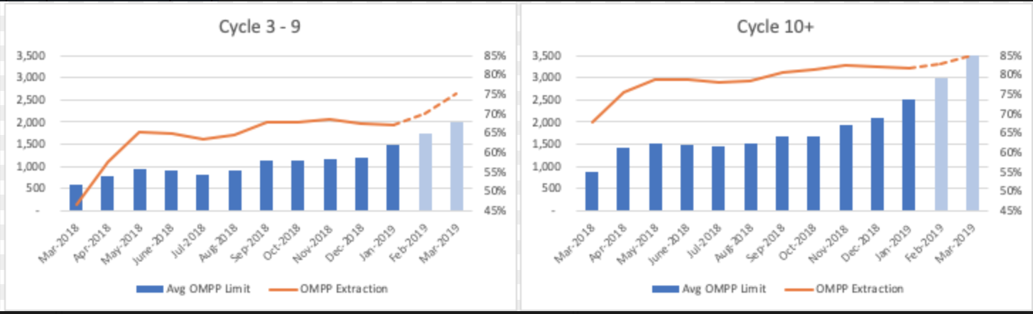
OMPP CLI - Impact on portfolio (2)
Portfolio status on credit limit:
Avg OMPP Limit for 10+cycle users has increased from ~1K to 2.5K so far. Targeted 4K by Mar-2019.
OMPP extraction for these users have increased from 68% to 82%. Targeted to reach 85% by Mar-2019
Avg OMPP Limit for 3 to 9 cycle users have increased from ~0.5K to 1.5K so far. Targeted 2K by Mar-2019.
OMPP extraction for these users have increased from 47% to 67%. Targeted to reach 75% by March-2019
Cycle 1 and 2 does not have line increases unless severe exhaustion use cases found.
Low and Grow discipline to control risk

Slide 47
Section 4
Collections

Slide 48
Collection Overview
Collection comes at the end of credit life cycle and is one of the most important lever for managing the risk. An efficient collection strategy, helps in clearing caught-up capital, dispute resolution (and hence better NPS) and risk reduction
Collection provides crucial feedbacks for building better strategy in underwriting/ Life cycle management and in improving the product. Eg. Customers from a particular geography or persona disputes (or threatens the collector); Repayment funnel sketcy.
Two major business sub functions: Analytics and Ops. Analytics provides timely signals (proactive) and action strategy, Ops helps in effective execution (reactive)
Why does customer default? Major reasons are explained below:
Tried repayment but due to product downtime not able to repay
Forgot to repay
Deterioration in financial health of customer
Product awareness: long term repercussion of default on availing future loans
Product proposition for the customer declines
Fraudulent intent
Emergency in Customers’ life
Disputes with product or service
From left to right, Low to High derogatory behaviour ⇒ Recovery propensity decreases, collection efforts change

Slide 49
Collections - (Decisions, Drivers, Actions)
Collections Strategy and Ops revolves around 3 Decisions that need to be taken:
Who | When | How
Which customer to take an action on collecting | When should this action be taken after the account becomes due | What action is to be taken to get the best return
For eg. if a credit card has been delinquent for 2 days then: Should we call after 2 days vs. send sms immediately vs. do nothing for 7 days (self cure)
2. Parameters that drive these 3 decisions are fundamentally:
ROI - Collect back maximum amount with minimum cost of collection actions
Effectiveness - Absolute collectability since bad debt should be minimized even if investment is needed
NPS - Customer satisfaction during the collection process since it can always trigger attrition.
3. Postpaid specific collections action
Actions: Push w/ fallback to SMS, SMS, IVR, Call, Field (Yet to start)
Biz Functions: Analytics, Product, Operations
Stakeholders: Internal, External 3rd party vendors

Slide 50
Section 4.1
Strategy

Slide 51
Collections Strategy
RePayment: f (connectability, efficiency, deterrents)
1) Connectability: Push = (~82%), SMS = (~80%), IVR (~50%); Call = (~35%)
Strategies to improve connectability:
Identify AM vs. PM preference of a customer for picking up manual calls
Connect on alternate phone no. of the user from based on login activity on a dual SIM device
Bureau based alternate contact info for bureau hits
2) Efficiency: Matching the delinquency stage with appropriate channel based on person of customer gives best efficiency
Strategies to improve efficiency:
Actively source signals from sloppy payers who are given most effective collections action earlier than others
Timing the actions from different channels based on previous repayment behavior (at a customer level)
Month end surge in payments to be capitalised by launch of fixed cycle feature
3) Deterrent: Mobility need was the only deterrent till late payment got added starting Jan 2019
Strategies to add deterrents:
Communication (true threat) of ola credit score in medium stage delinquency (30 - 60)
Communication (false threat) of legal action in late stage delinquency (60-90)

Slide 52
Collection Strategy Impacted by
Ride Behavior
Collection (from 0 - 15 days bucket) largely dependent on the customer ride need. Good deterrent.
Customer makes the payment, when (s)he is in the need for ride - 45% customers took ride in next 1 hours just after making repayment
With increase in use cases for Postpaid with external merchants, this will diminish
Cycle of the customer
First 2 cycles customers show higher defaults compared to rest of the cycles
10+ cycles, DPD values are constant. Returning and reliable customer with lowest risk profile
Deterrents vs. Need case
No major deterrent to delay or skip payment. Industry uses late payment, credit bureau reporting etc
Late payment live on 90%+ population of postpaid
Ride/Mobility driven need to repay. Easy availability of alternate modes to travel when payment blocks Ola.
External merchant adoption to expand need.
Lack of strong contactability of customer. Phone number limits the reach.
Leveraging bureau for alternate contact. KYC based Upgrade ensures good contactability on high ticket loans
Macro factors
Cabs supply scenario and drop in mobility need during festivals impacts repayments in those cohorts
Irregular riders on Ola (High ATS + LF) returning on OMPP during times of long weekends and bandhs cure slowly

Slide 53
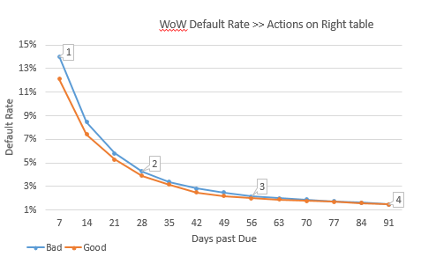
Analytics (Strategy) ==> Actions (Ops)
Segments based on Cash/Cashless
Tenure on OMPP (New Vs old)
Credit risk
Behavioral changes on Ola before/after OMPP activation
Credit risk change outside Ola (Bureau)
Analytics
Ops/Actions
Early indicator of risk suggests 7DPD is 2% higher than good week.
RCA performed to identify segments which are not performing upto expectation.
Specific action plan was devised
1
2
28 DPD has gap of 0.5%, increased calling performed for specific segment
3
Based on action, bad rate conversion started reaching at 56 DPD level
4
Final impact at 91 DPD was 1BP. Then special actions was revoked

Slide 54
Section 4.2
Operations

Slide 55
Operations by Buckets - Lending in general
0 to 30 DPD*
30 to 60 DPD
60 to 90 DPD
90+ DPD
Communication starts from D-1 (1 day prior to default)
Reminder messaging spaced at regular intervals - Basis customer frequency
Modes of Communication
SMS
Email
Push
IVR
Internal Calling team of 15 - better experience
Increase in the frequency of communication
Tonality also goes up
Modes of Communication
SMS
Email
Push
IVR
Outsourced to external agency with 15 agents
Fully integrated environment
Base outsources to 3rd party agency ideally to manage scaling up easily
Commission based model in place
Threat of Impact on Credit Score
Communication in sync with the pitch from the agency
SMS / IVR are placed at moderate intervals
Constitutes the Hard collection part
External agency based calling
Commission based model
Severe threats and messaging opted
SMS & IVR are also used for conveying high severity
*DPD is days past due

Slide 56
Collections Cadence in first 30 days
We have five communication channels to remind customers to repay their outstanding due.
DPD | 0 | 1 | 2 | 3 | 4 | 5 | 6 | 7 | 8 | 9 | 10 | 11 | 12 | 13 | 14 | 15 | 16 | 17 | 18 | 19 | 20 | 21 | 22 | 23 | 24 | 25 | 26 | 27 | 28 | 29 | 30
Outbound Call |  |  |  |  |  |  | >1000 |  |  |  |  | >1000 |  |  |  |  | >500 |  |  |  |  | ALL |  |  | ALL |  |  |  |  | ALL
SMS
PUSH
Email
IVR
Push Rs.{{total_due_amount}} Ola Money Postpaid amount is due! Please pay by {{grace_date}} to avoid paying any late fee. Click here to pay now.
SMS
Your ₹{{total_due_amount}} Ola Money Postpaid amount is due since {{biling_cycle}}. Daily ₹{{per_day_fine}} late fee will be added to your Postpaid dues from today. Pay now to avoid more extra charges : http://bit.ly/2zeq7sV

Slide 57
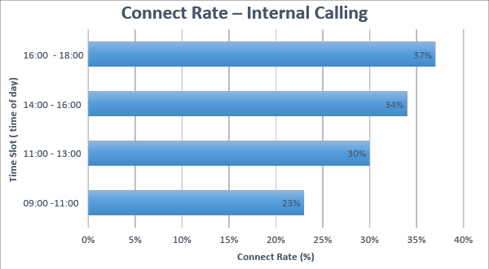
Internal Calling Ops Performance
Week No | Agents Allocated | GMV for Connected Customers | Paid GMV from connect (excluded customers who paid due to need for ride) (A) | Paid % from Connect customers | GMV for non-connected customers | Paid GMV from non connect (excluded customers paid due to need for ride) | Paid % from Non connect customers | Cost of Collection (B) | GMV Recovered for every Rs1 spent (A/B)
W50 | 15 | 89,07,187 | 26,97,562 | 30.29% | 2,29,64,029 | 13,86,880 | 6.04% | 1,75,000 | ₹ 15.41
W51 | 15 | 87,32,516 | 20,89,616 | 23.93% | 2,37,23,020 | 9,98,739 | 4.21% | 1,75,000 | ₹ 11.94
W52 | 15 | 88,12,387 | 19,08,712 | 21.65% | 2,20,16,876 | 8,22,656 | 3.74% | 1,75,000 | ₹ 10.91
W1 | 15 | 72,30,381 | 12,82,339 | 17.74% | 1,48,66,323 | 8,32,761 | 5.60% | 1,75,000 | ₹ 7.33
W2 | 13 | 94,41,477 | 22,05,361 | 23.36% | 1,75,08,322 | 9,80,173 | 5.60% | 1,75,000 | ₹ 12.60
W3 | 13 | 88,05,576 | 22,56,722 | 25.64% | 1,33,20,381 | 849,249 | 6.38% | 1,75,000 | ₹ 12.90
W4 | 15 | 98,47,529 | 17,23,367 | 17.50% | 2,25,67,402 | 9,09,592 | 4.03% | 1,75,000 | ₹ 9.85
 |  |  | 1,41,63,679 |  |  |  |  | 12,25,000 | ₹ 11.56
For every rupee we put into outbound calling campaign , we recover Rs 11.5

Slide 58
Section 4.3
Capabilities

Slide 59
Channel Capabilities
Communication Channels
SMS / Email / Push notifications
IVR currently has been outsourced to 1Point1,
Daily capacity of 1L, Fully integrated, can schedule SMS basis how much time customer has listened to script
Outbound calling Capacity
4 different set ups handling 4 different buckets
0 - 30 handled internally (15 seats, with auto-dailler)
30 - 60 with 1Point1, - 15 seats
60 - 90 With Dhruv Agency - 10 seats
90+ with Samaya Agency - 10 seats
Collections Ops Calling
Early Collections (0-60 DPD)
Late Collections (60+ DPD)
Payment is fixed cost structure
Payment is commission based structure on amount collected

Slide 60
Tool capabilities
Clevertap: Workflow management tool that is being used for sending ~65K reminders for collections daily
Dynamic segmentation, trigger based real time contextual communication
Integrated with Push/SMS/Email
Integration of Call and IVR scheduled by Mar
Realtime A/B testing & scale up of learnings
Feedback looping through CRM to increase efficiency
Easy to build decision rules → Fast to execute actions
Plan to migrate all Late fees, Repayments, Fixed Cycle, Standing Instructions communications by Mar end
Example flow implemented on Clevertap
Not Picked
Try on Sunday
Transfer to agency
Internal Calling
Promise to Pay
Run IVR
Customer Not Paid
Send legal SMS
Refused to Pay
Transfer to Field after 4 days with daily Push till then

Slide 61
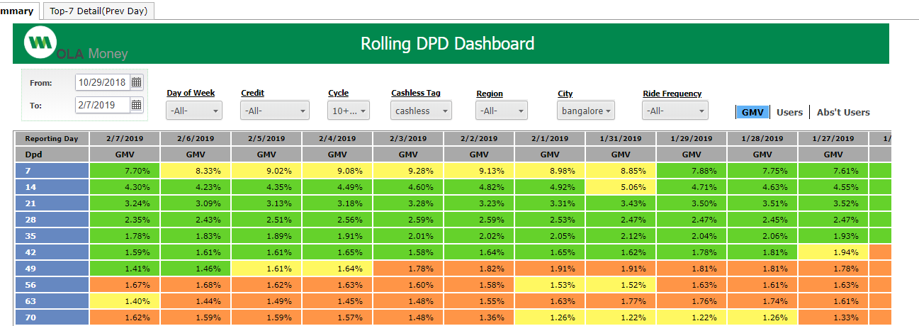
Reporting capabilities (MIS) - OFS MSTR
MSTR, is being used for extensively as alert system and risk control tower in collection and measuring business health.
All the delinquency related metrics are further segmented at Cash/Cashless on Ola (while Underwritten), Geography, number of cycle on OMPP etc.
These segmented measurement helps in understanding focus group of collection actions.

Slide 62
Product Capabilities (Interventions)
Late Payment Fees
Customers to get 15 days + 7 days time to repay back the dues
Post 7 days, variable late payment fees to be applied basis balance due- Rs 1, Rs 2, Rs 3
Processes in place to take care of customer issues
Live on External Merchants
Customers will be able to make payments on external merchants using Postpaid
Increase the use cases for Postpaid and reduce the dependency on Cabs
Error Handling for Repayment
More intuitive repayment product flow
Customer to get real time update on issues, ride unblock to be handled to avoid customer issues
Fixed Cycle
Currently cycle starts when customer takes the first ride and it's for next 15 days
Going forward, customers to be moved to two fixed cycles - 10th & 25th
Easier for customers to remember and make repayment on time, easier for managing calling

Slide 63
Strategy Formulation Capabilities (Learnings)
Unbalanced growth
Too many new customer acquisition in short span leads to higher proportion of first cycle GMV
First cycle has higher defaults and thus leads to increase in overall defaults
The growth to be managed in balanced fashion while acquiring the customers
Repayment Issues
Bug in the repayment funnel created impact on the collection, it impacted only certain Android app version that too customers who tried making repayment using “Saved Cards”.
Tracking payment gateway success rates every week to keep track of each customer failure on repayment and quick reaction mechanism to handle such cases
Customer Pain areas
Customers unhappy about certain issues, refuse to pay the due amount
Issues could be - Cancellation charges, driver denied duty, driver insisting on cash
Routing such cases back to In-House calling for better resolution
Notes:
Impacted numbers - value

Slide 64
Section 4.4
Reporting & Monitoring

Slide 65
Collections Monitoring - Roll rate & Cure rate
Roll rate
Weekly cohorts checked for 3 major milestones: 30, 60 and 90 DPD
MSTR enables deep diving at a specific segment viz. “Mumbai collections affected by bandh on cash early adopters”
Split by every 7 day buckets of DPD there is RCA at a granular level that helps decisive focused reaction to repayments
Cure rate
Curing targets set using back calculating desired 30 DPD (eg. 3.5%): Green, Amber, Red for each 7 days curing period
What works and what doesn’t is constantly monitored to catch up with risk trends evolution
Log of actions and impact maintained for streamlined learning

Slide 66
Weekly Collections Monitoring - Roll Rate
DPD | 04-Feb | 28-Jan | 21-Jan | 14-Jan | 07-Jan | 31-Dec | 24-Dec | 17-Dec | 10-Dec | 03-Dec | 26-Nov | 19-Nov | 12-Nov | 05-Nov | 29-Oct | 22-Oct
7 | 11.53% | 10.92% | 10.27% | 10.72% | 11.54% | 11.62% | 11.07% | 10.33% | 12.17% | 14.11% | 14.45% | 20.13% | 15.40% | 12.11% | 14.23% | 14.01%
14 | 6.91% | 6.96% | 6.97% | 6.82% | 6.94% | 7.73% | 7.12% | 8.46% | 8.54% | 8.93% | 13.15% | 10.40% | 7.42% | 8.63% | 8.46% | 8.74%
21 | 5.20% | 5.36% | 5.08% | 5.03% | 5.72% | 5.64% | 6.75% | 6.55% | 5.93% | 9.20% | 7.45% | 5.27% | 5.74% | 5.80% | 6.15% | 5.70%
28 | 4.16% | 4.07% | 3.87% | 4.27% | 4.17% | 5.31% | 4.94% | 4.55% | 6.55% | 5.75% | 3.91% | 4.32% | 4.29% | 4.63% | 4.45% | 4.37%
35 | 3.32% | 3.18% | 3.46% | 3.14% | 4.08% | 4.03% | 3.64% | 5.07% | 4.48% | 3.14% | 3.44% | 3.39% | 3.58% | 3.49% | 3.58% | 3.31%
42 | 2.70% | 3.02% | 2.75% | 3.45% | 3.33% | 3.13% | 4.38% | 3.78% | 2.48% | 2.81% | 2.82% | 2.96% | 2.87% | 2.94% | 2.80% | 2.52%
49 | 2.74% | 2.51% | 3.17% | 3.01% | 2.82% | 4.00% | 3.44% | 2.20% | 2.33% | 2.47% | 2.62% | 2.52% | 2.55% | 2.41% | 2.25% | 2.15%
56 | 2.29% | 2.97% | 2.73% | 2.51% | 3.62% | 3.06% | 2.00% | 2.07% | 2.15% | 2.38% | 2.29% | 2.30% | 2.15% | 2.01% | 1.98% | 1.89%
63 | 2.79% | 2.58% | 2.26% | 3.32% | 2.82% | 1.88% | 1.94% | 2.01% | 2.15% | 2.14% | 2.15% | 2.02% | 1.87% | 1.83% | 1.80% | 1.69%
70 | 2.38% | 2.08% | 3.05% | 2.65% | 1.77% | 1.84% | 1.86% | 2.05% | 1.99% | 2.05% | 1.93% | 1.78% | 1.74% | 1.71% | 1.63% | 1.50%
77 | 1.91% | 2.79% | 2.46% | 1.71% | 1.73% | 1.74% | 1.87% | 1.86% | 1.92% | 1.82% | 1.71% | 1.68% | 1.65% | 1.53% | 1.45% | 1.33%
84 | 2.47% | 2.23% | 1.59% | 1.64% | 1.63% | 1.74% | 1.71% | 1.77% | 1.65% | 1.62% | 1.63% | 1.59% | 1.43% | 1.34% | 1.24% | 1.40%
91 | 1.96% | 1.46% | 1.52% | 1.47% | 1.60% | 1.55% | 1.62% | 1.51% | 1.45% | 1.52% | 1.55% | 1.33% | 1.24% | 1.14% | 1.29% | 1.35%
30 | 3.85% | 3.71% | 3.57% | 3.95% | 3.85% | 4.98% | 4.00% | 4.85% | 5.98% | 4.88% | 3.32% | 4.26% | 3.92% | 4.12% | 4.21% | 3.96%
60 | 2.42% | 2.97% | 2.04% | 3.23% | 3.33% | 2.15% | 1.89% | 2.11% | 2.11% | 2.23% | 2.27% | 2.07% | 2.06% | 1.86% | 1.89% | 1.80%
91 | 1.96% | 1.46% | 1.52% | 1.47% | 1.60% | 1.55% | 1.62% | 1.51% | 1.45% | 1.52% | 1.55% | 1.33% | 1.24% | 1.14% | 1.29% | 1.35%
Percentage of customers moved to higher delinquency bucket on weekly basis

Slide 67
Portfolio Collections Reporting - Curing Rates
 | 04-Feb | 28-Jan | 21-Jan | 14-Jan | 07-Jan | 31-Dec | 24-Dec | 17-Dec | 10-Dec | 03-Dec | 26-Nov
7_14 | 36.80% | 32.20% | 35.00% | 40.90% | 40.30% | 30.20% | 31.10% | 30.50% | 39.50% | 38.20% | 34.70%
14_21 | 25.40% | 23.10% | 25.50% | 27.50% | 26.00% | 20.80% | 20.20% | 23.30% | 33.60% | 30.00% | 28.40%
21_28 | 22.40% | 20.00% | 23.10% | 25.30% | 26.10% | 21.30% | 24.60% | 23.30% | 28.80% | 22.80% | 25.80%
28_35 | 18.40% | 17.80% | 19.00% | 24.70% | 23.20% | 18.40% | 20.00% | 22.60% | 22.10% | 19.70% | 20.40%
35_42 | 15.20% | 12.80% | 12.40% | 15.40% | 17.40% | 14.00% | 13.60% | 15.60% | 21.00% | 18.30% | 16.80%
42_49 | 9.30% | 8.80% | 8.10% | 9.60% | 9.90% | 8.70% | 9.00% | 11.30% | 17.10% | 12.40% | 11.50%
49_56 | 8.90% | 6.40% | 9.30% | 11.00% | 9.50% | 11.00% | 9.10% | 11.20% | 13.00% | 9.20% | 9.10%
56_63 | 6.20% | 5.70% | 10.00% | 8.30% | 7.80% | 6.00% | 6.30% | 6.50% | 9.70% | 6.60% | 6.50%
63_70 | 7.50% | 7.70% | 8.10% | 6.00% | 5.90% | 5.20% | 7.50% | 4.70% | 7.00% | 4.70% | 4.50%
70_77 | 8.30% | 8.70% | 7.20% | 3.40% | 6.00% | 6.50% | 8.80% | 6.50% | 6.30% | 5.70% | 3.90%
77_84 | 11.20% | 9.50% | 7.00% | 5.20% | 6.30% | 7.00% | 8.10% | 7.80% | 9.30% | 5.30% | 3.00%
84_91 | 12.00% | 7.90% | 7.30% | 9.80% | 8.00% | 9.40% | 8.50% | 8.50% | 10.50% | 6.70% | 2.50%
7_28 | 61.20% | 64.80% | 66.70% | 61.40% | 59.60% | 56.40% | 65.00% | 68.50% | 67.50% | 62.70% | 67.70%
28_56 | 45.20% | 44.10% | 44.70% | 44.80% | 44.70% | 46.80% | 48.80% | 52.10% | 49.90% | 48.60% | 48.50%
56_91 | 35.90% | 26.80% | 26.60% | 31.60% | 32.80% | 32.30% | 29.60% | 29.80% | 27.90% | 23.20% | 18.00%
Current 7 DPD is trending at 10-11%
Current recovery rate is at 88.5% from 7 DPD to 91 DPD
~65% of amount cures from 7 to 28 DPD
Similarly ~50% of amount cures from 28 to 56 DPD
~30% amount cures from 56 to 91 DPD
Avg Curing %
35.40%
25.80%
23.95%
20.57%
15.68%
10.52%
9.79%
7.24%
6.25%
6.48%
7.25%
8.28%
63.77%
47.11%
28.59%
The percentage of amount recovered from delinquent accounts in each 7 day curing period

Slide 68
MoM Roll Rate and Cure Rate
30/60/90 DPD numbers at monthly level
Bucket wise curing rate at monthly level
Month | 30 DPD | 60 DPD | 90 DPD
May'18 | 3.29% | 2.32% | 1.47%
Jun'18 | 5.12% | 2.64% | 2.03%
July'18 | 3.66% | 2.10% | 1.58%
Aug'18 | 3.57% | 1.83% | 1.27%
Sep'18 | 3.59% | 1.74% | 1.37%
Oct'18 | 3.98% | 2.11% | 1.59%
Nov'18 | 3.97% | 2.07% | 1.55%
Dec'18 | 5.01% | 2.85%
Jan'19 | 3.77%
Month | <30 DPD | 31-60 DPD | 61-90 DPD
May'18 | 96.71% | 29.48% | 36.64%
Jun'18 | 94.88% | 48.44% | 23.11%
July'18 | 96.34% | 42.62% | 24.76%
Aug'18 | 96.43% | 48.74% | 30.60%
Sep'18 | 96.41% | 51.53% | 21.26%
Oct'18 | 96.02% | 46.98% | 24.64%
Nov'18 | 96.03% | 47.86% | 25.12%
Dec'18 | 94.99% | 43.11%
Jan'19 | 96.23%
Jun - single cash campaign with just 4K activations
Oct - cash activations started to flow in (continues in Nov)
Dec - Due to holidays
Jan - Pre-cash levels of risk in spite of 35% activations from cash (late fee benefits)

Slide 69
Section 4.5
Current Performance

Slide 70
Monthly Collections Cohorts
Month | GMV in CR | M-1** | M | M+1 | M+2 | M+3 | M+4 | M+5 | M+6 | M+7 | M+8
May'18 | 46.00 | 7.05% | 86.90% | 96.05% | 97.76% | 98.15% | 98.23% | 98.28% | 98.29% | 98.32% | 98.34%
Jun'18 | 52.41 | 7.64% | 87.76% | 97.41% | 98.21% | 98.59% | 98.68% | 98.70% | 98.74% | 98.75%
Jul'18 | 53.66 | 7.23% | 87.54% | 97.53% | 98.43% | 98.85% | 98.96% | 98.99% | 99.01%
Aug'18 | 54.57 | 7.33% | 88.54% | 97.53% | 98.48% | 98.82% | 98.96% | 98.99%
Sep'18 | 53.96 | 7.56% | 87.00% | 97.24% | 98.11% | 98.63% | 98.74%
Oct'18 | 58.06 | 9.37% | 90.12% | 97.24% | 98.22% | 98.64%
Nov'18 | 48.44 | 13.99% | 88.24% | 96.39% | 97.65%
Dec'18 | 69.10 | 20.97% | 89.71% | 97.18%
Jan'19 | 73.60 | 20.41% | 91.11% | 97.75%*
Feb'19 | 89.00 | 22.00%* | 91.80%*
* Projected numbers for February and March based on curing rate and late fee roll-out population being 95% in Feb’19
**M-1 is payment received before due date (i.e within 15 days of cycle start date till Nov’19. After softblock was introduced in Dec’19, this is pmts within 22 days of cycle start date)

Slide 71
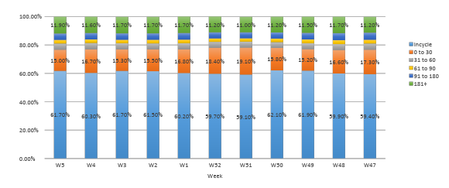
Portfolio Risk Reporting - Business Health
GMV distribution, should be skewed towards in-cycle and <=30 days past due.
Over the period 181+ contribution should be decreasing (after write-off).
OMPP book is consistent across the expected segment. 181+ is not shrinking as there is no write-off done of all the past 181+, which is contributing to major chunk of 181+ days past due

Slide 72
Section 5
Enabling Entities

Slide 73
Enabling Entities - How they impact Decision Science
Skills: In a constantly changing lending landscape,leaders who have seen complete lending cycle (both peak and downturn) bring much needed preparedness for unseen future. Xperience across other regions, multiple credit products and credit life cycles is valuable.
Decision Science
&
Enablers
01
Skills
Data
MIS
Fraud
Collections
Underwriting
Data: Data is the new currency. Bringing new insights from traditional data (using ML) or using unexplored non-traditional data is key in beating competition. Being Fintech OFS needs to be on top of Data based intelligence for survival.
Core responsibilities
03
02
Tools
Infra
Lifecycle Management
Tools: Tools help us make smarter and efficient decisions. Being new to industry semi automated processes are good to start off but given regulatory compliance tools will be needed sooner than later.
Policy
Infra: Infra helps scale-up, which is much needed for any business more so in a financial environment where speed of decisions without errors is a must have.

Slide 74
Section 5.1
Team Profile and Skills

Slide 75
Decision Science Team - Profile and Skills
Nitin G.
CEO (OFS)
Sharat C.
Head - Decision Science
Experience: 11 yrs in credit risk; SE Asia+EMEA+US markets;
Risk: Modeling, Strategy, Bureau score dev, Tools and Applications
Products: All unsecured lending, Deposits, Mortgage
Yogesh R.
Underwriting & Fraud
Ravi S.
Life cycle Management
TBD
Collection Analytics
TBD
Data Science
Managed till Jan’ 19
Collection Ops
Experience: Combined 10 yrs in credit risk; EMEA+US markets;
Risk: Indian Bureau, Data Science, Risk Policy
Products: Fintech lending, Credit cards, Personal Loans, SME
Binit K.
Md. Akhtar
Vaishnavi M.
Tirtha K.
Dheer T.
Mukund K.
Swarnima K.
Pavan V.
Anannya R.
Supreeth M.
Nikita G.
Ops Team
Experience: Combined 25 yrs; 15 in credit risk;
Domain: Data Science, U/W, LCM, Collections, Fraud, Marketing

Slide 76
Section 5.2
Data Sources

Slide 77
Ola data - Relevance to lending business
Ability to Pay | Intent to Pay | Contactability
Premium Savvy (Preferred mode of Sedan on ola) Propensity of being cashless in taking rides Ride intent (Work, geo location based tagging of tech parks) Total spend on transportation Avg recharge on Ola wallet Airport, outstation, rental trips frequency and value Income estimator model that predicts income from pure Ola data variables, with incremental value on bureau data | Repayment behavior on Ola Postpaid Device fingerprinting CC/DC ride payment behavior Wifi based social/employment proxies Geo location based ride activity in high credit risk pincodes Gender (algo based) Customer rating on app Customer dispute type | Phone number actively used IMEI/Google ID Saved favorites in locations Nearby residence communities Loyalty (Higher confidence on contactability)

Slide 78
Alternate data
Other than Bureau, Trusting social (leading telecom Bureau in SE Asia), Payback (Subsidiary of Amex), Zeotap (major telecom operators as data partners) and LinkedIn are being explored
Most of the tradition banks, are able to crack risk for Bureau hit population and hence risk for this particular segment. Banks are still dependent on salary slip/balance statement to predict capacity to pay.
Industry Example: Kabbage, leading SME lending Fintech in US, underwrites loan from $500-$250K line in <7mins, by doing data alliance with Yodlee/Paypal to predict capacity to pay.
Alt data - Positions Fintech to Improve risk, Reduce CAC, Optimise Revenue
Trusting Social
Pilot is performed, data didn’t help much in the pilot stage.
Payback
Payback captures loyalty points related information on debit as well as credit card, It has association with Amazon, Flipkart, Bigbazar, ICICI, Indusland etc. which provides great opportunity to understand New to credit customers (Customers’ doesn’t have CC)
Current Stage: data exercise will happen by 4th week of Feb’19
LinkedIn
LinkedIn provides great opportunity to understand customers’ capacity to pay metrics, which will inturn help in automating product (specially for higher lines).
Current stage: Initial phases of discussion
Zeotap
Zeotap contains targeting data by different merchants, which further provides proxy for customers propensity to buy product and hence it can be good predictor of customers’ affluence

Slide 79
Section 5.3
Tools

Slide 80
Tools in OFS Decision Science
Data Science Tool
Decision Engine
Communication Engine
Monitoring Tool
R, Python, Hive: All of these are open-source tools and don’t have any licensing cost but do have small maintenance cost. These tools are enabler for analysts to find insights, build models etc.
Business Rule Engine:
This will enable us to make automated decisions in future for customers in live environment, which may be used at underwriting, credit line increase.
Clevertap:
This tool helps us to send communications, roll-out campaigns at customer segment level and hence, enables us to test hypothesis and as well roll-out full fledged campaigns
MSTR:
This tool enables us to monitor key business and risk metric for each phase of customer lifecycle in real-time basis.
For collections, a risk tower has been built to identify early trends in risk deterioration

Slide 81
Section 5.4
Infrastructure

Slide 82
Infrastructure which helps us scale
Hue/hive Database
Efficiency & Scaling Up
Automation
Data lake
Hue Database:
Owing to inbuilt capabilities of hue, it’s scalable with controlled cost.
Presto & Zeppelin:
Presto will bring efficiency into interactive queries.
Zeppelin is a open source notebook feature that make it easy to share and document across analysts
Automation:
Schedulers and workflows inbuilt in hive have enabled us to automate our decision models, strategy and decision making process
Data lake:
OFS has created an comprehensive list of ~1500 chars, based on bookings history, transaction history, usage of different payment modes. All of these chars are generated automatically every month and enables us to make quick and sharp decisions

Slide 83
OMPP Current stage >> OMPP stage by April’19
Policy
Model
Strategy
Tracking
Current Stage
Semi-Automated
Semi-Automated
Semi-Automated
Semi-Automated
By April ’19
Fully- Automated
Fully- Automated
Semi-Automated*
Fully Automated
Has no dependency on external tools/applications. It is driven by internal Data PE and dedicated data lake owners within OFS
* Strategy requires many A/B testing to mature. Also, strategy keeps on changing due to changing business scenario. Therefore, for evolving lenders, automating it is very difficult

Slide 84
Appendix

Slide 85
Weekly Collections Tracking Contd.
Cash Customers ; Cycle 1,2
Cashless Customers ; Cycle 1,2
DPD | 04-Feb | 28-Jan | 21-Jan | 14-Jan | 07-Jan | 31-Dec | 24-Dec | 17-Dec | 10-Dec
7 | 30.73% | 27.93% | 29.26% | 27.86% | 29.70% | 33.24% | 36.14% | 14.74% | 27.37%
14 | 22.68% | 24.42% | 23.60% | 23.40% | 26.76% | 31.93% | 11.90% | 22.86% | 25.05%
21 | 20.82% | 20.39% | 19.92% | 22.06% | 28.68% | 10.77% | 20.77% | 22.04% | 12.22%
28 | 18.13% | 18.24% | 19.42% | 24.40% | 9.28% | 19.14% | 20.50% | 11.27% | 16.24%
35 | 16.35% | 17.85% | 22.14% | 8.54% | 17.93% | 18.82% | 10.74% | 14.60% | 9.90%
42 | 16.43% | 20.77% | 8.02% | 17.02% | 17.99% | 10.23% | 13.22% | 8.94% | 7.64%
49 | 20.03% | 7.56% | 16.31% | 17.56% | 9.74% | 12.71% | 9.05% | 6.54% | 7.45%
56 | 7.12% | 15.88% | 16.90% | 9.30% | 12.11% | 8.46% | 5.85% | 6.82% | 11.64%
63 | 15.54% | 16.74% | 8.74% | 11.79% | 8.29% | 5.75% | 6.90% | 11.50% | 8.12%
70 | 16.52% | 8.39% | 11.40% | 8.18% | 5.51% | 6.45% | 10.93% | 8.12% | 8.10%
77 | 8.09% | 10.66% | 7.95% | 5.50% | 6.45% | 10.82% | 6.94% | 8.10% | 10.95%
84 | 9.93% | 7.70% | 5.15% | 6.45% | 10.73% | 6.94% | 7.46% | 10.95% | 14.97%
91 | 7.02% | 4.94% | 6.01% | 10.43% | 6.73% | 6.78% | 11.13% | 14.97% | 19.16%
30 | 16.52% | 17.97% | 19.62% | 21.37% | 10.46% | 19.67% | 16.48% | 13.77% | 13.35%
60 | 11.40% | 18.38% | 8.95% | 12.70% | 9.24% | 7.35% | 5.39% | 9.29% | 10.25%
91 | 7.02% | 4.94% | 6.01% | 10.43% | 6.73% | 6.78% | 11.13% | 14.97% | 19.16%
DPD | 04-Feb | 28-Jan | 21-Jan | 14-Jan | 07-Jan | 31-Dec | 24-Dec | 17-Dec | 10-Dec
7 | 15.67% | 15.91% | 16.33% | 16.35% | 19.56% | 22.19% | 21.15% | 14.51% | 16.93%
14 | 11.12% | 11.49% | 11.52% | 12.91% | 15.44% | 15.51% | 9.87% | 11.70% | 11.98%
21 | 8.92% | 8.87% | 9.89% | 11.61% | 12.18% | 7.77% | 9.50% | 9.45% | 7.23%
28 | 6.95% | 7.99% | 9.09% | 9.52% | 6.16% | 7.91% | 7.85% | 5.91% | 9.60%
35 | 6.48% | 7.39% | 7.77% | 4.85% | 6.46% | 6.72% | 5.07% | 7.99% | 7.14%
42 | 6.36% | 6.93% | 4.38% | 5.62% | 6.15% | 4.52% | 7.24% | 6.24% | 4.65%
49 | 6.34% | 4.05% | 5.12% | 5.75% | 4.18% | 6.82% | 5.83% | 4.33% | 4.70%
56 | 3.74% | 4.87% | 5.43% | 3.77% | 6.38% | 5.39% | 4.00% | 4.37% | 4.59%
63 | 4.68% | 5.23% | 3.44% | 5.91% | 5.12% | 3.83% | 4.17% | 4.34% | 4.46%
70 | 4.97% | 3.22% | 5.49% | 4.88% | 3.69% | 4.02% | 4.10% | 4.29% | 4.27%
77 | 3.00% | 5.13% | 4.52% | 3.59% | 3.86% | 3.96% | 3.98% | 4.05% | 3.69%
84 | 4.60% | 4.10% | 3.43% | 3.70% | 3.76% | 3.74% | 3.87% | 3.42% | 3.62%
91 | 3.72% | 3.19% | 3.49% | 3.38% | 3.51% | 3.54% | 3.20% | 3.37% | 3.29%
30 | 6.58% | 7.83% | 8.48% | 8.27% | 5.70% | 7.98% | 5.85% | 6.88% | 9.19%
60 | 3.91% | 5.85% | 3.31% | 5.45% | 5.87% | 3.89% | 4.15% | 4.42% | 4.39%
91 | 3.72% | 3.19% | 3.49% | 3.38% | 3.51% | 3.54% | 3.20% | 3.37% | 3.29%

Slide 86
Weekly Collections Tracking Contd.
Cash Customers ; Cycle 2+
Cashless Customers ; Cycle 2+
DPD | 04-Feb | 28-Jan | 21-Jan | 14-Jan | 07-Jan | 31-Dec | 24-Dec | 17-Dec | 10-Dec
7 | 8.65% | 7.53% | 7.46% | 8.03% | 8.94% | 9.58% | 7.10% | 8.35% | 9.66%
14 | 4.44% | 4.36% | 5.10% | 5.50% | 6.02% | 4.17% | 6.47% | 7.45% | 7.14%
21 | 3.45% | 4.10% | 3.98% | 4.58% | 3.35% | 3.94% | 6.58% | 5.78% | 4.90%
28 | 3.37% | 3.37% | 3.46% | 2.14% | 2.76% | 5.54% | 4.61% | 3.78% | 5.17%
35 | 2.65% | 2.96% | 1.57% | 2.14% | 4.14% | 3.40% | 3.01% | 4.82% | 5.60%
42 | 2.48% | 1.41% | 1.94% | 3.74% | 3.17% | 2.71% | 3.58% | 5.60% | 3.27%
49 | 1.37% | 1.92% | 3.57% | 2.76% | 2.34% | 3.58% | 5.50% | 2.98% | 0.34%
56 | 1.92% | 3.51% | 2.43% | 2.34% | 2.47% | 5.17% | 2.98% | 0.34% | 3.21%
63 | 3.51% | 2.37% | 2.34% | 2.11% | 5.17% | 2.98% | 0.34% | 3.21% | 3.71%
70 | 2.37% | 1.94% | 2.02% | 5.11% | 2.98% | 0.34% | 3.21% | 3.71% | 2.41%
77 | 1.94% | 2.02% | 4.16% | 2.95% | 0.34% | 3.21% | 3.71% | 2.23% | 4.05%
84 | 1.51% | 3.92% | 2.66% | 0.34% | 3.21% | 3.71% | 2.23% | 4.05% | 4.84%
91 | 3.47% | 2.66% | 0.34% | 2.95% | 3.71% | 1.52% | 4.05% | 4.09% | 0.88%
30 | 3.60% | 3.72% | 2.24% | 2.16% | 2.70% | 4.77% | 4.25% | 3.90% | 6.01%
60 | 1.82% | 3.77% | 1.71% | 3.48% | 3.72% | 2.61% | 2.26% | 1.74% | 4.93%
91 | 3.47% | 2.66% | 0.34% | 2.95% | 3.71% | 1.52% | 4.05% | 4.09% | 0.88%
DPD | 04-Feb | 28-Jan | 21-Jan | 14-Jan | 07-Jan | 31-Dec | 24-Dec | 17-Dec | 10-Dec
7 | 10.14% | 9.49% | 8.76% | 9.37% | 10.26% | 10.21% | 9.78% | 9.83% | 10.85%
14 | 5.61% | 5.72% | 5.91% | 5.72% | 5.74% | 6.64% | 6.75% | 7.41% | 7.81%
21 | 4.10% | 4.47% | 4.19% | 4.01% | 4.76% | 5.33% | 5.79% | 5.91% | 5.57%
28 | 3.37% | 3.28% | 3.05% | 3.43% | 3.88% | 4.39% | 4.29% | 4.16% | 5.88%
35 | 2.64% | 2.47% | 2.75% | 2.85% | 3.19% | 3.42% | 3.24% | 4.42% | 4.09%
42 | 2.05% | 2.36% | 2.48% | 2.61% | 2.71% | 2.73% | 3.76% | 3.41% | 2.16%
49 | 2.11% | 2.25% | 2.38% | 2.40% | 2.43% | 3.39% | 3.07% | 1.88% | 1.96%
56 | 2.04% | 2.19% | 2.13% | 2.14% | 3.02% | 2.71% | 1.71% | 1.72% | 1.76%
63 | 2.02% | 1.99% | 1.91% | 2.75% | 2.47% | 1.59% | 1.59% | 1.64% | 1.82%
70 | 1.80% | 1.74% | 2.51% | 2.31% | 1.49% | 1.50% | 1.51% | 1.72% | 1.71%
77 | 1.58% | 2.27% | 2.14% | 1.42% | 1.40% | 1.39% | 1.56% | 1.58% | 1.74%
84 | 2.00% | 1.94% | 1.31% | 1.32% | 1.30% | 1.44% | 1.44% | 1.60% | 1.45%
91 | 1.69% | 1.20% | 1.21% | 1.17% | 1.32% | 1.30% | 1.46% | 1.32% | 1.25%
30 | 3.14% | 2.95% | 2.77% | 3.28% | 3.45% | 4.13% | 3.53% | 4.24% | 5.42%
60 | 1.89% | 2.26% | 1.71% | 2.62% | 2.92% | 1.88% | 1.56% | 1.73% | 1.76%
91 | 1.69% | 1.20% | 1.21% | 1.17% | 1.32% | 1.30% | 1.46% | 1.32% | 1.25%

Slide 87
Solves to reduce Fraud (30 to 50 BP) from current 90+ rate of 1.5%
Current Fraud Framework:
User present on Ola platform with multiple profiles
This is identified using their multiple fingerprints (imei, google advt id, android id)
Fraudulent practice identified on their current Ola Money account
Enhancements being built in Fraud Framework:
Identify the users whose primary phone number(sourced from bureau) is not same as phone number registered with Ola
Identify the users whose any device fingerprint matches with any driver’s device fingerprint
Identify the users who are using same credit card/ debit card number or same UPI handles as 90 days past due user on Ola platform
Identify the geolocations who have high concentration of 90 days past due users
Identify the wifi mac address who have high concentration of 90 days past due users
Identify the users who have logged into significantly high number of devices in last 3 month
Identify the users whose devices have significantly high number of signups in last 3 months

Slide 88
Overall portfolio risk is being maintained in three segments:
Cost of experimentation: This is the cost to unlock new target groups (cash cycle 1 & 2 users). Loss rates are expected to be higher than the matured portfolio. But, the contribution to overall portfolio losses are quite low. This is quite important in order to keep unlocking new segment of customers
Cost of acquisition: This is the cost of acquiring new customers. This is always expected to be slightly higher than matured portfolio. This is also important to keep the business growth intact.
Cost of bad debt: This is the usual losses expected in lending business
90DPD GMV rates (segment wise)
Segments | Before Late Fine | After Late Fine
Cash Cycle 1 & 2 | 6.7% | 6.1%
Cashless Cycle 1 & 2 | 2.9% | 2.2%
All customers Cycle 3+ | 1.3% | 0.9%
Segment contribution to overall portfolio 90dpd
Segments | Before Late Fine | After Late Fine
Cash Cycle 1 & 2 | 0.13%* | 0.24%
Cashless Cycle 1 & 2 | 0.39% | 0.26%
All customers Cycle 3+ | 1.06% | 0.70%
Total | 1.58% | 1.20%

