Slide 1
Implementing data-driven approaches for property renovation to optimize market value
Author: Marife Ramoran

Slide 2
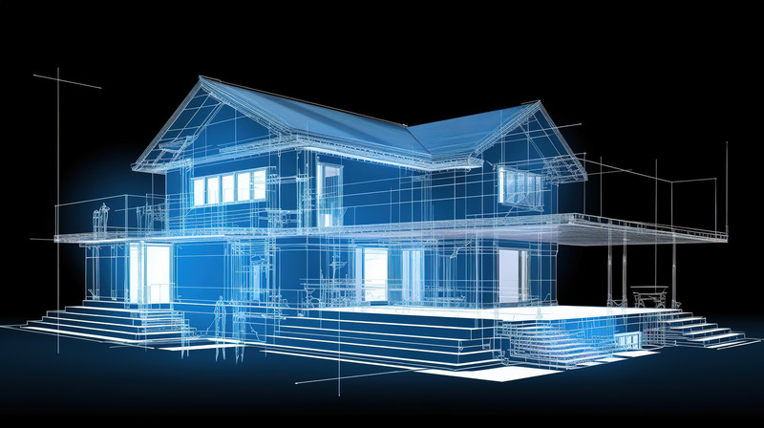
Summary
Applying linear regression analysis to the King County Sales Record dataset unveils essential findings
Identifying crucial renovations for boosting property market value
Predicting the anticipated increase in market value following renovations

Slide 3
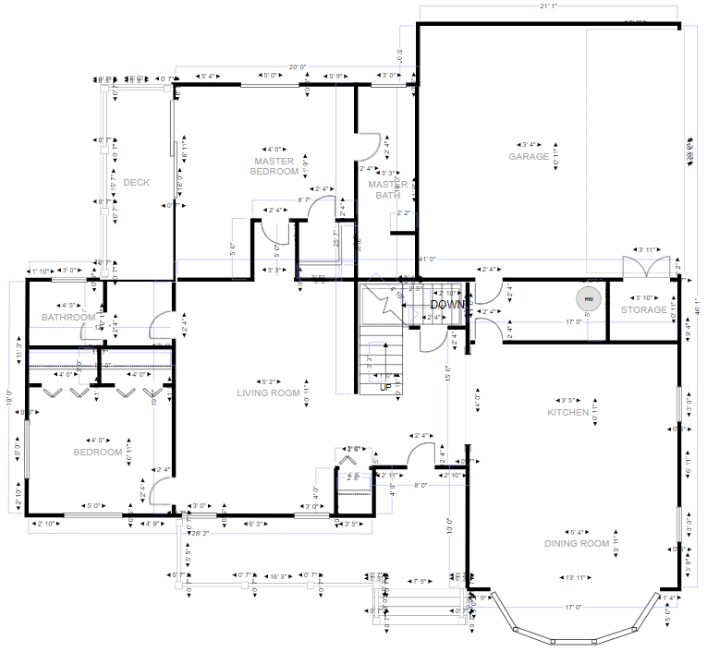
Outline
Business Problem
Data & Methods
Results
Conclusion

Slide 4
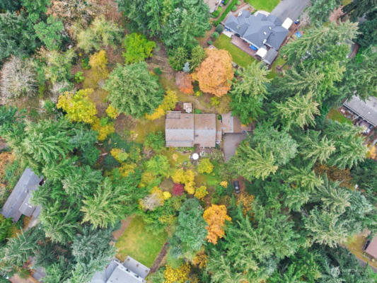
Business Problem
The real estate agency seeks to offer strategic advice to potential homebuyers planning to acquire and renovate properties. This advice aims to pinpoint essential renovation priorities that can maximize the property's market value growth, along with providing estimates of value increments to optimize their resale potential.
The real estate agency seeks to offer strategic advice to potential homebuyers planning to acquire and renovate properties. This advice aims to pinpoint essential renovation priorities that can maximize the property's market value growth, along with providing estimates of value increments to optimize their resale potential.

Slide 5
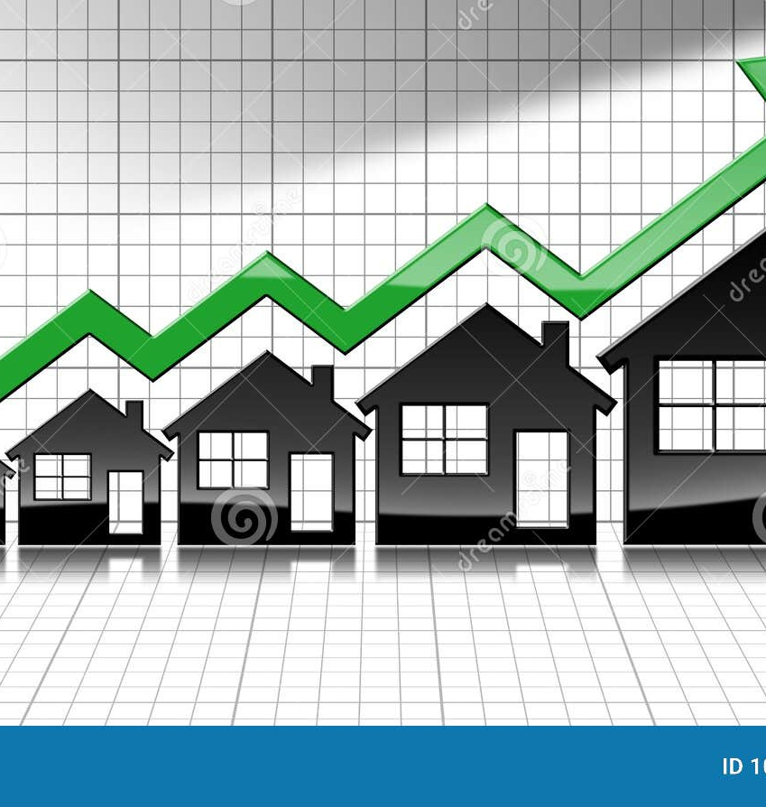
Data and Methods
The dataset utilized for this model comprises information from houses in King County, which were sold between 2014 and 2015. It encompasses 21,597 entries, incorporating details about the house such as the number of bedrooms, bathrooms, and its rating (grade)

Slide 6
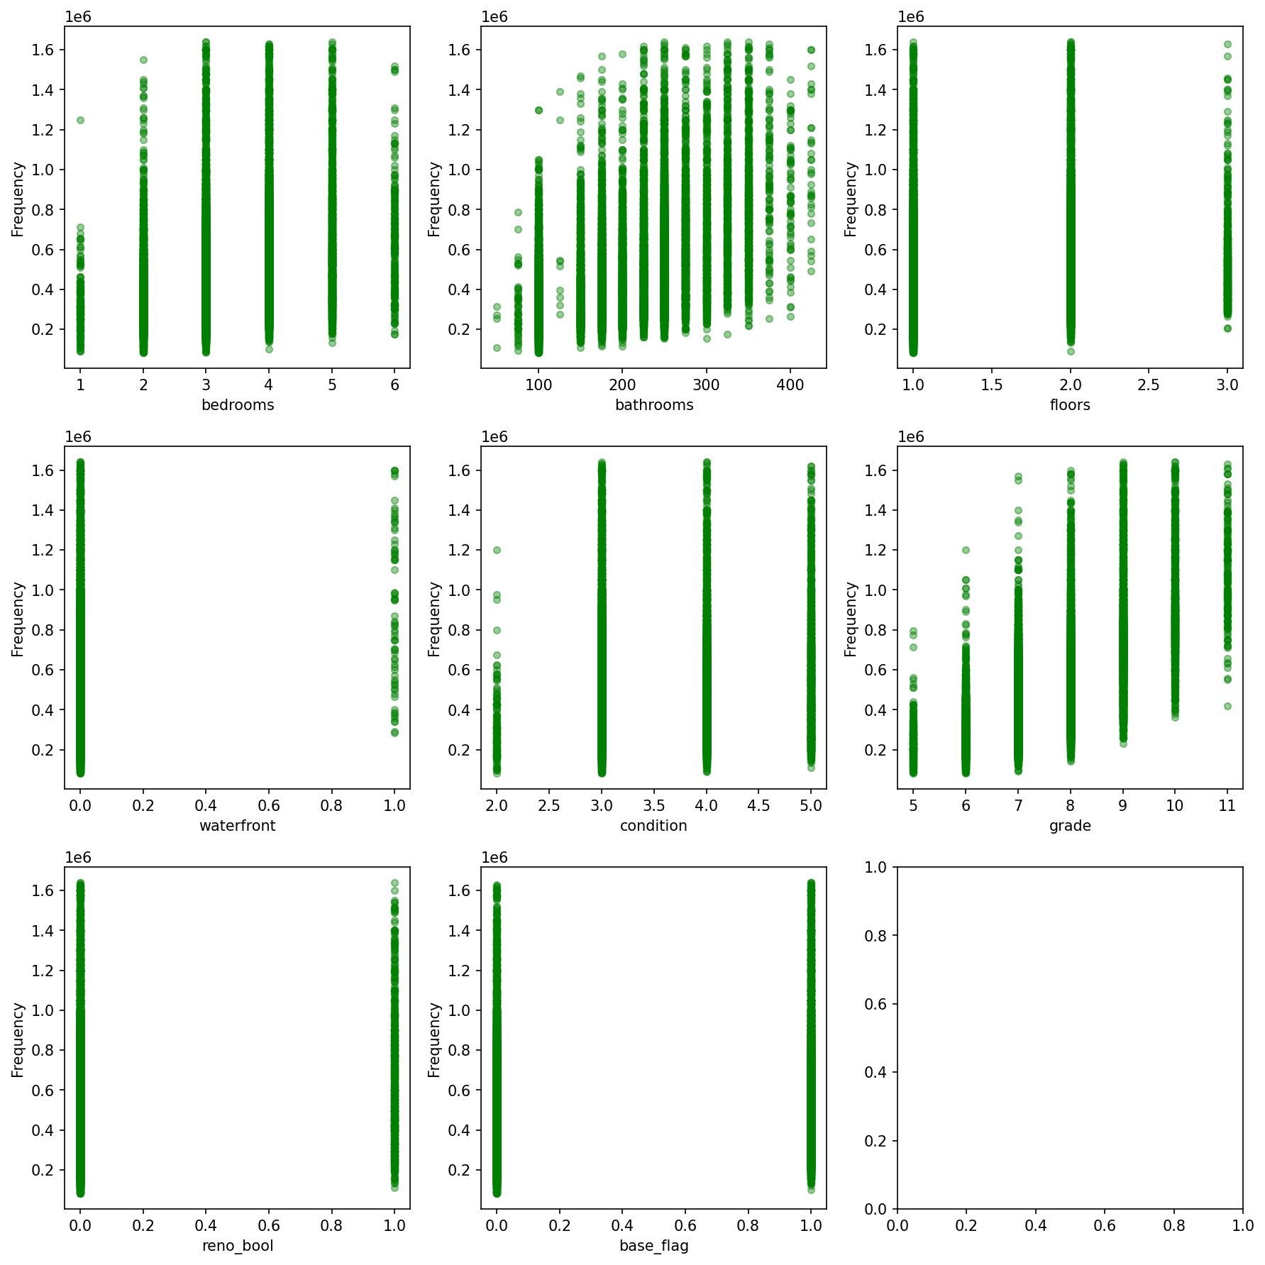
Data & Methods
Utilizing data sourced from King County, information is extracted from a dataset encompassing over 20,000 distinct houses. This dataset includes various house statistics such as the number of bedrooms, bathrooms, and the grade assigned by the King County Assessors.

Slide 7
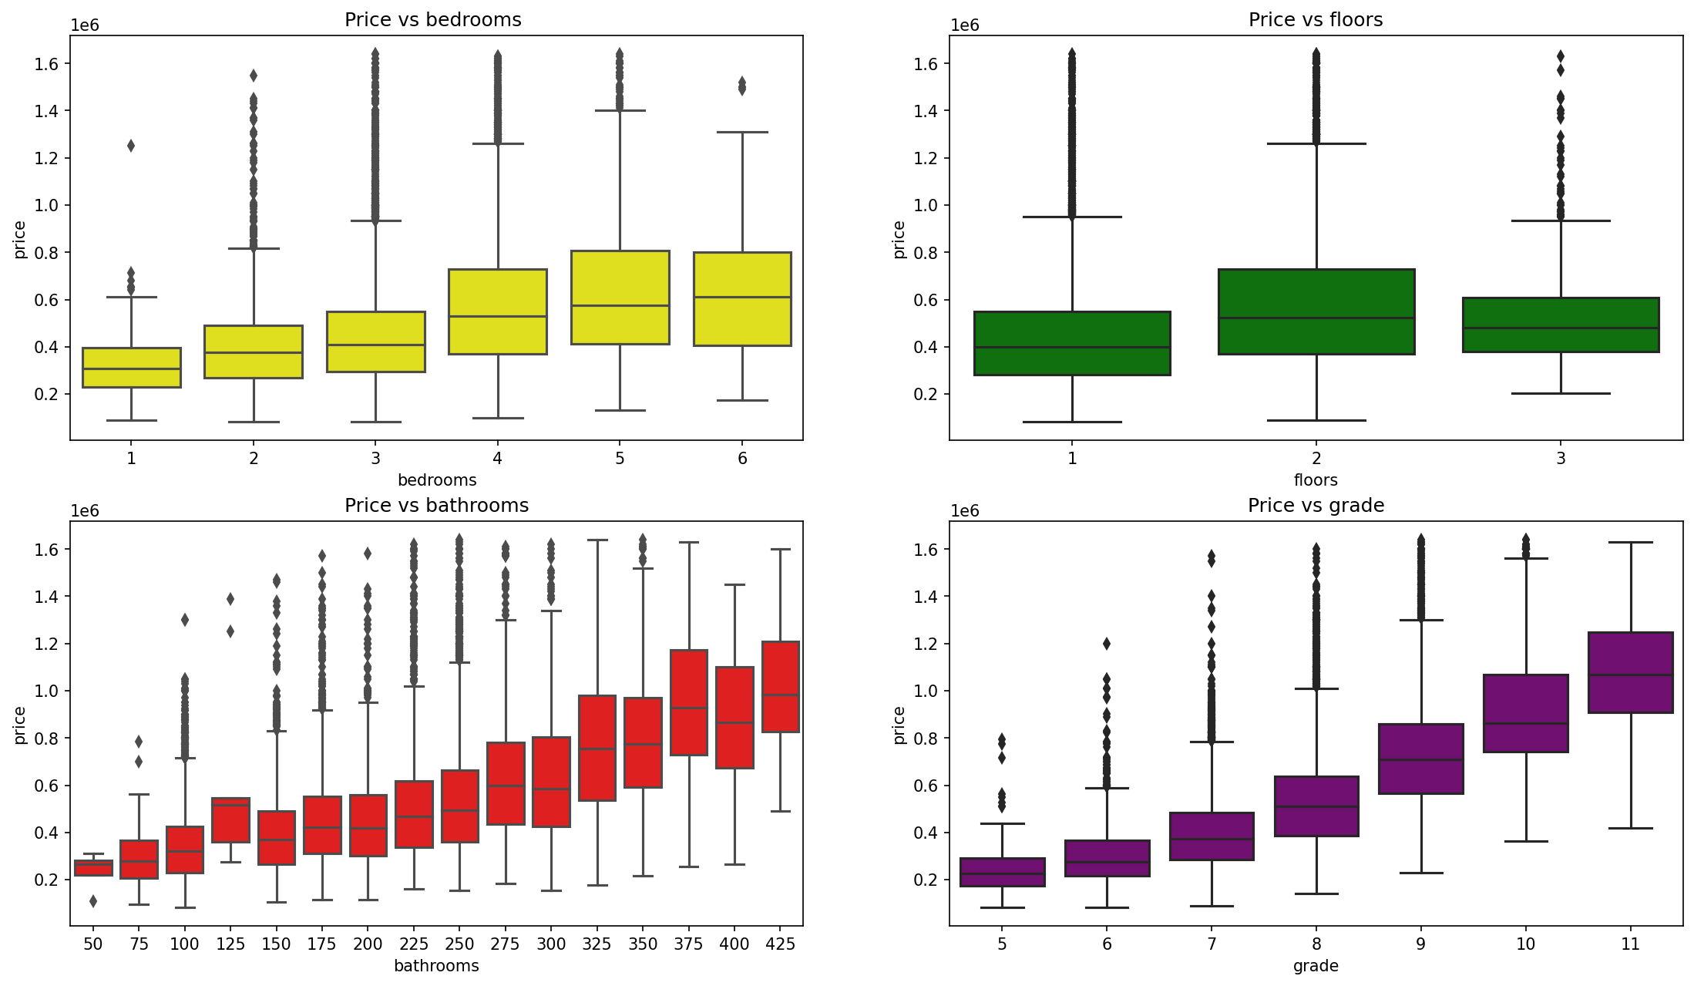

Data & Methods
To ensure more conclusive results, certain portions of the data were excluded due to the presence of anomalies

Slide 8
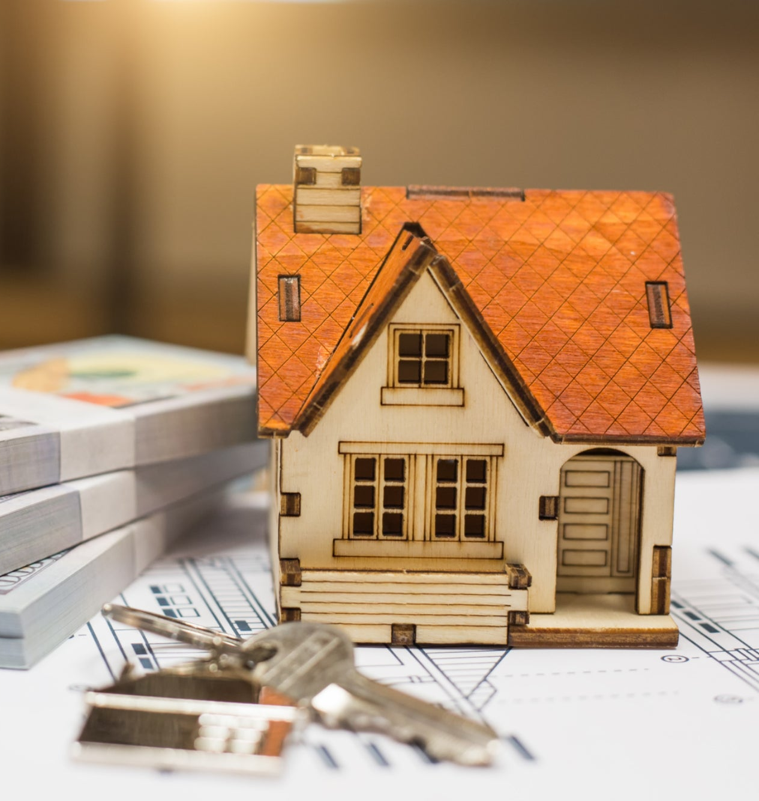
Results
The model derived from the data in the King County dataset indicates…
The discovery highlights that possessing a higher grade is a significant factor contributing to the increased market value of the home.

Slide 9
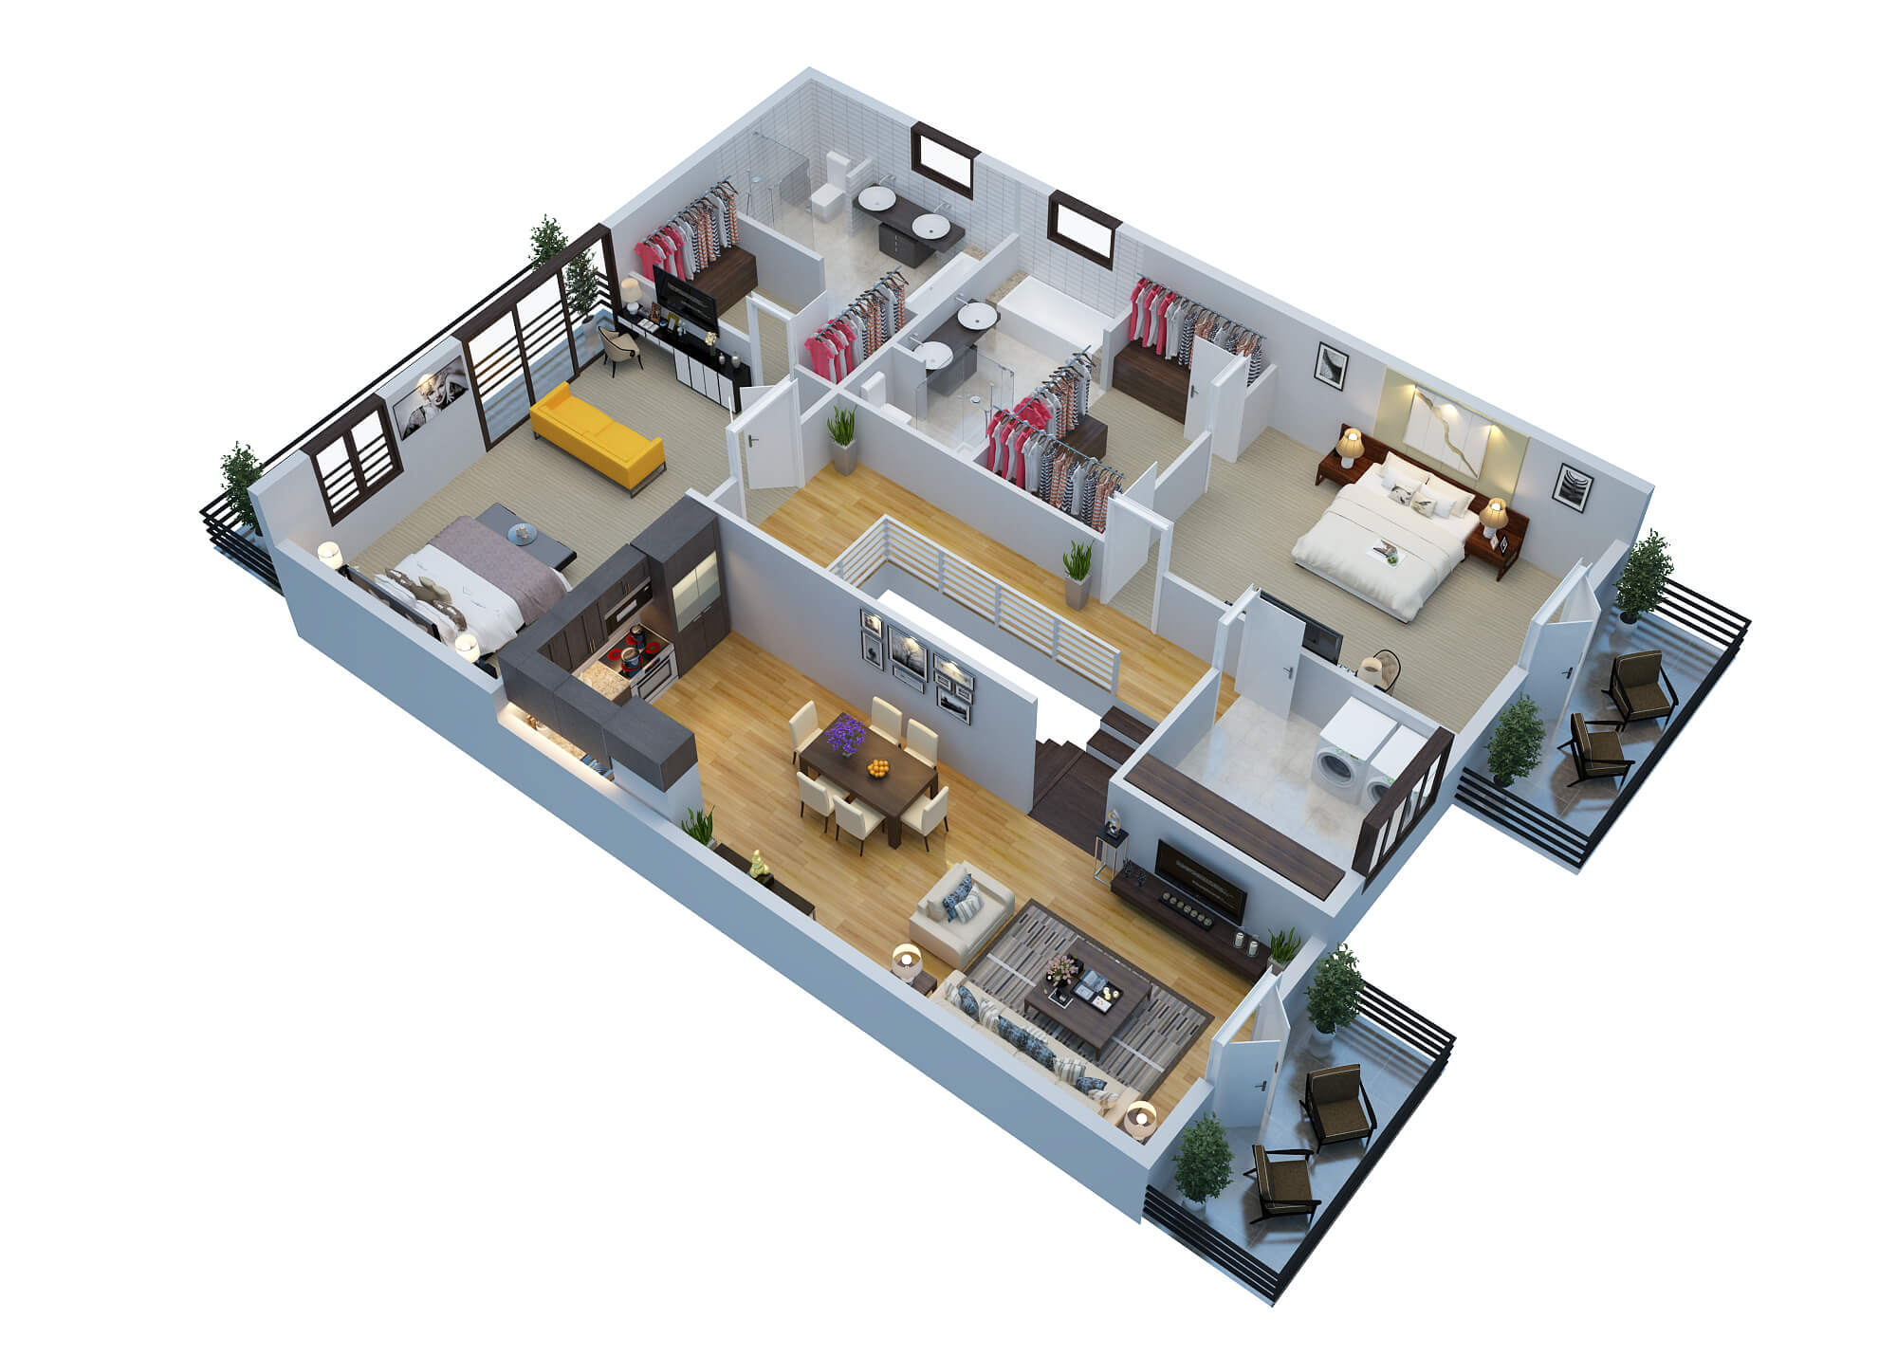
Results
Addressing the key renovation properties to maximize the property's market value, we identified the top five contributors:
sqft_living: Increasing the square footage of the home can raise the price by 83,010.
flr_3: Having a three-story house would increase the property's worth by 66,690.
bath_425: Adding 4.25 bathrooms can increase the property's worth by 304,400.
wtr_1: Having a waterfront view will increase the property's worth by 305,700.
grade_11: Achieving a building grade of 11 in King County can increase the property's worth by 714,500.

Slide 10
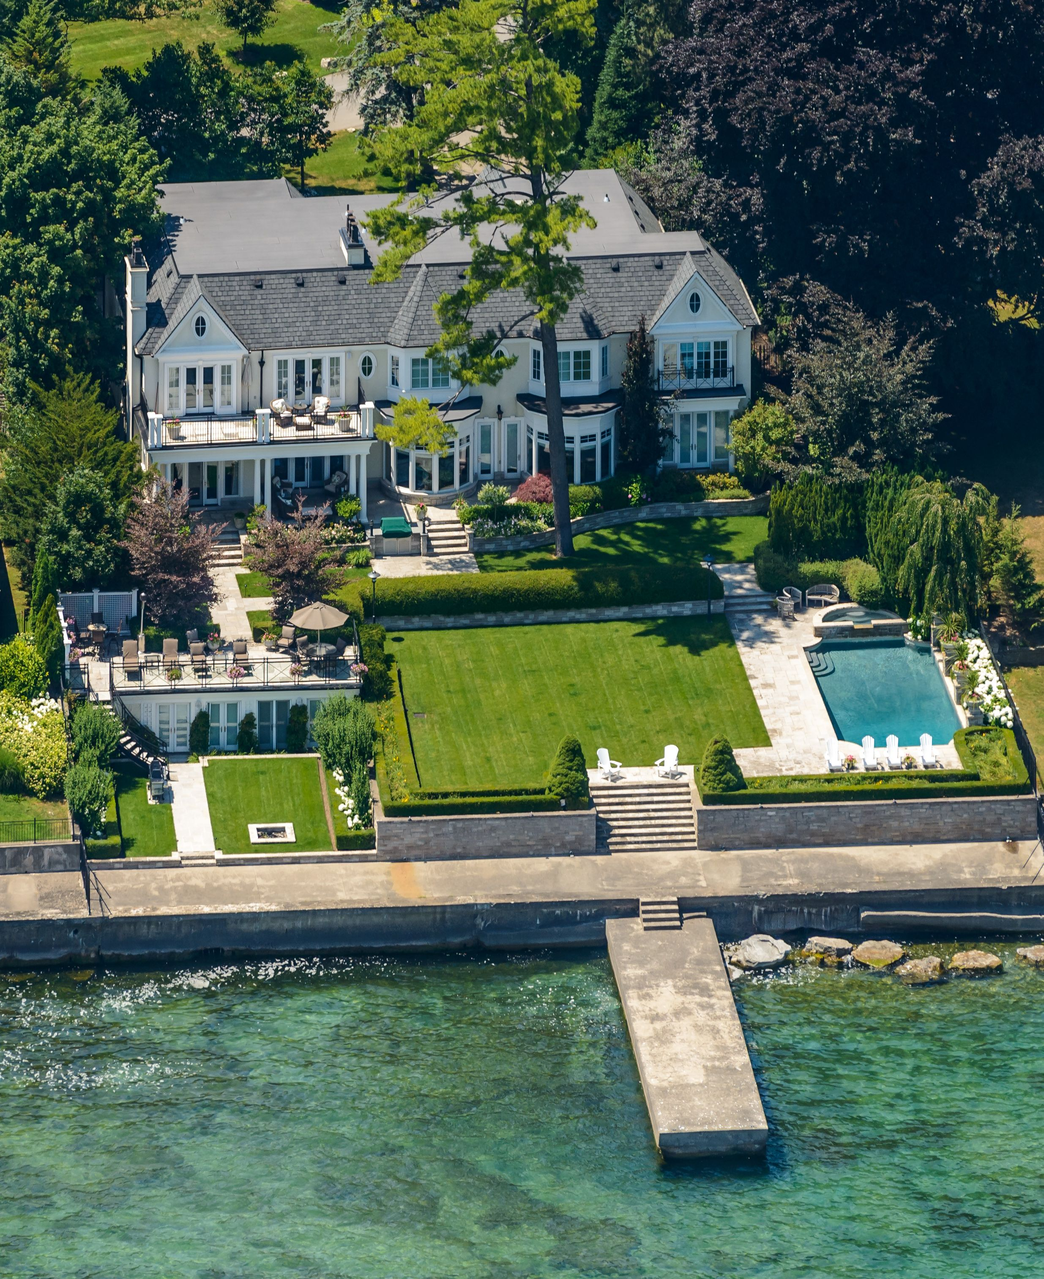
Conclusion
Investing in high-quality materials and luxury options during renovation
Securing a house with a waterfront view, if feasible
Adding more bathrooms

Slide 11

THANk YOU! Email: mariferamoran@gmail.com Github: @marifermrn LinkedIn: www.linkedin.com/in/marifermrn
]

