Slide 1

Implementation and attempted improvement of:
“A comparison of artificial neural network and classical regression models for earthquake-induced slope displacements”
Original paper by: Youngkyu Cho, Farid Khosravikia, Ellen M. Rathje
Report by: Mariglen Hutka (mh64878)

Slide 2
Heteroscedastic ANN for Slope Displacement Prediction
Data source: DesignSafe-CI (PRJ-3028)
Simulations using LS-DYNA: Earthquake-Induced Permanent Displacements
Based on Cho et al. (2022), Soil Dynamics & Earthquake Engineering
Pytorch heteroscedastic ANN predicts μ(x) and σ(x)
Efficient training with early stopping (approximately 440 epochs)
GitHub_link_code: https://github.com/mariglenh18-sys/Heteroscedastic-ANN-for-Slope-Displacement-Prediction.git
Notes:
2

Slide 3
Key Methodological Differences
Original ANN1 (Cho et al. 2022): TensroFlow (only mean μ(x))
This model: PyTorch heteroscedastic ANN (μ(x) and σ(x)
Loss: Gaussian Negative Log-Likelihood (NLL)
Learn aleatory variability directly, not from residuals
Adds full probabilistic predictive capability
Notes:
3

Slide 4
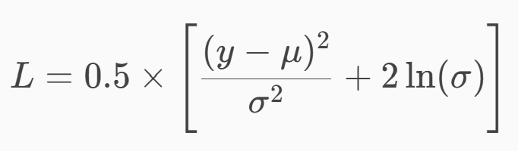
Model Loss Function
Gaussian NLL used for training:
Ensures σ(x) > 0 via softplus activation
Penalizes both prediction error and underestimation of uncertainty
Allows modeling input-dependent variability
Notes:
4

Slide 5
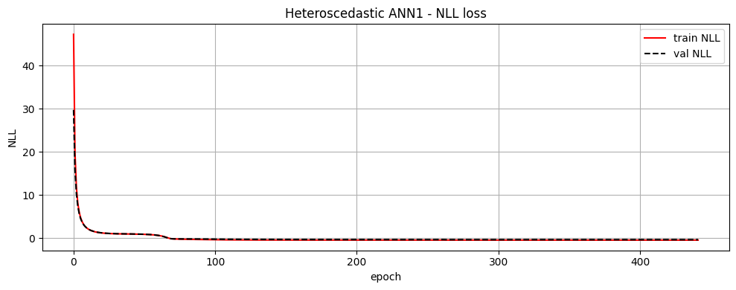
Training Performance
Trained efficiently on Google Colab GPU
Early stopping at epoch 442 (fast convergence)
Best validation NLL = -0.3259
Smooth loss curves with minimal overfitting
More stable and faster than original TF-based workflow (ANN1 time to train: ≈1 hour, this model: 1min)
Notes:
5

Slide 6
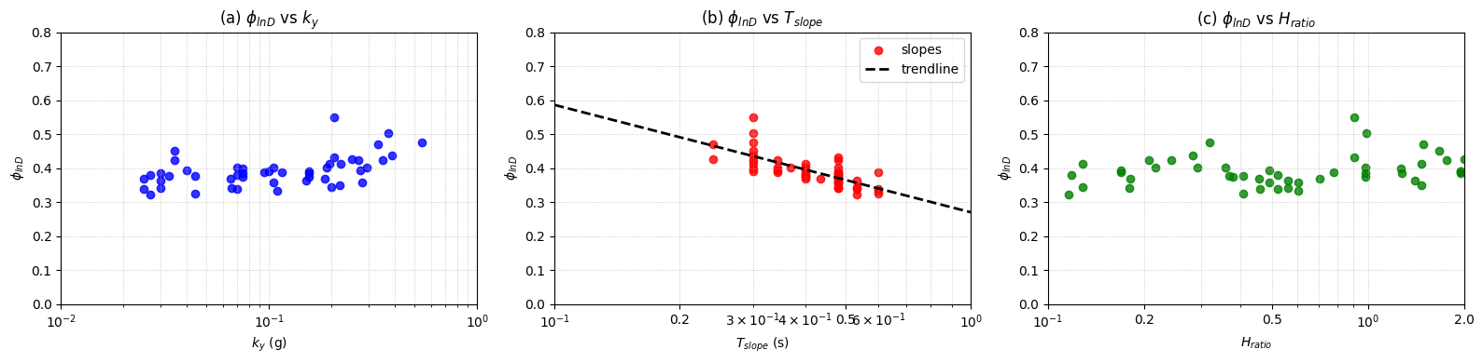
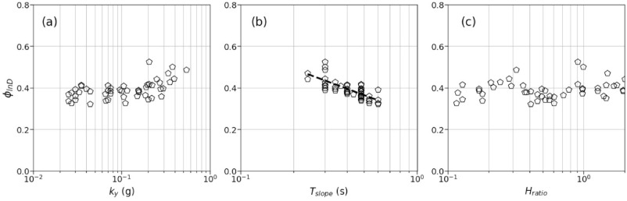
Variability Analysis – φ_lnD Trends
This study:
Computed φ per slope using residuals
Trendline: φ = 0.27 – 0.137ln(Tslope)
This matches exactly Cho et al. (2022) trendline
φ vs ky: mild increasing pattern (as paper)
φ vs Hratio: weak dependence (as paper)
Cho et al. 2022:
Notes:
6

Slide 7
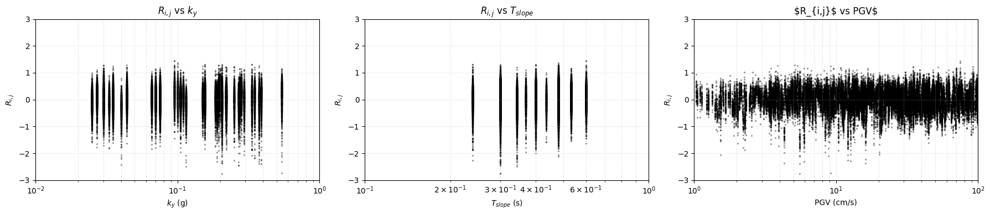
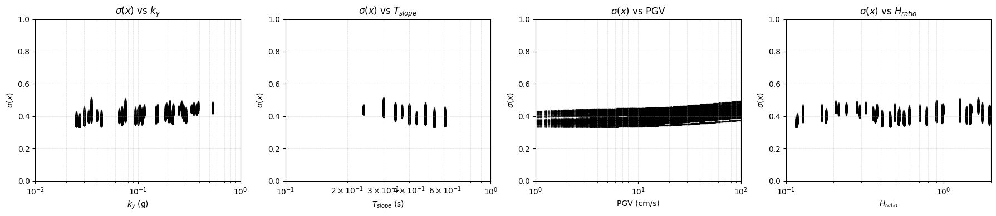
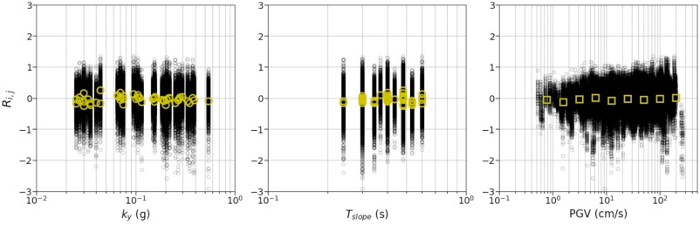
Residuals and σ(x) Analysis
This study:
Residual R ranfe (-3, 3), (as in original paper)
Centered around zero: unbiased model
σ(x) increases with PGV: physically meaningful
σ(x) decreases with ky and Tslope: stiffer slopes, lower uncertainty
Heteroscedastic ANN provides uncertainty unavailable in original ANN1
Cho et al. 2022:
Notes:
7

