Slide 1
FRAUDULENT
TRANSACTION
DETECTION
Gilles Faltz
Johanna Gerdts
Antonia Engel
Mariia Rumiantseva
4 December 2020 Le Wagon - Data Science Bootcamp Berlin, Germany

Slide 2
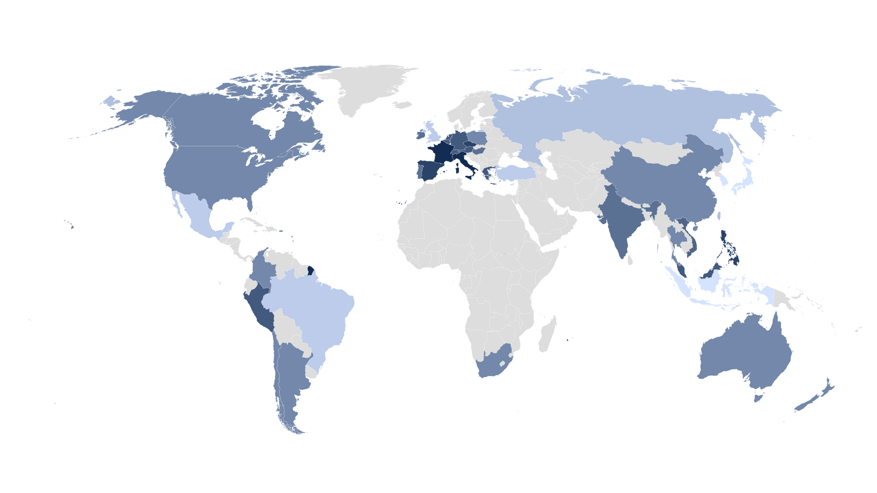
CONCEPT
For the payment industry, the public health crisis triggered by the COVID-19 pandemic has accelerated the move from “physical” to “virtual” banking.
The 2020 McKinsey Global Payment Report https://www.mckinsey.com/~/media/mckinsey/industries/financial%20services/our%20insights/accelerating%20winds%20of%20change%20in%20global%20payments/2020-mckinsey-global-payments-report-vf.pdf

Slide 3
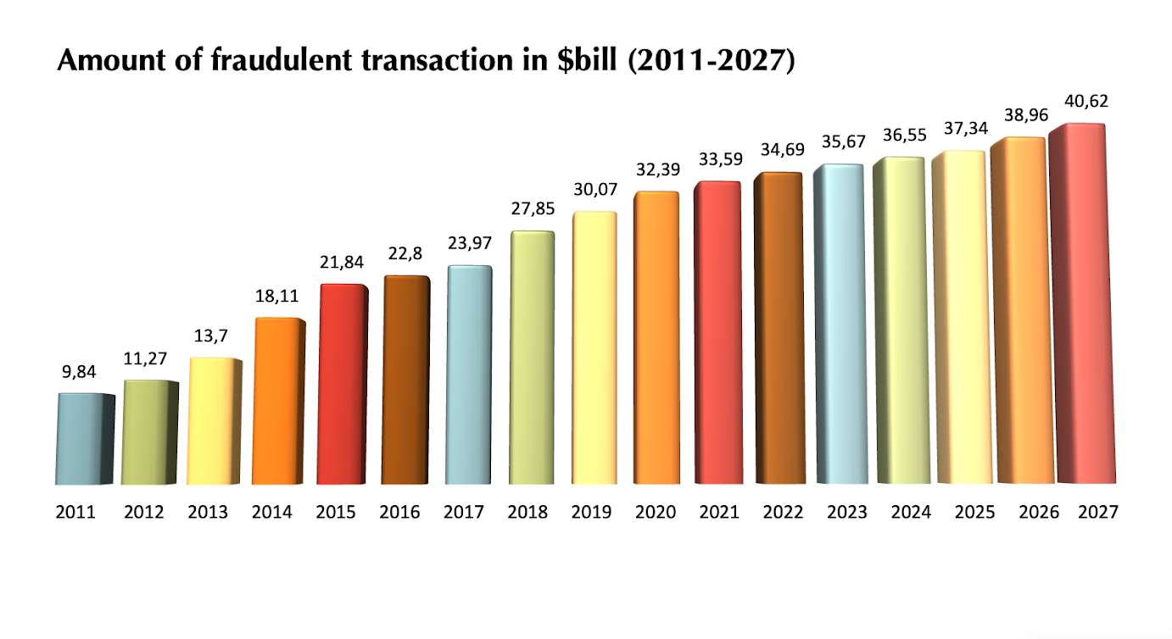
A BRIEF INTRODUCTION TO THE PROBLEM
The amount of card fraud projected worldwide increases every year.

Slide 4
MAIN QUESTION
How can we define whether a transaction is fraudulent or not?

Slide 5
SOLUTION
The prediction model can be utilized in a credit card fraud detection system.
The model can be applied to the transaction data set of the client. If the model finds a transaction that is below a “fraudulent threshold”, this transaction can be put on hold for manual review.

Slide 6

ABOUT DATA
The data comes from Vesta's real-world e-commerce transactions and contains a wide range of features, from device type to product features.
https://www.kaggle.com/c/ieee-fraud-detection

Slide 7
FEATURE
ENGINEERING
New Features:
Weekday
Hour of the day
Credit-card specific features

Slide 8
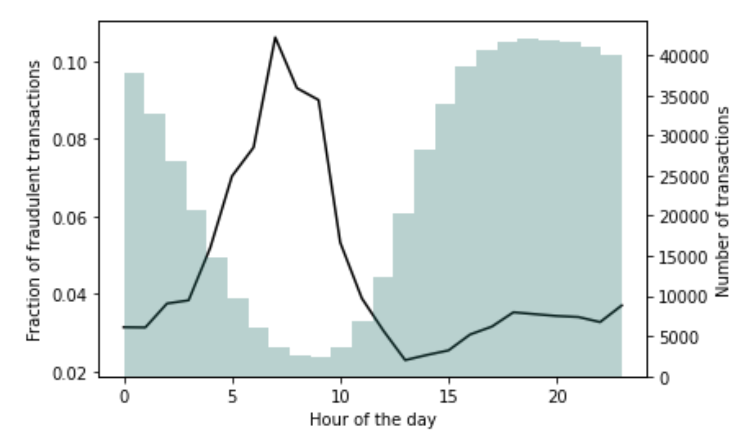
FEATURE
ENGINEERING
# of transactions vs. fraction of fraudulent transactions

Slide 9
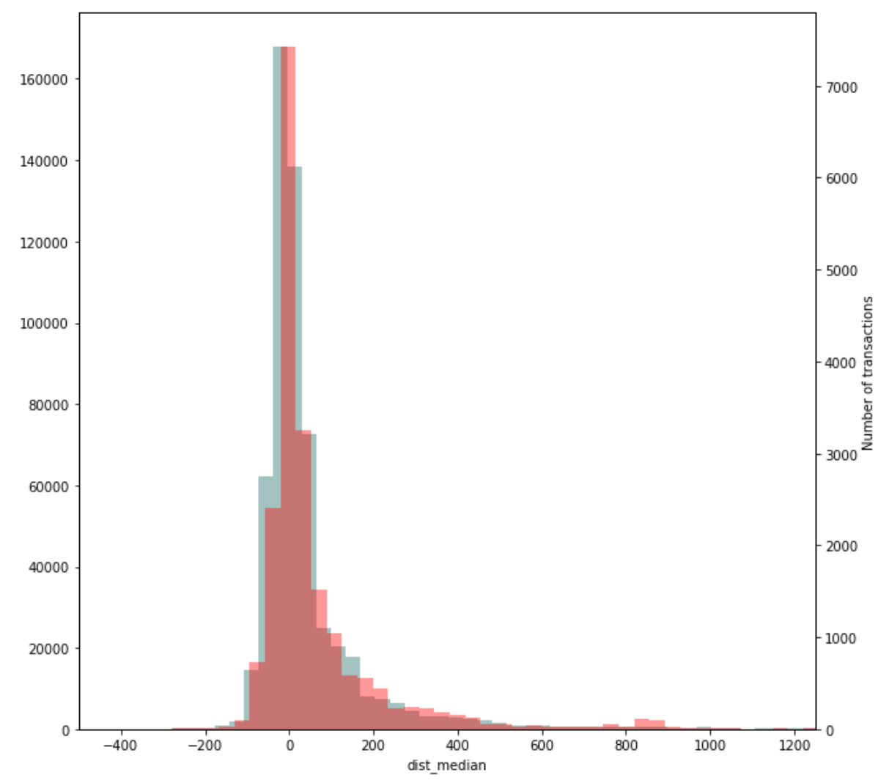
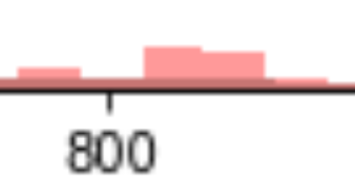
FEATURE
ENGINEERING
Distance of current transaction from median value of transactions of one credit card vs. fraud

Slide 10
METRICS
Recall
Precision
Evaluates the model’s ability to detect fraudulent transactions
Evaluates the model’s ability to avoid false fraudulent transactions
F1
Notes:
In order to analyze which model we should use for our classification problem, we looked at several metrics:
First of all, we compared the Recall metrics which evaluates the model’s ability to detect fraudulent transactions. This Metric is especially important to identitfy as many occurences as possible
Secondly, we looked at Recall which evaluates the model’s ability to avoid false alarms.
Finally, we compared the F1 score, which is a combination of recall and precision.

Slide 11
MODEL RESULTS
 | F1 | Recall
Random Forest Classifier | 51.3 | 34.78
XGBoost Classifier | 39.97 | 26.34
LGBM Classifier | 28.61 | 17.68
Notes:
We mainly compared the Random Forest Classifier, the XGBoost Classifier and the LGBM Classifier. Finally we found that the random forest Classifier has the highest F1 and Recall score. Thus for our final model we used the Random Forest Classifier.

Slide 12
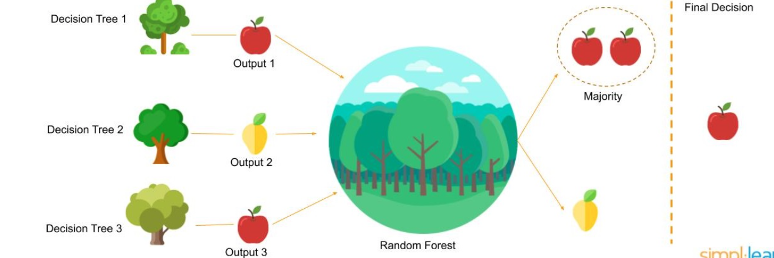
RANDOM FOREST CLASSIFIER
The trees protect each other from their individual errors since the majority voting counts
Notes:
One of the main advantages of the Random Forest Classifier is that the trees protect each other from their individual errors since the majority voting counts.

Slide 13
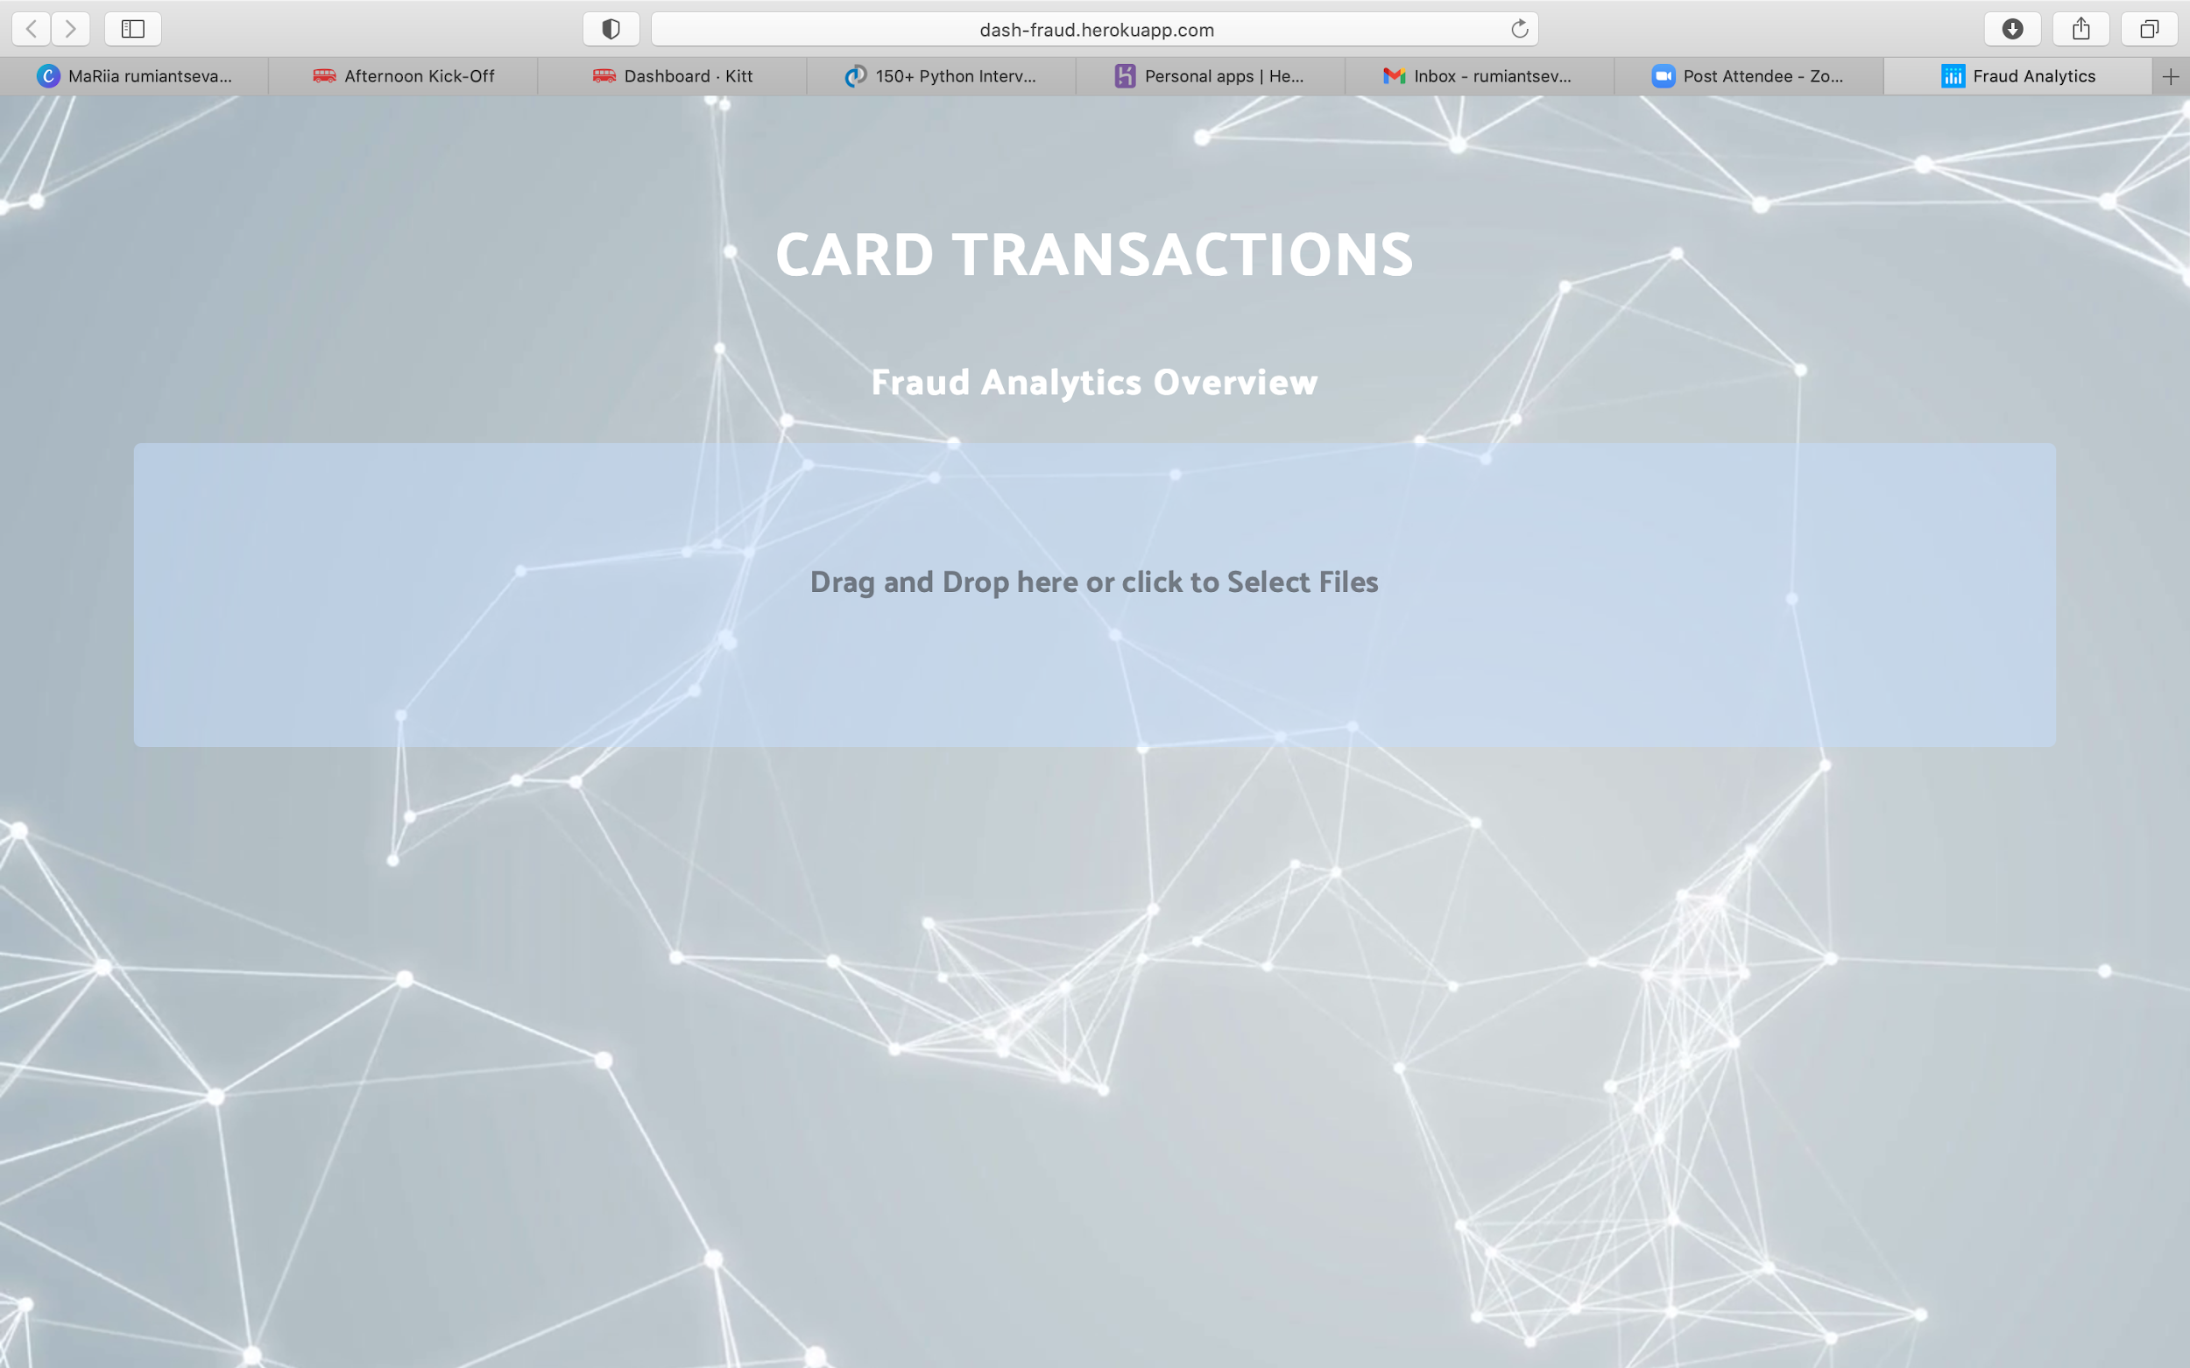
HEROKU APP
https://dash-fraud.herokuapp.com

Slide 14
THANK YOU FOR ATTENTION

