Slide 1
Project structure
Modeling Task_v3b.xlsx
├── data_curation.py # Data preprocessing
├── model.py # XGBoost training with self-training
├── requirements.txt # Python dependencies
└── Modeling Task_v3b.xlsx # Original data
data_curation.py
data.csv
model.py
trained_model.json
label_encoder.pkl

Slide 2
How you went about building this model?
Data exploration and preprocessing
Problem definition
Modeling strategy
Training and evaluation
Next steps

Slide 3
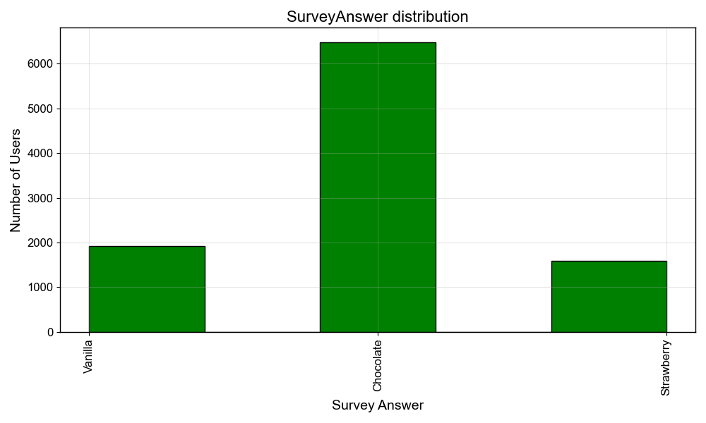
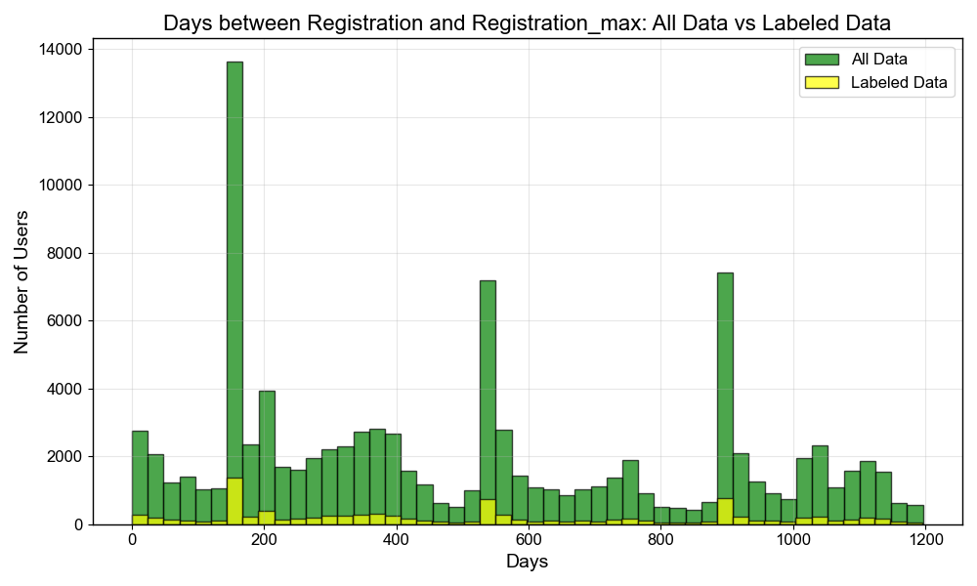
Main data exploration findings
The labelled dataset is limited (10%) and skewed
towards the "Chocolate" class.
Some inconsistent categorical entries (e.g., MOBILE vs Mobile, MobileAPP vs mobile, etc.).
Over 1% of records show the first bet occurring before registration (potential data quality issue).
Three distinct peaks in registrations were observed (likely corresponding to major sporting events).

Slide 4
Problem definition
Building a multiclassification model to predict user survey responses (Chocolate/Strawberry/Vanilla) from sports betting user behavior data.
Simple model
Data preprocessing
Labelled data
Training
Validation on the validation set
Validation on the test set
Save the model
train/validation/test = 70/10/20
XGBClassifier

Slide 5
Why XGBClassifier?
Sequential trees focus on misclassified examples (helping minority classes).
Supports categorical features natively (XGBoost ≥ 1.5).
No need for numerical feature scaling.
Allows class weighting to further address imbalance.
Notes:
Improving the model’s performance on minority classes was prioritized over maximizing overall accuracy.

Slide 6
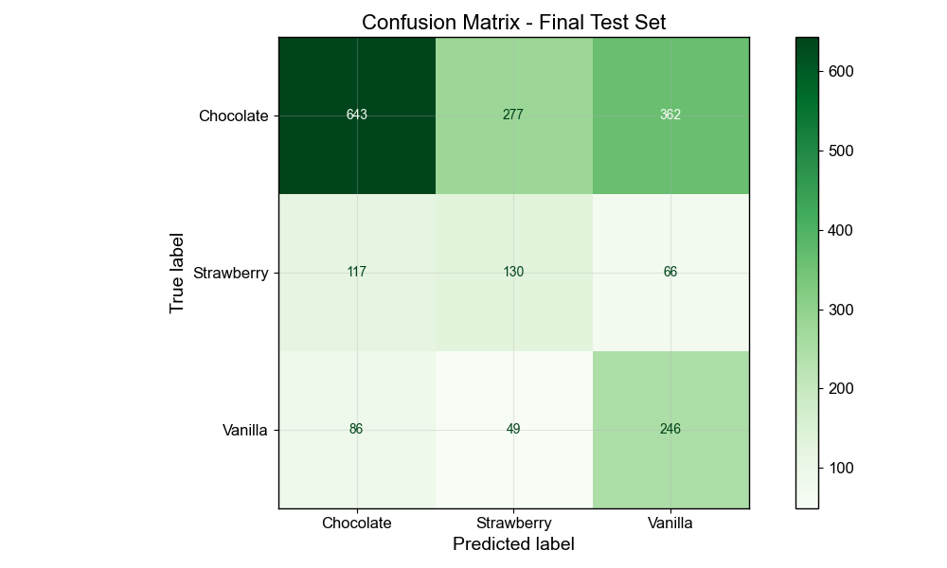
Simple model results
The model appears to be overfitting to the majority class (Chocolate).
Performance is weakest for the Strawberry class.

Slide 7
What else would you do if you had more time?
Semi-supervised approach
Iterative process
Confident decision
Validation on the validation set
Classify unlabelled data
Labelled data
Training
Validation on the test set
Data preprocessing
Save the model
Unlabelled data
Unconfident decision
Notes:
Semi-supervised approach allows gradual training set expansion by the samples that the model predicted with high confidence. Class-specific confidence thresholds can be applied to reduce bias.

Slide 8

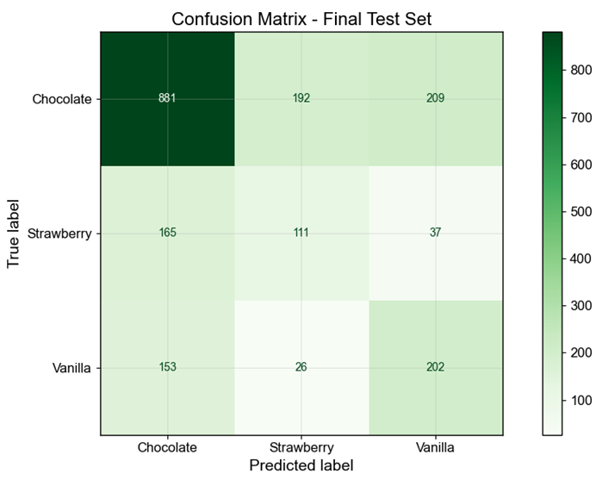
Semi-supervised model results and comparison
The semi-supervised approach slightly improved F1 scores across all classes, with the most noticeable improvement in the Chocolate class.
Overall accuracy has also improved.

Slide 9
Next steps?
Creating new categorical features with info about big sport events and age groups. Some inconsistent categorical entries (e.g., MOBILE vs Mobile, MobileAPP vs mobile, etc.).
Better handling of inconsistent categorical entries and negative DaysToFirstBet (clarification info is needed).
Hyperparameter tuning.

