Slide 1
DengAI
Predicting Disease Spread
https://www.drivendata.org/competitions/44/dengai-predicting-disease-spread/
Mariia Deriglazova, Hendrik Winkhardt

Slide 2
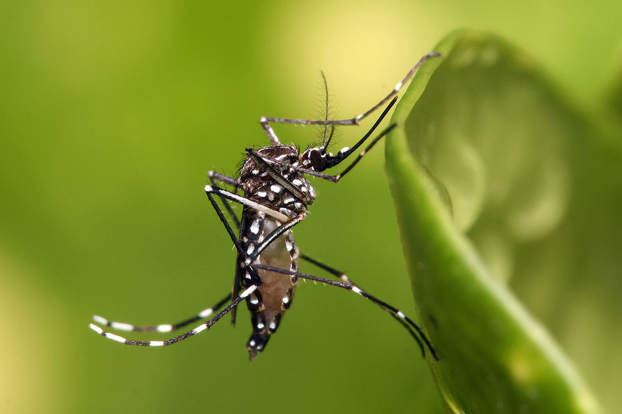
Dengue Fever
Disease
Fever, headache, pain, rashes, sometimes life-threatening bleeding
Incubation time of ca. 14 days
Length of 3-7 days
Not contagious between humans
Transmitted by Aedes Aegypti
Egg: 2-6 days
Larva: >4 days
Pupae: 2 days
Adult: 14-28 days
Total time between egglaying and fever outbreak:
Fig. 1: Aedes aegypti
https://commons.wikimedia.org/wiki/File:Aedes_aegypti.jpg

Slide 3
Data
Weekly Data
1455 usable observations
Weather Data (Temperature, Humidity, Rainfall)
Vegetation Data (NDVI)
Total Cases of Fever
Two Cities:
San Juan, Puerto Rico, April 1990 – April 2008 (936 observations)
-> Monsoon Climate, Northern Hemisphere
Iquitos, Peru, July 2000 – June 2010 (519 observations)
-> Tropical Rainforest, Southern Hemisphere
Goal: Predict number of cases for the following years

Slide 4
Data
Strong yearly seasonality
Strong difference between the two cities

Slide 5
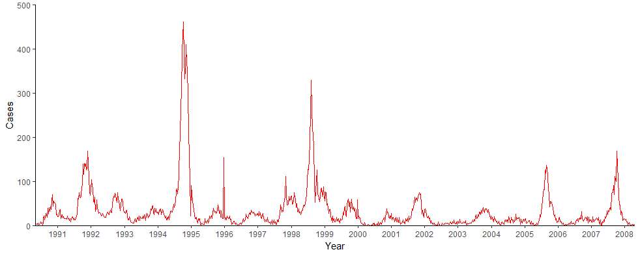
Descriptives: Cases in San Juan
Fig. 2: Cases in San Juan per Week, 1990-2008

Slide 6
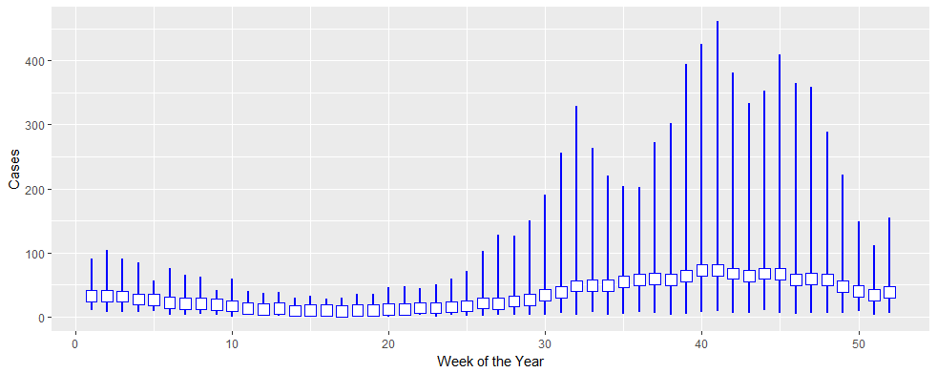
Descriptives: Cases in San Juan by Week

Slide 7
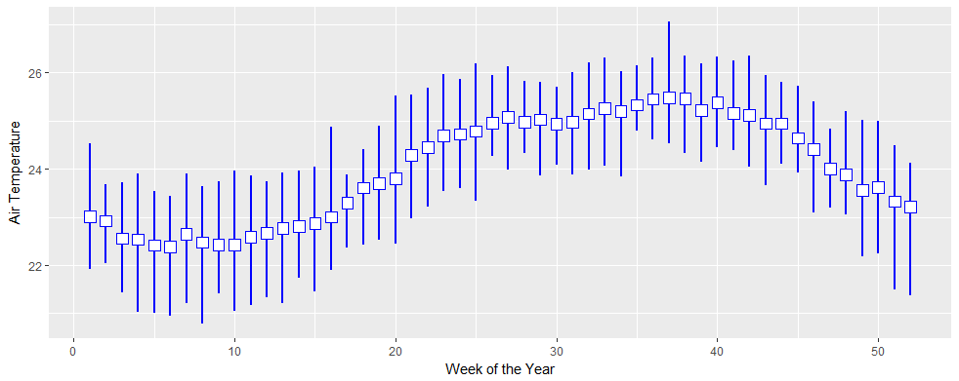
Descriptives: Air Temperature in San Juan

Slide 8
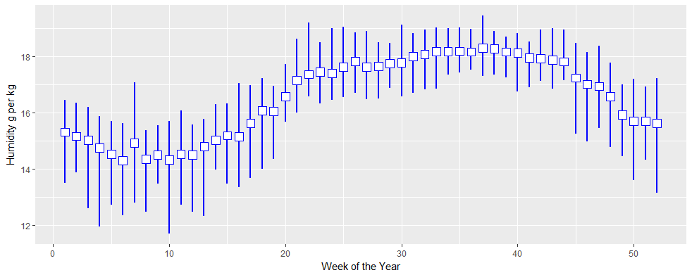
Descriptives: Humidity in San Juan

Slide 9
First tries
Some simple Poisson-/ Negative Binomial-models
ARIMA
Correlogram:
Data differs heavily between San Juan and Iquitos
San Juan

Slide 10
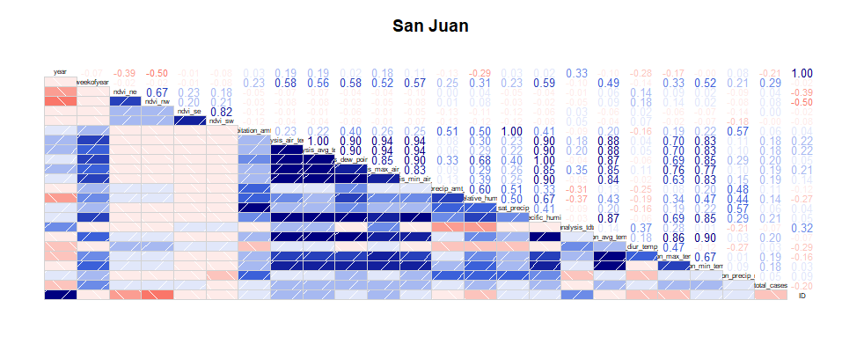
Correlogram San Juan

Slide 11
Evaluation
Minimizing Mean Squared Error for the Prediction

Slide 12
Issues
Missing values
Small dataset with (some) redundant information
Unobserved factors
Lag (Mosquito Lifespan, Incubation Time)

