Slide 1
DengAI
Predicting Disease Spread
https://www.drivendata.org/competitions/44/dengai-predicting-disease-spread/
Mariia Deriglazova, Hendrik Winkhardt

Slide 2
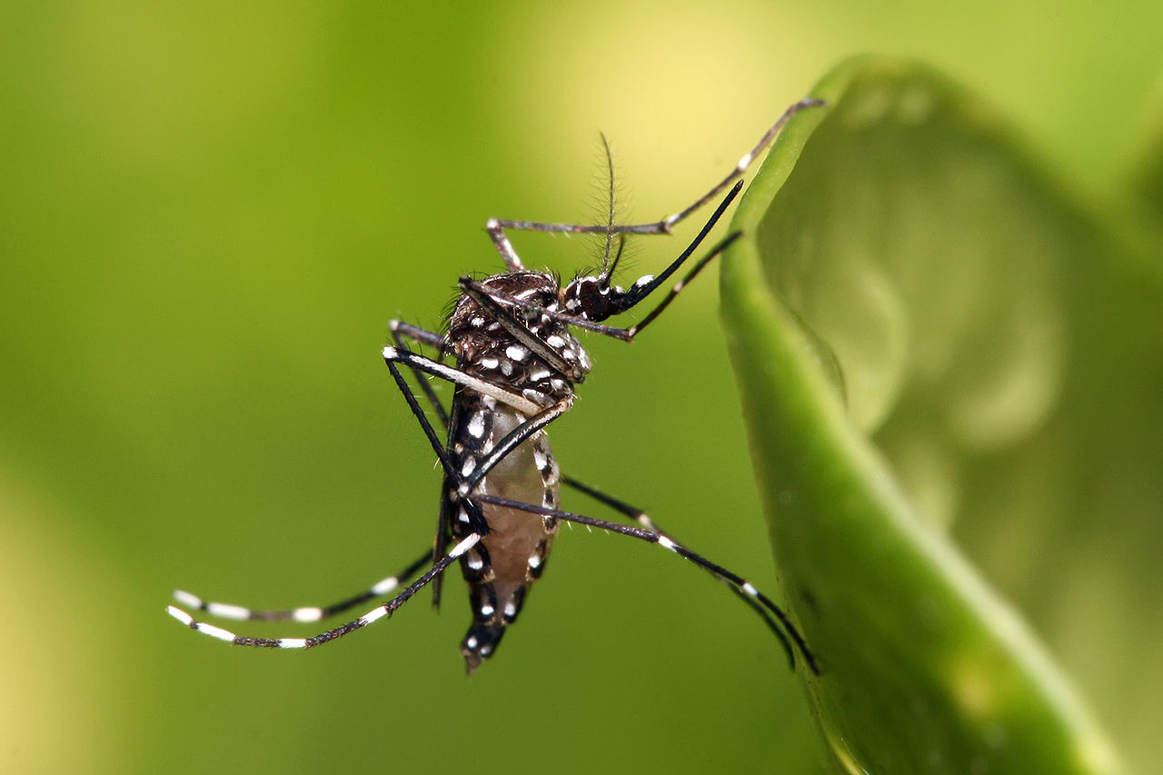
Dengue Fever
Disease
Fever, headache, pain, rashes, sometimes life-threatening bleeding
Incubation time of ca. 14 days
Length of 3-7 days
Not contagious between humans
Transmitted by Aedes Aegypti
Egg: 2-6 days
Larva: >4 days
Pupae: 2 days
Adult: 14-28 days
Total time between egglaying and fever outbreak: 3-4 weeks
Fig. 1: Aedes aegypti
https://commons.wikimedia.org/wiki/File:Aedes_aegypti.jpg

Slide 3
Data
Weekly Data
1455 usable observations
Weather Data (Temperature, Humidity, Rainfall)
Vegetation Data (NDVI)
Total Cases of Fever
Two Cities:
San Juan, Puerto Rico, April 1990 – April 2008 (936 observations)
-> Monsoon Climate, Northern Hemisphere
Iquitos, Peru, July 2000 – June 2010 (519 observations)
-> Tropical Rainforest, Southern Hemisphere
Goal: Predict number of cases for the following years : until 2013
Evaluation: Mean Absolute Error (MAE)

Slide 4
Data
Strong yearly seasonality
Epidemics
Strong difference between the two cities

Slide 5
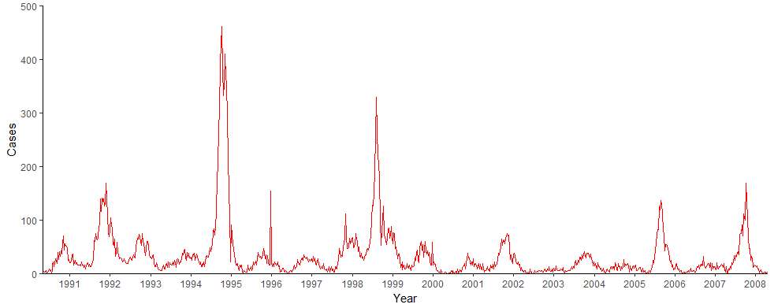
Descriptives (Cases in San Juan)
Fig. 2: Cases in San Juan per Week, 1990-2008

Slide 6
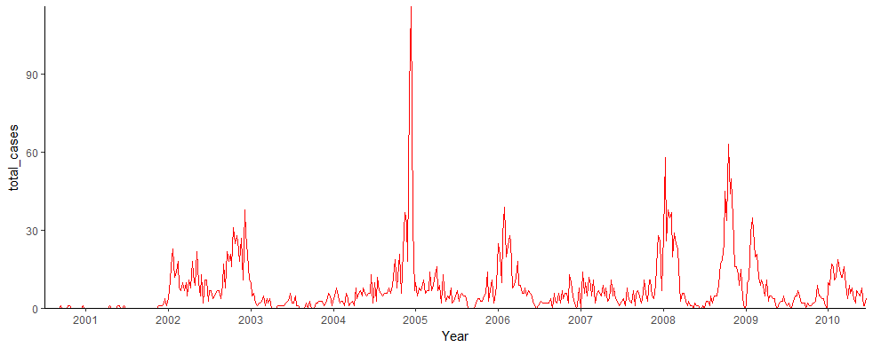
Descriptives (Cases in Iquitos)

Slide 7
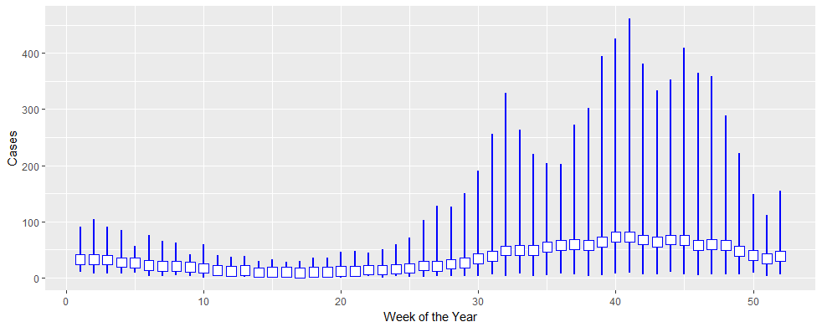
Descriptives: Cases in San Juan

Slide 8
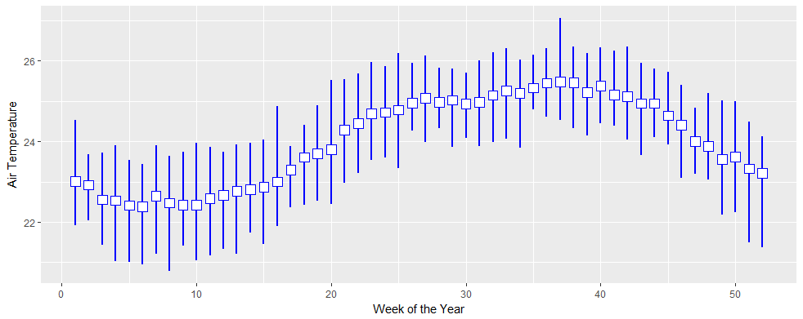
Descriptives: Air Temperature in San Juan

Slide 9
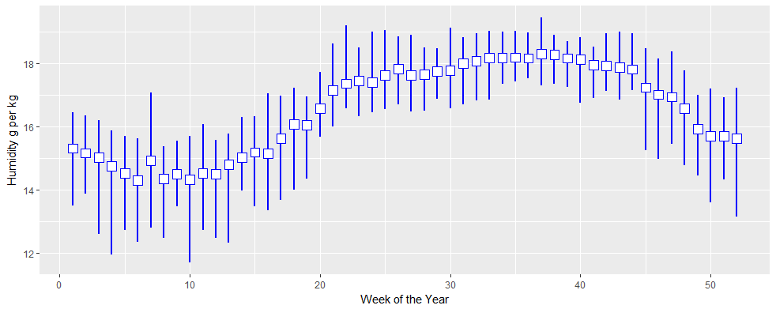
Descriptives: Humidity in San Juan

Slide 10
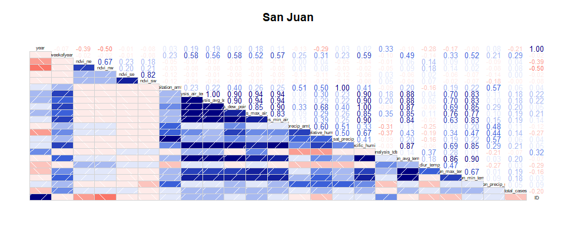
Correlogram

Slide 11
First tries
Some simple Poisson-& Negative Binomial/models on all the data
ARIMA on the total cases
Univariate
Stationary
Good at approximating historical patterns
Improvement: climate variables as external regressor

Slide 12
Issues
Missing values
Small dataset with (some) redundant information
Unobserved factors?
Lag (Mosquito Lifespan, Incubation Time)
Model Selection

