Slide 1
DengAI
Predicting Disease Spread
https://www.drivendata.org/competitions/44/dengai-predicting-disease-spread/
Mariia Deriglazova, Hendrik Winkhardt

Slide 2
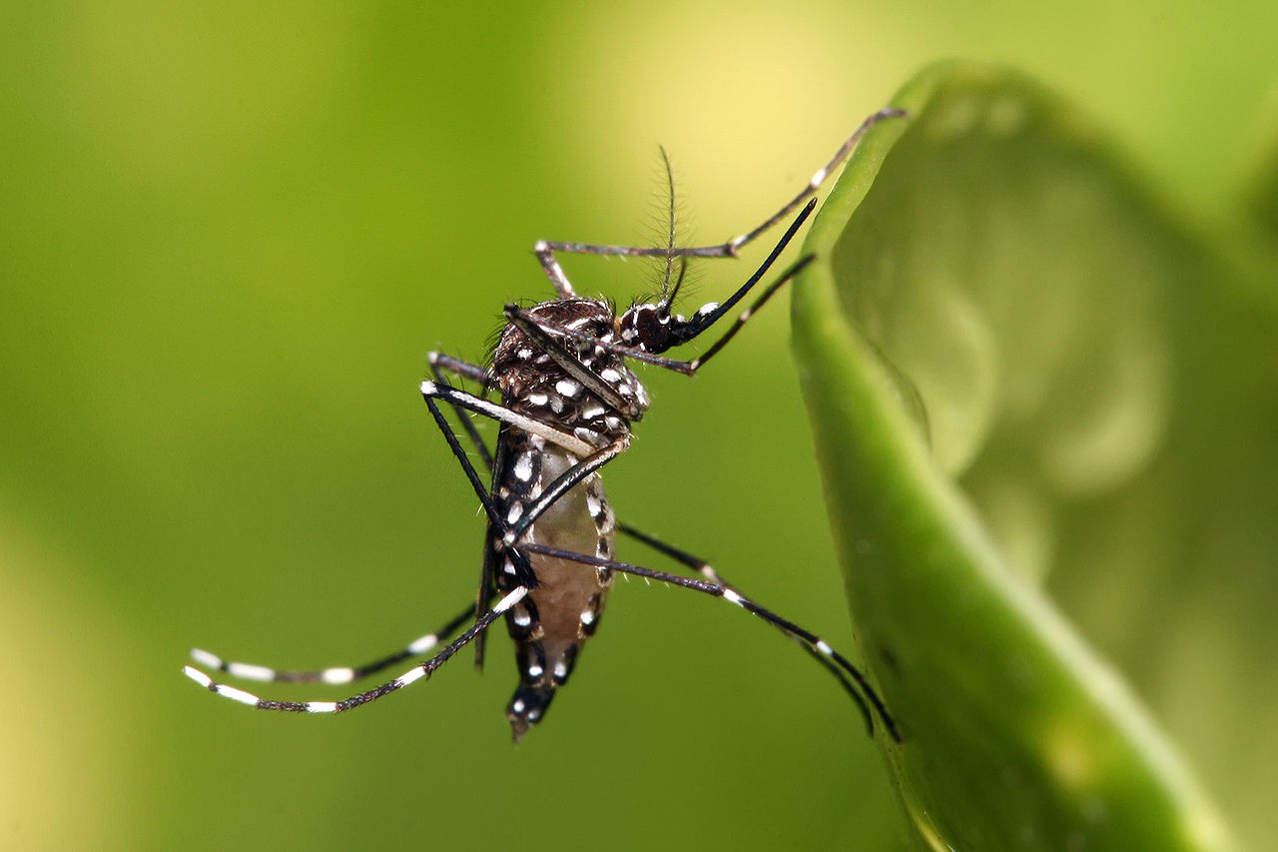
Dengue Fever
Disease
Fever, headache, pain, rashes, sometimes life-threatening bleeding
Incubation time of ca. 14 days
Length of 3-7 days
Not contagious between humans
Transmitted by Aedes Aegypti
Egg: 2-6 days
Larva: >4 days
Pupae: 2 days
Adult: 14-28 days
Total time between egglaying and fever outbreak: 3-4 weeks
Fig. 1: Aedes aegypti
https://commons.wikimedia.org/wiki/File:Aedes_aegypti.jpg

Slide 3
Data
Weekly Data
1455 usable observations
Weather Data (Temperature, Humidity, Rainfall)
Vegetation Data (NDVI)
Total Cases of Fever
Two Cities:
San Juan, Puerto Rico, April 1990 – April 2008 (936 observations)
-> Monsoon Climate, Northern Hemisphere
Iquitos, Peru, July 2000 – June 2010 (519 observations)
-> Tropical Rainforest, Southern Hemisphere
Goal: Predict number of cases for the following years : until 2013
Evaluation: Mean Absolute Error (MAE)

Slide 4
Data
Strong yearly seasonality
Epidemics
Strong difference between the two cities

Slide 5
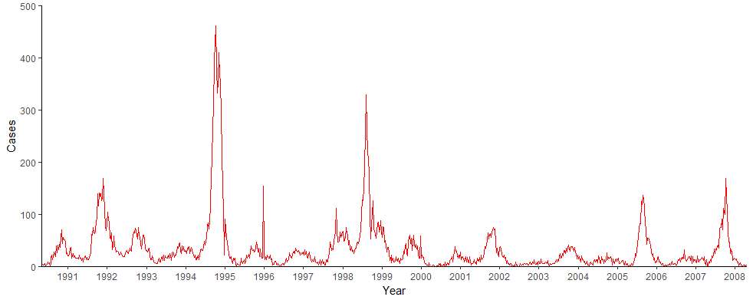
Descriptives (Cases in San Juan)
Fig. 2: Cases in San Juan per Week, 1990-2008

Slide 6
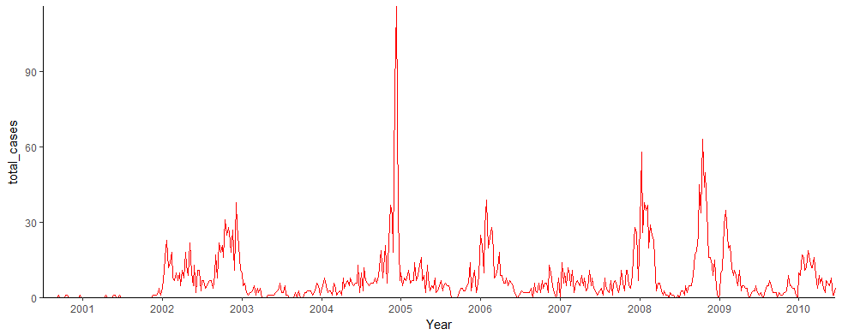
Descriptives (Cases in Iquitos)

Slide 8
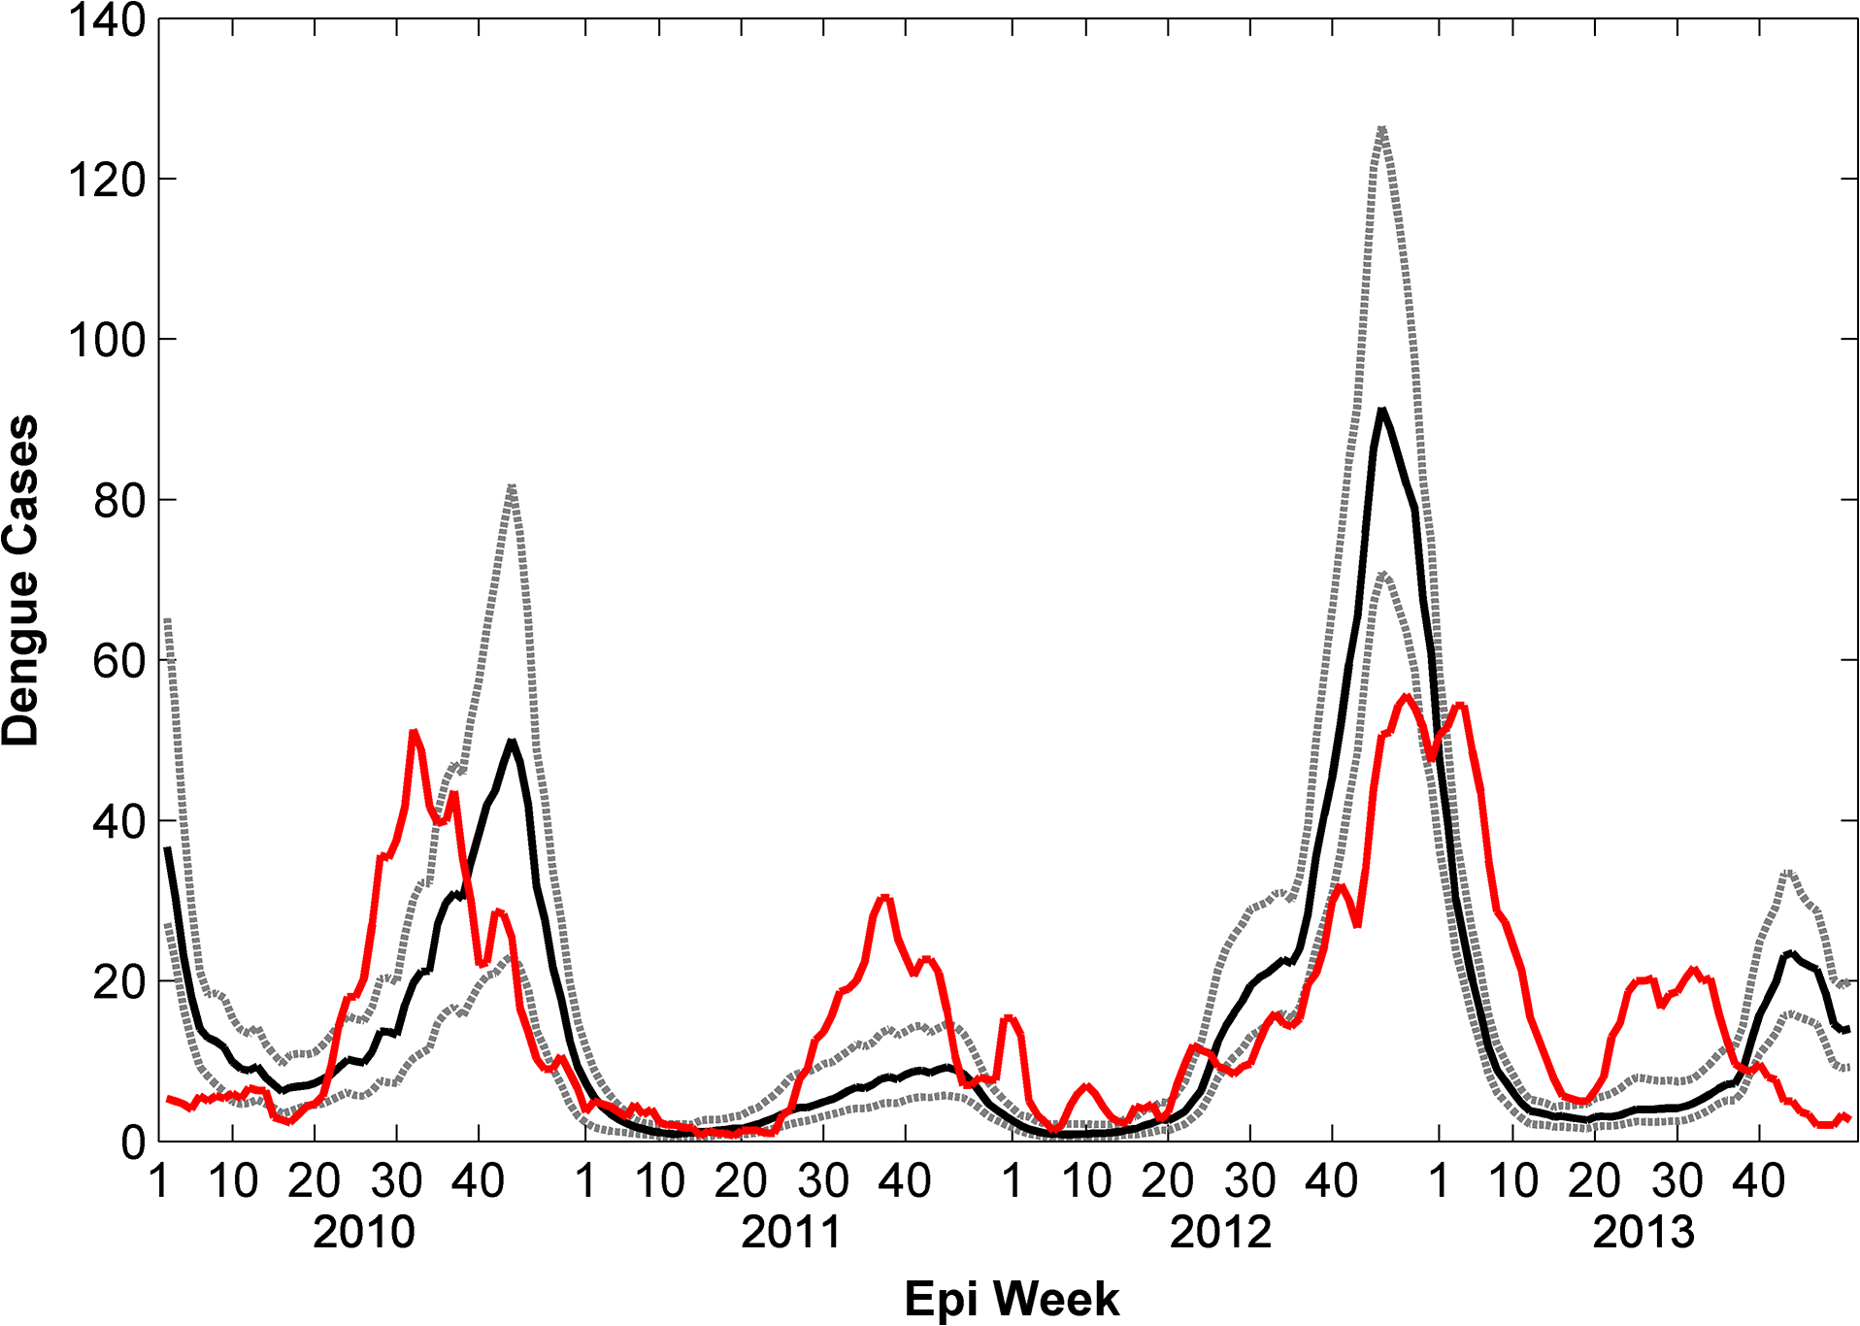
Real Life Cases San Juan (Monaghan et al. 2015, https://doi.org/10.1371/journal.pntd.0004002.g002)

Slide 9
Variable selection and lagging
Correlograms for all variables against the number of total cases, for all weeks in the previous year respectively
Winners:
Temperature at dew point: 9 Weeks (SJ), 11 Weeks (IQ)
Air humidity: 9 Weeks (SJ), 11 Weeks (IQ)
Avg. Temperature: 11 Weeks (SJ), 14 Weeks (IQ) (***)
Minimum Temperature: 11 Weeks (SJ), 10 Weeks (IQ)
Absolute Precipitation: 2 Weeks (SJ), 4 Weeks (IQ)
Also included lagged cases in some runs

Slide 10
Linear Models
Mainly Negative Binomial
Important: T

Slide 11
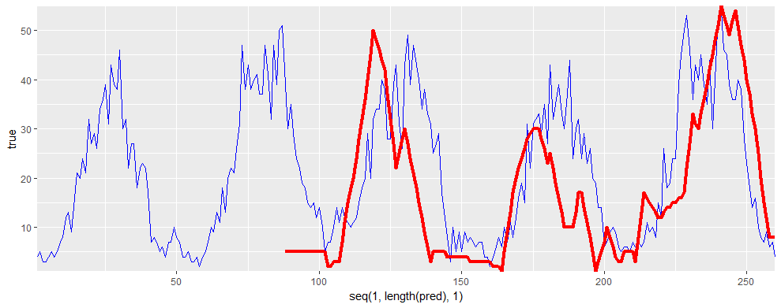
Comparison to Real Life Data (San Juan)
Red: Real-Life cases, Blue: Prediction, MAE=10.5

Slide 12
ARIMA
ARIMA (p,d,q) (P, D, Q)
Univariate
Stationary
Good at approximating historical patterns
Good for approximating the training data
Parameters are taken from autocorrelation and partial autocorrelation plots
Submission MAE is 27.4111

Slide 13
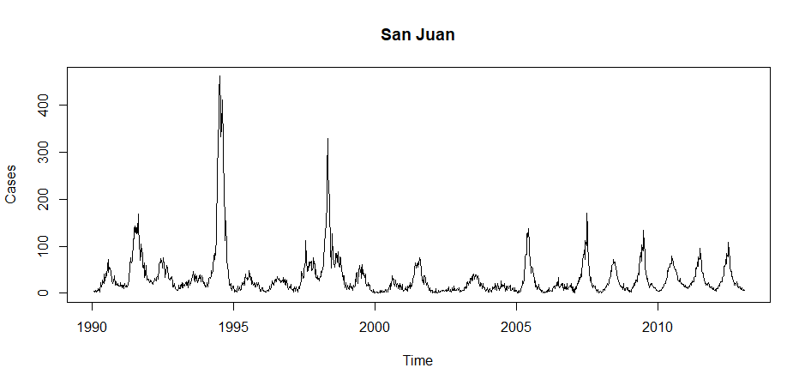
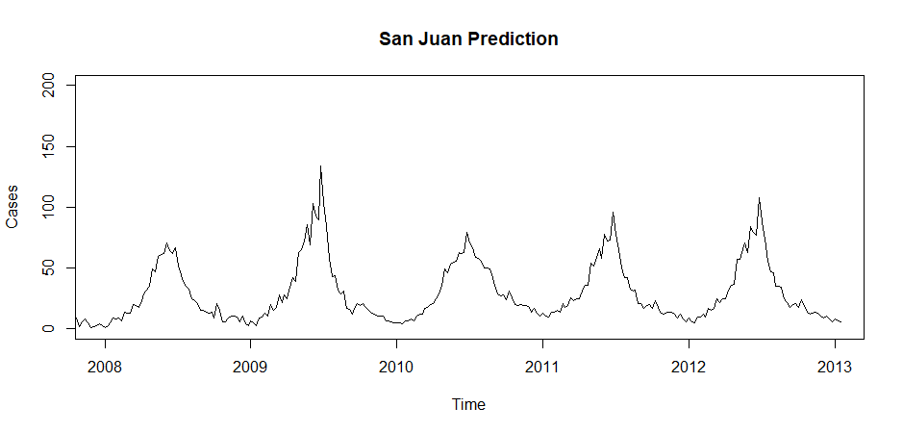

Slide 14
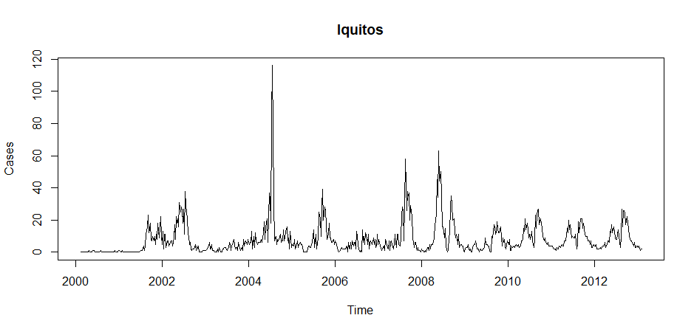
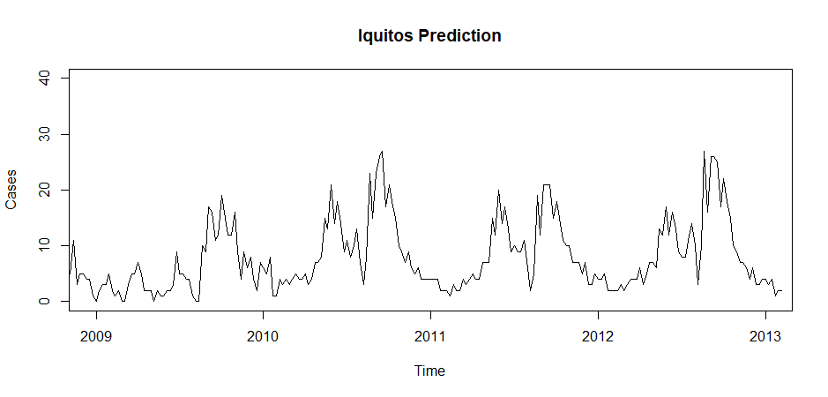

Slide 15
Tree-based Models

Slide 16
Conclusion
Result: Bad Rank 10XX / 42XX
Capturing the training data is not the problem
What to train on?

