Slide 1
DengAI
Predicting Disease Spread
https://www.drivendata.org/competitions/44/dengai-predicting-disease-spread/
Mariia Deriglazova, Hendrik Winkhardt

Slide 2
Contents
General Information
Data
Preprocessing
Descriptives
Models
Conclusion

Slide 3
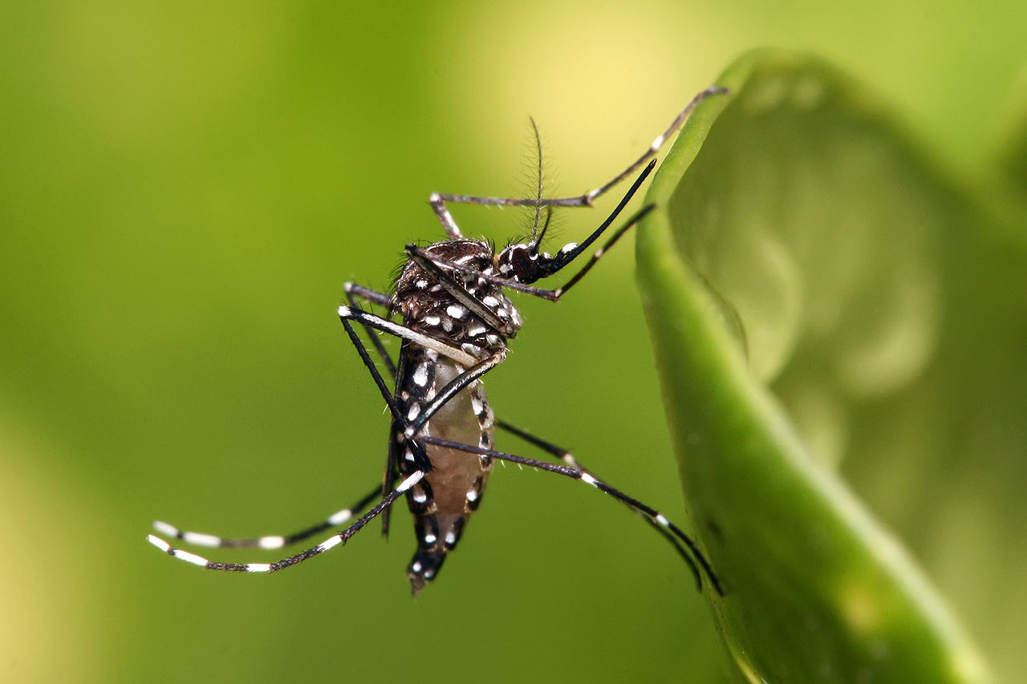
Dengue Fever
Disease
Fever, headache, pain, rashes, sometimes life-threatening bleeding
Incubation time of ca. 14 days
Length of 3-7 days
Not contagious between humans
Transmitted by Aedes Aegypti
Egg: 2-6 days
Larva: >4 days
Pupae: 2 days
Adult: 14-28 days
Total time between egglaying and fever outbreak: 3-4 weeks
Fig. 1: Aedes aegypti
https://commons.wikimedia.org/wiki/File:Aedes_aegypti.jpg

Slide 4
Data
Weekly Data
1455 usable observations
Weather Data (Temperature, Humidity, Rainfall)
Vegetation Data (NDVI)
Total Cases of Fever
Two Cities:
San Juan, Puerto Rico, April 1990 – April 2008 (936 observations)
-> Monsoon Climate, Northern Hemisphere
Iquitos, Peru, July 2000 – June 2010 (519 observations)
-> Tropical Rainforest, Southern Hemisphere
Goal: Predict number of cases for the following years (until 2013)
Evaluation: Mean Absolute Error (MAE)

Slide 5
Data
Strong yearly seasonality
Some years with epidemics
Strong difference between the two cities
Hemisphere
Climate
Total cases

Slide 6
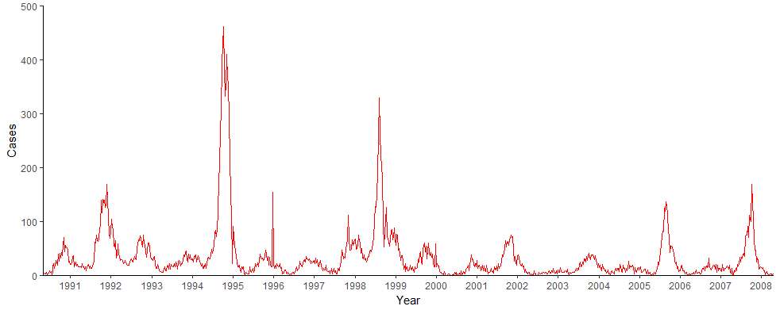
Descriptives (Cases in San Juan)
Fig. 2: Cases in San Juan per Week, 1990-2008

Slide 7
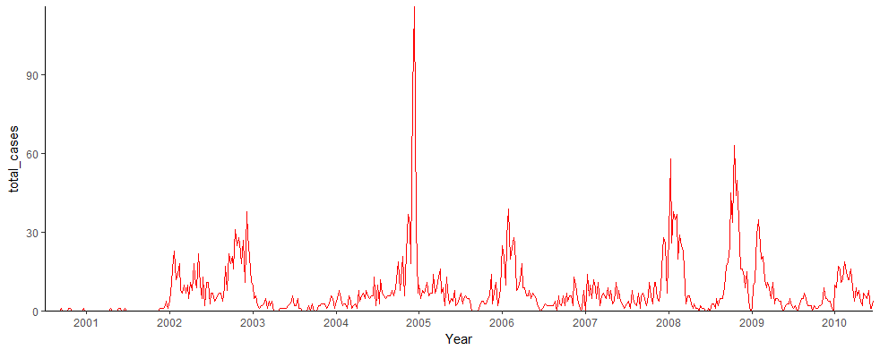
Descriptives (Cases in Iquitos)
Fig. 3: Cases in Iquitos per Week, 2000-2010

Slide 8
Preprocessing
Small and relatively clean Data Set
Occasional NAs (1.5% of values)
Likely are similar to the surrounding values
Imputed linearly from the surrounding cases
Lagging of some variables where fit (see below)
Same in the testing data

Slide 9
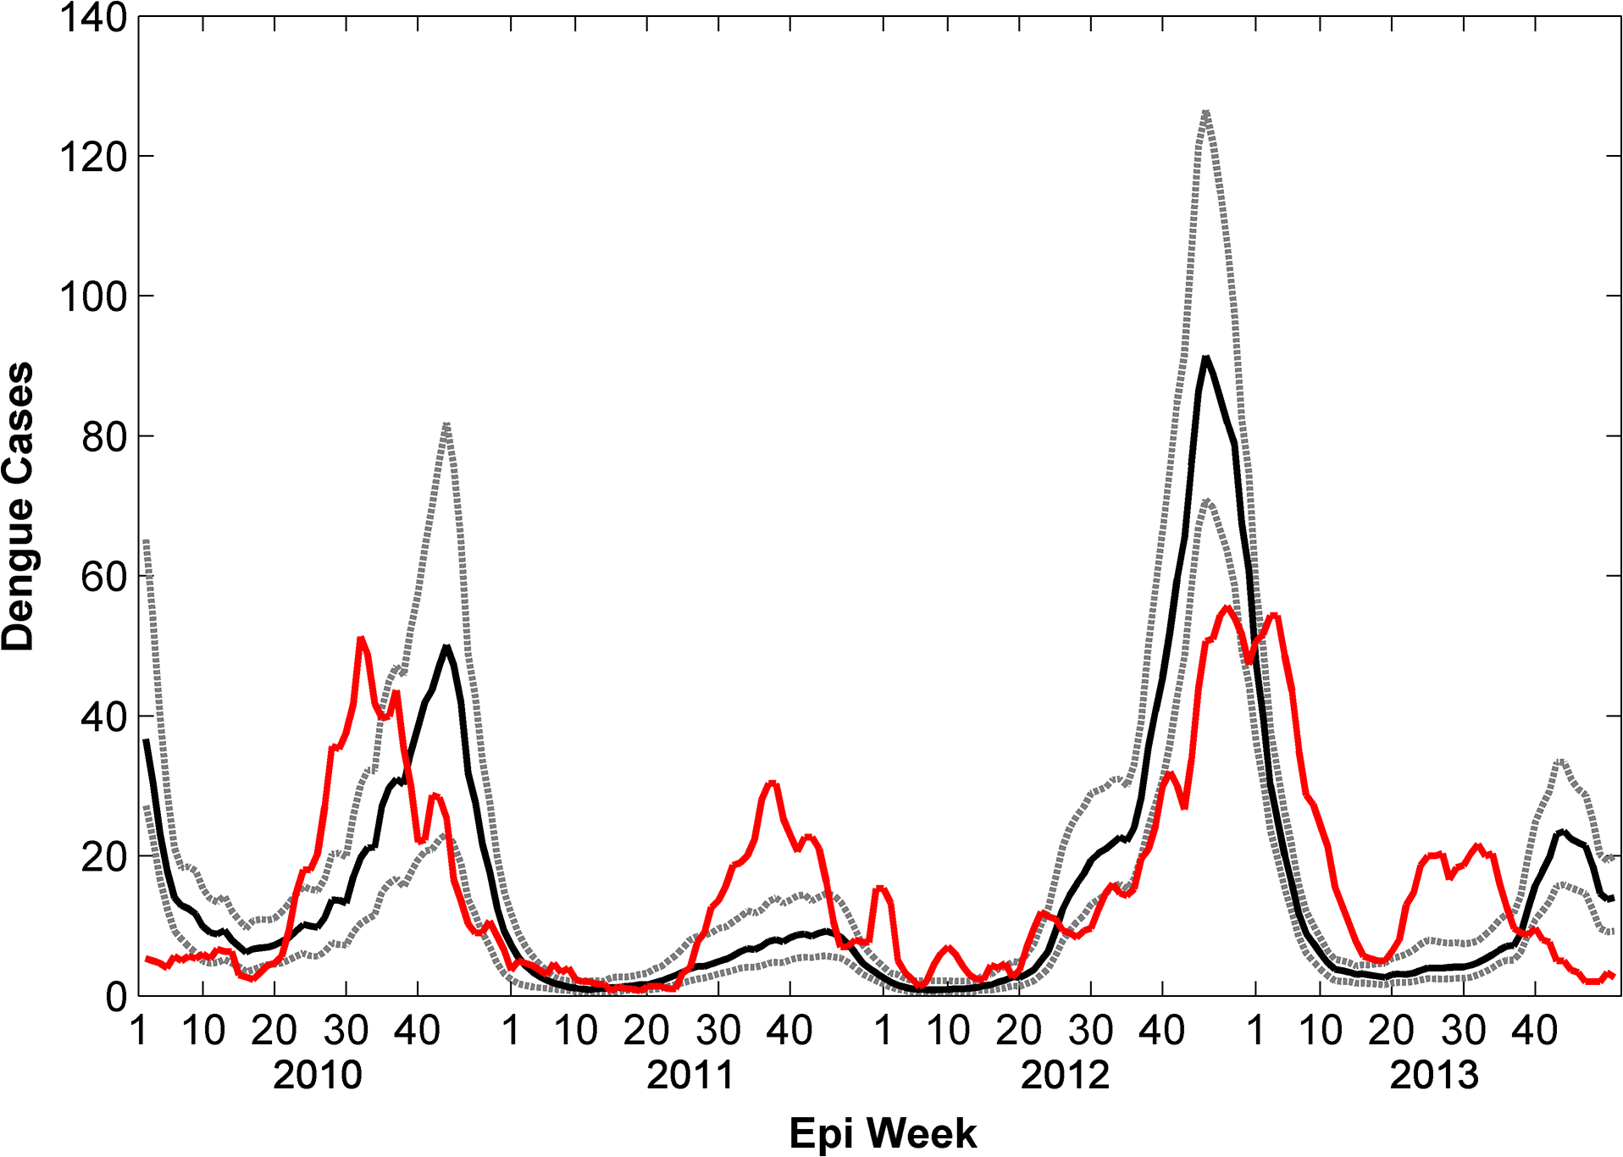
Real Life Cases San Juan (Monaghan et al. 2015, https://doi.org/10.1371/journal.pntd.0004002.g002)
Fig. 4: True Cases (red) in San Juan per Week, 2010-2013, Monaghan et al (2015)

Slide 10
Variable selection and lagging
Correlograms for all variables against the number of total cases, for all weeks in the previous year respectively
Winners:
Temperature at dew point: 9 Weeks (SJ), 11 Weeks (IQ)
Air humidity: 9 Weeks (SJ), 11 Weeks (IQ)
Avg. Temperature: 11 Weeks (SJ), 14 Weeks (IQ) (***)
Minimum Temperature: 11 Weeks (SJ), 10 Weeks (IQ)
Absolute Precipitation: 2 Weeks (SJ), 4 Weeks (IQ)
Also included lagged cases in some runs

Slide 11
Identifying Epidemics (Spikes)
Coding values in Spikes vs. values in Non-Spikes
Linear Regression did not identify spikes correctly
Solution: Data Mining
Decision Tree on training dataset
Correctly identifies spikes

Slide 12
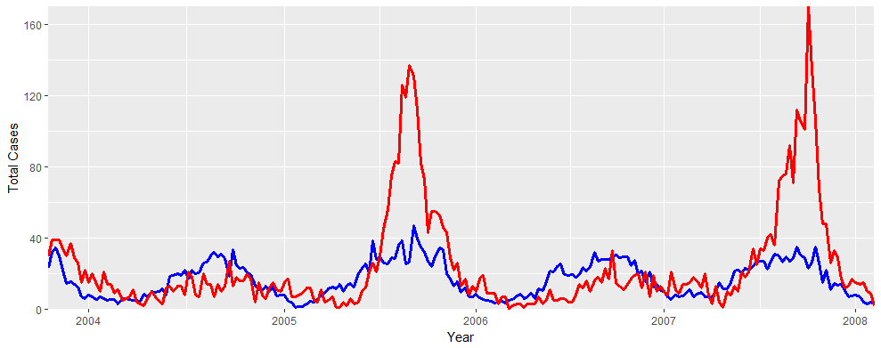
Linear Models
Mainly Negative Binomial for positive natural numbers
With and without Lag
If previous cases are used as an estimator:
Prediction one week at a time
Testing within the training data (MAE 15.0):
Result: 27.4
Fig. 5: Comparison of estimated and true cases for San Juan Oct. 2003 – April 2008

Slide 13
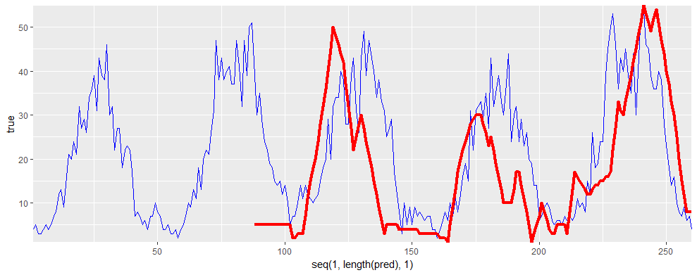
Comparison to Real Data (San Juan)
Red: Real cases, Blue: Prediction, MAE=10.5
Fig. 6: Comparison of estimated and true cases for San Juan in the testing data 2008-2013

Slide 14
ARIMA
ARIMA (p,d,q) (P, D, Q)
Univariate
Stationary
Good at approximating historical patterns
Good for approximating the training data
Parameters are taken from autocorrelation and partial autocorrelation plots
Estimating forward yearwise
San Juan: ARIMA (1,0,0) (3,1,0)
Iquitos: ARIMA (1,0,3) (4,1,0)
Dynamically with Lag
Best MAE was 27.4 with parameters

Slide 15
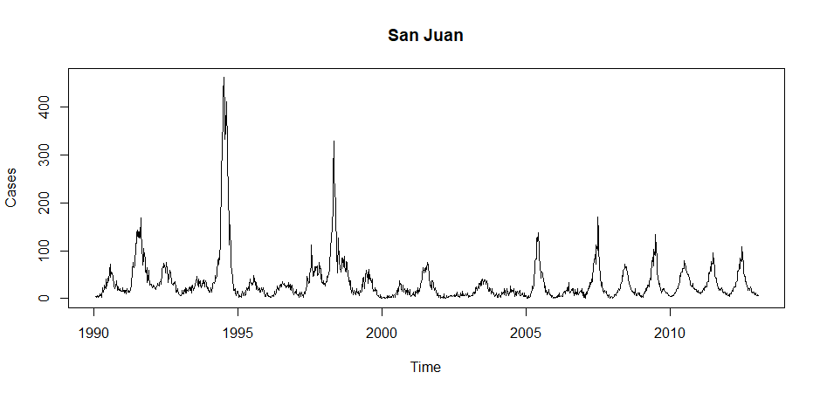
ARIMA estimate for San Juan
Fig. 7: ARIMA estimate for San Juan, training and testing data

Slide 16
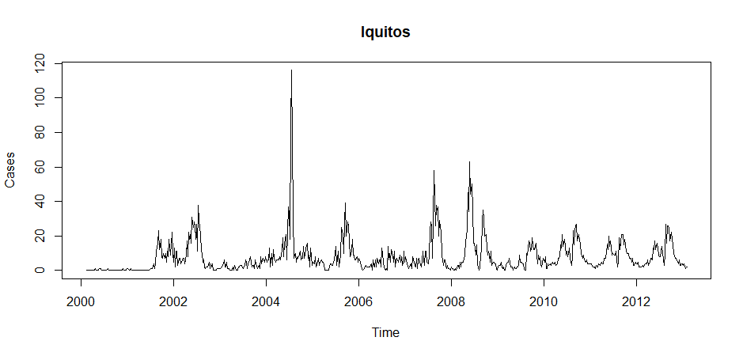
ARIMA estimate for Iquitos
Fig. 8: ARIMA estimate for Iquitos, training and testing data

Slide 17
Tree-based Models
Decision Tree for Poisson-Modelling
Lagged variables
Minimum split at 50
Splits mostly at temperature variables
Maximum at high temperature and medium precipitation
Result: 26.4327

Slide 18
Conclusion
Result: a bad 1001 / 4260
Capturing the training data is not the problem
Probably overfitting
Mean of the testing data
Combining approaches might be interesting

Slide 19
QUESTIONS

